Slide 1
10/07 個人咪挺 MobileNet V3 Large、Small 訓練結果

Slide 2
Train Setting
I5-10500 + 2080Ti
Random seed = 42
Adam(lr = 1e-4) + BCEWithLogitsLoss
ABCD Dataset as training set (0.8 for training and 0.2 for validating)
Google Dataset as testing set

Slide 3
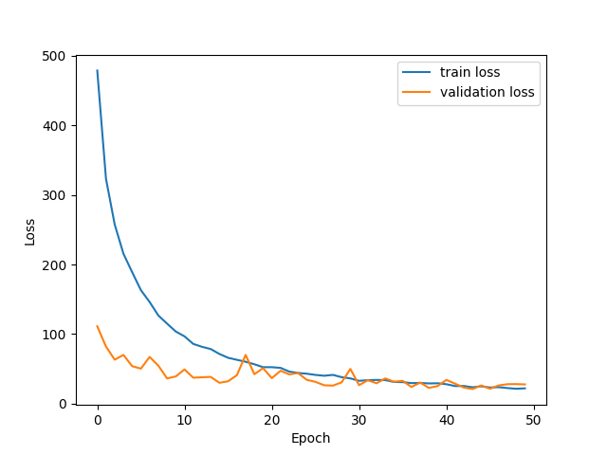
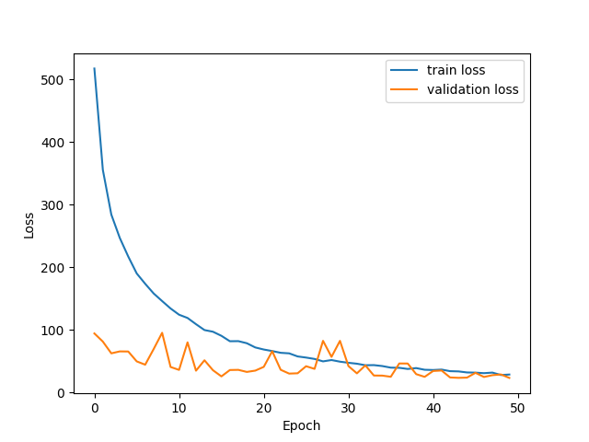
Loss Curve（epoch = 50）
Large
Small

Slide 4
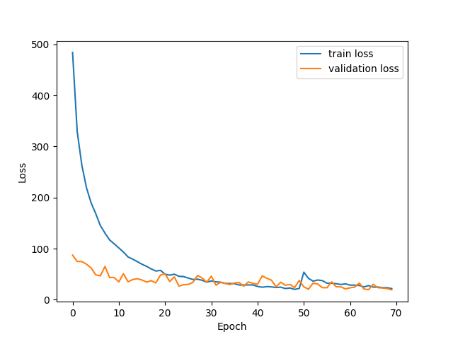
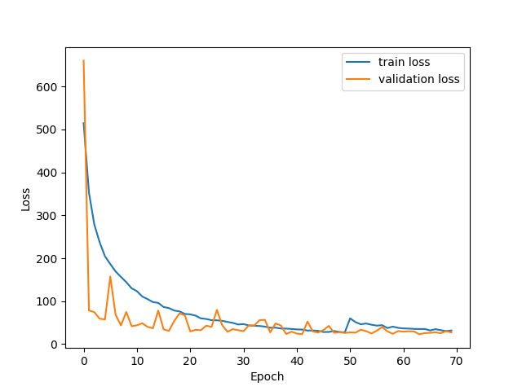
Loss Curve（epoch = 70）
Large
Small

Slide 5
Accuracy
Teacher
87.30% for epoch = 50
94.23% for epoch = 70
Student
90.31% for epoch = 50
90.83% for epoch = 70

