Slide 1
9/16個人咪挺 Handover（采潔）

Slide 2
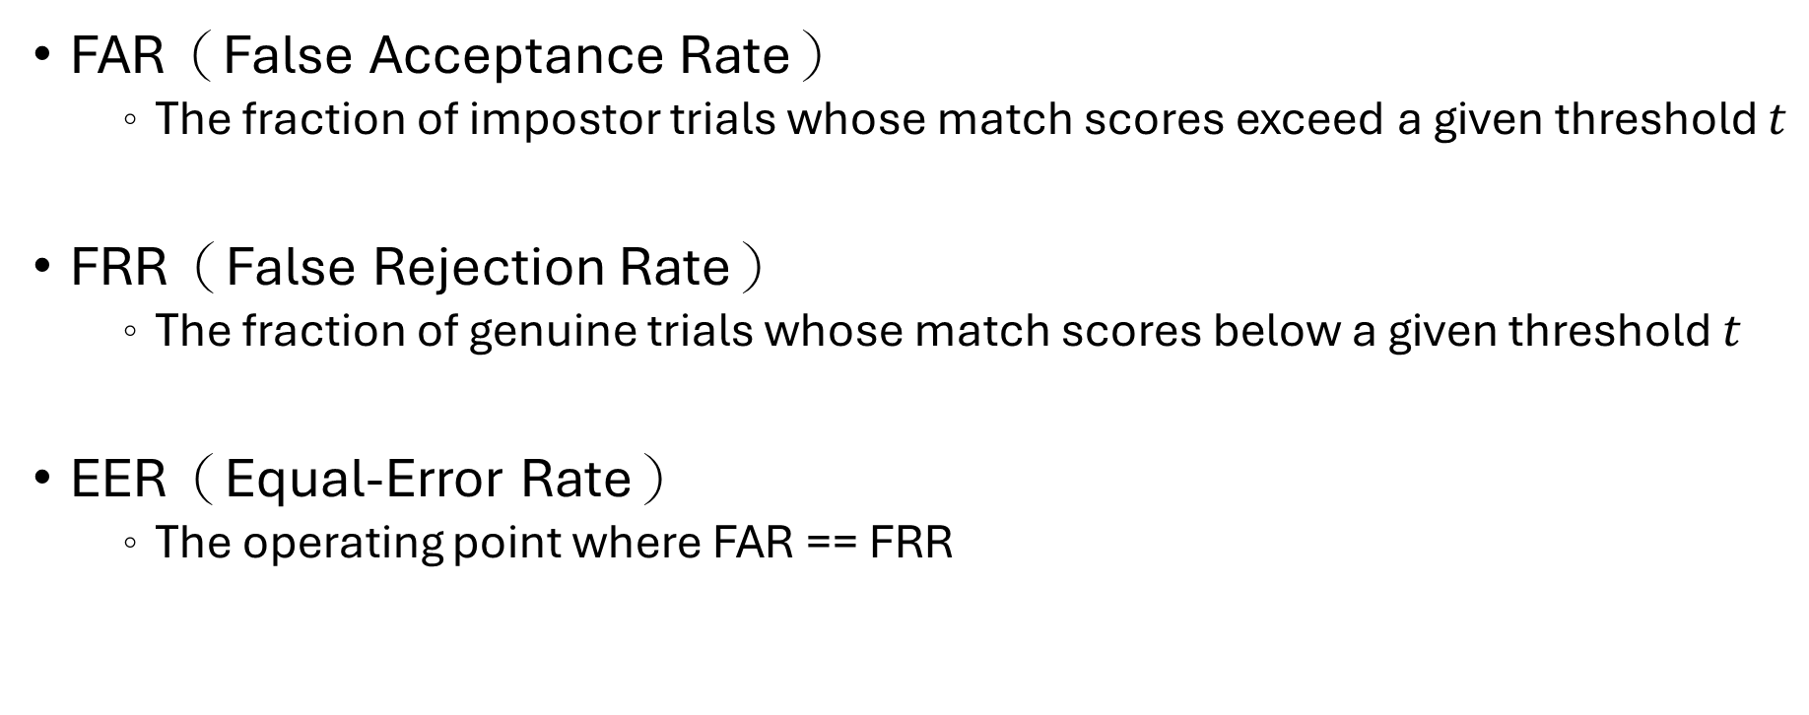
Metrics
FAR（False Acceptance Rate）
The fraction of impostor trials whose match scores exceed a given threshold $t$
FRR（False Rejection Rate）
The fraction of genuine trials whose match scores below a given threshold $t$
EER（Equal-Error Rate）
The operating point where FAR == FRR

Slide 3
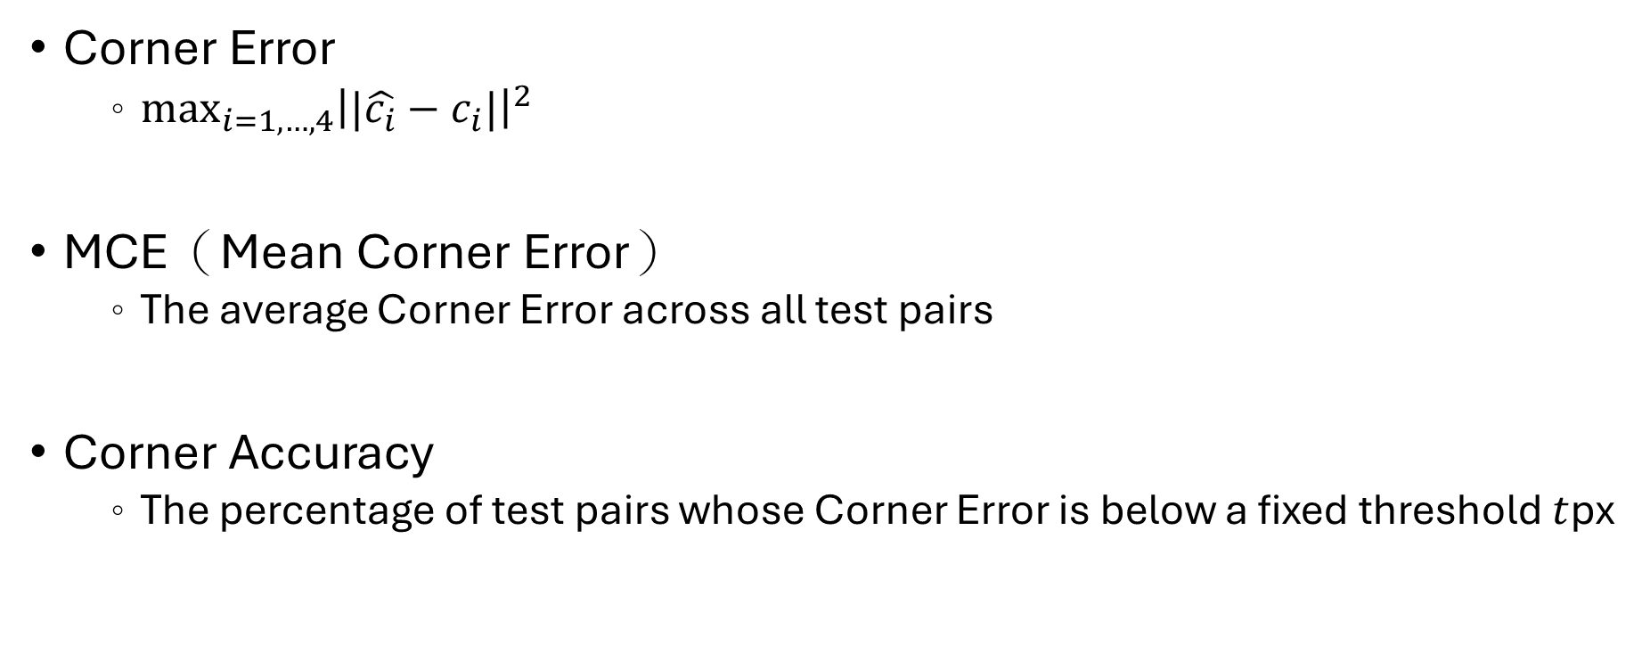
Metrics
Corner Error
$\max_{i=1, …, 4}{{\left||\hat{c_{i}}−c_{i}|\right|}^{2}}$
MCE（Mean Corner Error）
The average Corner Error across all test pairs
Corner Accuracy
The percentage of test pairs whose Corner Error is below a fixed threshold $t$px

Slide 4
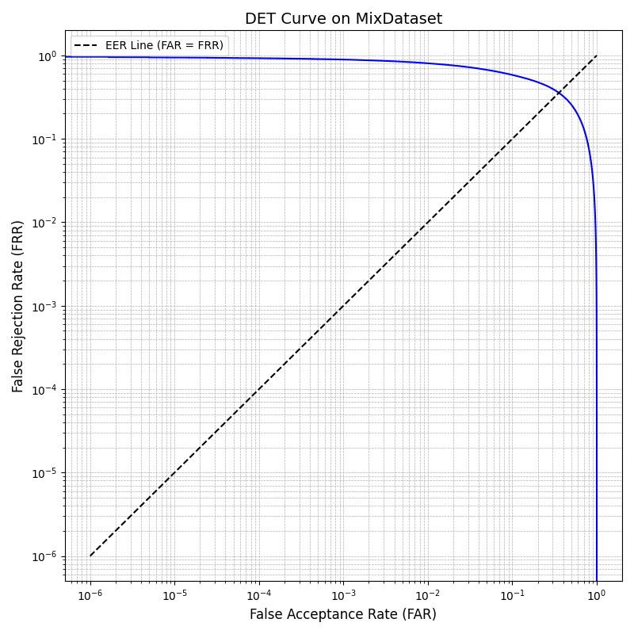
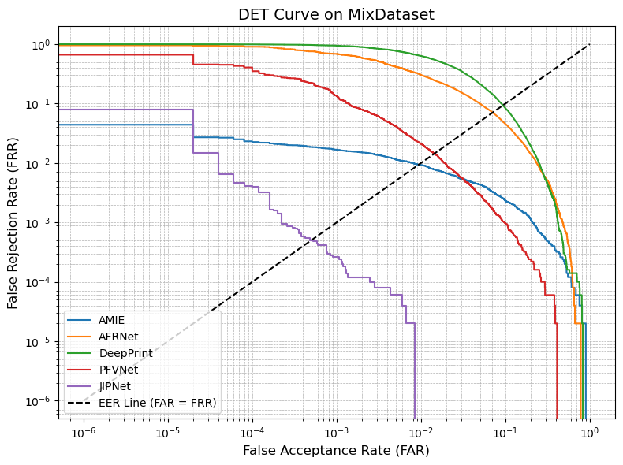
DET Curve（No pretrained weight）

Slide 5
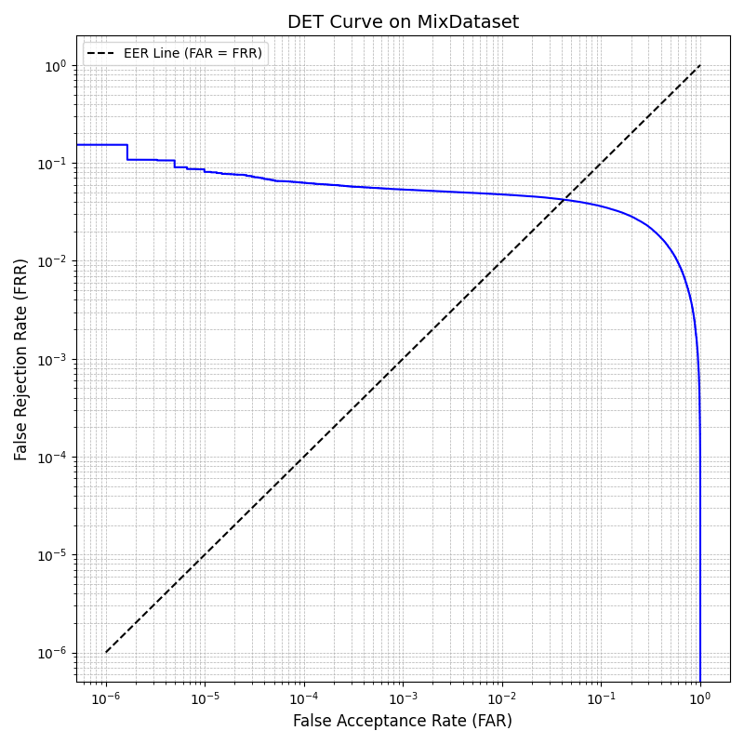
DET Curve（With pretrained weight）

Slide 6
Comparison
 | EER | FRR(0.1%) | FRR(0.01%) | FRR(1e-3%) | Corner ACC |  | MCE
 |  |  |  |  | <= 5px | <= 10px
學姊 | 2.255 % | 1.676 % | 2.256 % | 4.404 % | 85.48 % | 90.33 % | 6.24
No pretrained | 35.585% | 89.183 % | 92.556 % | 93.998 % | 3.03 % | 6.48 % | 69.72
With pretrained | 4.213 % | 5.349 % | 6.265 % | 7.607 % | 90.99 % | 94.55 % | 5.855

