Slide 1
9/23個人咪挺 MobileNet V3 實作架構以及feature layers挑選

Slide 2
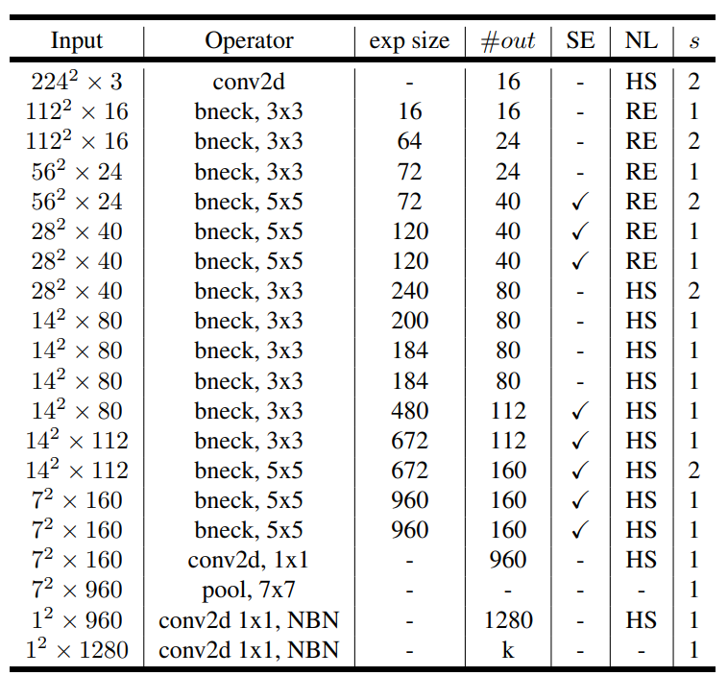
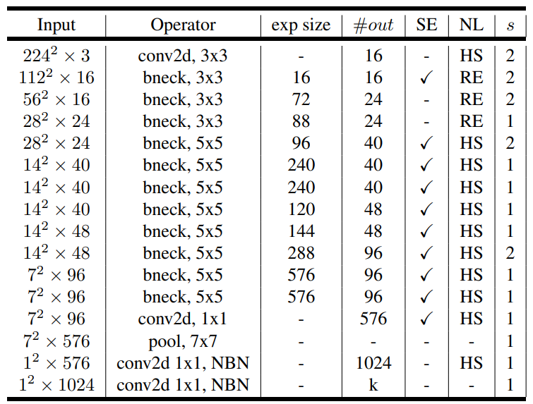
Comparison

Slide 3
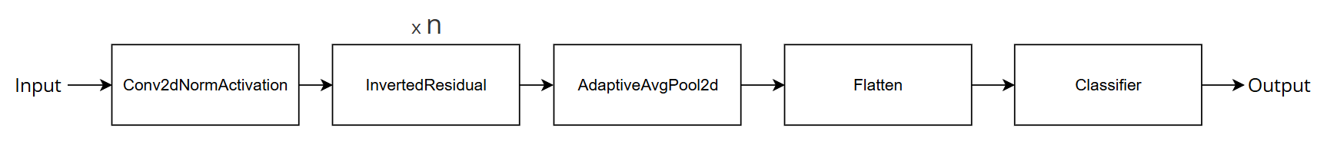
Implementation
Architecture

Slide 4
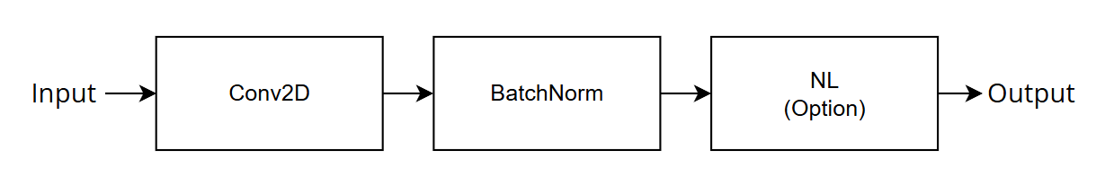
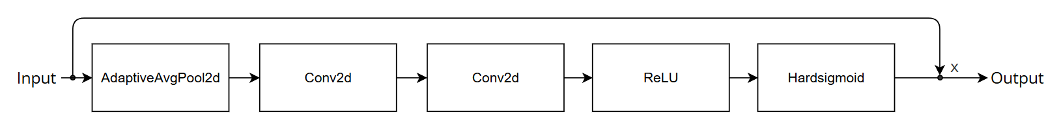
Implementation
Conv2dNormActivation
SqueezeExcitation

Slide 5
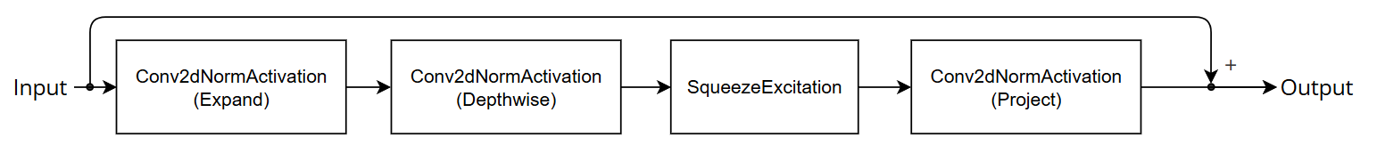

Implementation
Inverted Residual（bneck）
Expand only when input_channel $≠$ expand_channel
Residual Connect only when input_channel $=$ output_channel

Slide 6
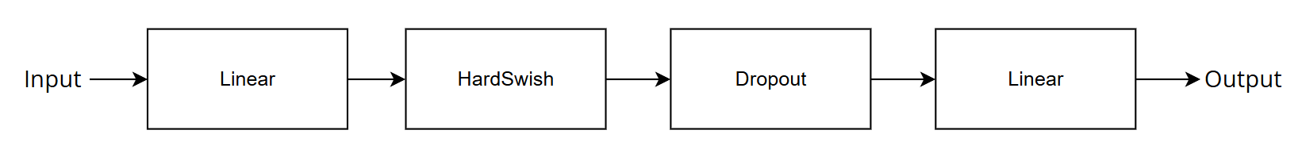
Implementation
Classifier

Slide 7
Which Feature Layers

