Slide 1
Sigfox and LoRaWAN Datasets for Fingerprint Localization in Large Urban and Rural Areas
汇报人：任晓琪

Slide 2
Because of the increasing relevance of the Internet of Things and location based services, researchers are evaluating wireless positioning techniques, such as fingerprinting, on LPWAN communication.
The goal is to provide the research community with a tool to evaluate fingerprinting algorithms in large outdoor environments
Notes:
物联网与位置定位服务相关性越来越高，研究者开始评估无线定位技术，例如指纹定位。

Slide 3
LPWAN standards
long-range communication and high scalability of end-devices at a low cost
be used outdoor as well as indoor
Global Navigation Satellite Systems(GNSS)
consume a lot of power
lose connectivity in indoor environments
high accuracy localization more interest in long battery life-time
Notes:
The Internet of Things (IoT) its growing importance creates a rapidly increasing necessity for wide area communication standards
that guarantee reliable connectivity between a multitude of IoT devices.
For this purpose, researchers have been developing various Low Power Wide Area Network (LPWAN) standards.

Slide 4
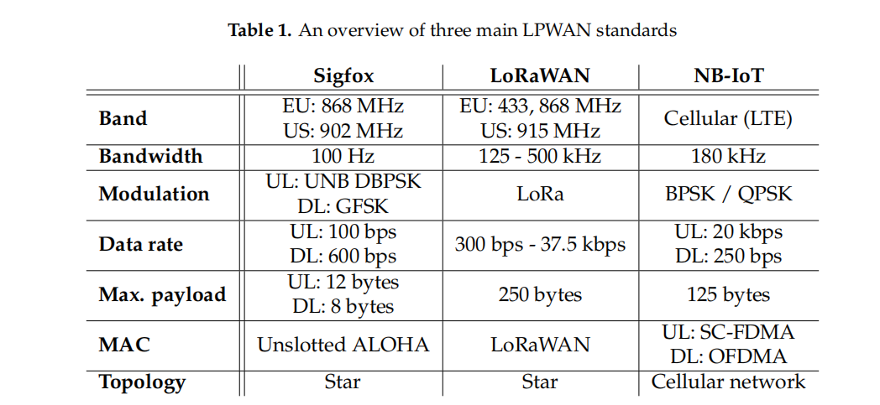
2. Sigfox , LoRaWAN and NB-IoT
Notes:
非授权频段广域网技术：sigfox和LoRaWAN
从接入网络：
sigfox:采用超窄宽带调制技术（UNB），最大上行吞吐量（每秒数据传输）为100bps，1GHz免许频段，每条消息宽度：100Hz
轻量级协议：处理小的数据信息，更少能源消耗。电池寿命更长
小的有效载荷：上行消息具有12字节的有效载荷，下行消息有效负载容量8个字节
从技术上：
星型网络架构
---------------------------------------------------------------------------------------------------------------------------------
从接入网络：
LoRaWAN:采用线性扩频调制技术（LoRa）的远距离无线传输，每秒数据传输远程为300bps最高可为37.5kbps,1GHz免许频段
有效载荷：，支持多通道，250b有效载荷
从技术上：
星型网络架构
```````````````````````````````````````````````````````````````````````````````````````````````````````````````````````````````````````````````````````````````````````````````````````````````
授权频段广域网技术：NB-loT
从接入网络：
NB-loT:采用基于蜂窝的窄带物联网，构建于蜂窝网络，180KHz的带宽，可直接部署于LTE网络，以降低部署成本、实现平滑升级

Slide 5
3. Collection Methodology
Firstly, a Sigfox dataset between Antwerp and Ghent (± 1068 km2 )
Secondly, another Sigfox dataset around the city center of Antwerp(52.97 km2 ).
Lastly, a LoRaWAN dataset in the same urban area.
Sigfox datasets:a proprietary, nation-wide Sigfox network which was deployed by EngieM2M was used. 专有的，全国性的Sigfox网络。
The LoRaWAN dataset was collected over a proprietary, nation-wide network that was rolled out by Proximus.

Slide 6
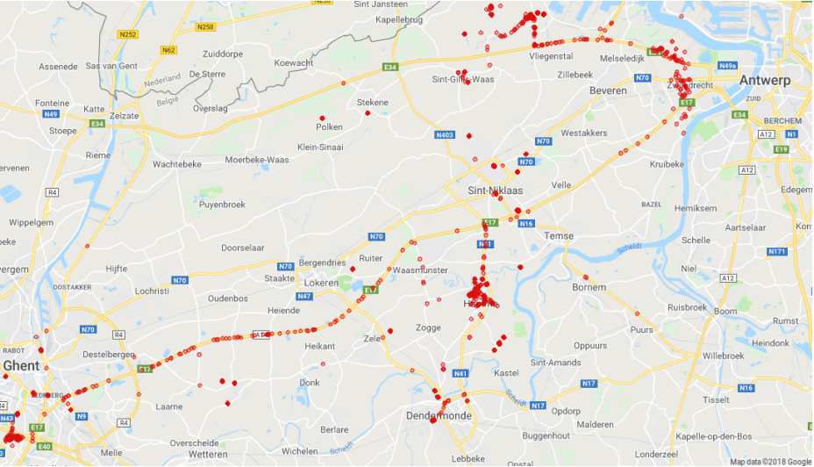
3.1 Sigfox Rural

Slide 7
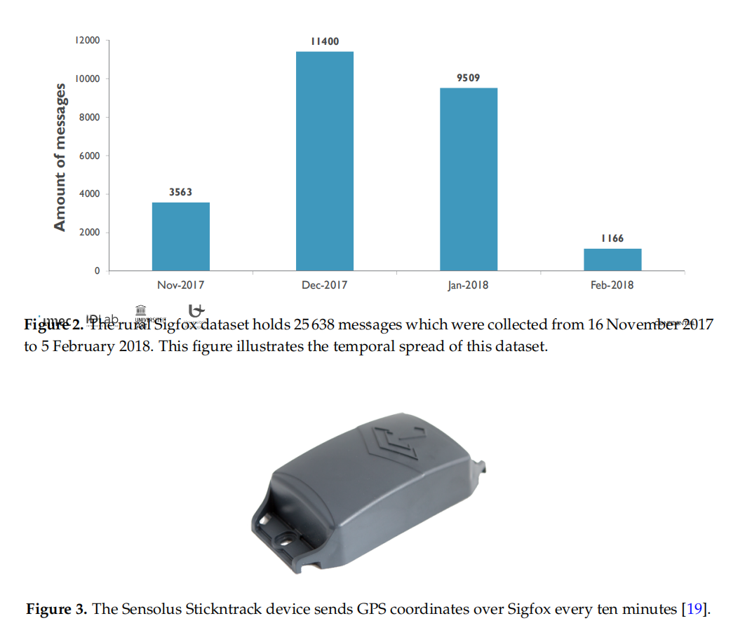
Notes:
25 638 Sigfox messages
ten Sensolus Stickntrack devices contain a Ublox CAM-M8C GPS receiver, which obtains a GPS fix every ten minutes.
carried by people who commute
transmission time of a Sigfox message six seconds,
the received coordinates of the transmitting device could differ from the actual device coordinates at receiving time.
hold an additional GPS location estimation error of tens of meters, depending on the ground speed of the transmitting device
Additional information such as the ground speed of the devicecould not be included in the message because of the limited Sigfox payload size
----------------------------------------------------------------------------------------------------------------------------------------------------------------
After receiving a message from a Stickntrack device, a callback function in the Sigfox backend forwards a JSON string for every base station that received that message.
the collection methodology for an indoor WiFi fingerprinting database（在收到来自Stickntrack设备的消息后，
Sigfox后台的一个回调函数为接收到该消息的每个基站转发一个JSON字符串。存储在当地的数据库中）

Slide 8
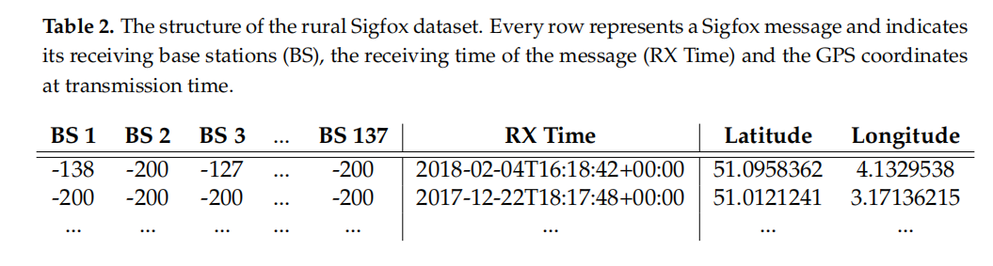

Slide 9
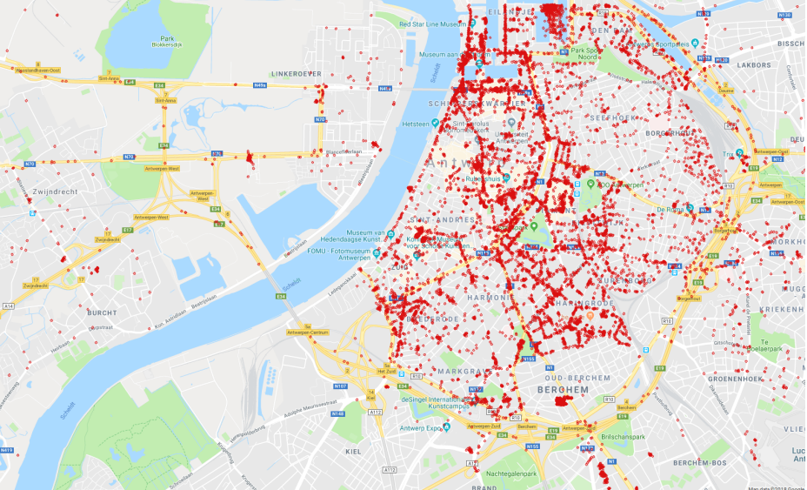
3.2 Sigfox Antwerp

Slide 10
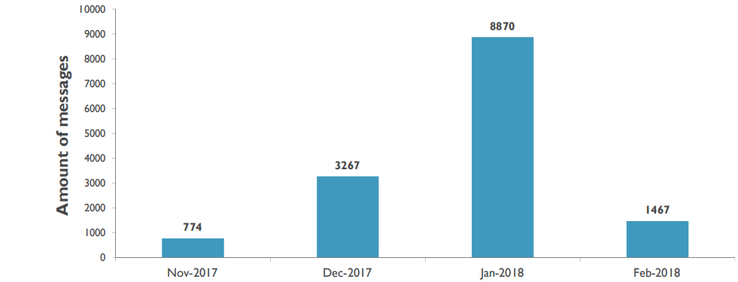
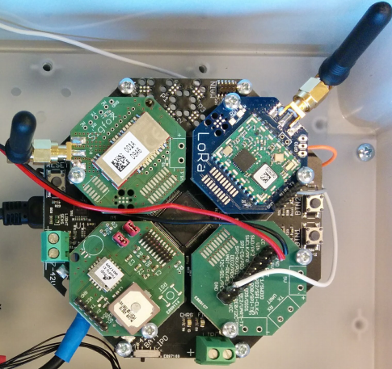
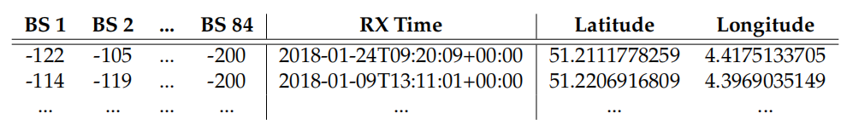
Notes:
hold an additional GPS error. However, this error will be less severe compared to the rural Sigfox dataset, as traffic in the city center does not move as fast as in rural areas.
---------------------------------------------------------------------------------------------------------------------------------------------------------------------------------------------
Top left: TD1207R RF module for Sigfox communication.
Top right: IM880B-L RF module for LoRaWAN communication

Slide 11
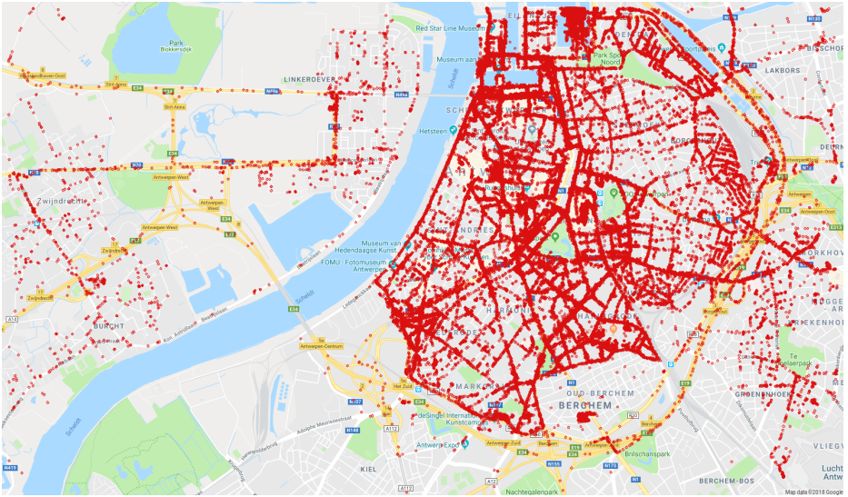
3.3 LoRaWAN Antwerp

Slide 12
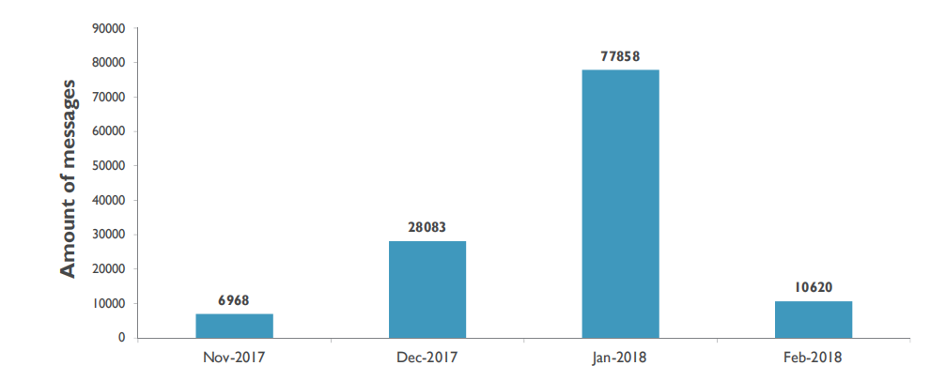
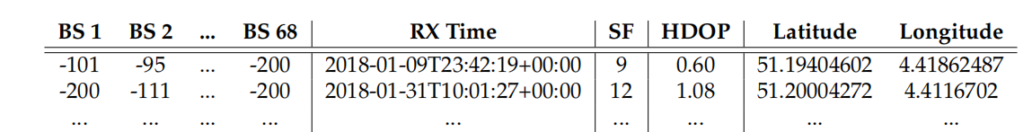
Notes:
123 529 messages
twenty cars of Antwerp’s postal service drove around in the city center while carrying this hardware
the Firefly X1 GPS receiver: latitude and longitude ; the HDOP of the GPS signal
LoRaWAN implements a much wider bandwidth and higher data rate
However, the GPS coordinates at receiving time could still differ from the GPS coordinates at transmission time, especially if the transmitter is moving at high speeds.

Slide 13
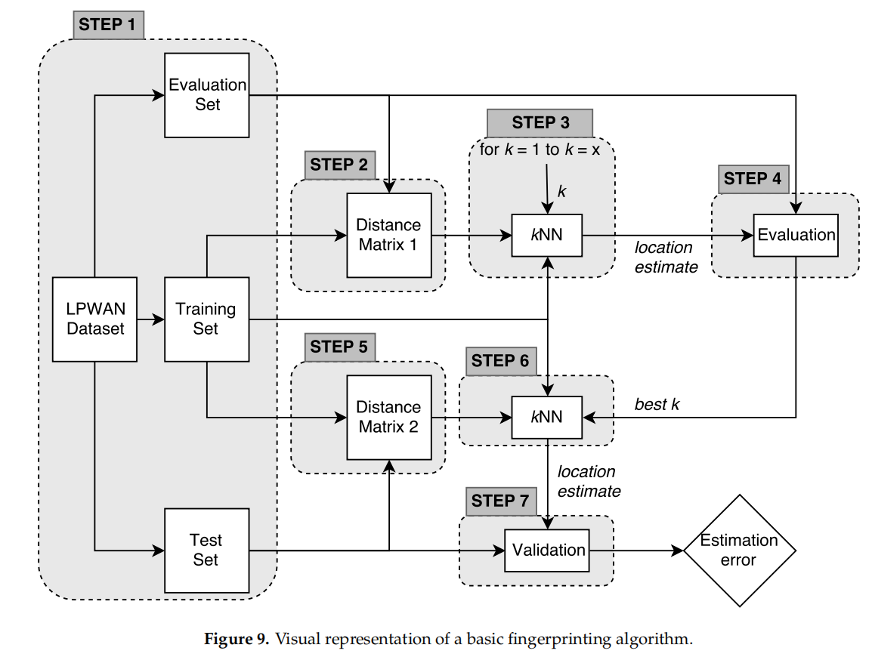

Slide 14
4. Analysis
Firstly, a distance matrix
Secondly, this distance matrix is used to find the k Nearest Neighbors (kNN) of an evaluation fingerprint
Lastly, the test subset is used to validate this optimal k with fingerprints that do not occur in the training or evaluation subset.

Slide 15
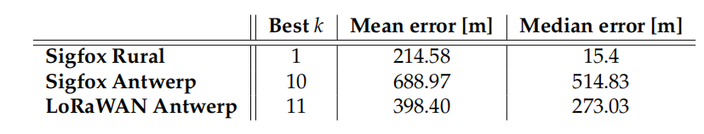
5. Results
To evaluate the usability of our LPWAN datasets, we have executed the fingerprinting algorithm that was described in Section 4 on all three datasets.
It becomes clear that the fingerprinting method has the best results on the rural Sigfox dataset.

Slide 16
5.1 Results
the spatial spread of this dataset, in Figure 1.
but a major part of these measurements were taken while the cars were parked, usually even on the same parking spot.
dataset consists of dense message clusters on several small parking lots which are far apart from each other.
the best results : there is a high probability that the nearest neighbor of a test sample is located in the same message cluster.
Notes:
1. Measurements were conducted by people who commute by car in the rural area between Antwerp and Ghent,
but a major part of these measurements were taken while the cars were parked, usually even on the same parking spot.
Therefore, the rural Sigfox dataset mainly consists of dense message clusters on several small parking lots which are far apart from each other.

Slide 17
5.2 Results
As shown in Figure 4, this dataset has a more equal spatial density compared to the rural Sigfox dataset.
Consequently, location estimations will be based on a higher number of nearest neighbors: we evaluated that the optimal k for this dataset equals 10.

Slide 18
5.3 Results
The mean and median estimation error of the LoRaWAN dataset are significantly lower than those of the urban Sigfox dataset, which is mainly a consequence of the large size of the LoRaWAN dataset (123529 messages).
. In the LoRaWAN set, it is more likely that the 11 nearest neighbors of a test sample are close to the actual location of the test sample, as the dataset holds more messages in the same urban area. This can also be empirically evaluated by comparing Figures 4 and 7, which display the spatial spread of the urban Sigfox dataset and the LoRaWAN dataset respectively. Hence, we expect to decrease the location estimation error of the urban Sigfox dataset by adding more messages to this set

Slide 19
This paper has described the collection methodology of three large LPWAN datasets, as well as their suitability for fingerprint-based localization. With these datasets, we intend to provide the global research community with a benchmark tool to evaluate fingerprinting algorithms for LPWAN standards.
Notes:
本文描述了三种大型LPWAN数据集的收集方法，以及它们对基于指纹的定位的适用性。通过这些数据集，我们打算为全球研究社区提供一个基准工具，以评估LPWAN标准的指纹算法。

Slide 20
谢谢观看

