Slide 1
Object classiﬁcation in 3D baggage security computed tomography imagery using visual codebooks

Slide 2
Introduction
Baggage screening plays a central role within the aviation security domain.
This has led to increased research interest in the potential use of object detection and classification techniques to perform automated analyses tasks on such 3D-baggage imagery.

Slide 3

Previous works
There is limited prior work in the area of automatic recognition of items in scanned baggage-CT imagery
. Several techniques have been presented for the detection of handguns use edge detection to characterise
handgun features but only considering handguns in fixed orientations.
. A small dataset was used (40 handgun images, 400 clutter images)
with two simple examples of handgun detection shown but no statistical results presented

Slide 4
Previous works
Turcsany et al
Present a BoW model using the Speeded-Up Robust Features (SURF) and a Support Vector Machine (SVM)
classifier for automated object recognition within 2D X-ray baggage imagery.
Correct classification rates in excess of 99%
False positive rate of approximately 4% are demonstrated on a diverse dataset

Slide 5

Introduction
This work has investigated the suitability
of the Bag-of-Words (BoW) approach in the classification of two object classes
(handguns and bottles) in 3D baggage-CT imagery. In low resolution and noise.
This poses a novel and unique challenge for rigid object classification within complex and cluttered volumetric imagery.

Slide 6

Introduction
In this paper they extend the BoW model to 3D
transmission imagery (X-ray CT) from its conventional
application in 2D (photographic) imagery.

Slide 7



Introduction
They explore combinations of four 3D feature descriptors
Density Histogram (DH).
Density Gradient Histogram (DGH).
Scale Invariant Feature Transform (SIFT).
Rotation Invariant Feature Transform (RIFT).

Slide 8



Introduction
Three codebook assignment methodologies
Hard
Kernel
Uncertainty
Seven codebook sizes.

Slide 9

Interest point detection
They perform interest point detection using a 3D extension to the SIFT algorithm
Scale-space extreme detection:
The 3D input volume I(x, y ,z ) is convolved with a 3D Gaussian filter
G (x, y, z, kσ) at multiple scales to generate a series of multi-scale Difference-of-Gaussian (DoG) volumes:

Slide 10

⋆ represents the convolution operator
k is an integer in the range 1 …5 representing the scale index
are defined in voxel coordinates.
A three level pyramid l=(0,1,2)
is constructed up by subsampling the Gaussian filtered volume for k=4 and repeating the process

Slide 11
Key point refinement
The candidate key points are refined by rejecting poor-
contrast key points and key points poorly localised on edges.
The removal of low-contrast keypoints (determined by a density threshold τc = 0:05

Slide 12

H is the 3 * 3 Hessian matrix at a given candidate point
τe = 40

Slide 13
Interest-point neighbourhood weighting
A Gaussian window function, w(d, σ),
is used to limit the contribution of voxels around the point of interest
to those in the local neighbourhood

Slide 14

Interest-point neighbourhood weighting
d is the voxel distance from the point of interest to the contributing voxel
σ defines the extent of the local contribution.
This function is used in conjunction with each of the four descriptors

Slide 15
Density histogram (DH) descriptor
This descriptor defines the local density variation at a given interest point as an N-bin histogram defined over a continuous density range.
Density Gradient Magnitude Histogram (DGH) descriptor
for a given interest point quantifies the distribution of the density gradient magnitude in the local neighbourhood of that point.

Slide 16
Rotation Invariant Feature Transform
Examines the local neighbourhood gradients with reference to a radial vector emanating from the point of interest
Scale-Invariant Feature Transform
Considering the correct definition of 3D orientation, based on azimuth, elevation and tilt

Slide 17

Hard assignment
Is the original and the most basic codebook assignment approach
k is the number of clusters
M is the number of descriptors in the volume.

Slide 18
Kernel assignment
In order to overcome the problems associated with a hard assignment methodology.
Is used to provide the assignment ambiguity in the codebook.

Slide 19

σ is the smoothing parameter defining the degree of assignment ‘fuzziness’
k is the number of clusters
M is the number of descriptors in the volume

Slide 20
Uncertainty assignment:
The aforementioned limitation of the kernel assignment procedure may be addressed by adopting a normalisation scheme whereby each descriptor contributes the same cumulative (sum) value to the codebook

Slide 21
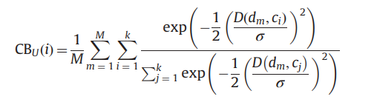
k is the number of clusters
M is the number of descriptors in the volume.
Ci Essentially the closest cluster to the descriptor
σ is the smoothing parameter

Slide 22
Object classification methodology
A set of training descriptors is extracted from a given set of training volumes
These descriptors are passed to the k means algorithm to derive a set of cluster centres or visual words
The algorithm is executed 10 times and the result with the minimal cluster compactness is chosen

Slide 23
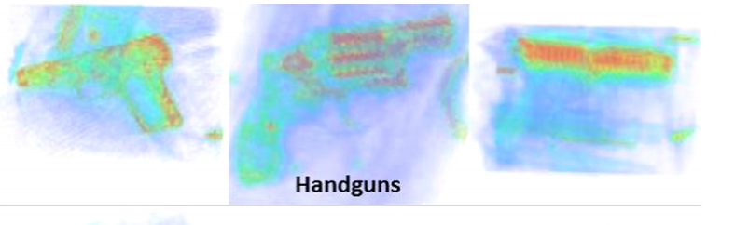
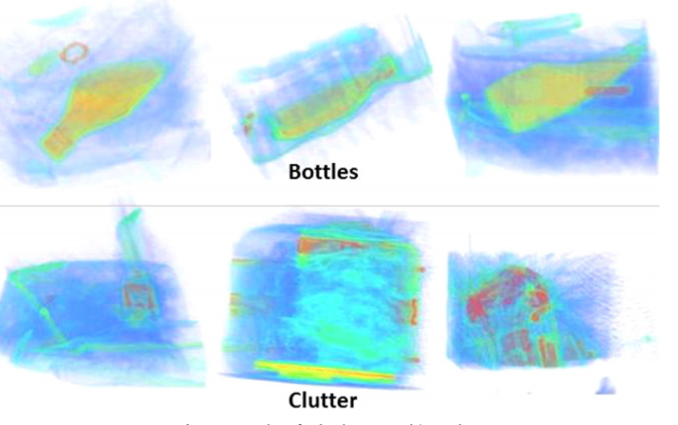
Results

Slide 24
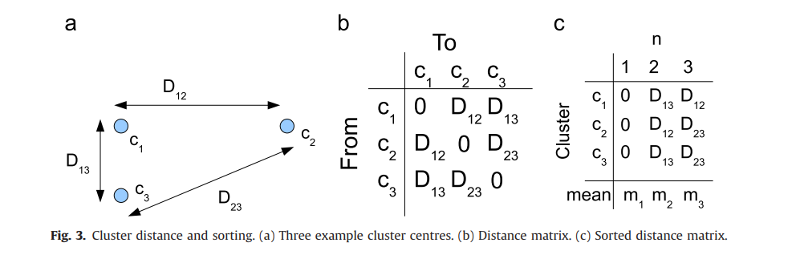
Results

Slide 25
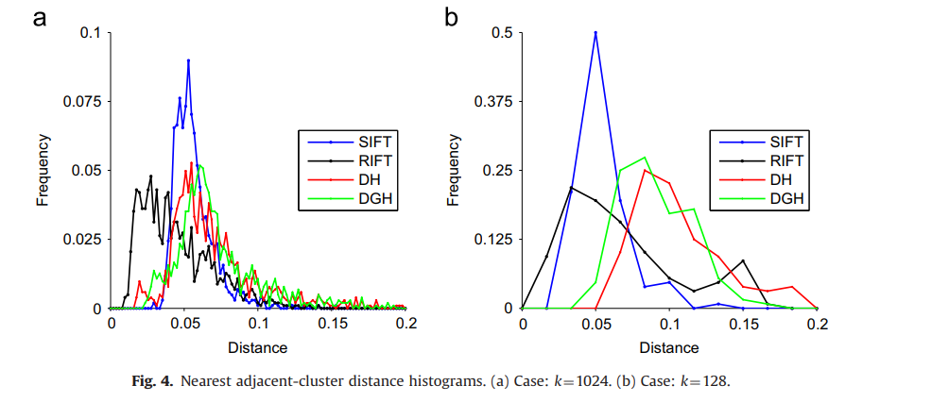
Results

Slide 26
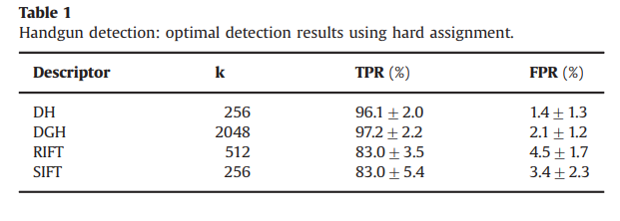
Results
Handgun results

Slide 27
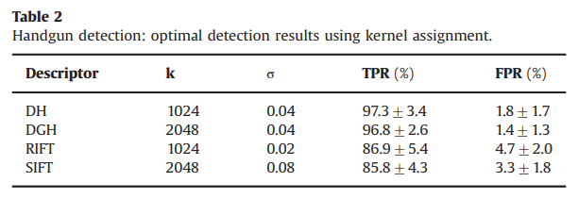
Results
Handgun results

Slide 28
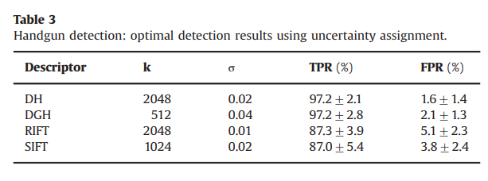
Results
Handgun results

Slide 29
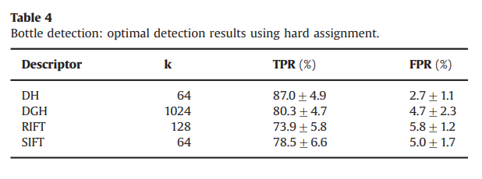
Results
Bottle results

Slide 30
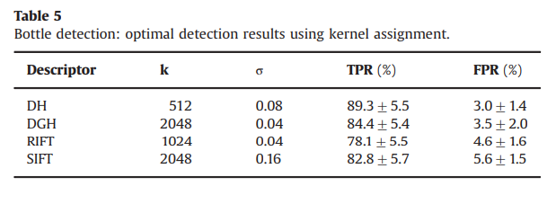
Results
Bottle results

Slide 31
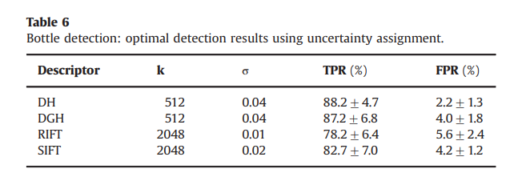
Results
Bottle results

Slide 32
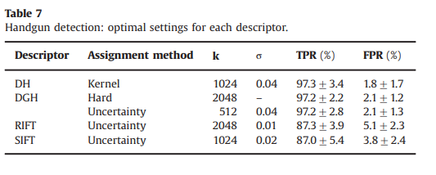
Results
Handgun results

Slide 33
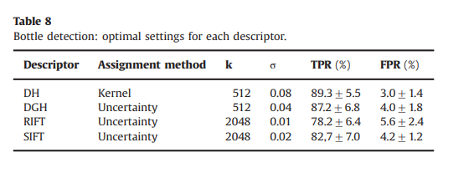
Results
Bottle results

Slide 34


Conclusions
The DH descriptor yielded the highest true-positive rates (97.3% for handguns; 89.3% for bottles)
lowest false-positive rates (1.8% for handguns; 3.0% for bottles)

Slide 35

Conclusions
The performance of the more complex SIFT and RIFT descriptors
was significantly poorer, yielding both lower detection rates and
higher false positive rates.

Slide 36

Conclusions
Optimal performance is achieved using the DH and DGH descriptors in conjunction with an uncertainty assignment methodology
Detection rates
89% for bottles
97% for handguns
False-positive rates
Approximately 2–3%

Slide 37


