Slide 1


Path Planning for Swarms by Combining Probabilistic Roadmaps and Potential Fields
Erion Plaku
Dept. of Electrical Engineering and Computer Science
Catholic University of America
Washington DC, USA
Alex Wallar
School of Computer Science
University of St Andrews
St Andrews, Scotland
http://aw204.host.cs.st-andrews.ac.uk/CRoPS

Slide 2
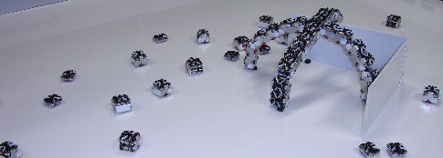
Motivation
Enables a large group of robots to complete complex tasks through simple interactions
Used for
  Monitoring
  Mapping
  Inspection
  Surveying
  Exploration
  Search and Rescue
www.eggshell-robotics.com

Slide 3
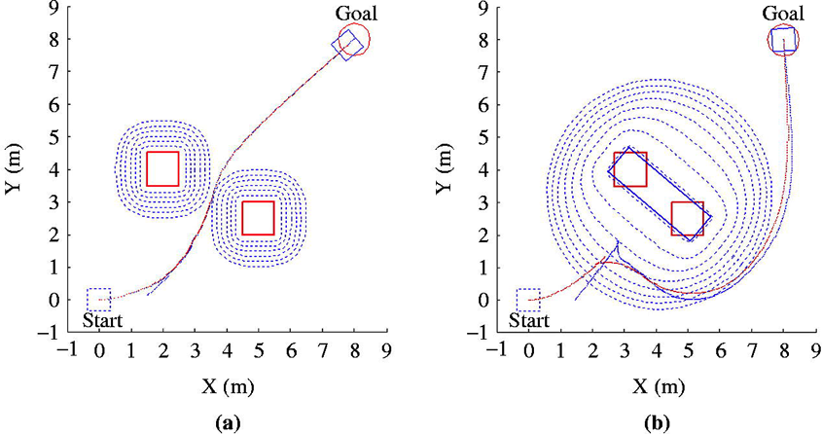
Path Planning for Swarms via Potential Fields
Attractive potential field around the goal
Repulsive potential field around obstacles
Very fast field computation
www.emeraldinsight.com

Slide 4
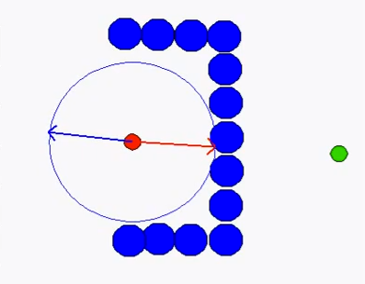
Limitations of Path Planning via Potential Fields
Local minima problem
Potential fields often lead robots into local minima especially when dealing with complex environments and large swarms

Slide 5
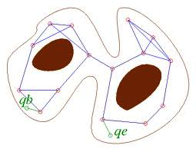
Path Planning for Swarms via Probabilistic Roadmaps (PRMs)
Randomly distribute points in the environment
Connect collision free points
Use a shortest path algorithm to determine the path from initial to final configurations
Captures the connectivity of the environment
robotics.stanford.edu

Slide 6
Limitations of Path Planning via PRMs
As the number of robots increases
  It becomes difficult to sample collision-free configurations
  It becomes difficult to generate collision free paths
  Larger roadmaps are needed to capture the connectivity of the sample space
PRMs do not promote fluidity in movement

Slide 7
Swarm Motion
Proposed Approach
Combine roadmaps and potentials for swarms (CRoPS) to enable fast path planning for swarms
Potential fields provide scalability
Probabilistic roadmaps provide high-level guidance of how swarm should move towards the goal
Bots will move in cohesion due to potential fields

Slide 8
Swarm Motion
Swarm Motion
There is long range attraction to intermediate goals and final destination
Robots are repulsed from obstacles
Robots move as a swarm while keeping some separation from one another
A robot’s heading is influenced by the headings of its neighbors

Slide 9
Swarm Motion
CRoPS: Combined Roadmaps and Potential Fields
Construct roadmap using PRM
Search roadmap to compute intermediate goals for each the swarm
Repeat until solved
  assign next goal to boids that have reached current goal
  compute overall potential for each boid
  compute new heading based on overall potential
  update positions

Slide 10
Swarm Motion
Roadmap Construction
Nodes are randomly distributed in environment
Nodes are connected to k collision free nodes within a radius
Nodes that spawn within a minimum distance from an obstacle are discarded

Slide 11
Swarm Motion
Roadmap Weights
In order to bias the swarm towards less cluttered areas, nodes further away from obstacles are assigned higher weights
Edge costs reflect not only the distance among the endpoints, but also their clearance away from obstacles, i.e.,

Slide 12
Swarm Motion
Guiding the Swarm through the Shortest Roadmap Path
Shortest roadmap path serves as high-level guide
Computed using Dijkstra's algorithm
Guide provides a series of intermediate goals defined as circles centered at the path vertices
CRoPS seeks to move the swarm to the final destination by passing each bot through these intermediate goals

Slide 13
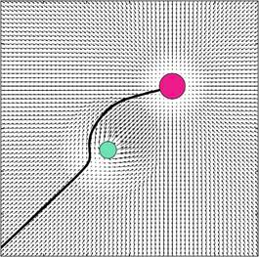
Swarm Motion
Potential Fields
CRoPS uses five potential fields
  Repulsion from obstacles
  Repulsion from other robots
  Attraction to current intermediate goal
  Neighbor heading influence
  Random walks
www.cs.mcgill.ca

Slide 14
Swarm Motion
Repulsion From Obstacles
A strong potential field is used to repel bots in the swarm from obstacles
The repulsion is only computed for obstacles within a certain distance from the bot

Slide 15
Swarm Motion
Repulsion From Other Robots
Robots should not come too close or too far from each other
Uses weak sigmoidal potential function to show that obstacle field is dominant
Similar to the obstacles, robots that are far away should not influence this field.

Slide 16
Swarm Motion
Attraction to Immediate Goal
represents the next immediate goal defined in the a shortest path for a boid b.
A weak sigmoidal function is used to increase potential as the robot gets closer to the goal
This allows the swarm to increase speed and promotes fluidity

Slide 17
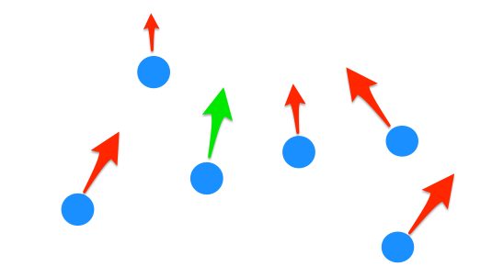
Swarm Motion
Neighbor Heading Influence
The heading of a robot is influenced by the headings of its neighbors
The neighbors are chosen to be not too far nor too close
Moreover, bots that are “stuck” are unable to be chosen

Slide 18
Swarm Motion
Escaping Local Minima
Each robot keeps track of past its past locations
Bot is considered stuck if it has moved very little in the last l time steps
If the bot is stuck, a random walk in the form of another potential field is applied

Slide 19
Swarm Motion
Superimposition of Potential Fields
Different potential fields are superimposed to obtain the overall force vector applied to the robot
This superimposition ensures that the subfield with the highest potential has the most influence

Slide 20
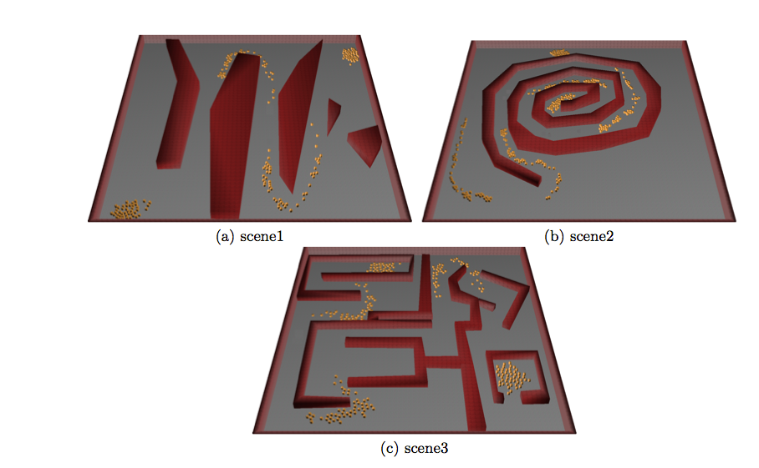
Swarm Motion
Experiments and Results

Slide 21
Swarm Motion
Time Analysis
Graph 1 & 2 show that as the number of robots increase, the time needed to navigate through each environment increases linearly

Slide 22
Swarm Motion
Swarm Analysis 1
Figure shows that robots reach the last goal at generally the same time on different environments

Slide 23
Swarm Motion
Swarm Analysis 2
Varied levels of separation based on the environment
Separation generally constant regardless of number of bots

Slide 24
Swarm Motion
Research Direction
Incorporate moving obstacles
Improve the interplay between the global path planner and the potential fields
Deal with probabilistic environments
Create threat maps based on amount of movements in an area
Increase the dimensions of the environment

Slide 25
Swarm Motion
Conclusion
The combination between potential fields and low dimensional roadmaps enable fast swarm planning
CRoPS presents an efficient, computationally cheap algorithm for swarm path planning
CRoPS is scalable due to the linear time complexity
Bots still act as a swarm, obeying the four base principles

Slide 26

Swarm Motion
Questions

