Slide 1
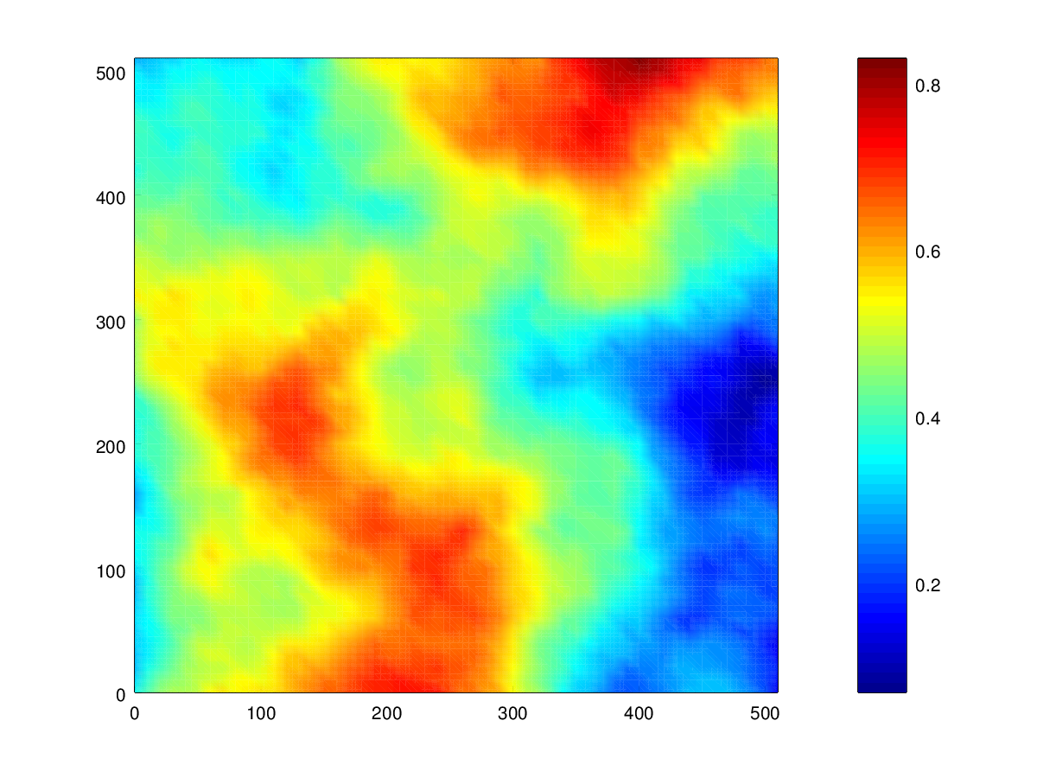

Risk Sensitive Surveillance with Optimal Sensor
Quality for Distributed Robotic Systems
Goals
  To provide high quality sensory information of a given region
  To minimize the risk of capture or damage to an acquiring agent
  To allow for a dynamic number of agents without significant algorithmic modification
Figure showing the risk of a given area
Alex Wallar

Slide 2
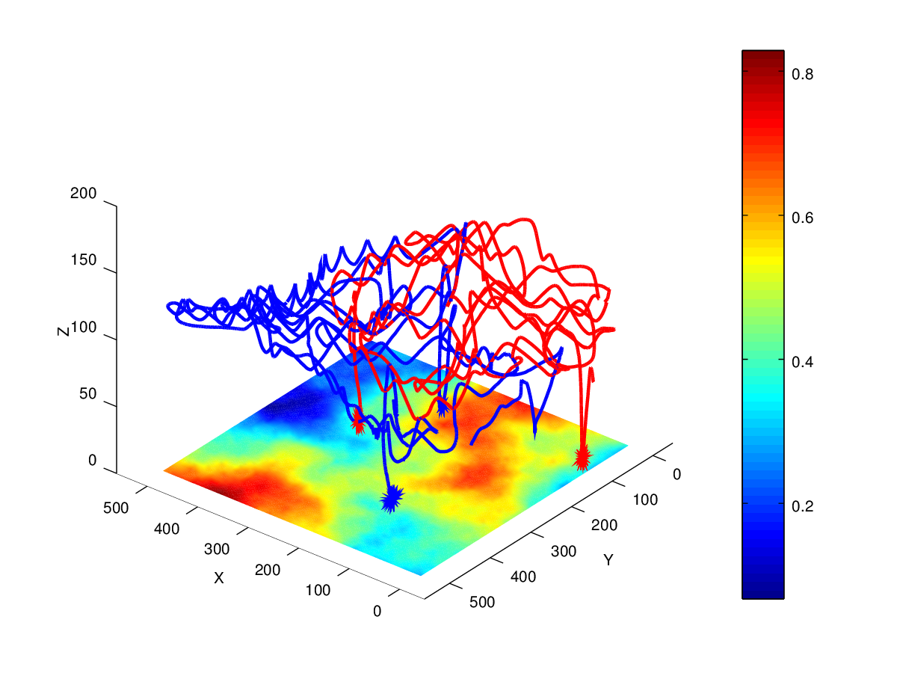
Risk Sensitive Surveillance with Optimal Sensor
Quality for Distributed Robotic Systems
Method
  Move to regions of the map that have a combination of the largest uncertainty and lowest risk
  Determine the altitude by maximizing the sensor quality whilst minimizing the risk
Figure showing the trajectories of quadrotors during a practical experiment
Alex Wallar

Slide 3
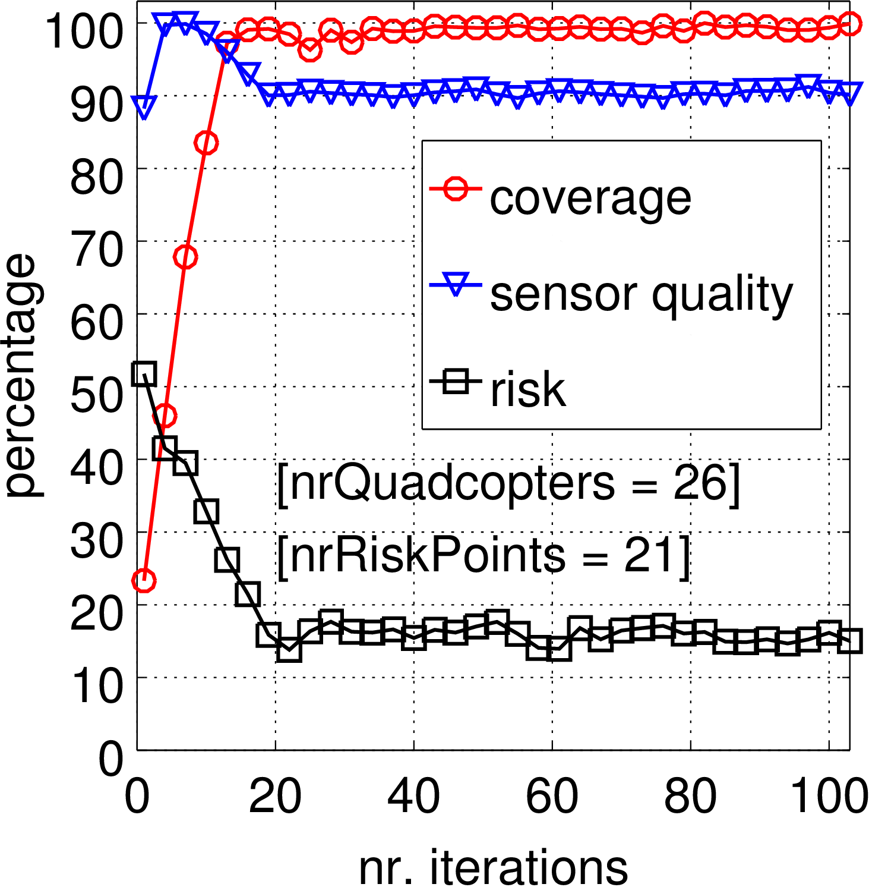
Risk Sensitive Surveillance with Optimal Sensor
Quality for Distributed Robotic Systems
Results
  The algorithm very quickly converges to total area coverage
  Measured risk and sensor quality are respectively minimized and maximized
  The algorithm scales linearly with the number of quadrotors
Figure showing the risk, sensor quality, and total coverage as a function of time (in iterations)
Alex Wallar

