Slide 1

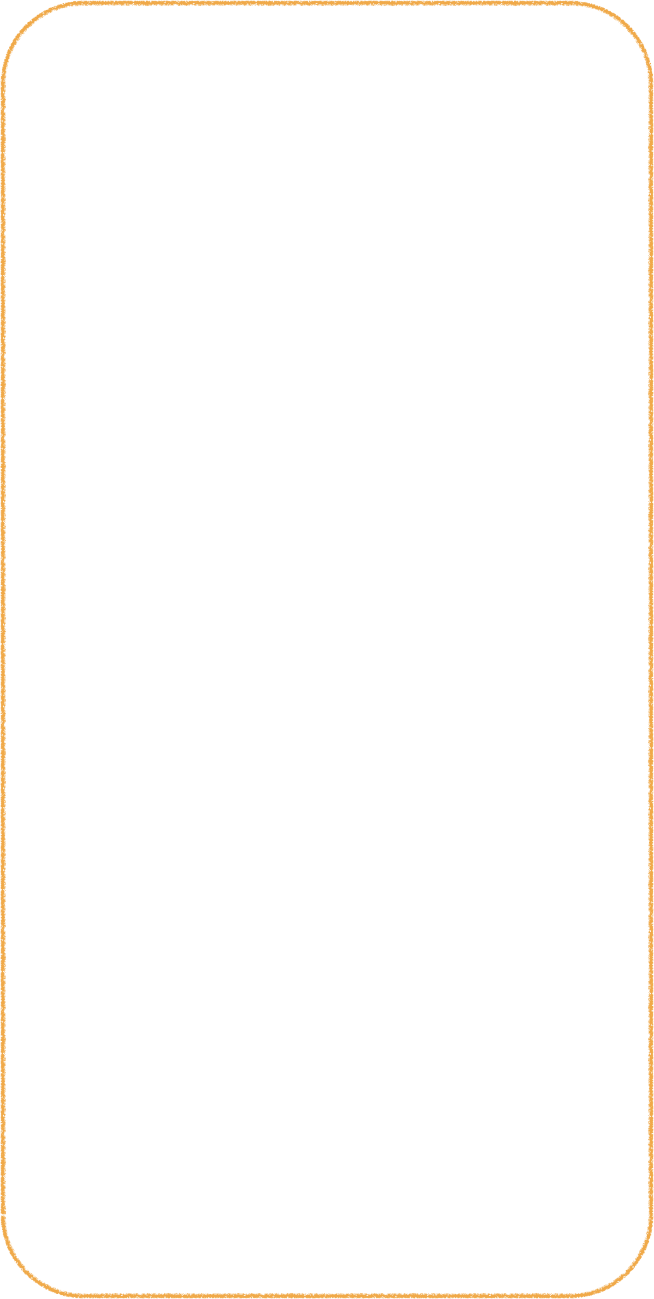
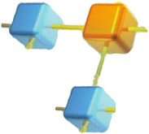
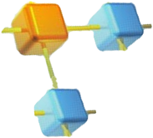
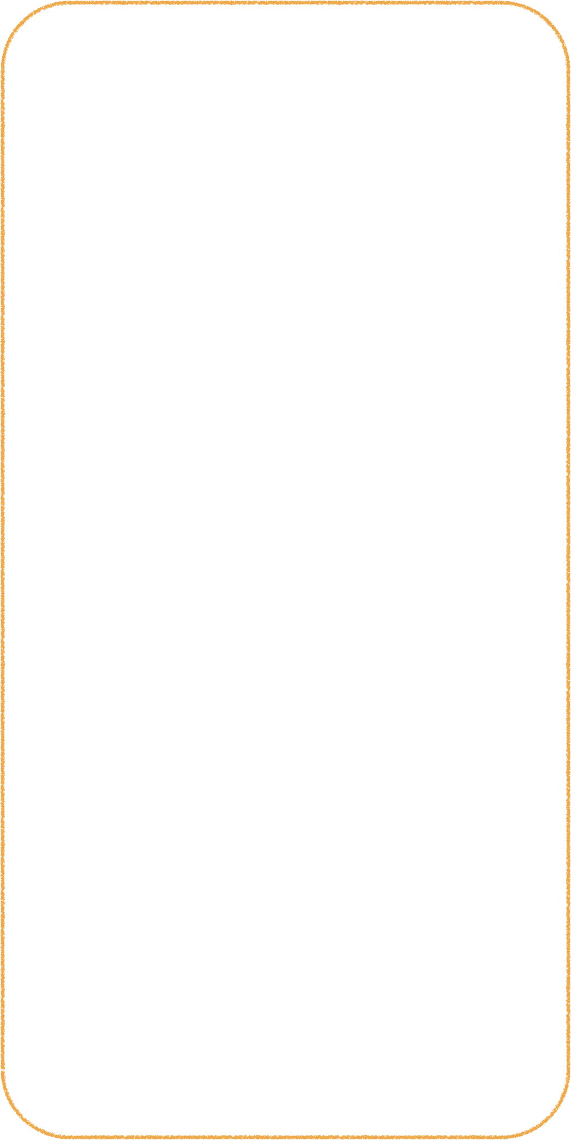
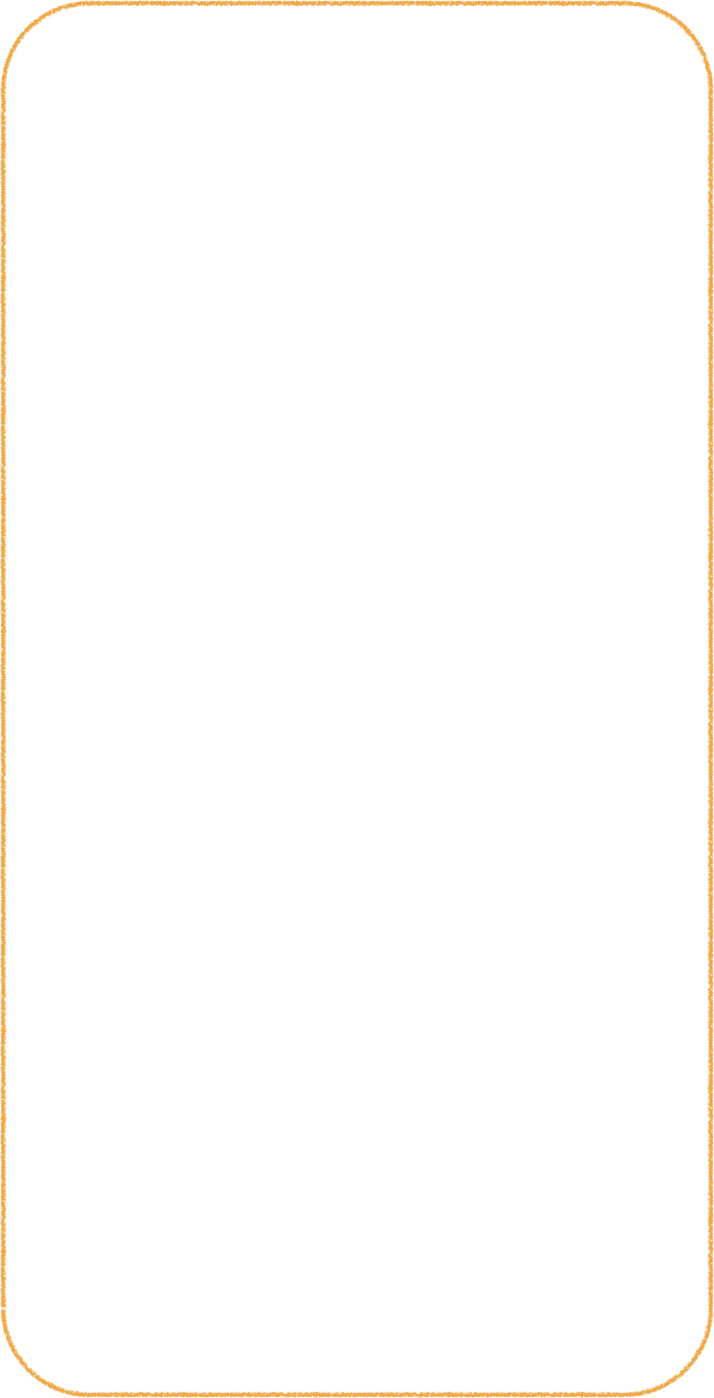


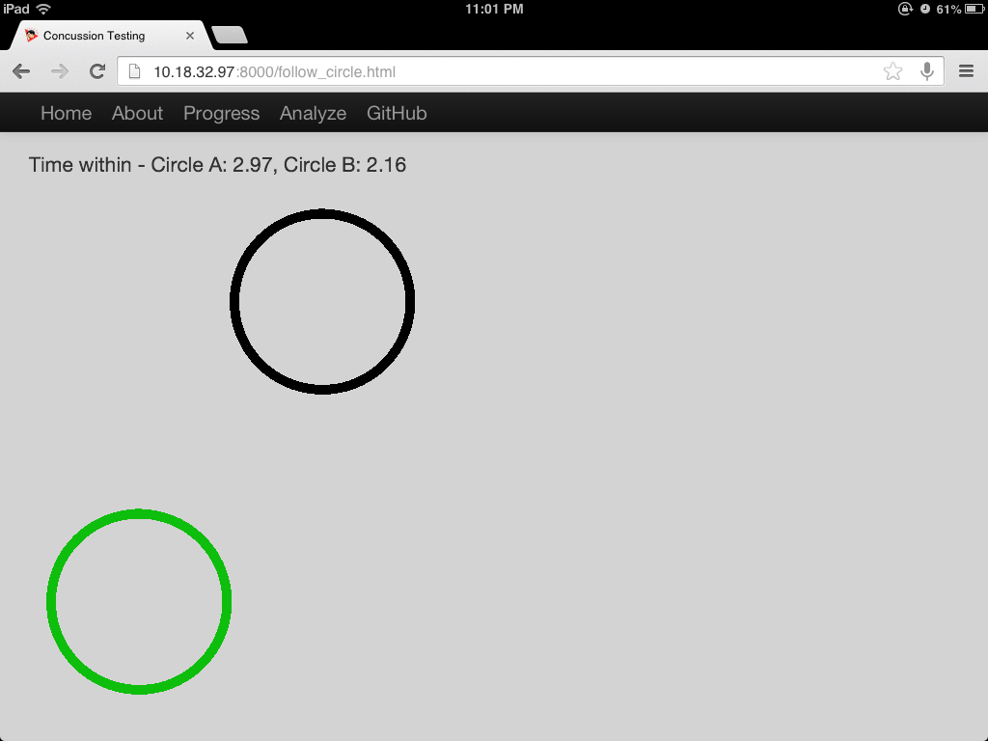
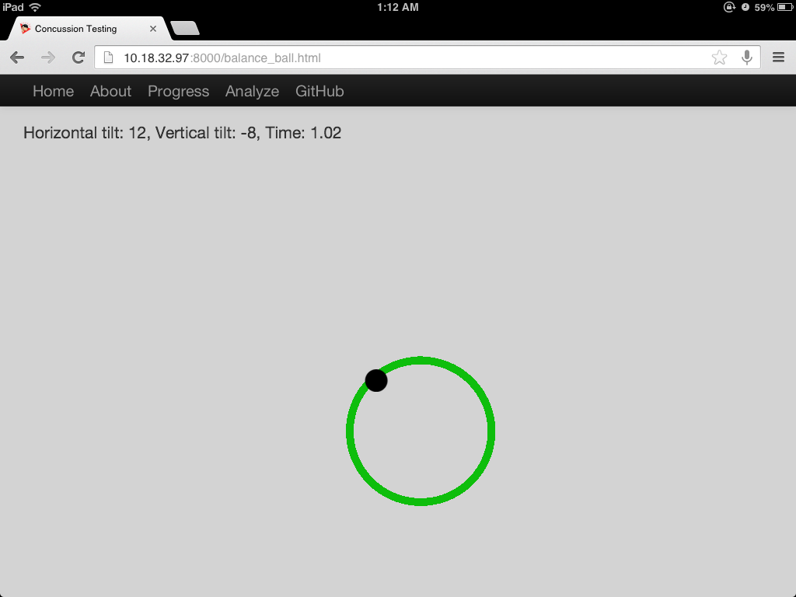
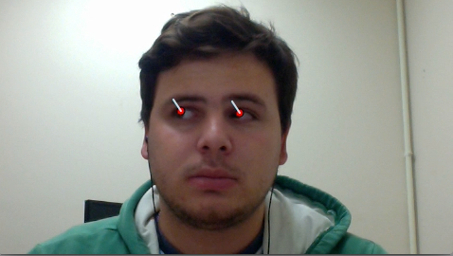
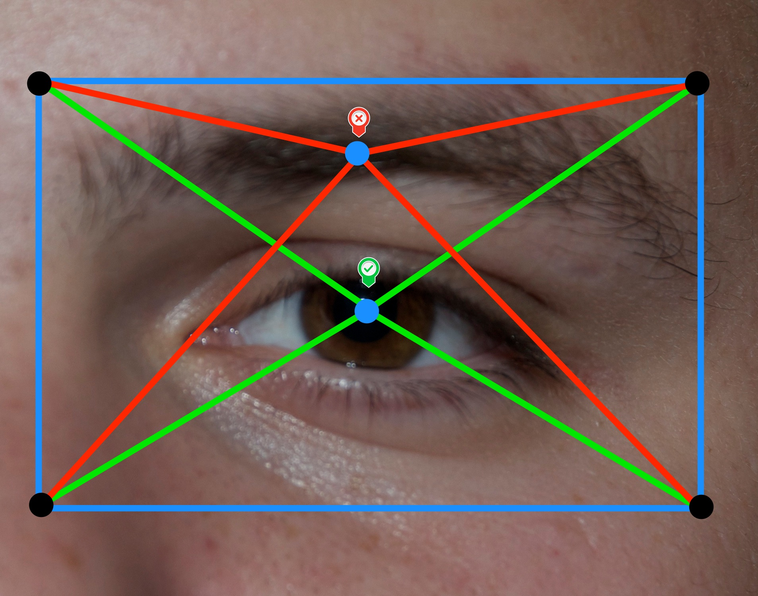
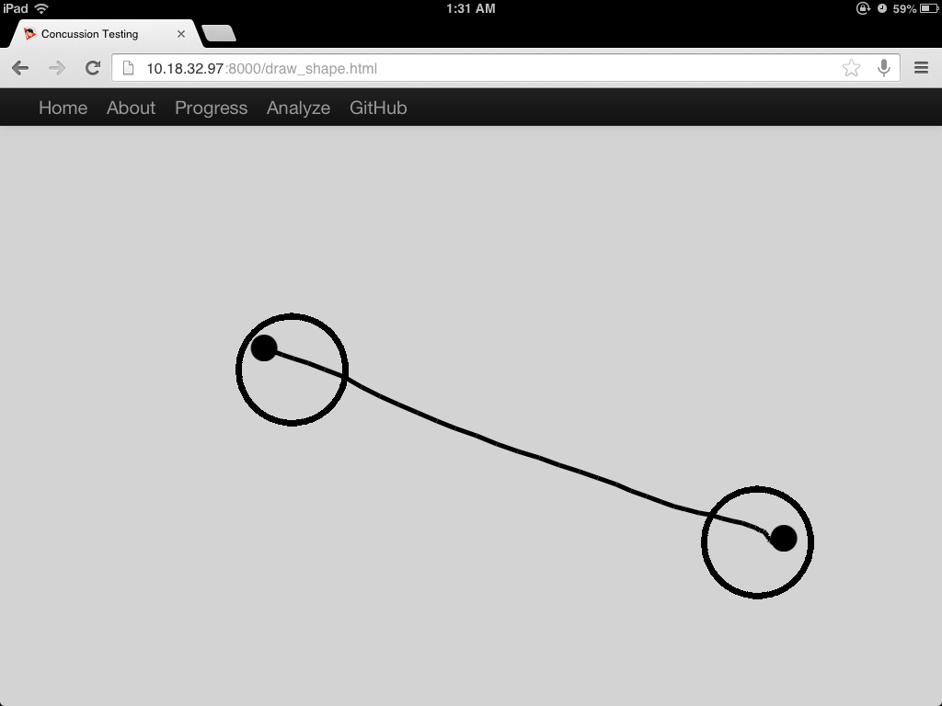
Alexander Wallar
aw204@st-andrews.ac.uk
http://github.com/wallarelvo
Reflexes
Mobile Concussion Testing
Eye Tracking & Gaze Detection
The reflex test is comprised of two randomly moving balls on an HTML5 canvas. The user is instructed to keep their fingers inside these circles and will be measured on how long they do so.
Whilst testing for a concussion, it is also beneficial to have a test to measure the eye responsiveness of the subject. It has been shown that impaired eye movements in post-concussion syndrome patients indicate suboptimal brain function beyond the influence of depression, malingering or intellectual ability [2]. Measuring these eye movements at an early stage with a mobile device could decrease these symptoms in the long term because users would seek the appropriate medical attention.
Research Statement & Motivation
To create a tablet based application that measures a user's memory, balance, and reflexes. Three different tests were created using JavaScript on the client side and Go on the server side. The results are stored in a RethinkDB database. The tests are registered under the user's email and are protected by a proctor's email and password. The proctor is also able to log in and view the results graphically and tabularly.
Method
There are a lot of concussions that go undiagnosed due to the lack of mobile medical resources. In a study, 30% of the subjects admitted to having a prior undiagnosed concussion. These athletes had a higher mean Post Concussion Symptoms Scale (PCSS) and were more likely to have a loss of consciousness [1]. By detecting concussions earlier, better medical attention can be given and the magnitude long term side effects can be reduced. This project provides an elegant mobile platform for concussion detection which can be administered without a physician by simply using a tablet and visiting a webpage. This is by no means a diagnostic tool, but rather, motivation for the user to seek medical attention.
Step 1: Detect the eyes using a Haar Cascade Classifier
Step 2: Convert the ROI image to grayscale
Step 3: Threshold the image and conduct blob detection on the binary image.
Step 4: Repeat Step 3 with varying minimum and maximum color thresholds, saving the result.
Step 5: Iterate through the results and only keep the blob that has the lowest overall average error. The error is computed by measuring how much the average absolute value of the angle from each of the corner positions differs from 45 degrees and by measuring how much the size of the blob differs from the empirical average size of a pupil.
Step 6: With the pupil that has been found, determine the centroid and find the resultant vector from each of the corner points in the Haar rectangle to the centroid. This will determine the gaze direction
Step 7: Scale and calibrate this result with an application on the screen
Balance Test
Balance
A subject's balance is measured in this test by having to keep a ball inside an open circle using the tilt functionality of the tablet. An initial acceleration is given to the ball which causes the user to compensate to keep it stable. The subject is measured on the percentage of time the ball is kept in the larger circle
Memory
The memory test works by presenting two open circles for a very short amount of time and asking the user to draw a line between where the two circles were. The memory is measured by the velocity at which the line is drawn and by how close the starting and ending points are to the respective circles.
http://www.ncbi.nlm.nih.gov/pubmed/23727697
http://www.ncbi.nlm.nih.gov/pubmed/19617197
UNIVERSITY of NOTRE DAME

