Slide 1



Pitch Perfector
Product Functionality
Vocal pitch correction
Programmable shifting
Core Demographic
Nervous karaoke singers
Bad X-Factor contestants
Unique Selling Points
Handheld operation
Cost
portability
A real-time pitch shifting microphone
@PerfectorPitch
pitch-perfector

Slide 2
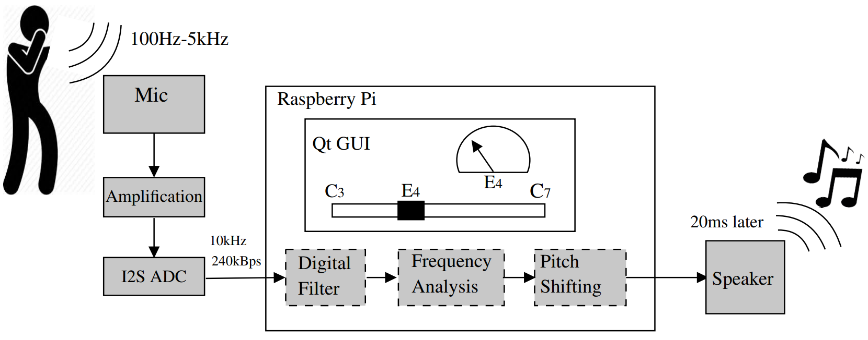
System Design
Real-time pitch shifting microphone
Notes:
ANDREW
Here you can see the system design for the handheld pitch shifting microphone
The singer sings into the handheld microphone
This audio is picked up by the ECM microphone and is amplified and converted into I2S
This I2C data-stream is input through the I2S configured pin to the Raspberry Pi
Using an IIR filter to acquire the required frequency range
Using a 10ms buffer FFT to analyse the frequency spectrum and determine the fundamental frequency
The frequency components will then be shifted in order to change the pitch of the vocals (phase vocoding - changing the length and playback speed of the sample)
This is then output to a speaker for playback
To allow for different operation, a GUI allows the user to change the note which is being shifted to
The GUI also provides feedback to let the singer know how far away from the desired note the vocals are

