Slide 1
Final Project
0540150 柳喬豐 0540107 馮宣淇

Slide 2
Introduction
A Wordbook Application

Slide 3
Features
Fetch the words automatically
Editable for user
Support word search
Plan your recitation and review
  According to the forgetting curve

Slide 4
Structure
User Interface：
Build and use vocabulary book
Search words
Making study plan
Start reciting

Slide 5
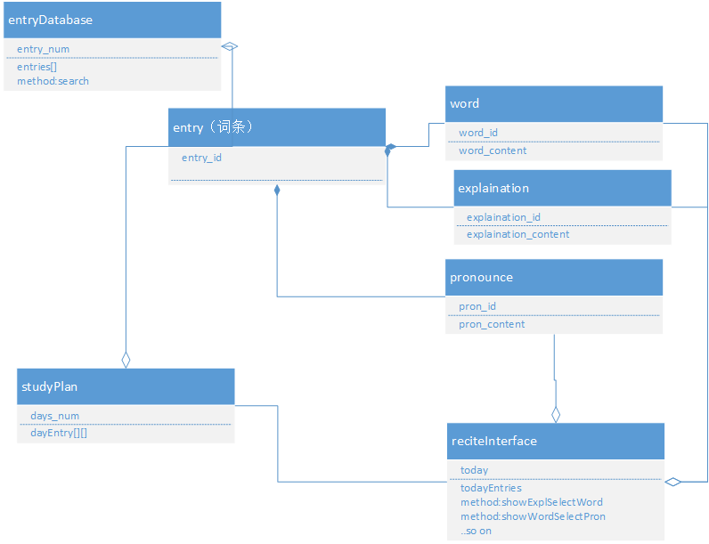
UML

Slide 6
Thanks for watching!

