Slide 1
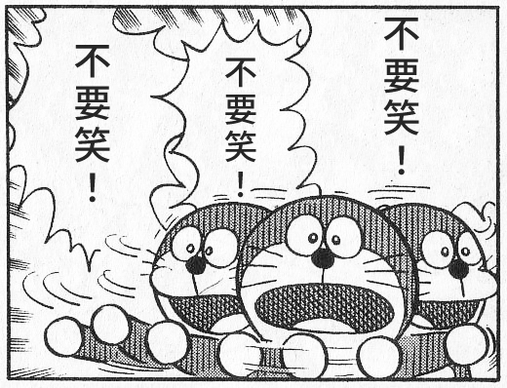
Item | UNIT PN | Test Result | Main | Aux | Spec
1 | 7249141700002 | PASS | -62 | -57 | -65
2 | 7249141700003 | PASS | -56 | -57 | -65
3 | 7249141700005 | PASS | -52 | -53 | -65asdfasdf
4 | 7249141700008 | PASS | -52 | -53 | -65
5 | 7249141700009 | PASS | -45 | -52 | -65
6 | 7249141700011 | PASS | -62 | -56 | -65
7 | 7249141700012 | PASS | -61 | -61 | -65
8 | 7249141800002 | PASS | -64 | -65 | -65
9 | 7249141800006 | PASS | -64 | -59 | -65
10 | 7249141800012 | PASS | -60 | -65 | -65
11 | 7249141800014 | PASS | -54 | -59 | -65
12 | 7249141800017 | PASS | -55 | -57 | -65
13 | 7249141800018 | PASS | -64 | -55 | -65
14 | 7249141800020 | PASS | -54 | -60 | -65
15 | 7249141800021 | PASS | -62 | -63 | -65
16 | 7249141800023 | PASS | -55 | -60 | -65
17 | 7249141800024 | PASS | -54 | -52 | -65
18 | 7249141800028 | PASS | -48 | -54 | -65
19 | 7249141800029 | PASS | -65 | -63 | -65
20 | 7249141800031 | PASS | -64 | -52 | -65
21 | 7249141800033 | PASS | -59 | -59 | -65
22 | 7249141800036 | PASS | -58 | -64 | -65
23 | 7249141800037 | PASS | -43 | -46 | -65
24 | 7249141800038 | PASS | -54 | -49 | -65
25 | 7249141800042 | PASS | -54 | -62 | -65
26 | 7249141800044 | PASS | -63 | -64 | -65
27 | 7249141800045 | PASS | -58 | -55 | -65
28 | 7249141800046 | PASS | -60 | -64 | -65
29 | 7249141800047 | PASS | -56 | -49 | -65
Item | UNIT PN | Test Result | Main | Aux | Spec
1 | 7249141700002 | PASS | -62 | -57 | -65
2 | 7249141700003 | PASS | -56 | -57 | -65
3 | 7249141700005 | PASS | -52 | -53 | -65asdfasdf
4 | 7249141700008 | PASS | -52 | -53 | -65
5 | 7249141700009 | PASS | -45 | -52 | -65
Item | UNIT PN | Test Result | Main | Aux | Spec
1 | 7249141700002 | PASS | -62 | -57 | -65
2 | 7249141700003 | PASS | -56 | -57 | -65
3 | 7249141700005 | PASS | -52 | -53 | -65asdfasdf
4 | 7249141700008 | PASS | -52 | -53 | -65
5 | 7249141700009 | PASS | -45 | -52 | -65
6 | 7249141700011 | PASS | -62 | -56 | -65
7 | 7249141700012 | PASS | -61 | -61 | -65
8 | 7249141800002 | PASS | -64 | -65 | -65
9 | 7249141800006 | PASS | -64 | -59 | -65
10 | 7249141800012 | PASS | -60 | -65 | -65
11 | 7249141800014 | PASS | -54 | -59 | -65
12 | 7249141800017 | PASS | -55 | -57 | -65
13 | 7249141800018 | PASS | -64 | -55 | -65
14 | 7249141800020 | PASS | -54 | -60 | -65
15 | 7249141800021 | PASS | -62 | -63 | -65
16 | 7249141800023 | PASS | -55 | -60 | -65
17 | 7249141800024 | PASS | -54 | -52 | -65
18 | 7249141800028 | PASS | -48 | -54 | -65
19 | 7249141800029 | PASS | -65 | -63 | -65
20 | 7249141800031 | PASS | -64 | -52 | -65
21 | 7249141800033 | PASS | -59 | -59 | -65
22 | 7249141800036 | PASS | -58 | -64 | -65
23 | 7249141800037 | PASS | -43 | -46 | -65
24 | 7249141800038 | PASS | -54 | -49 | -65
25 | 7249141800042 | PASS | -54 | -62 | -65
26 | 7249141800044 | PASS | -63 | -64 | -65
27 | 7249141800045 | PASS | -58 | -55 | -65
28 | 7249141800046 | PASS | -60 | -64 | -65
29 | 7249141800047 | PASS | -56 | -49 | -65

