Slide 1
Heap
Michael Tsai
2018/4/17

Slide 2
Array Representation of Tree
Tree
Array
Note that the index starts at 1 from the root node.

Slide 3
Heap
Definition: A max tree is a tree in which the key value in each node is no smaller (larger) than the key values in its children (if any).
Definition: A max heap is a complete binary tree that is also a max tree. A min heap is a complete binary tree that is also a min tree.
14
12
7
10
8
6

Slide 4
Max-Heapify
Assumption: the left and right subtrees are max-heaps, but the root node might violate the max tree property.
Max-Heap
Max-Heap
See Fig. 6.2 on p.155 of Cormen

Slide 5
Max-Heapify
Assumption: the left and right subtrees are max-heaps, but the root node might violate the max tree property.
Worst case: need to go all the way to the leaf.
h=O(log n)
See Fig. 6.2 on p.155 of Cormen

Slide 6
Max-Heapify

Slide 7
How to “heapify” an array?
Method: Starting from the last node, each time build a small max-heap with that node as the root.
Skip the leaves (already a “one-node heap”)
Find the first non-leaf node
Run max-heapify on that node, and afterwards the subtree with the node as the root will be a heap
When we are done with the root node (of the entire tree), it will become a heap.
4
1
3
2
16
9
14
8
7

Slide 8
Build-Max-Heap
Skipping the leaves
It can be shown that, with the array representation for storing an n-element heap, the leaves are the nodes indexed by . (problem 6.1-7 on Cormen p.154)

Slide 9
Time complexity
O(n) iterations
O(log n)
Therefore the time complexity is O(n log n). This bound is correct, but not asymptotically tight.

Slide 10

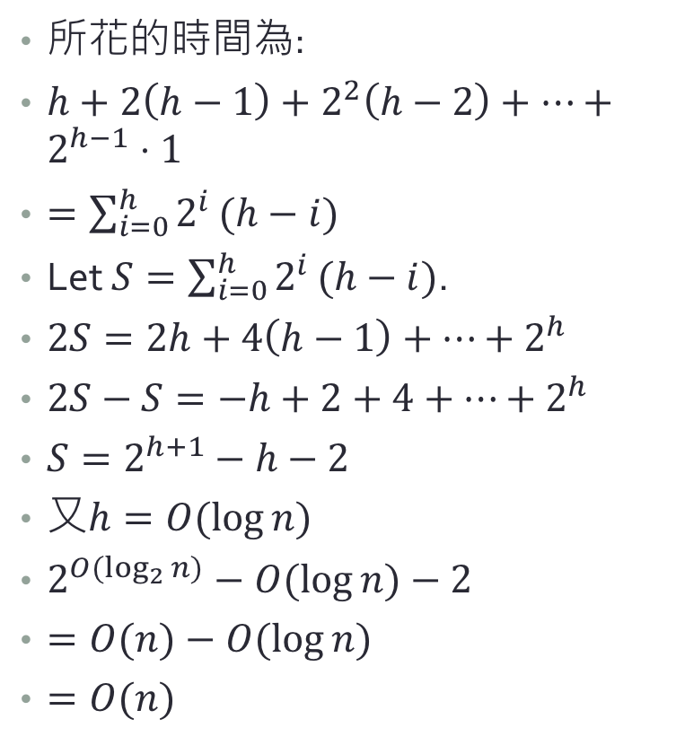
Time Complexity: Trial 2
所花的時間為:
$h+2\left(h−1\right)+2^{2}\left(h−2\right)+…+2^{h−1}⋅1$
$=\sum_{i=0}^{h}{2^{i}}(h−i)$
Let $S=\sum_{i=0}^{h}{2^{i}}(h−i)$.
$2S=2h+4\left(h−1\right)+…+2^{h}$
$2S−S=−h+2+4+…+2^{h}$
$S=2^{h+1}−h−2$
又$h=O(\log{n)}$
$2^{O(\log_{2}{n)}}−O(\log{n)}−2$
$=O(n)−O(\log{n})$
$=O(n)$
l=0
l=1
l=2
…
…
l=h
You can also see a different proof on p.159 of Cormen.

Slide 11
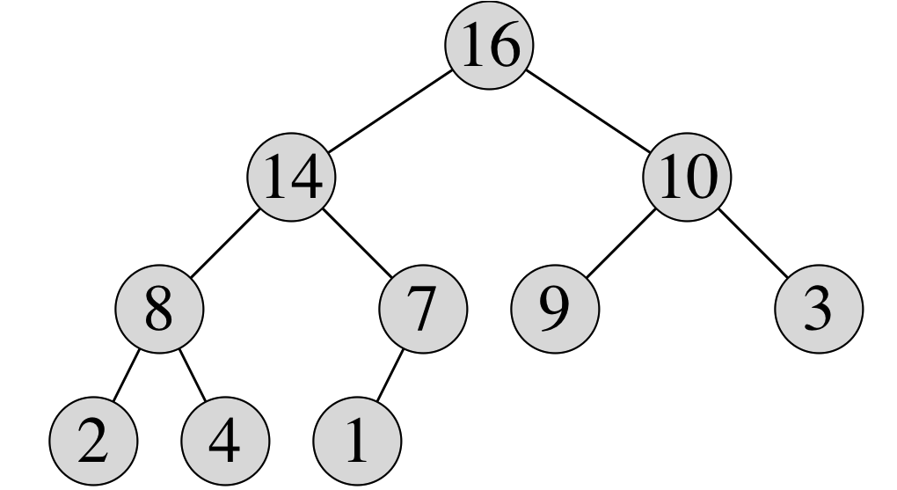
Heapsort: use a heap to sort

Slide 12



Heapsort: use a heap to sort
How?
Use Build-Max-Heap to build a max-heap.
Exchange the root node (maximum element) with the last node.
Heapify again to maintain the max-heap property.
Repeat the above until the heap is empty.
$$O(n)$$
$$O\left(h\right)=O(\log{n})$$
Total: $O(n\log{n})$
See Cormen p.161 Figure 6.4

Slide 13
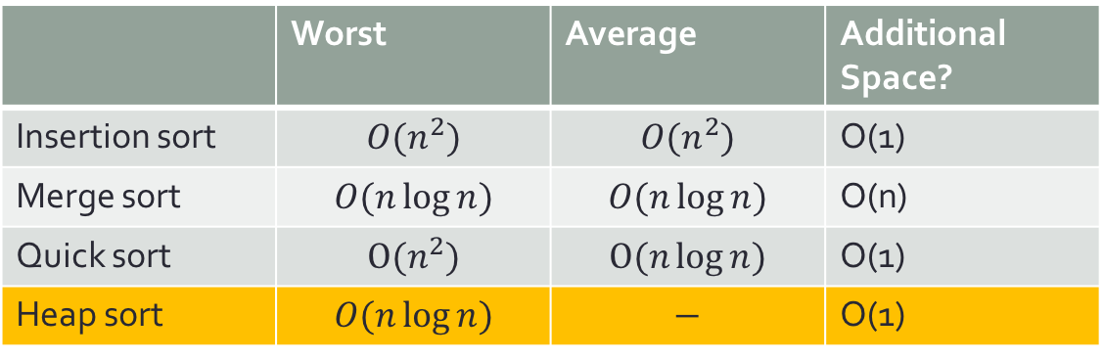
比較四大金剛
 | Worst | Average | Additional Space?
Insertion sort | $${O(n}^{2})$$ | $${O(n}^{2})$$ | O(1)
Merge sort | $$O(n\log{n})$$ | $$O(n\log{n})$$ | O(n)
Quick sort | $${O(n}^{2})$$ | $$O(n\log{n})$$ | O(1)
Heap sort | $$O(n\log{n})$$ | $$−$$ | O(1)
Covered today!
Insertion sort: quick with small input size n. (small constant)
Quick sort: Best average performance (fairly small constant)
Merge sort: Best worst-case performance
Heap sort: Good worst-case performance, no additional space needed!
Real-world strategy: a hybrid of insertion sort + others. Use input size n to determine the algorithm to use.

Slide 14
Priority queue
A priority queue is a data structure for maintaining a set S of elements, each with an associated value called a key.
It supports:
Insert(S,x) inserts the element x into the set S.
Maximum(S): returns the element of S with the largest key.
Extract-Max(S): removes and returns the element of S with the largest key
Increase-Key(S,x,k) increases the value of element x’s key to the new value k, which is at least as large as x’s current key value.
We already know how to do these!
See p. 164 on Cormen for the implementation of Increase-Key(). (very similar to insert)

Slide 15

Inserting a new element
1. Add the new element after the last leaf (it is always a complete binary tree)
2. Compare the value of the element with its parent’s value. If it violates the max-heap property, then exchange the two then repeat 2. again.
Time complexity?
14
12
7
10
8
6
20
Need to compare with 6?
No! Because 6’s parent is already larger. Therefore 20 will be even larger.
$$O(\log{n})$$

Slide 16
Summary – Priority Queue using Heap
Operation | Running time
Maximum | O(1)
Extract Maximum | O(log n)
Insert | O(log n)
Increase-Key | O(log n)
All operations can be completed in O(log n) time!

Slide 17
Related Reading
Cormen chapter 6

