Slide 1
Sorting
Michael Tsai
2019/3/19

Slide 2
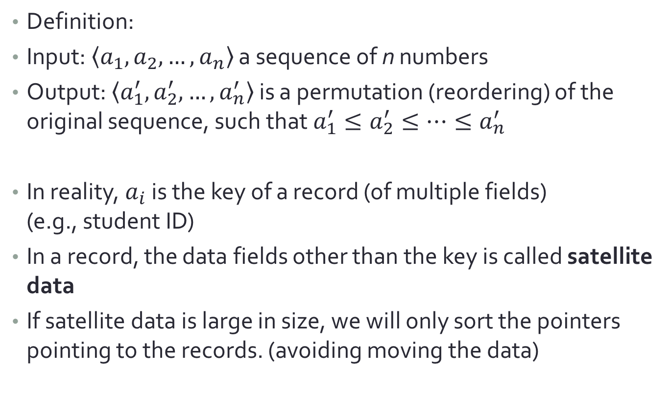
Sorting
Definition:
Input: $\left\langle a_{1},a_{2},…,a_{n}\right\rangle$ a sequence of n numbers
Output: $\left\langle a_{1}^{′},a_{2}^{′},…,a_{n}^{′}\right\rangle$ is a permutation (reordering) of the original sequence, such that $a_{1}^{′}≤a_{2}^{′}≤…≤a_{n}^{′}$
In reality, $a_{i}$ is the key of a record (of multiple fields) (e.g., student ID)
In a record, the data fields other than the key is called satellite data
If satellite data is large in size, we will only sort the pointers pointing to the records. (avoiding moving the data)

Slide 3
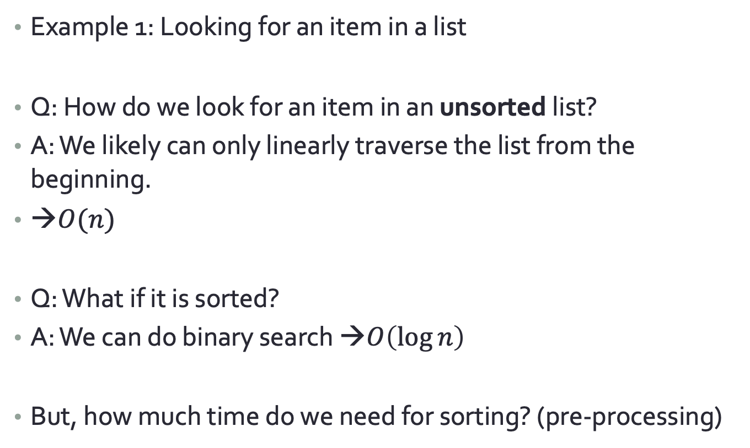
Applications of Sorting
Example 1: Looking for an item in a list
Q: How do we look for an item in an unsorted list?
A: We likely can only linearly traverse the list from the beginning.
→$O(n)$
Q: What if it is sorted?
A: We can do binary search →$O\left(\log{n}\right)$
But, how much time do we need for sorting? (pre-processing)
Notes:
https://www.geeksforgeeks.org/binary-search/

Slide 4
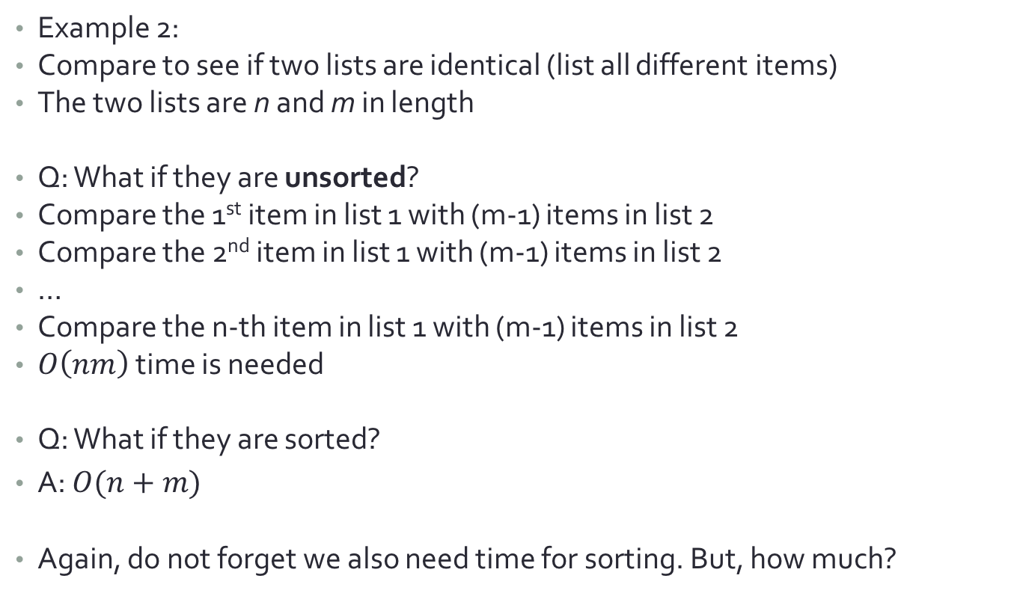
Applications of Sorting
Example 2:
Compare to see if two lists are identical (list all different items)
The two lists are n and m in length
Q: What if they are unsorted?
Compare the 1st item in list 1 with (m-1) items in list 2
Compare the 2nd item in list 1 with (m-1) items in list 2
…
Compare the n-th item in list 1 with (m-1) items in list 2
$O\left(nm\right)$ time is needed
Q: What if they are sorted?
A: $O(n+m)$
Again, do not forget we also need time for sorting. But, how much?

Slide 5
Categories of Sorting Algo.
Internal Sort:
Place all data in the memory
External Sort:
The data is too large to fit it entirely in the memory.
Some need to be temporarily placed onto other (slower) storage, e.g., hard drive, flash disk, network storage, cloud storage, etc.
In this lecture, we will only discuss internal sort.
Storage is cheap nowadays. In most cases, only internal sort is needed.

Slide 6
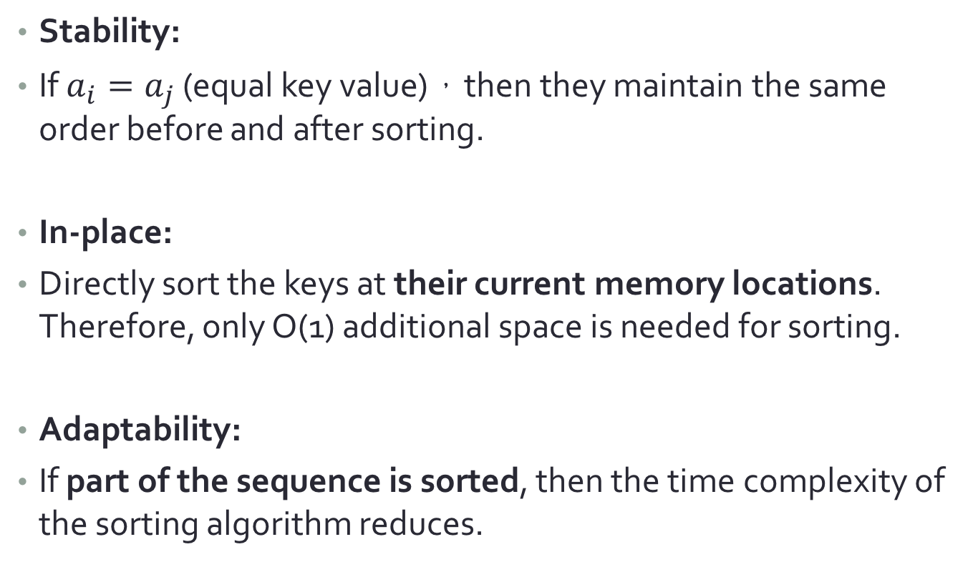
Some terms related to sorting
Stability:
If $a_{i}=a_{j}$ (equal key value)，then they maintain the same order before and after sorting.
In-place:
Directly sort the keys at their current memory locations. Therefore, only O(1) additional space is needed for sorting.
Adaptability:
If part of the sequence is sorted, then the time complexity of the sorting algorithm reduces.

Slide 7





How fast can we sort?
Assumption: compare and swap
Compare: compare two items in the list
Swap: Swap the locations of these two items
How much time do we need in the worst case?
[1,2,3]
$$K_{1}≤K_{2}$$
[1,2,3]
Yes
No
[2,1,3]
$$K_{2}≤K_{3}$$
$$K_{1}≤K_{3}$$
[1,3,2]
[2,1,3]
[3,1,2]
stop
$$K_{1}≤K_{3}$$
stop
$$K_{2}≤K_{3}$$
[1,2,3]
stop
stop
stop
stop
[3,1,2]
[3,2,1]
[1,3,2]
[2,3,1]

Slide 8


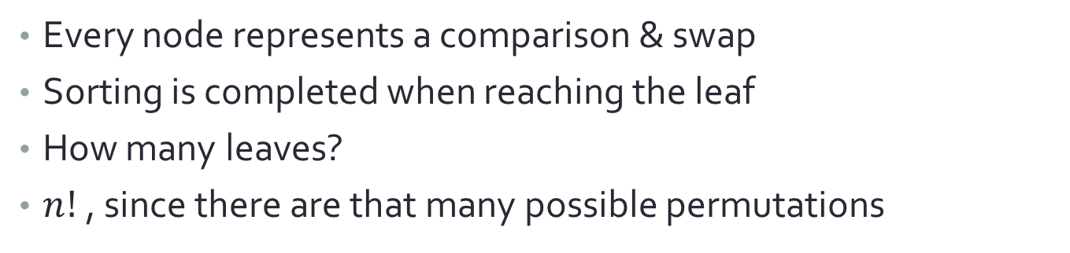



Decision tree for sorting
[1,2,3]
$$K_{1}≤K_{2}$$
[1,2,3]
[2,1,3]
$$K_{2}≤K_{3}$$
$$K_{1}≤K_{3}$$
[1,3,2]
[2,1,3]
stop
$$K_{1}≤K_{3}$$
stop
$$K_{2}≤K_{3}$$
[1,2,3]
stop
stop
stop
stop
[3,1,2]
[3,2,1]
[1,3,2]
[2,3,1]
Every node represents a comparison & swap
Sorting is completed when reaching the leaf
How many leaves?
$n!$, since there are that many possible permutations

Slide 9
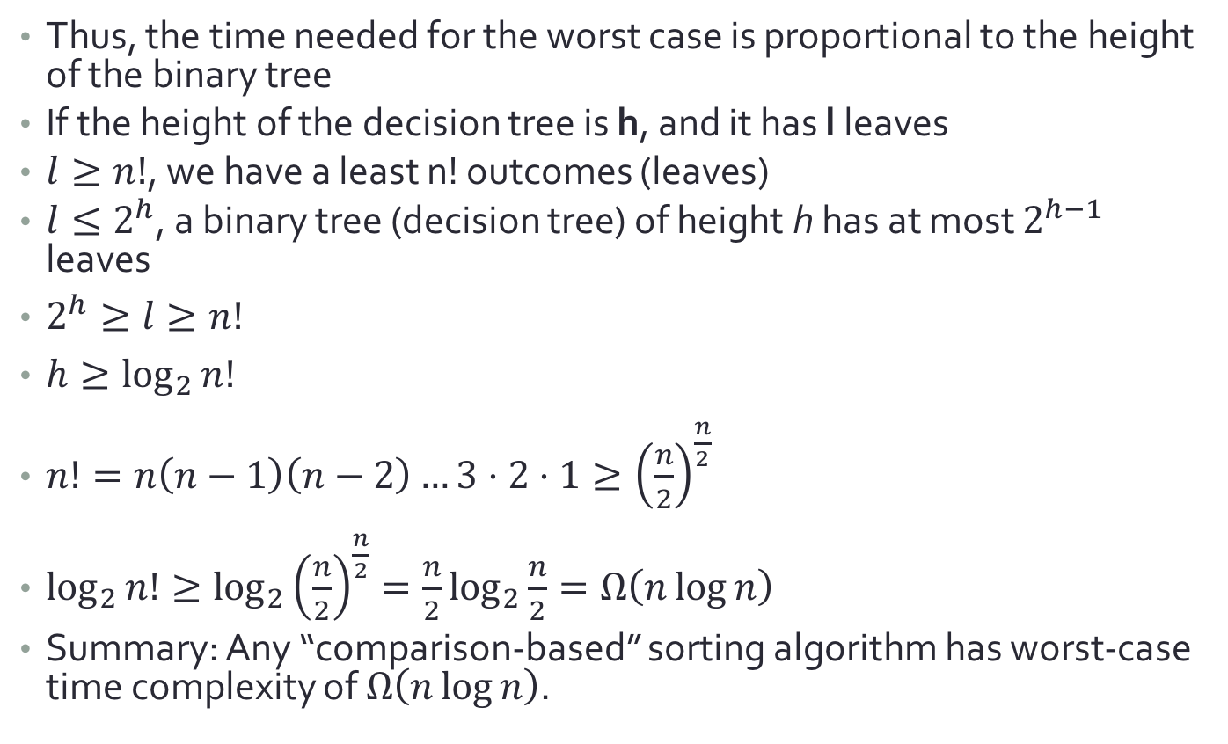
How fast can we sort?
Thus, the time needed for the worst case is proportional to the height of the binary tree
If the height of the decision tree is h, and it has l leaves
$l≥n!$, we have a least n! outcomes (leaves)
$l≤2^{h}$, a binary tree (decision tree) of height h has at most $2^{h−1}$ leaves
$2^{h}≥l≥n!$
$h≥\log_{2}{n!}$
$n!=n\left(n−1\right)\left(n−2\right)…3⋅2⋅1≥{\left(\frac{n}{2}\right)}^{\frac{n}{2}}$
$\log_{2}{n!}≥\log_{2}{{\left(\frac{n}{2}\right)}^{\frac{n}{2}}}=\frac{n}{2}\log_{2}{\frac{n}{2}}=Ω\left(n\log{n}\right)$
Summary: Any “comparison-based” sorting algorithm has worst-case time complexity of $Ω\left(n\log{n}\right)$.

Slide 10
Selection Sort
Select the smallest, move it to the first position.
Select the second smallest, move it to the second position.
….
The last item will automatically be placed at the last position.
ㄅ
ㄆ
1
1
ㄆ
2
ㄅ
1
2
ㄆ
ㄅ

Slide 11
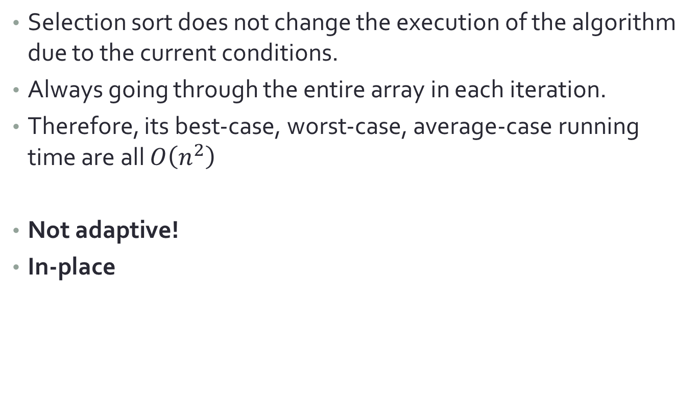
Selection Sort
Selection sort does not change the execution of the algorithm due to the current conditions.
Always going through the entire array in each iteration.
Therefore, its best-case, worst-case, average-case running time are all $O\left(n^{2}\right)$
Not adaptive!
In-place

Slide 12
Insertion Sort: Revisit
In each iteration, add one item to a sorted list of i item.
Turning it into a sorted list of (i+1) item
2 | 3 | 6 | 5 | 1 | 4
2 | 3 | 6 | 5 | 1 | 4
2 | 3 | 6 | 5 | 1 | 4
2 | 3 | 5 | 6 | 1 | 4
2 | 3 | 5 | 6 | 1 | 4
1 | 2 | 3 | 5 | 6 | 4
1 | 2 | 3 | 5 | 6 | 4
1 | 2 | 3 | 4 | 5 | 6

Slide 13
Pseudo code

Slide 14
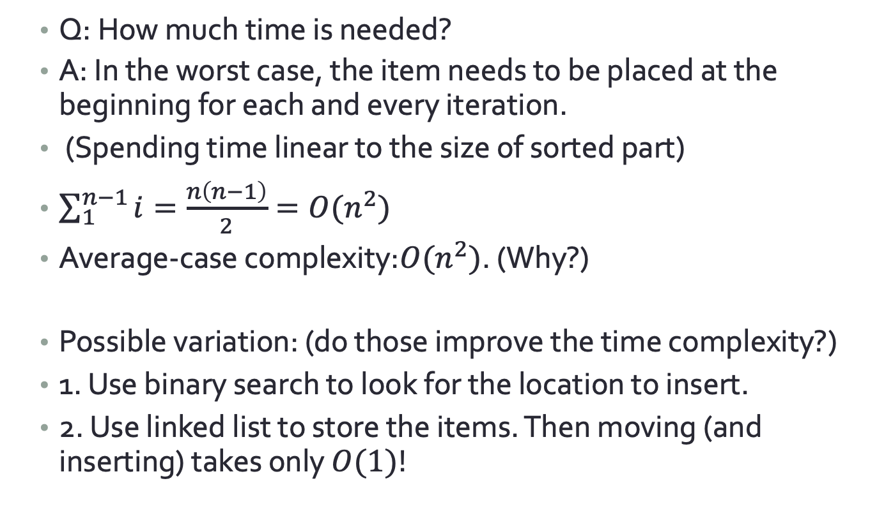
Insertion Sort
Q: How much time is needed?
A: In the worst case, the item needs to be placed at the beginning for each and every iteration.
(Spending time linear to the size of sorted part)
$\sum_{1}^{n−1}{i}=\frac{n\left(n−1\right)}{2}=O(n^{2})$
Average-case complexity:$O(n^{2})$. (Why?)
Possible variation: (do those improve the time complexity?)
1. Use binary search to look for the location to insert.
2. Use linked list to store the items. Then moving (and inserting) takes only $O(1)$!
Notes:
Moving still takes O(n). So no.
Constant time for moving the items. But finding the location of the item still takes O(n). So no.

Slide 15
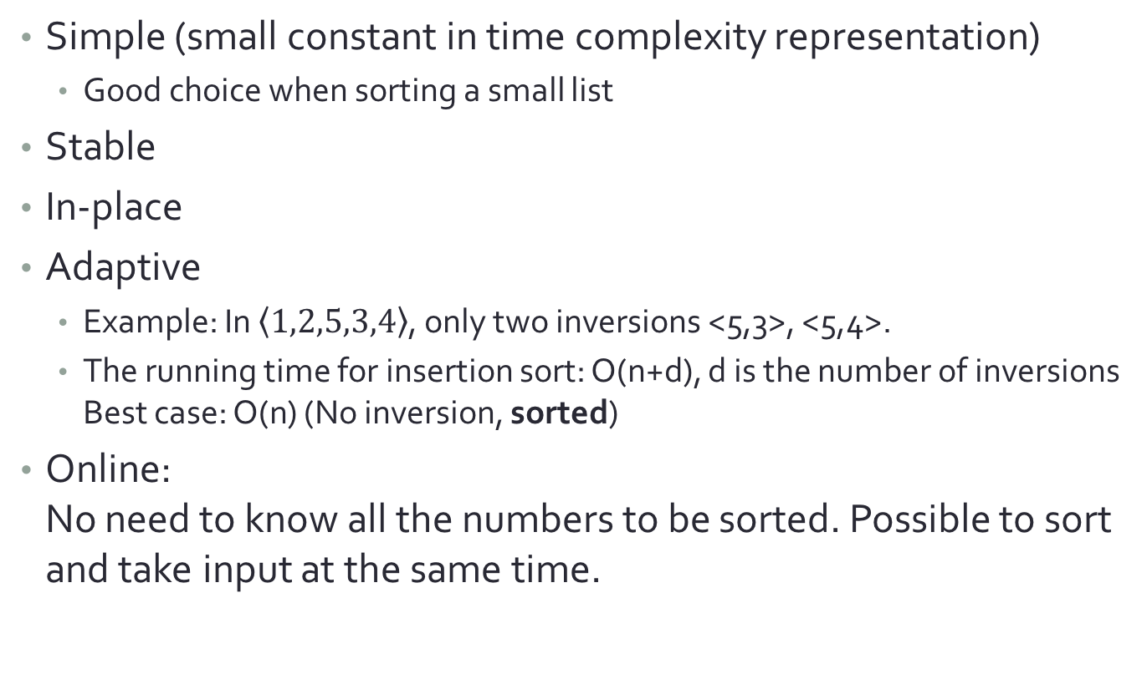
What’s good about insertion sort
Simple (small constant in time complexity representation)
Good choice when sorting a small list
Stable
In-place
Adaptive
Example: In $\left\langle 1,2,5,3,4\right\rangle$, only two inversions <5,3>, <5,4>.
The running time for insertion sort: O(n+d), d is the number of inversions Best case: O(n) (No inversion, sorted)
Online: No need to know all the numbers to be sorted. Possible to sort and take input at the same time.

Slide 16
Merge Sort
Use Divide-and-Conquer strategy
Divide-and-Conquer:
Divide: Split the big problem into small problems
Conquer: Solve the small problems
Combine: Combine the solutions to the small problems into the solution of the big problems.
Merge sort:
Divide: Split the n numbers into two sub-sequences of n/2 numbers
Conquer: Sort the two sub-sequences (use recursive calls to delegate to the clones)
Combine: Combine the two sorted sub-sequences into the one sorted sequence

Slide 17
Merge Sort
Divide
Conquer x2
Combine

Slide 18
Merge Sort
A[]: the array to be sorted temp: temporarily storage
left,right: the left & right indices of the range to be sorted.
void Mergesort(int A[], int temp, int left, int right) {
int mid;
if (right > left) {
mid=(right+left)/2;
Mergesort(A,temp,left,mid);
Mergesort(A,temp,mid+1,right);
Merge(A,temp,left,mid+1,right);
} }
Divide
Conquer
Combine

Slide 19
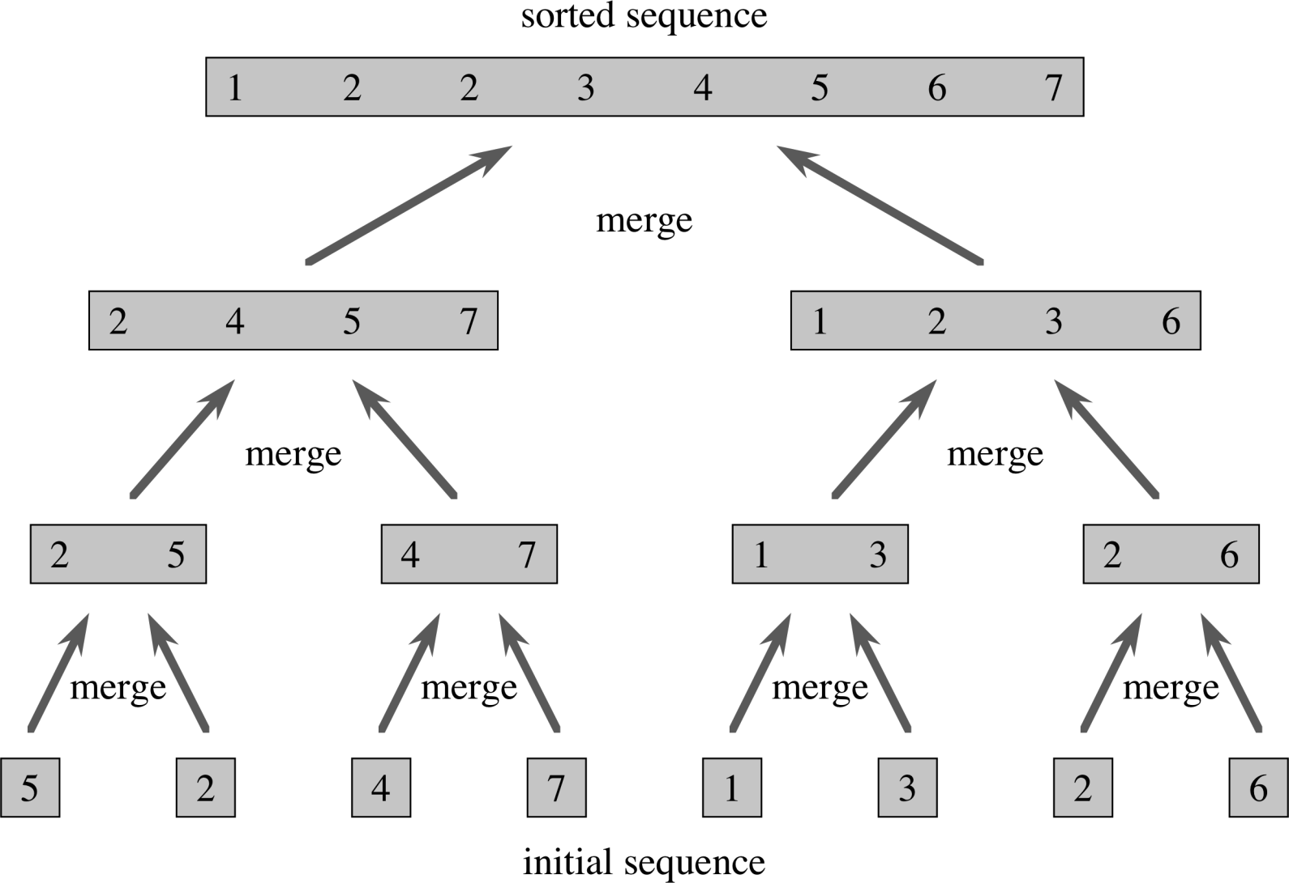
Merge Sort: Example

Slide 20
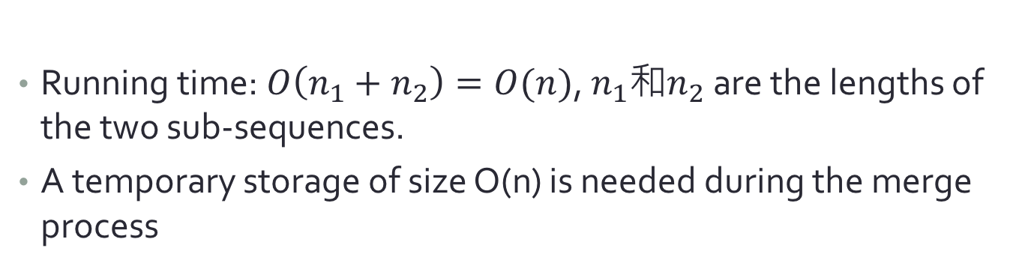
How to combine (merge)?
Temporary storage
i
j
1 | 4 | 5 | 8
2 | 3 | 6 | 9
Original array
1 | 2 | 3 | 4 | 5 | 6 | 8 | 9
Running time: $O\left(n_{1}+n_{2}\right)=O(n)$, $n_{1}$和$n_{2}$ are the lengths of the two sub-sequences.
A temporary storage of size O(n) is needed during the merge process

Slide 21
Implementation: Merge

Slide 22
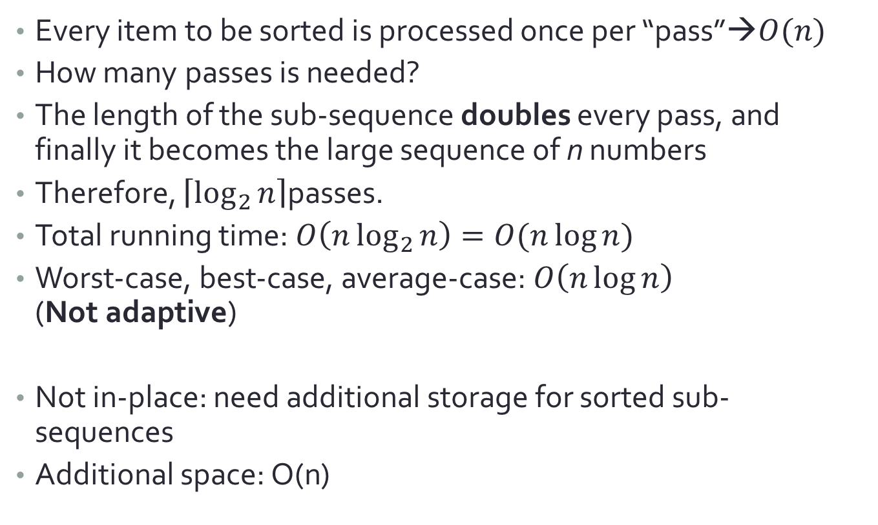
Merge sort
Every item to be sorted is processed once per “pass”→$O(n)$
How many passes is needed?
The length of the sub-sequence doubles every pass, and finally it becomes the large sequence of n numbers
Therefore, $\left\lceil \log_{2}{n}\right\rceil$passes.
Total running time: $O\left(n\log_{2}{n}\right)=O(n\log{n})$
Worst-case, best-case, average-case: $O\left(n\log{n}\right)$ (Not adaptive)
Not in-place: need additional storage for sorted sub-sequences
Additional space: O(n)

Slide 23
Quick Sort
Find a pivot(支點), manipulate the locations of the items so that:
(1) all items to its left is smaller or equal (unsorted),
(2) all items to its right is larger
Recursively call itself to sort the left and right sub-sequences.
26 | 5 | 37 | 1 | 61 | 11 | 59 | 15 | 48 | 19
26 | 5 | 37 | 1 | 61 | 11 | 59 | 15 | 48 | 19
26 | 5 | 19 | 1 | 61 | 11 | 59 | 15 | 48 | 37
26 | 5 | 19 | 1 | 15 | 11 | 59 | 61 | 48 | 37
11 | 5 | 19 | 1 | 15 | 26 | 59 | 61 | 48 | 37

Slide 24
Pseudo Code
Divide
Conquer x2
No Combine!

Slide 25
Quick Sort
11 | 5 | 19 | 1 | 15 | 26 | 59 | 61 | 48 | 37
1 | 5 | 11 | 19 | 15 | 26 | 59 | 61 | 48 | 37
1 | 5 | 11 | 19 | 15 | 26 | 59 | 61 | 48 | 37
1 | 5 | 11 | 15 | 19 | 26 | 59 | 61 | 48 | 37
1 | 5 | 11 | 15 | 19 | 26 | 59 | 61 | 48 | 37
1 | 5 | 11 | 15 | 19 | 26 | 48 | 37 | 59 | 61
1 | 5 | 11 | 15 | 19 | 26 | 37 | 48 | 59 | 61
1 | 5 | 11 | 15 | 19 | 26 | 37 | 48 | 59 | 61

Slide 26
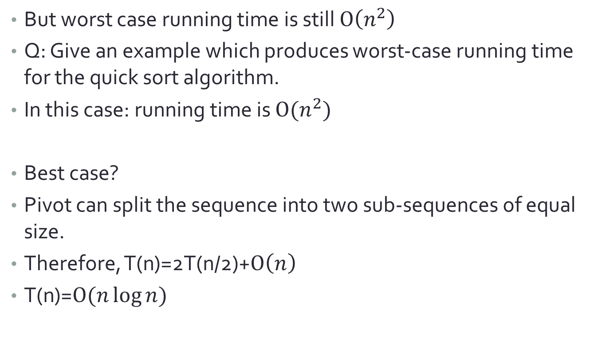
Quick Sort: Worst & Best case
But worst case running time is still $O\left(n^{2}\right)$
Q: Give an example which produces worst-case running time for the quick sort algorithm.
In this case: running time is $O(n^{2})$
Best case?
Pivot can split the sequence into two sub-sequences of equal size.
Therefore, T(n)=2T(n/2)+$O\left(n\right)$
T(n)=$O(n\log{n})$
Notes:
答: 每次pivot都是最大的. (or 每次都是最小的) →已經排好了!

Slide 27
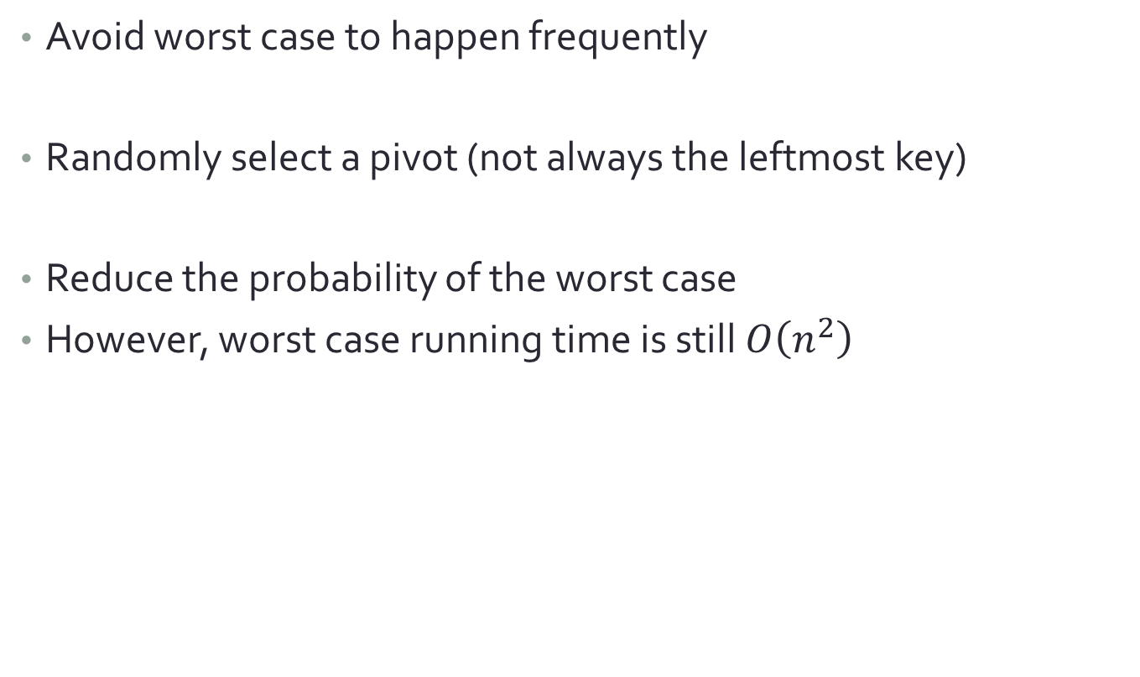
Randomized Quick Sort
Avoid worst case to happen frequently
Randomly select a pivot (not always the leftmost key)
Reduce the probability of the worst case
However, worst case running time is still $O\left(n^{2}\right)$
Randomly select a pivot
26 | 5 | 37 | 1 | 61 | 11 | 59 | 15 | 48 | 19
Swap in advance

Slide 28
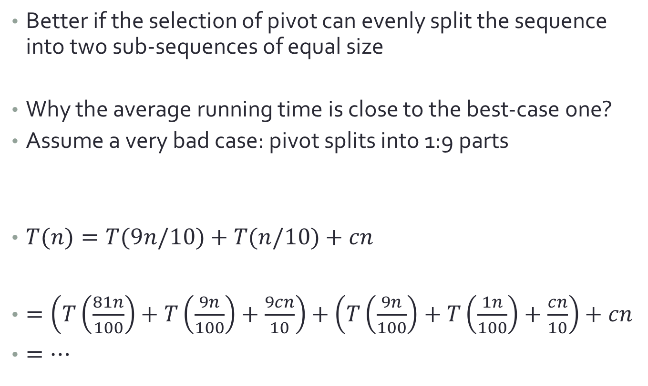
Average running time
Better if the selection of pivot can evenly split the sequence into two sub-sequences of equal size
Why the average running time is close to the best-case one?
Assume a very bad case: pivot splits into 1:9 parts
$T(n)=T(9n/10)+T(n/10)+cn$
$=\left(T\left(\frac{81n}{100}\right)+T\left(\frac{9n}{100}\right)+\frac{9cn}{10}\right)+\left(T\left(\frac{9n}{100}\right)+T\left(\frac{1n}{100}\right)+\frac{cn}{10}\right)+cn$
$=…$
Time needed for the “9/10 subsequence”
Time needed for partitioning
Time needed for the “1/10 subsequence”

Slide 29
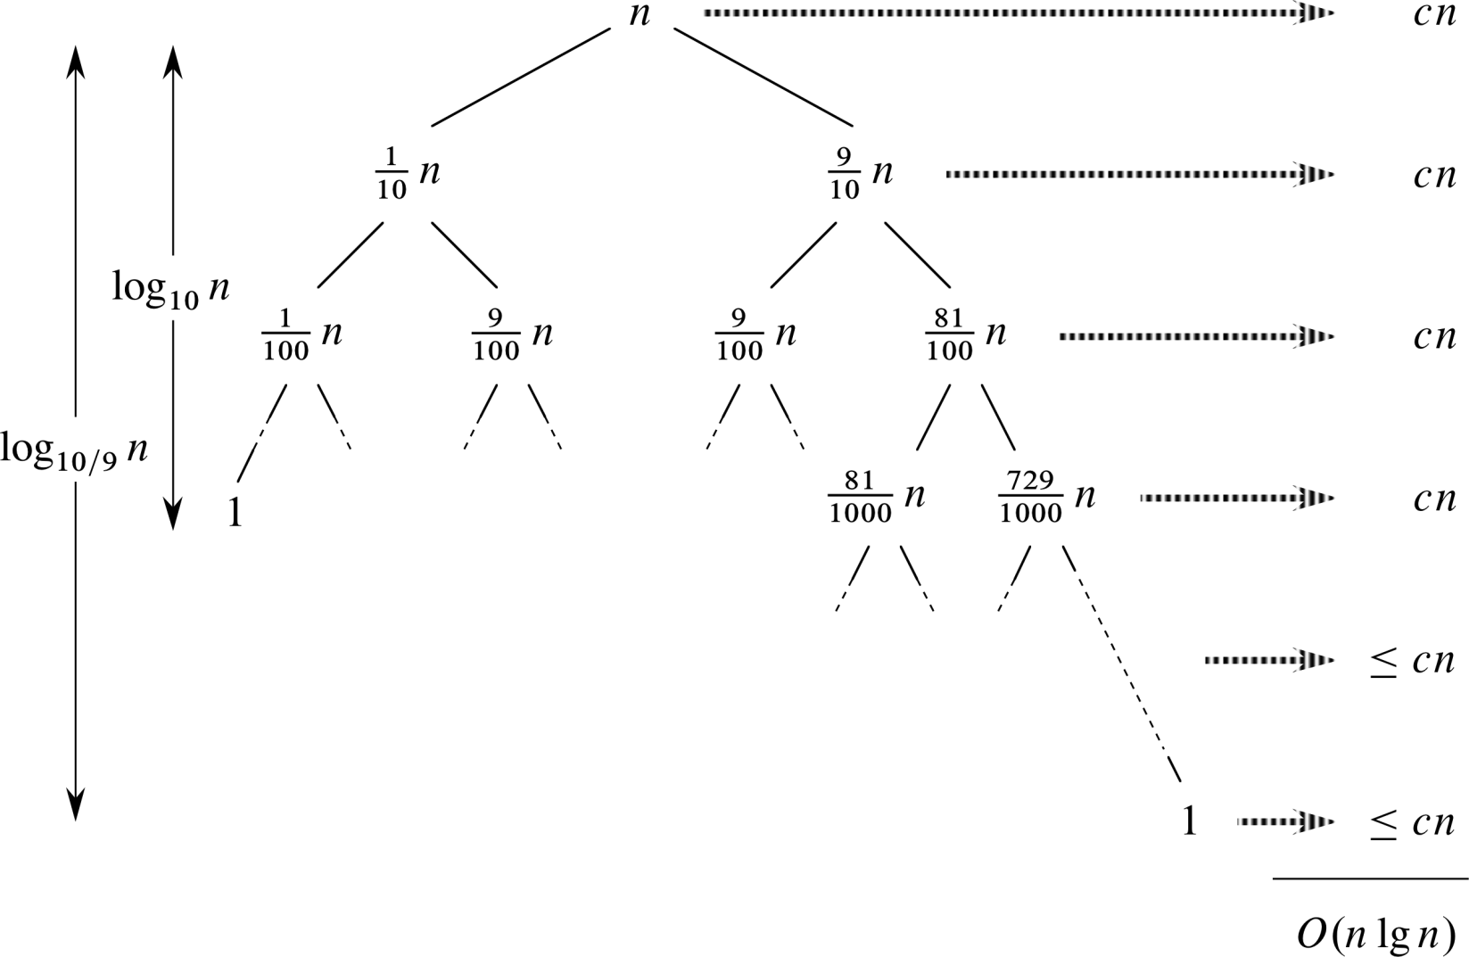
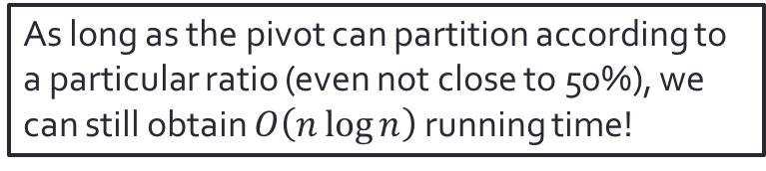
Average running time
As long as the pivot can partition according to a particular ratio (even not close to 50%), we can still obtain $O\left(n\log{n}\right)$ running time!

Slide 30
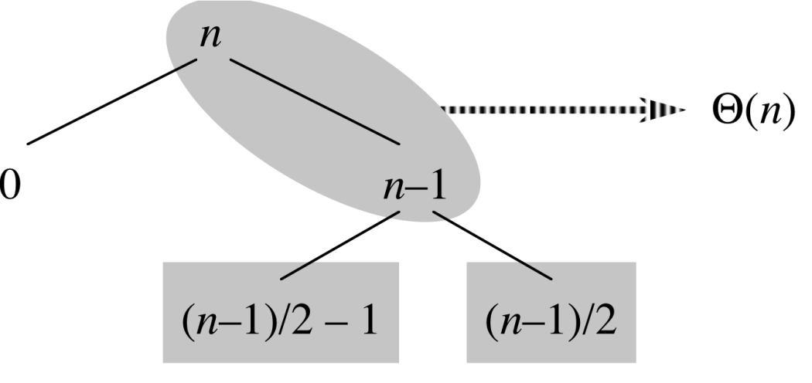
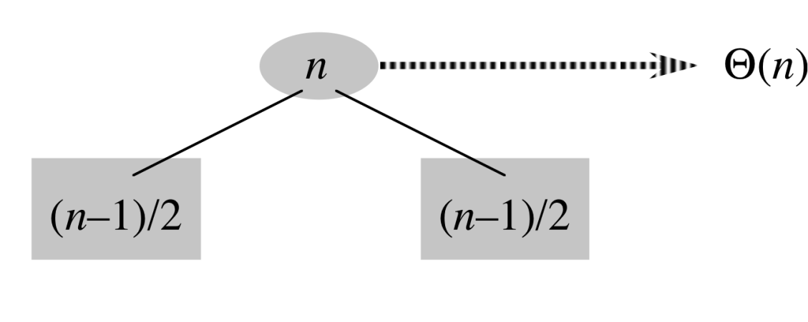

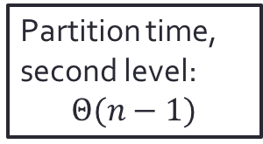

Average running time
Case 1: Worst case for the first level partition, but best-case for second level.
Partition time for the first level:$Θ(n)$
Partition time, second level: $$Θ(n−1)$$
$$Θ\left(n\right)+Θ\left(n−1\right)=Θ(n)$$
Case 2: Best case for the first level partition
Same!
(Case 1 has larger constant)
The better-partitioned level would “absorb” the extra running time for worse-partitioned level.
Partition time for the first level:$Θ(n)$

Slide 31
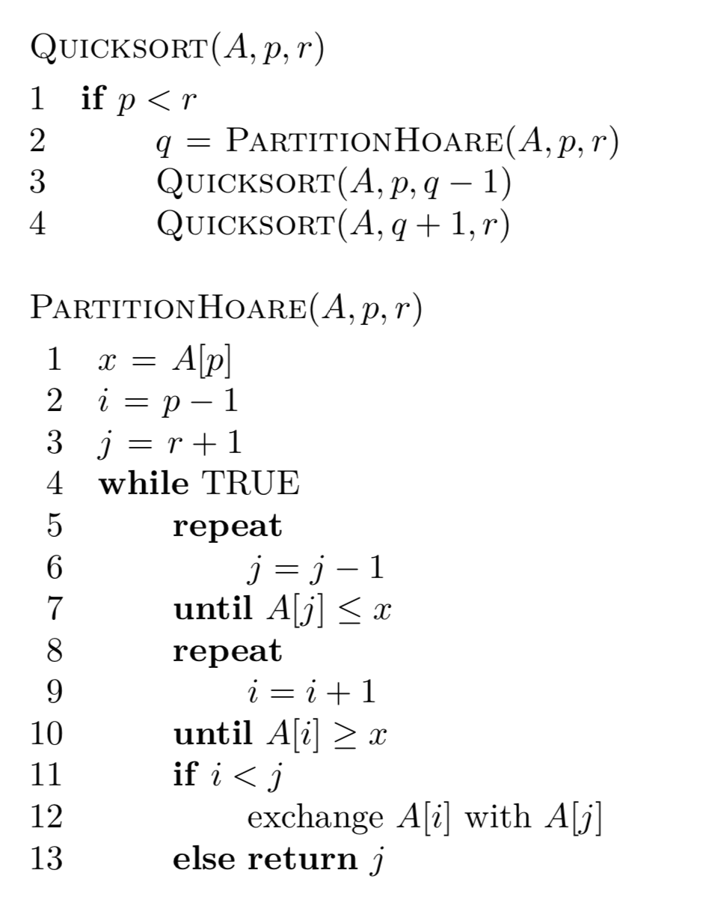
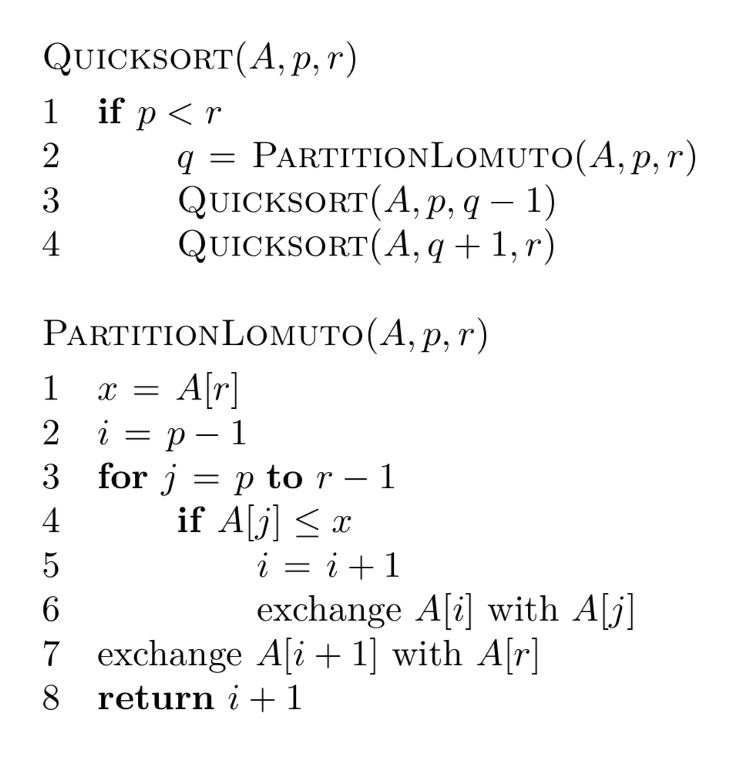
Homework: Lomuto & Hoare

Slide 32
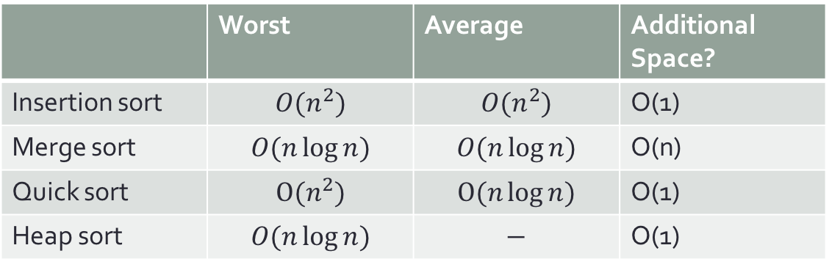
比較四大金剛
 | Worst | Average | Additional Space?
Insertion sort | $${O(n}^{2})$$ | $${O(n}^{2})$$ | O(1)
Merge sort | $$O(n\log{n})$$ | $$O(n\log{n})$$ | O(n)
Quick sort | $${O(n}^{2})$$ | $$O(n\log{n})$$ | O(1)
Heap sort | $$O(n\log{n})$$ | $$−$$ | O(1)
Not covered today!
Insertion sort: quick with small input size n. (small constant)
Quick sort: Best average performance (fairly small constant)
Merge sort: Best worst-case performance
Heap sort: Good worst-case performance, no additional space needed.
Real-world strategy: a hybrid of insertion sort + others. Use input size n to determine the algorithm to use.

