Slide 1
TreE
Michael Tsai
2018/04/10

Slide 2
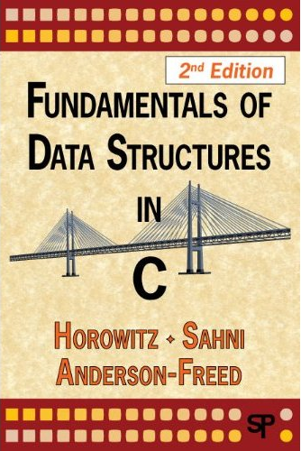
Reference
Fundamentals of Data Structures in C, 2nd Edition, 2008
Chapter 5
Horowitz, Sahni, and Anderson-Freed

Slide 3

Reference
Data Structures and Algorithms Made Easy, Second Edition, 2011, CareerMonk Publications, by Karumanchi
Chapter 6.11

Slide 4
BASICS

Slide 5

樹
The family tree of Sigmund Christoph von Waldburg-Zeil-Trauchburg
http://www.ahneninfo.com/de/ahnentafel.htm

Slide 6
In the CS world, we usually draw the tree upside-down.
Root
What are the properties of a tree?
Leaves
A nonlinear, hierarchical way to represent data.

Slide 7
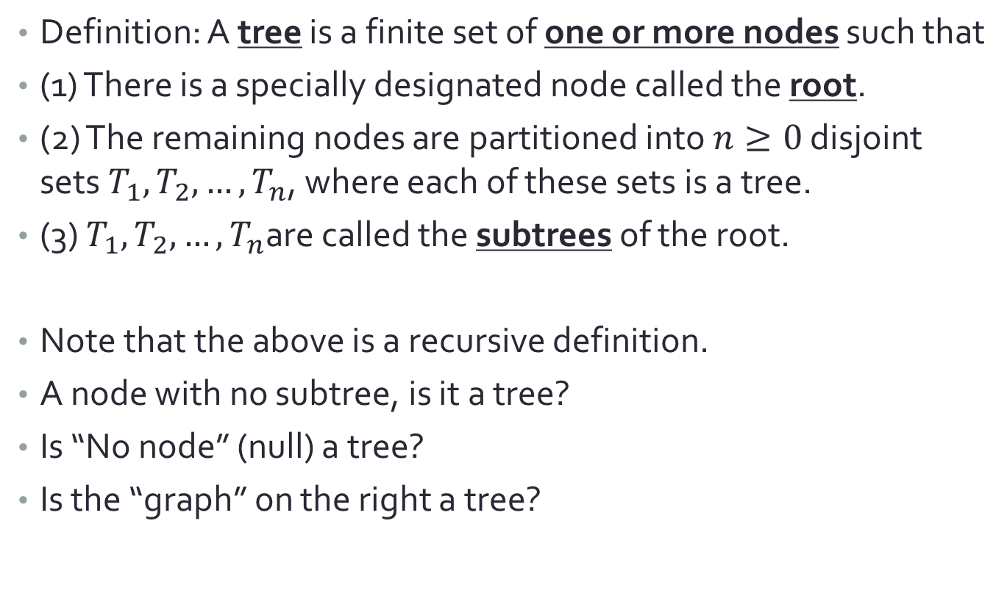
Definition
Definition: A tree is a finite set of one or more nodes such that
(1) There is a specially designated node called the root.
(2) The remaining nodes are partitioned into $n≥0$ disjoint sets $T_{1}, T_{2},…,T_{n}$, where each of these sets is a tree.
(3) $T_{1}, T_{2},…,T_{n}$are called the subtrees of the root.
Note that the above is a recursive definition.
A node with no subtree, is it a tree?
Is “No node” (null) a tree?
Is the “graph” on the right a tree?

Slide 8
Tree Dictionary
Root
Node/Edge (branch)
Degree (of a node): The number of subtrees of a node
Leaf/Terminal node: its degree=0
Parent/Children
Siblings they have the same parent.
Ancestors/Descendants
A
B
C
D
E
F
G
H
I
J
K
L
M

Slide 9
Tree Dictionary
Level/depth (of a node): The number of branch to reach that node from the root node. (i.e., root is at level 0)
Height (of a tree):
The number of levels in a tree (Note that some definitions start from level 1)
Size (of a tree): The number of nodes in a tree
Weight (of a tree): The number of leaves in a tree
Degree (of a tree): The maximum degree of any node in a tree
A
Level 0
D
Level 1
B
C
E
F
G
H
I
J
Level 2
K
L
M
Level 3

Slide 10
Representing a tree with array
[0]
What to store?
The data associated with each node
Array method
Store the data sequentially according to the level of the node
In the array:
How to find the parent of a node?
How to find the children of a node?
A
[1]-[3]
B
C
D
[10]-[12]
[7]-[9]
[4]-[6]
E
F
G
H
I
J
Max degree of the tree=3
0 | 1 | 2 | 3 | 4 | 5 | 6 | 7 | 8 | 9 | 10 | 11 | 12
A | B | C | D | E | F |  | G |  |  | H | I | J

Slide 11
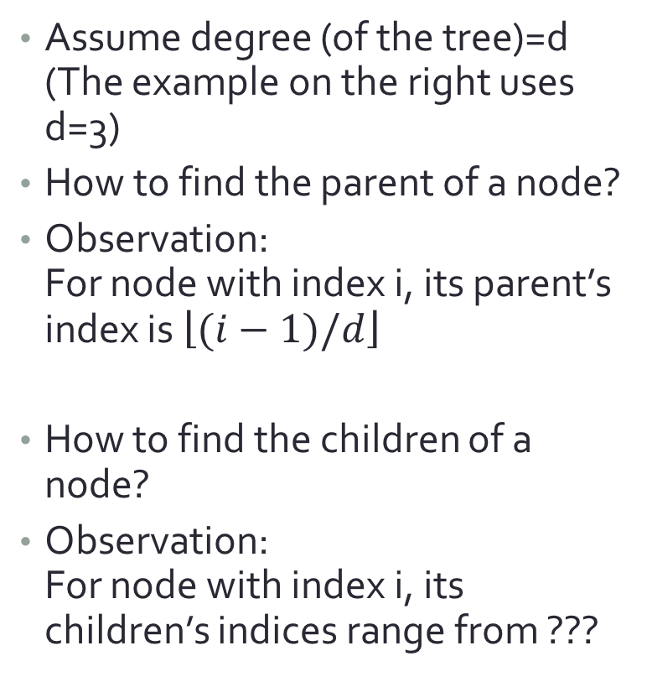
Representing a tree with array
Assume degree (of the tree)=d (The example on the right uses d=3)
How to find the parent of a node?
Observation: For node with index i, its parent’s index is $\left\lfloor (i−1)/d\right\rfloor$
How to find the children of a node?
Observation: For node with index i, its children’s indices range from ???
[0]
A
[1]-[3]
B
C
D
[10]-[12]
[7]-[9]
[4]-[6]
E
F
G
H
I
J

Slide 12
Representing a tree with array
Downside?
If there are many nodes with degree less than d,
then we waste a lot of space in the array.
A
B
C
D
E
G
H
I
J
0 | 1 | 2 | 3 | 4 | 5 | 6 | 7 | 8 | 9 | 10 | 11 | 12 | … | 31
A | B | C | D | E |  |  | G |  |  | H | I | J |  | K
K
Max degree of the tree=3
Waste of space!

Slide 13
Representing a tree with linked structure
A
Assume degree =3
struct TreeNode{
char data;
struct TreeNode* child1;
struct TreeNode* child2;
struct TreeNode* child3;
};
B
C
D
Wasting the space to store pointers instead
H
I
A
B | \0 | \0 | \0
C | \0 | \0 | \0
D |  |  | \0
Not actually solving the prob?
\0 == NULL
H | \0 | \0 | \0
I | \0 | \0 | \0
Notes:
如果資料的部分不只一個char, 而很大的話, linked structure有比array節省一些. (因為只浪費了指標)

Slide 14
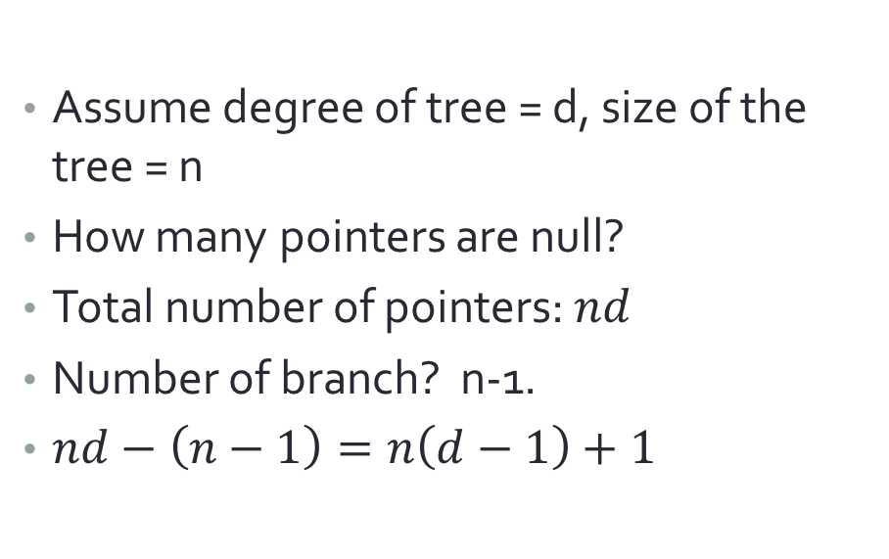
Representing a tree with linked structure
Data | child 1 | child 2 | child 3 | … | child k
Assume degree of tree = d, size of the tree = n
How many pointers are null?
Total number of pointers: $nd$
Number of branch? n-1.
$nd−\left(n−1\right)=n\left(d−1\right)+1$
A
1
d
2
…
B
C
ㄅ
…
Number of wasted pointers
Better if smaller!

Slide 15
左小孩-右兄弟姊妹 表示法
Left child-right sibling representation
Inspired by observations:
1. Each node has a leftmost child (是廢話)
2. Each node has only a immediately-right sibling (也是廢話)
Data | left child | Right sibling

Slide 16
Converting to LCRS tree
A
A
B
C
D
B
C
D
E
F
G
H
I
J
E
F
G
H
I
J
K
L
M
K
L
M

Slide 17
LCRS tree
It’s always a degree-two tree!
Converting to from an arbitrary-degree tree to a degree-two tree!
Root does not have a right child (because root in the original tree does not have a sibling)
A
A
B
C
D
B
C
D
E
F
G
H
I
J
E
F
G
H
I
J
K
L
M
K
L
M

Slide 18
Binary Tree
Definition: A binary tree is a finite set of nodes that is either empty or consists of a root and two disjoint binary trees called the left subtree and the right subtree.
According to this definition:
Note: “null” (no node) is a valid tree.
Note: the order of the children (left or right) is meaningful.

Slide 19
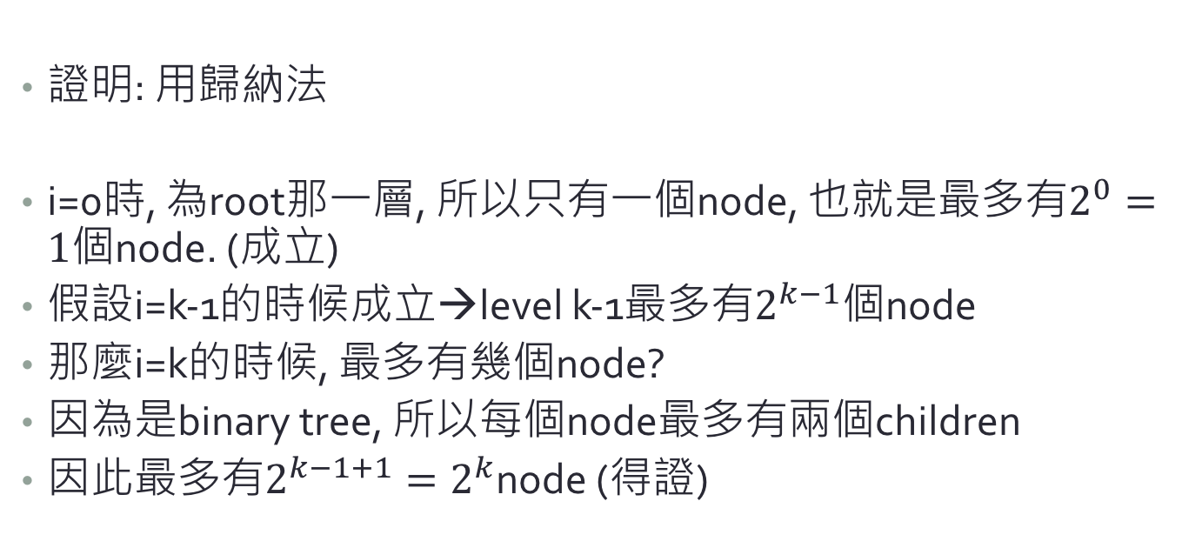
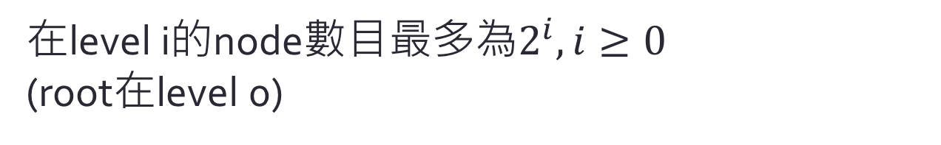
一些證明
在level i的node數目最多為$2^{i}, i≥0$ (root在level 0)
證明: 用歸納法
i=0時, 為root那一層, 所以只有一個node, 也就是最多有$2^{0}=1$個node. (成立)
假設i=k-1的時候成立→level k-1最多有$2^{k−1}$個node
那麼i=k的時候, 最多有幾個node?
因為是binary tree, 所以每個node最多有兩個children
因此最多有$2^{k−1+1}=2^{k}$node (得證)
Notes:
Intentionally left to be Chinese for the students to understand more easily.

Slide 20
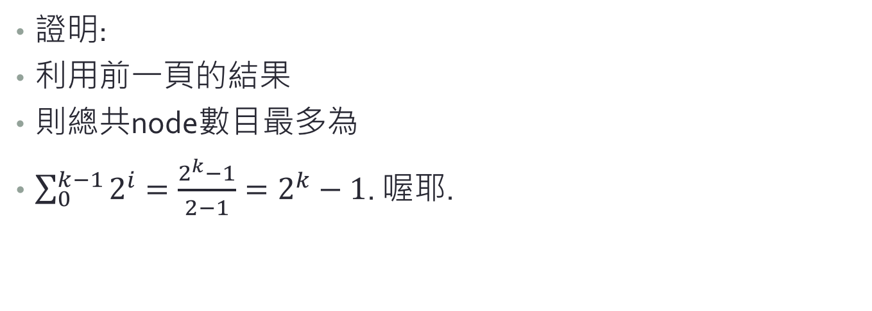
兩些證明(誤)
一棵height為k的binary tree, 最多有$2^{k}−1$個node, $k≥1$.
證明:
利用前一頁的結果
則總共node數目最多為
$\sum_{0}^{k−1}{2^{i}}=\frac{2^{k}−1}{2−1}=2^{k}−1$. 喔耶.

Slide 21
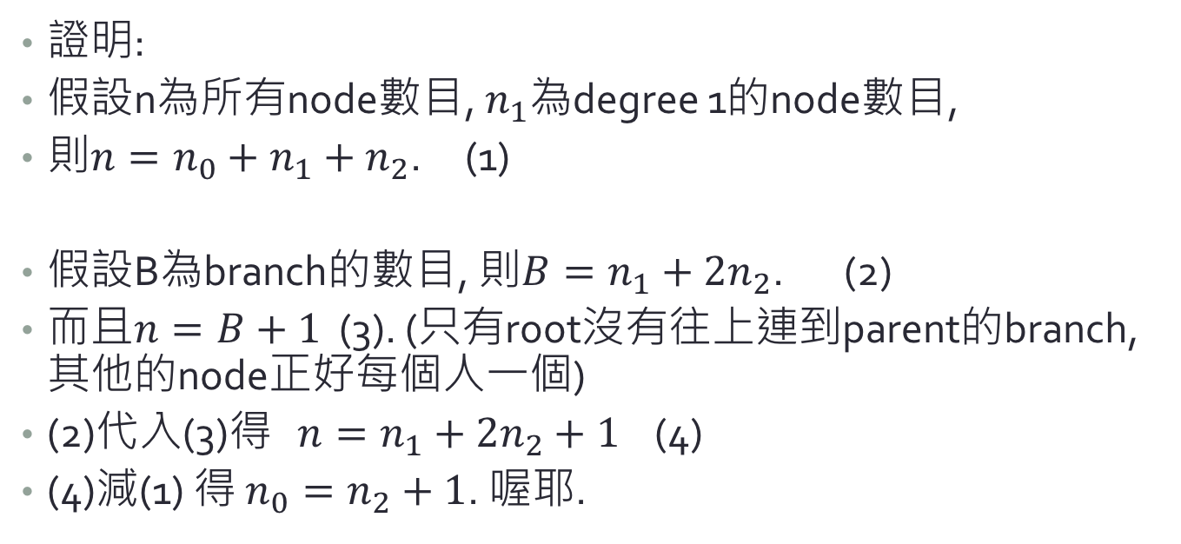
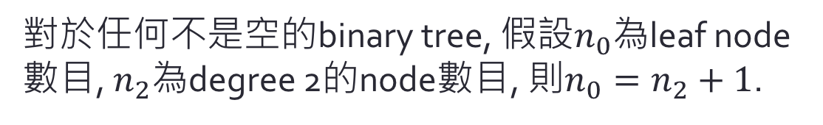
三些證明(誤)
對於任何不是空的binary tree, 假設$n_{0}$為leaf node數目, $n_{2}$為degree 2的node數目, 則$n_{0}=n_{2}+1$.
證明:
假設n為所有node數目, $n_{1}$為degree 1的node數目,
則$n=n_{0}+n_{1}+n_{2}$. (1)
假設B為branch的數目, 則$B=n_{1}+2n_{2}$. (2)
而且$n=B+1$ (3). (只有root沒有往上連到parent的branch, 其他的node正好每個人一個)
(2)代入(3)得 $n=n_{1}+2n_{2}+1$ (4)
(4)減(1) 得 $n_{0}=n_{2}+1$. 喔耶.

Slide 22

Full binary tree
Definition: a full binary tree of depth k is a binary tree of depth k having $2^{k}−1$ nodes, $k≥1$.
In other words, the maximum size tree of depth k (full)
All nodes except the leaves have two children
1
3
Full binary tree of depth 3
2
4
5
6
7

Slide 23
Complete binary tree
Definition: A binary tree with n nodes and depth k is complete iff its nodes correspond to the nodes numbered from 1 to n in the full binary tree of depth k.
All leaves at level k-1 and k-2 (the last two levels) have no “missing ones”
1
1
1
1
1
2
3
2
3
2
2
2
3
4
5
4
5
6
4
5
5
6
Yes
Yes
Yes
No
No

Slide 24
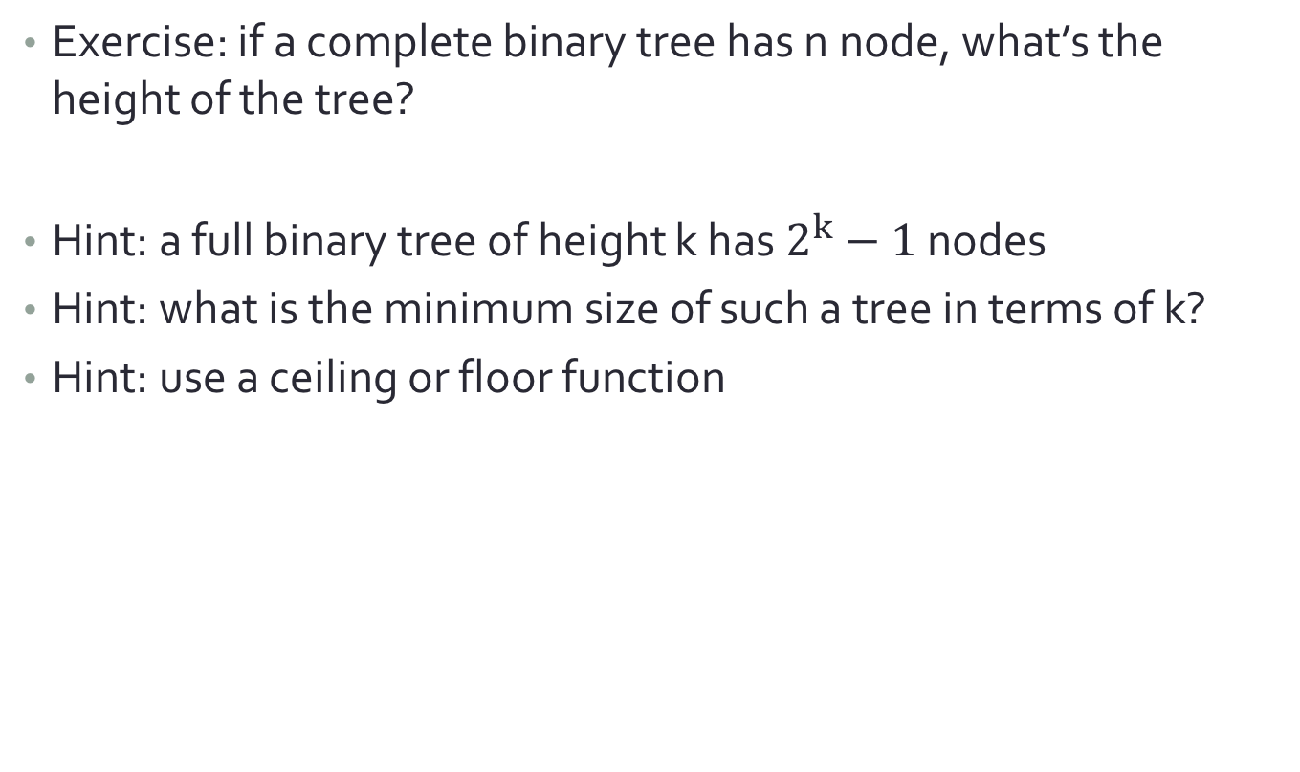
Height of a complete binary tree
Exercise: if a complete binary tree has n node, what’s the height of the tree?
Hint: a full binary tree of height k has $2^{k}−1$ nodes
Hint: what is the minimum size of such a tree in terms of k?
Hint: use a ceiling or floor function

Slide 25
TREE Traversal

Slide 26
Binary Tree Traversal
How do we traverse each node in the given binary tree?
When we reach a certain node, there are three possible actions:
Go to left child (use L to represent left branch)
Go to right child (use R to represent right branch)
Process the data of this node (use V to represent visiting this node)
1
2
3
4
5
6
7

Slide 27
Binary Tree Traversal
Usually L takes place before R.
Then we have 3 possibilities:
VLR: preorder
LVR: inorder
LRV: postorder
Preorder: ABCGE
Please write down the results of inorder & postorder traversals.
A
B
E
C
G

Slide 28
Recursive traversal
Use recursive implementation for tree traversal:
void inorder(treePointer ptr) {
inorder(ptr->leftChild);
visit(ptr);
inorder(ptr->rightChild);
}
A
B
E
C
G

Slide 29
How about non-recursive? (iterative)
Use a stack to help:
for(;;) {
for(;node;node=node->leftChild)
push(node);
node=pop();
if (!node) break;
printf(“%s”, node->data);
node=node->rightChild;
}
A
B
E
C
G
Notes:
Trace the code here.

Slide 30
Arithmetic Expression
Example: 1+2*3-5/(4+5)/5
We have:
Operand – 1, 2, 3, 5, 4, 5, etc.
Operator – + * - /
Parenthesis– (,)
Feature 1: left-to-right associativity
Feather 2: infix: operator is between two operands
Association order is according to the priority of the operator
Example: multiplication’s priority is larger than addition

Slide 31
Alternative expressions
Postfix: put the operator after the two operands
Example
2+3*4 →2 3 4 * +
a*b+5 → ?
(1+2)*7 → ?
a*b/c →?
(a/(b-c+d))*(e-a)*c→?
a/b-c+d*→?
e-a*c→?

Slide 32
Binary tree with arithmetic expression
Every arithmetic expression can be converted to an expression tree
Preorder → prefix
Inorder → infix
Postorder → postfix
Exercise:
Draw the arithmetic expression tree of (a/(b-c+d))*(e-a)*c
*
-
5
2
3

Slide 33
Level-order traversal
A
What if we use a queue to help with the traversal?
add(ptr);
for(;;) {
ptr=delete();
if (ptr) {
printf(“%s”, ptr->data);
if (ptr->leftChild)
add(ptr->leftChild);
if (ptr->rightChild)
add(ptr->rightChild);
} else break;
}
B
E
C
G

Slide 34
Binary Search Tree

Slide 35
Binary search tree
Problem: looking for the grade of a particular student in the university database.
Assumptions:
We know the student ID (key)
Use the key to find the location where the data is stored
Frequent addition of new students
Frequent removal of students who dropped out

Slide 36
Binary search tree
Definition: A binary search tree is a binary tree. It may be empty. If it is not empty then it satisfies the following properties:
1. The root has a key.
2. The keys (if any) in the left subtree are smaller than the key in the root
3. The keys (if any) in the right subtree are larger than the key in the root
4. The left and right subtrees are also binary search trees
(Hidden) All keys are distinct.
Note that the definition is recursive.
root.key
<root.key
>root.key

Slide 37
Binary search tree
30
Are these binary search trees?
What’s next when we find the node?
5
40
Yes
2
No. 55
HW1 | 65
HW2 | 65
HW3 | 空
Extra | -20000
20
60
15
25
70
12
10
22
65
80
No
Yes

Slide 38
BST struct definition
struct BinarySearchTreeNode {
int data;
struct BinarySearchTreeNode *left;
struct BinarySearchTreeNode *right;
};

Slide 39
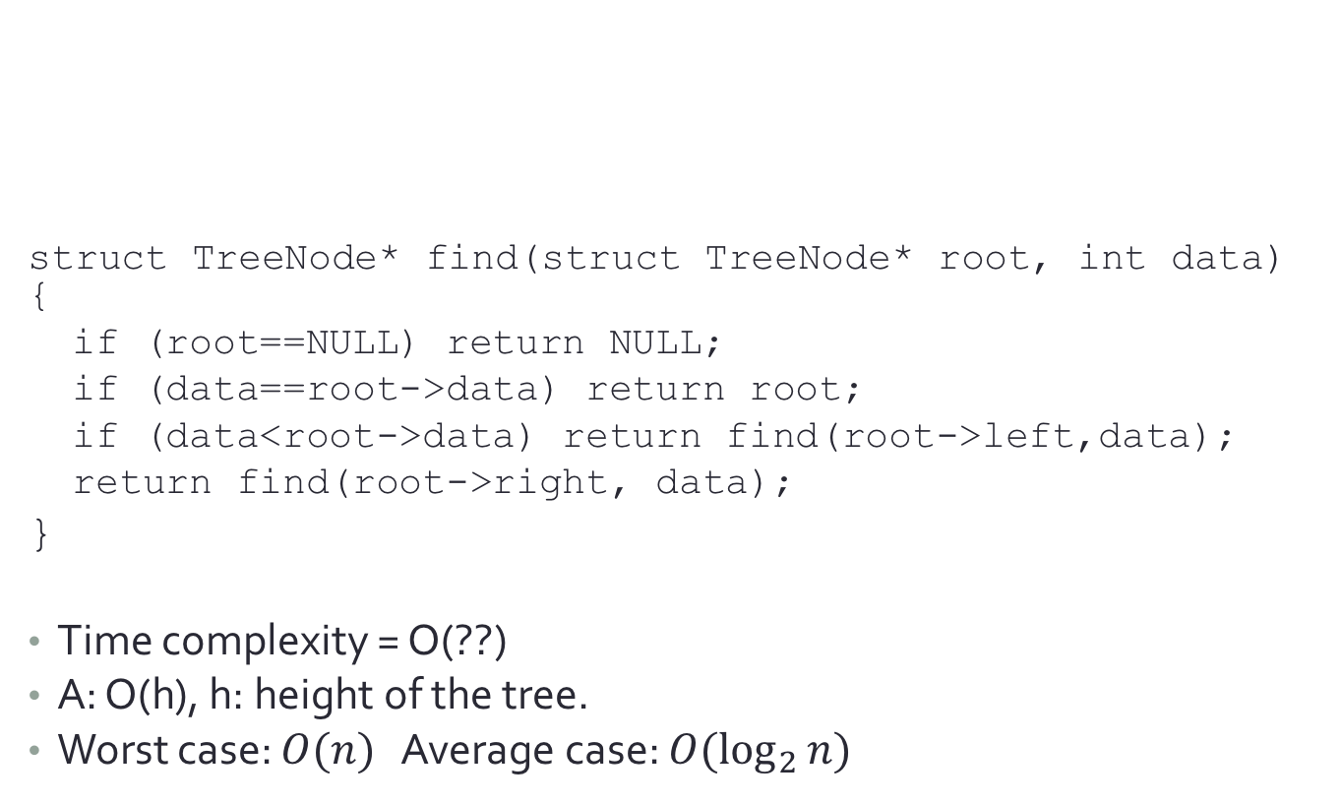
Search
20
struct TreeNode* find(struct TreeNode* root, int data) {
if (root==NULL) return NULL;
if (data==root->data) return root;
if (data<root->data) return find(root->left,data);
return find(root->right, data);
}
Time complexity = O(??)
A: O(h), h: height of the tree.
Worst case: $O(n)$ Average case: $O(\log_{2}{n})$
12
22
10
15
25
Binary Search Tree Algorithm usually is like:
(1) If the key matches the key of this node, then we process and return.
(2) If key is larger or smaller, then use a recursive call to process left or right branch.
Notes:
答案: O(h). h is the height of the tree.

Slide 40
Other operations
20
12
22
10
15
25
Q: How to find the largest or smallest key in the BST?
A: Keep going right (left), until reaching NULL (a leaf).
Q: How to list all keys in a binary search tree in ascending order?
A: Perform inorder traversal of the BST.

Slide 41
How to insert a new node?
Search if there exists the same key in the BST (Recall the rule: each key in the BST is unique)
If not found, insert at the last location (where we cannot find the key)
Insert: 11
11
20
12
22
10
15
25

Slide 42
struct BinarySearchTreeNode *Insert(struct BinarySearchTreeNode *root, int data) {
if (root==NULL) {
root=(struct BinarySearchTreeNode*)malloc(sizeof(struct BinarySearchTreeNode));
if (root==NULL) {
printf("Error\n");
exit(-1);
}
root->data=data;
root->left=NULL;
root->right=NULL;
}else{
if (data<root->data)
root->left=Insert(root->left,data);
else if (data>root->data)
root->right=Insert(root->right,data);
}
return root;
}
Finding NULL means we have reached a leaf and the key is not found. → insert at this location.
If larger or smaller, use a recursive call to process.
Return to prev. level

Slide 43
How to delete a node?
First find the location of the node
Then, according to the conditions:
The node with the key has no branch (degree=0)
Remove the node and then done!
20
12
22
10
15
25
11

Slide 44
How to delete a node?
If the node with the key has one branch (degree=1)
Then get its only child and attach to the parent
Example: remove 22
Q: How to remember the pointer?
(return to the previous level to process, similar to slide #37)
(Karumanchi p.152)
20
12
22
10
15
25
11

Slide 45
How to delete a node?
What if both branches of the node with the key exist (degree=2)?
Example: remove 12
Find the largest node of the left branch (or the smallest of the right branch)
Remove that node and move it to where the node with the key was.
Q: What if that node still has child node(s)?
20
12
22
10
15
25
11
A: there would be only one child.
Notes:
答案: 最多只會有一個child, 所以很好處理

Slide 46
struct TreeNode *delete(struct TreeNode *root, int data) {
TreeNode * temp;
if (root==NULL) {
printf(“error\n”);
return NULL;
} else if (data < root->data)
root->left=delete(root->left, data);
else if (data > root->data)
root->right=delete(root->right, data);
else { // data == root->data
if (root->left && root->right) { //two children
temp=findmax(root->left);
root->data=temp->data;
root->left=delete(root->left,root->data);
}else{ // one child or no child
temp=root;
if (root->left==NULL)
root=root->right;
if (root->right==NULL)
root=root->left;
free(temp);
}
return root; }
}
If larger or smaller, use a recursive call to process.
Return to the prev. level. If we delete the current node, we can use this to connect the parent node to a child node.
If we have found the key, process it here.

