Slide 1
Deep Learning
HW2 Convolutional Autoencoder

Slide 2
HW2 Convolutional Autoencoder
Deadline : 11/23 11:59 p.m.
Only use pytorch.
Plagiarism is strictly prohibited and punishable!
Submission:
Code
Readme.txt (explain how to run your code).
Data (data.npy, label.npy)
Report

Slide 3
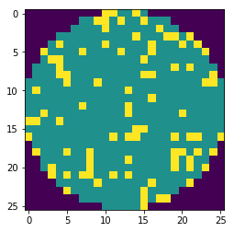
Wafer Data
Boundary
All wafer images are stored in data.npy as one numpy array whose size is (1281, 3, 26, 26).
First channel :
‘1’ denotes boundary and the rest pixels are ‘0’.
Second channel:
‘1’ denotes normal region and the rest pixels are ‘0’.
Third channel:
‘1’ denotes defect and the rest pixels are ‘0’.
Every pixel belongs to one kind ‘normal’, ‘boundary’ or ‘defect’.
Normal
Defect
Total : 1281
Center (0): 90
Donut (1): 1
Edge-Loc (2): 296
Edge-Ring (3): 31
Loc (4): 297
Near-full (5): 16
Random (6): 74
Scratch (7): 72
none (8): 404

Slide 4
Implementation
Design your own encoder and decoder (hint: Conv2D, ConvTranspose2D).
Latent vector should be less than input vector.
Size of output image is (26, 26, 3).
Encoder
Decoder
Input Wafer
Reconstructed Wafer
Latent vector

Slide 5
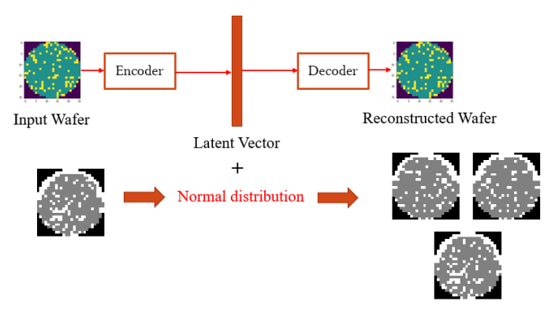
Implementation
Train all images (1281) using reconstruction loss.
Generate another 6405 new samples from original 1281 samples by adding gaussian noise into the latent code.
Output:
gen_label.npy
gen_data.npy
No need to upload.

Slide 6

Implementation
Some class is less like class 1, only have one images.
You can use data augmentation like flip when training.
Report :
Show your model architecture and loss function. (MSE or …)
Plot training loss.
Visualize 5 generated samples for each class like this:
Visualize
Normal : 0
Defect : 0.5
Boundary : 1

