Slide 1
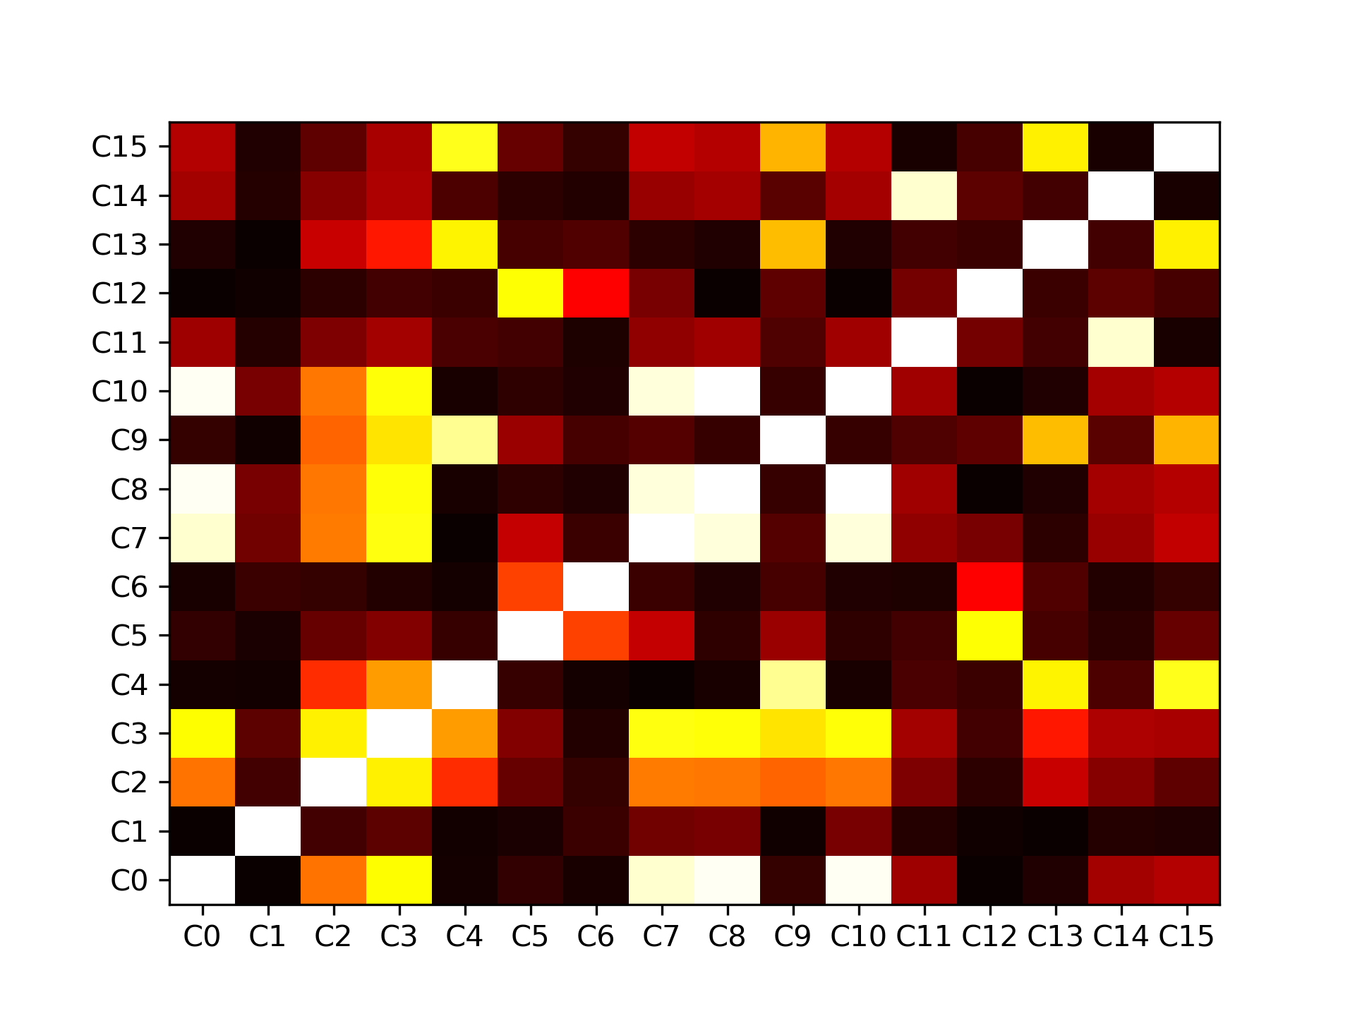
a
b
C0 | C10 | C3 | C11
C8 | C7 | C14 | C13
C2 | C6 | C5 | C4
C9 | C15 | C12 | C1
Sort Pearson’s ρ
Fix “C0” @ the top-left corner

