Slide 1
Deep Learning HW1 Neural Network
Advisor : Kuo shyuan Chen
Date : 10/16

Slide 2
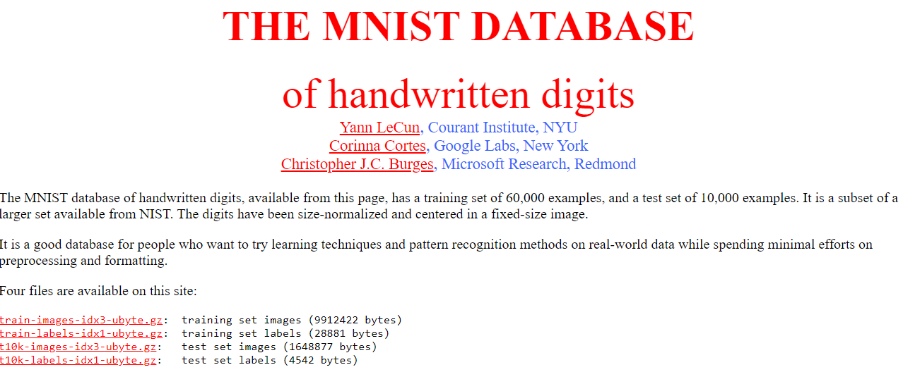
Neural Network
Only use python3
Learning libraries (Sklearn, PyTorch, TensorFlow…) are not allowed.
Download the image from http://yann.lecun.com/exdb/mnist/ .

Slide 3
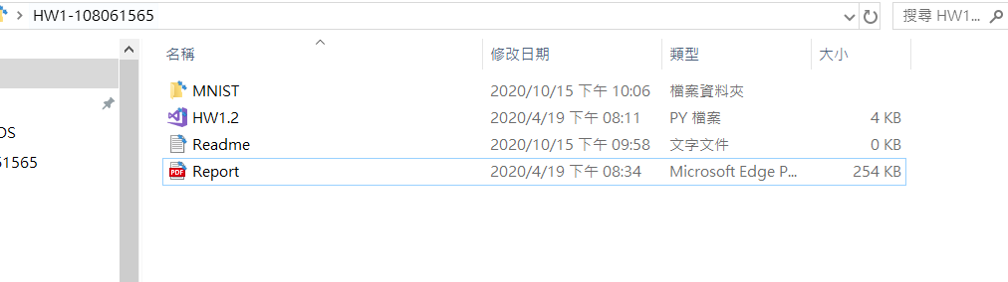
Neural Network
Create your own file loader. Do not use pytorch dataset, dataloader.
Not use your own data path when you read data.
ex : cv2.read(./陳國軒/HW1/MNIST/IMAGE)
上傳須包含: dataset, code, readme , report(如下圖所示)

Slide 4
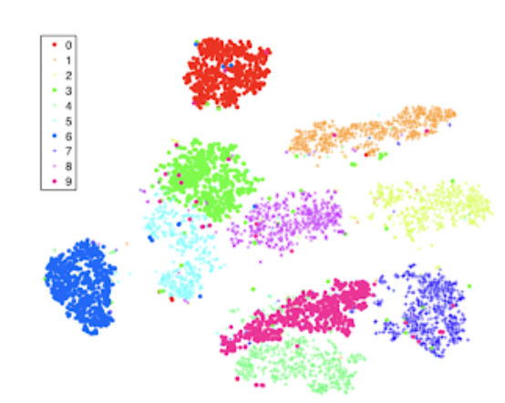
Neural Network
MNIST reading & splitting : split the original training data into validation data and training data.
Testing accuracy: Reach 95% to get 10 points, 90~95% -> 7 points, 85~90% -> 5 points, zero.
Result: t-SNE results.(可使用套件)

Slide 5

Final Project
AIdea人工智慧共創平台 https://aidea-web.tw/

Slide 6

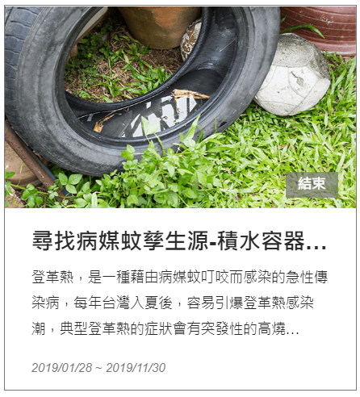
Final Project
Theme selection may be decided by lottery.

Slide 7
Colab
Colab : https://colab.research.google.com/notebooks/intro.ipynb?authuser=2#scrollTo=lSrWNr3MuFUS
介紹Colab: https://www.slideshare.net/itembedded/how-to-goolge-colab?fbclid=IwAR0JOxfj_tEo4ag9ZpnGn1DF_-dsODXi661Bn1Oc1QE5WtyXN3CscvbIrlM

Slide 8
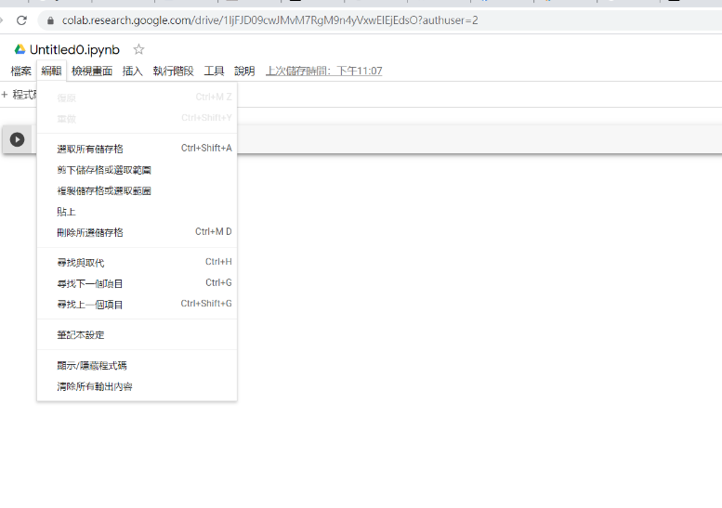
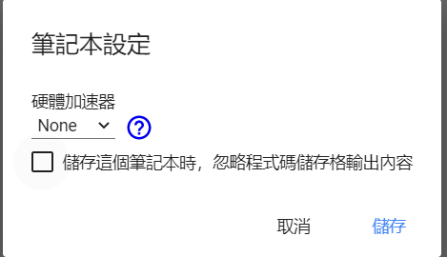
Colab
Setting GPU : 編輯 ->筆記本設定 -> GPU

Slide 9
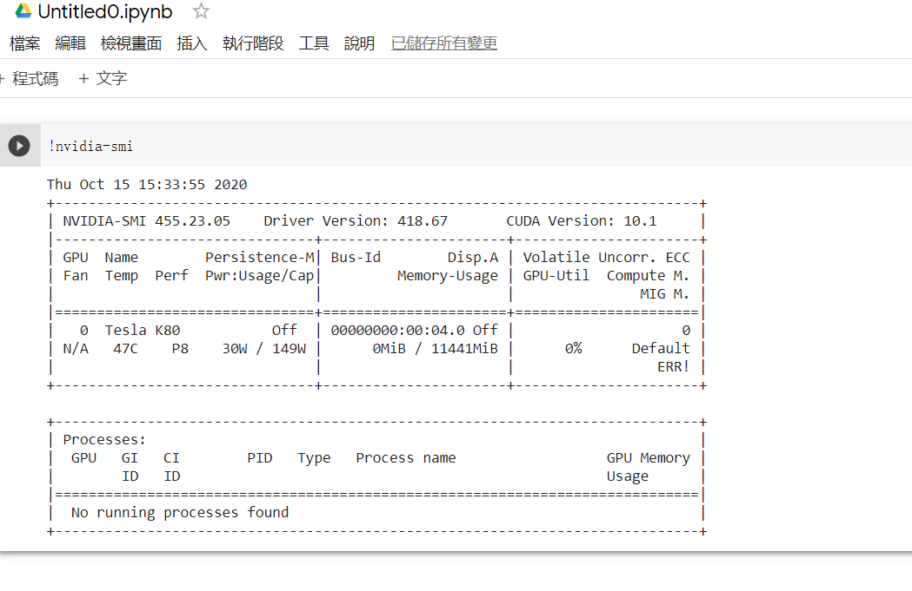
Colab
!nvidia-smi

Slide 10
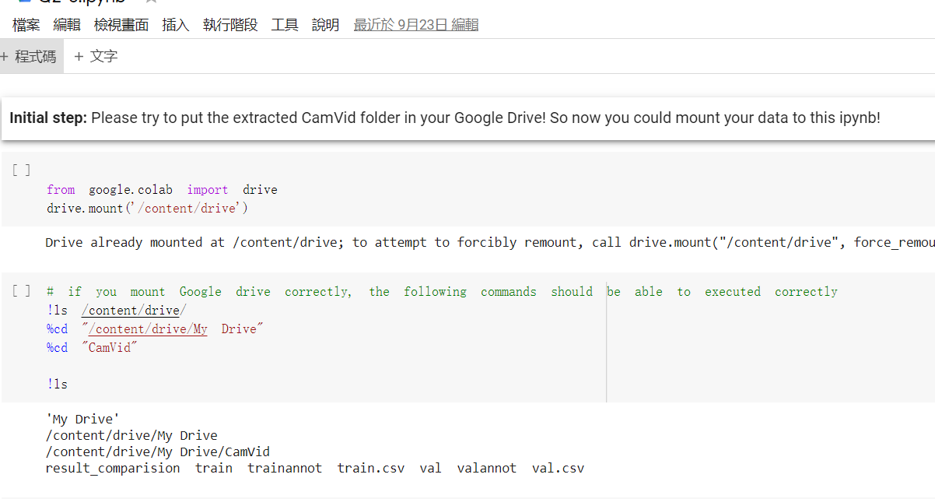
Colab

