Slide 1





Z axis
$$𝒵$$
Reference Ellipsoid
Prime Meridian
$$𝒢$$
$$𝒪$$
Y axis
Equator
X axis
$$𝒵$$
：Conventional International Origin
$$𝒢$$
：Greenwich
$$𝒪$$
：Earth’s Center of Mass

Slide 2
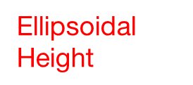

Z axis
E$\text{llipsoidal}$
$$\text{H}\text{eight}$$
h★
Z★
Celestial Equator
φ★
Y axis
λ★
X★
Y★
X axis
Cartesian coordinate : (X★, Y★, Z★)
spherical coordinate : (φ★, λ★, h★)
$$\text{Meridian}$$

