Slide 1
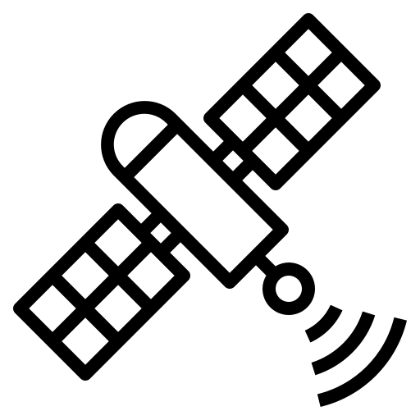



Satellite P @ time_{i}
$${L1}_{B}^{P}$$
$${L1}_{A}^{P}$$
Receiver A @ time_{i}
Receiver B @ time_{i}

Slide 2

Satellite Q @ time_{i}
Satellite P @ time_{i}
$${L1}_{A}^{Q}$$
$${L1}_{A}^{P}$$
Receiver A @ time_{i}

Slide 3



Satellite Q @ time_{i}
Satellite P @ time_{i}
$${L1}_{A}^{Q}$$
$${L1}_{B}^{P}$$
$${L1}_{A}^{P}$$
$${L1}_{B}^{Q}$$
Receiver A @ time_{i}
Receiver B @ time_{i}

Slide 4








Satellite Q @ time_{i}
Satellite P @ time_{j}
Satellite Q @ time_{j}
Satellite P @ time_{i}
$${L1}_{B}^{Q}(i)$$
$${L1}_{A}^{Q}(i)$$
$${L1}_{A}^{P}(j)$$
$${L1}_{B}^{P}(j)$$
$${L1}_{A}^{Q}(j)$$
$${L1}_{B}^{P}(i)$$
$${L1}_{B}^{Q}(j)$$
$${L1}_{A}^{P}(i)$$
Receiver A @ time_{i}
Receiver B @ time_{i}

