Slide 1
Implementation details

Slide 2
About Dataset
Three types of Iris:
class 0: 'setosa’
class 1: 'versicolor’
class 2: 'virginica’
Four features:
'sepal length (cm)’,
'sepal width (cm)’,
'petal length (cm)’,
'petal width (cm)’
Data:
#150 items
…with equal portion of classes 50/50/50

Slide 3
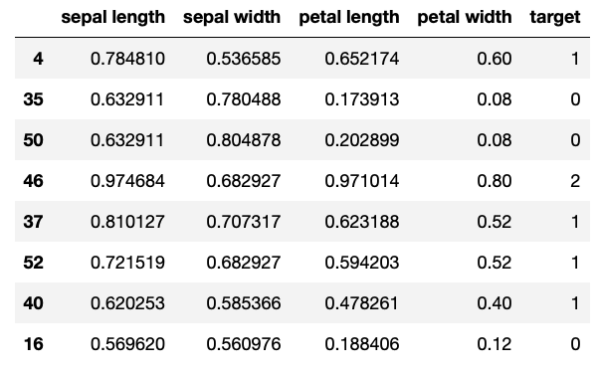
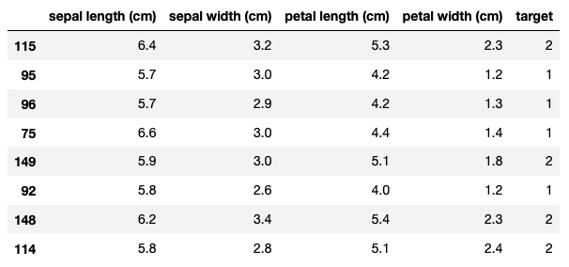
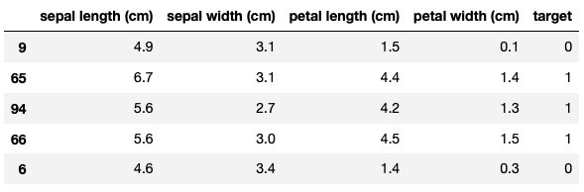
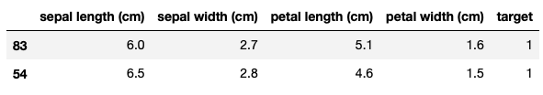
Our pipeline
Normalized Dataset
Shuffled, Splitted
Train
Test
Original Dataset

Slide 4
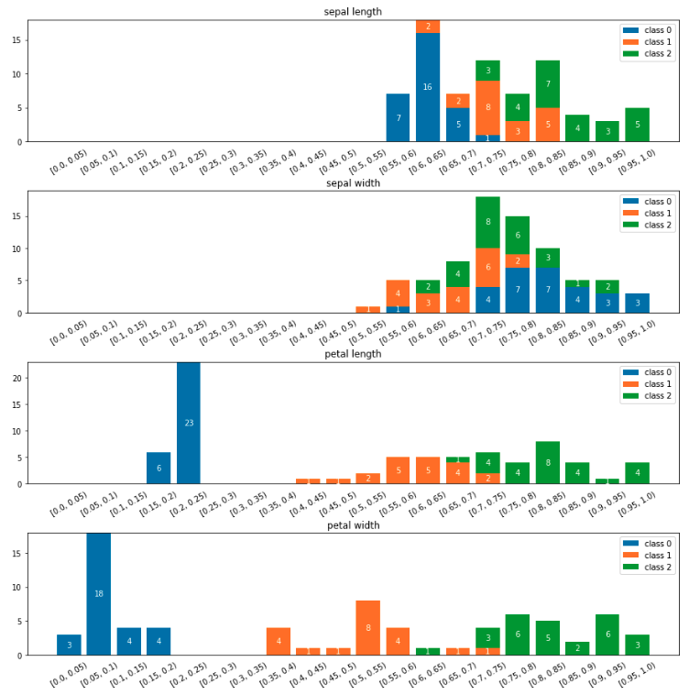
Our pipeline
Normalized Dataset
Shuffled, Splitted
Train
Original Dataset

Slide 5
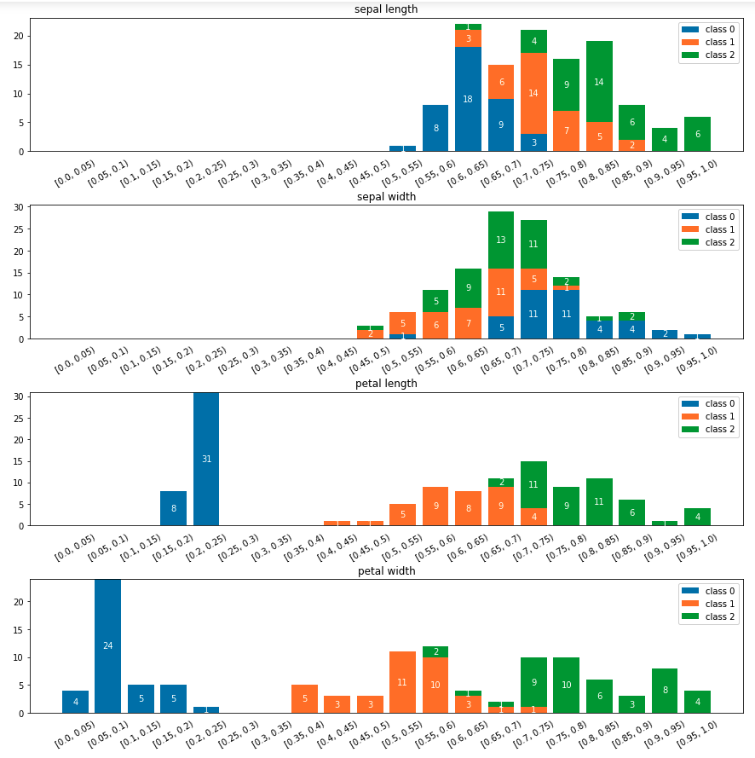



Problem statement
so, the problem statement:
What’s the probability, that X_test[0] belongs to class N, if:
F1 is here (0.7, 0.75) and
F2 is here (0.65, 0.7) and
F3 is here (0.7, 0.75) and
F4 is here (0.95, 1.0)
Or…
$$P \left(C=0 \right| x1=F1, x2=F2, x3=F3, x4=F4)= ?$$
$$P \left(C=1 \right| x1=F1, x2=F2, x3=F3, x4=F4)= ?$$
$$P \left(C=2 \right| x1=F1, x2=F2, x3=F3, x4=F4)= ?$$

Slide 6
Bayes Theorem
$$P \left(C=0 \right| x1=F1, x2=F2, x3=F3, x4=F4)= ?$$
$$P \left(C=1 \right| x1=F1, x2=F2, x3=F3, x4=F4)= ?$$
$$P \left(C=2 \right| x1=F1, x2=F2, x3=F3, x4=F4)= ?$$
let’s check it for more simple case for only feature:
$$P \left(C=0 \right| x1=F1)= ?$$

Slide 7
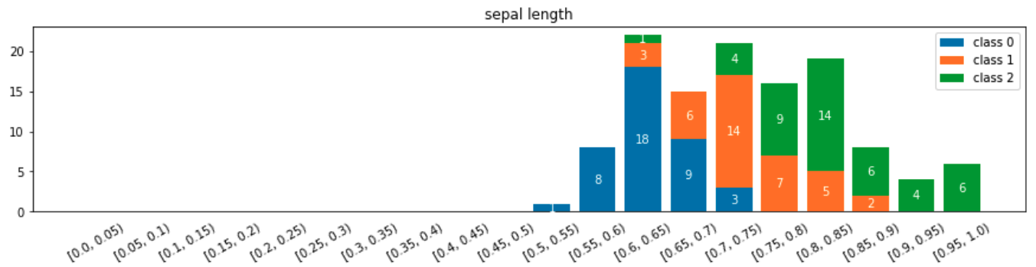
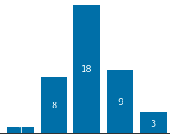


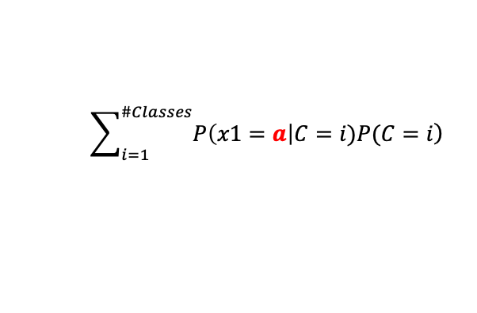

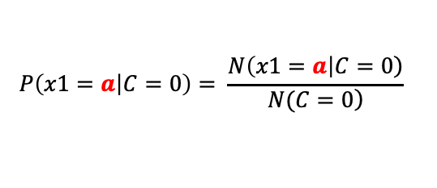
Bayes Theorem
a
#0: 39
#1: 37
#2: 44
let’s check it for more simple case for only feature:
$$P\left(x1=a | C=0\right)= \frac{\left.N\left(x1=a\right|C=0\right)}{\left.N(C=0\right)}$$
$$P\left(C=0\right)= \frac{N\left(C=0\right)}{N}$$
$$P\left(x1=a\right|C=0)∗P(C=0)$$
$$P \left(C=0 \right| x1=a)=$$
$$\sum_{i=1}^{\#Classes}{\left.P\left(x1=a\right|C=i)P(C=i\right)}$$

Slide 8

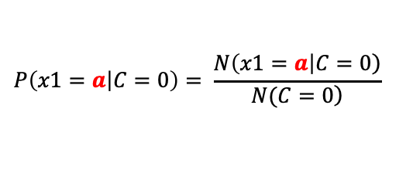

Bayes Theorem
a
#0: 39
#1: 37
#2: 44
let’s check it for more simple case for only feature:
$$P\left(x1=a | C=0\right)= \frac{\left.N\left(x1=a\right|C=0\right)}{\left.N(C=0\right)}$$
$$= \frac{3}{39}$$
$$P\left(C=0\right)= \frac{N\left(C=0\right)}{N}$$
$$= \frac{39}{120}$$
$$P\left(x1=a\right|C=0)∗P(C=0)$$
$$P \left(C=0 \right| x1=a)=$$
$$\sum_{i=1}^{\#Classes}{\left.P\left(x1=a\right|C=i)P(C=i\right)}$$

Slide 9
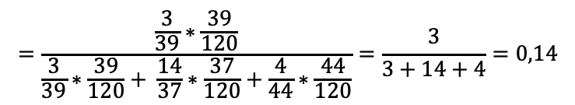
Bayes Theorem
a
#0: 39
#1: 37
#2: 44
let’s check it for more simple case for only feature:
$$P\left(x1=a | C=0\right)= \frac{\left.N\left(x1=a\right|C=0\right)}{\left.N(C=0\right)}$$
$$= \frac{3}{39}$$
$$P\left(C=0\right)= \frac{N\left(C=0\right)}{N}$$
$$= \frac{39}{120}$$
$$P\left(x1=a\right|C=0)∗P(C=0)$$
$$=\frac{\frac{3}{39}∗\frac{39}{120}}{\frac{3}{39}∗\frac{39}{120}+ \frac{14}{37}∗\frac{37}{120}+\frac{4}{44}∗\frac{44}{120}}=\frac{3}{3+14+4}=0,14$$
$$P \left(C=0 \right| x1=a)=$$
$$\sum_{i=1}^{\#Classes}{\left.P\left(x1=a\right|C=i)P(C=i\right)}$$

Slide 10
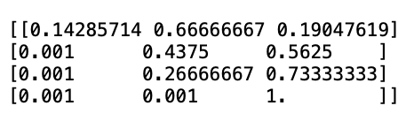
Bayes Theorem
a
#0: 39
#1: 37
#2: 44
Back to complex case:
Class 0
Class 1
Class 2
F1
F2
F3
F4

Slide 11

Class 0
Class 1
Class 2
F1
F2
F3
F4

Slide 12
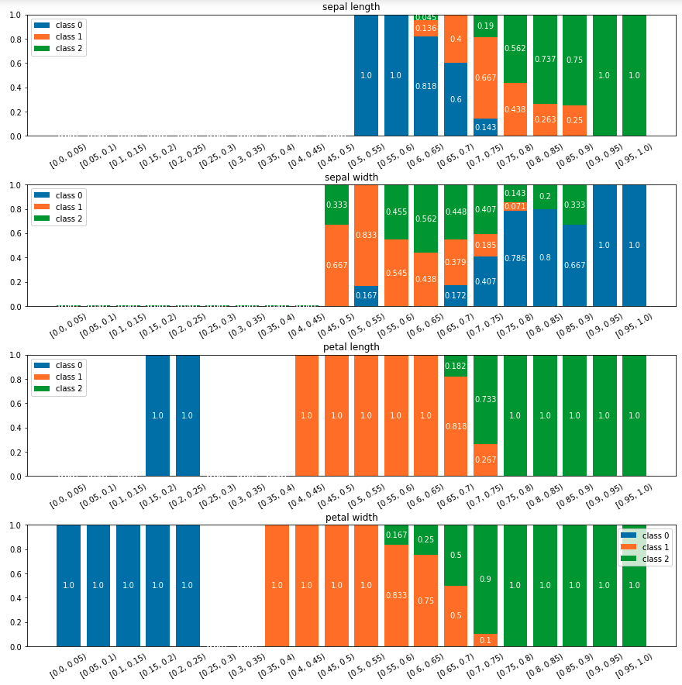
Class 0
Class 1
Class 2
F1
F2
F3
F4

Slide 13
Let’s go to the code…

