Slide 1
ReviveCheck
Migration acceptance
for Portaldot V3
For Solidity developers and the maintainers reviewing their migration
RPC settings, mapped accounts, deployment logs and contract state
need one repeatable acceptance record.
Check-in prototype, 23 October 2026
1/6
Notes:
Sources: README.md; docs/PRODUCT.md; docs/CHECK_IN.md. Portaldot Hacker House 2026, intended track Modular Cloud & Middleware. Working local prototype.

Slide 2
V3 makes acceptance specific
01
Native and EVM accounts
ReviveApi resolves both directions. The report records the actual
account pair before treating it as the same caller.
02
A shared finalized checkpoint
Native and EVM block hashes differ. ReviveApi.ethBlockHash links
the same finalized height across both interfaces.
03
Constructor encoding
A real unsigned simulation reproduces EvmConstructorNonEmptyData.
Appending the ABI argument to EVM initcode corrects that failure.
2/6
Notes:
Sources: docs/CHAIN_FINDINGS.md; artifacts/constructor-dryrun.json; officially recommended guide https://github.com/ItsCogumellum/portaldot-v3-testnet-guide and FAQ. Findings verified on Portaldot V3 testnet.

Slide 3
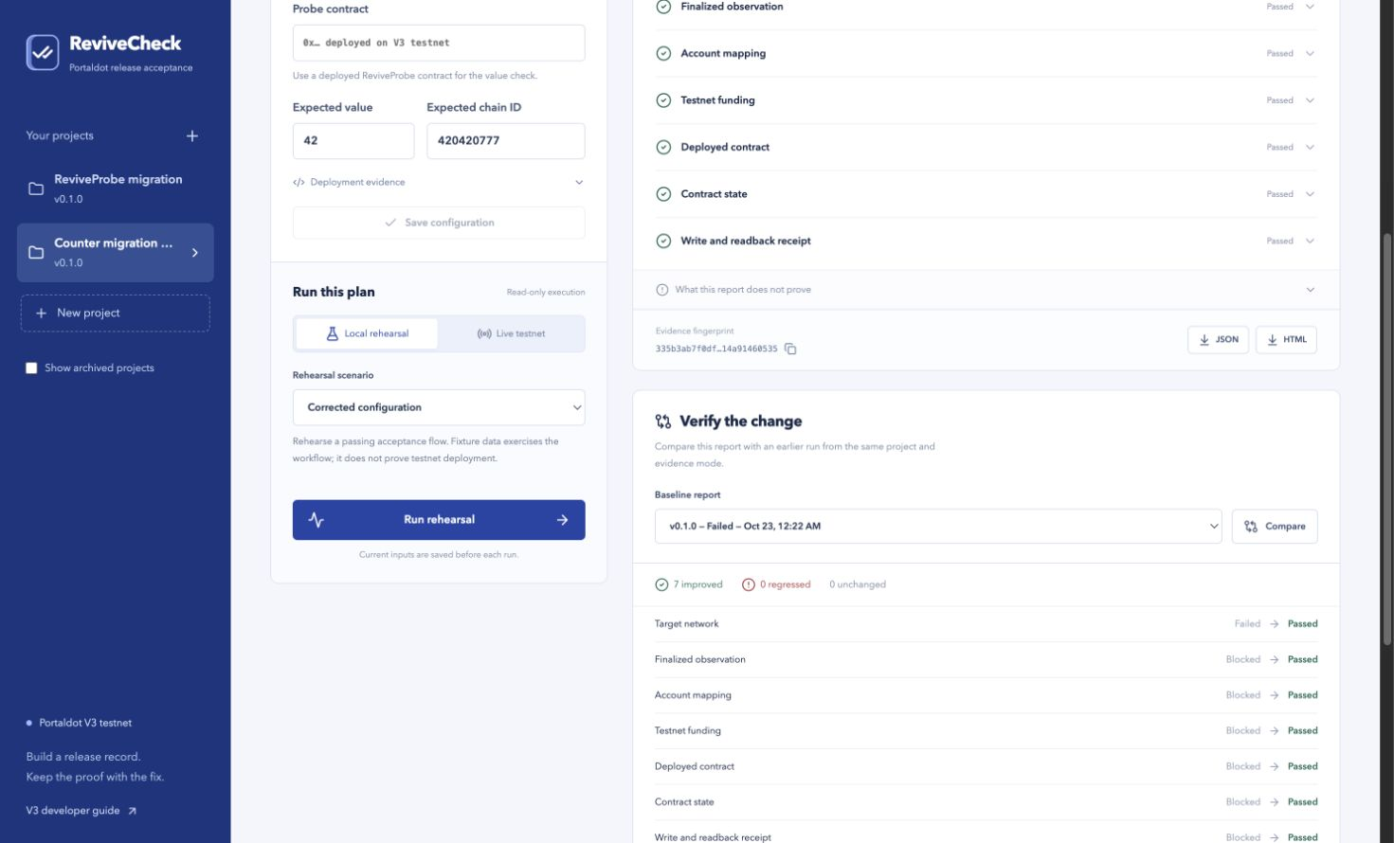
One project, repeatable review
Create a target
Run acceptance
Correct and rerun
Compare saved inputs
Export the evidence
Changed account, contract or assertion requires a new baseline.
The screenshot shows explicitly synthetic rehearsal results.
3/6
Notes:
Sources: README.md; docs/VALIDATION.md; actual application screenshot video/assets/03-compare.png. The screenshot shows synthetic rehearsal comparison, not signed testnet execution.

Slide 4
Evidence at Check-in
26
Real read-only network evidence
V3 identity and finalized checkpoint verified
Five deployment-related checks remain blocked
automated tests passed
Production build passed
Real unsigned constructor simulation
Failure reproduced and correction verified
Simulation does not establish deployment
JSON report integrity verifies through the CLI. Its live result remains blocked.
4/6
Notes:
Sources: docs/VALIDATION.md: complete npm test run, 26 passed, 0 failed, 0 skipped; successful production build. artifacts/live-readonly.json at finalized height 155464: network.chain-id and network.finalized passed, five other checks blocked. artifacts/constructor-dryrun.json records unsigned failure/correction. artifacts/example-live-report.json verifies with scripts/verify-report.js and retains status blocked.

Slide 5
Next chain milestone
Signed deployment and write/readback remain pending
01
Confirm test-token funding
The latest recorded dedicated-wallet balance is 0 tPOT.
Ticket creation does not establish token receipt.
02
Deploy and record a finalized receipt
Use the isolated native wallet with fresh weight/storage estimates
and an explicit test-token budget.
Then perform a separate state-changing write and finalized dual-interface readback.
5/6
Notes:
Sources: docs/CHECK_IN.md; docs/TOKEN_REQUEST.md; docs/VALIDATION.md. The latest recorded dedicated-wallet balance was 0 tPOT. The support ticket exists, but funding-request delivery and token receipt were not confirmed. No owned contract address or signed deployment receipt is claimed. Constructor dry-run estimates maximum storage deposit 56.2635 tPOT, with fees additional.

Slide 6
Continued ecosystem work
Reusable V3 acceptance plans and reviewable comparisons
The next validation is one external builder bringing a compatible contract,
running the workflow, and explaining the result without reconstructed logs.
Initial distribution: MIT-licensed local workbench and CLI.
Next scope: a CI example and additional validated V3 assertions.
Independent adoption, time savings, revenue and production safety remain unvalidated.
6/6
Notes:
Sources: docs/PRODUCT.md; README.md; LICENSE. External developer validation, saved time, adoption and revenue remain unvalidated. Intended track Modular Cloud & Middleware is subject to organizer evaluation. Current user-facing product is a local single-developer workbench, not a hosted multi-user service or security audit.

