Slide 1
FIELD INTELLIGENCE
Catch crop disease
before it spreads
Turn a clear leaf image into an earlier, more confident field decision.

Slide 2



THE OPPORTUNITY
A leaf photo can become an early warning
See signals earlier
Scout with focus
Keep judgment local
Spot visible disease signals before damage becomes widespread.
Support faster scouting and more targeted action.
Keep the grower in control of the final decision.

Slide 3
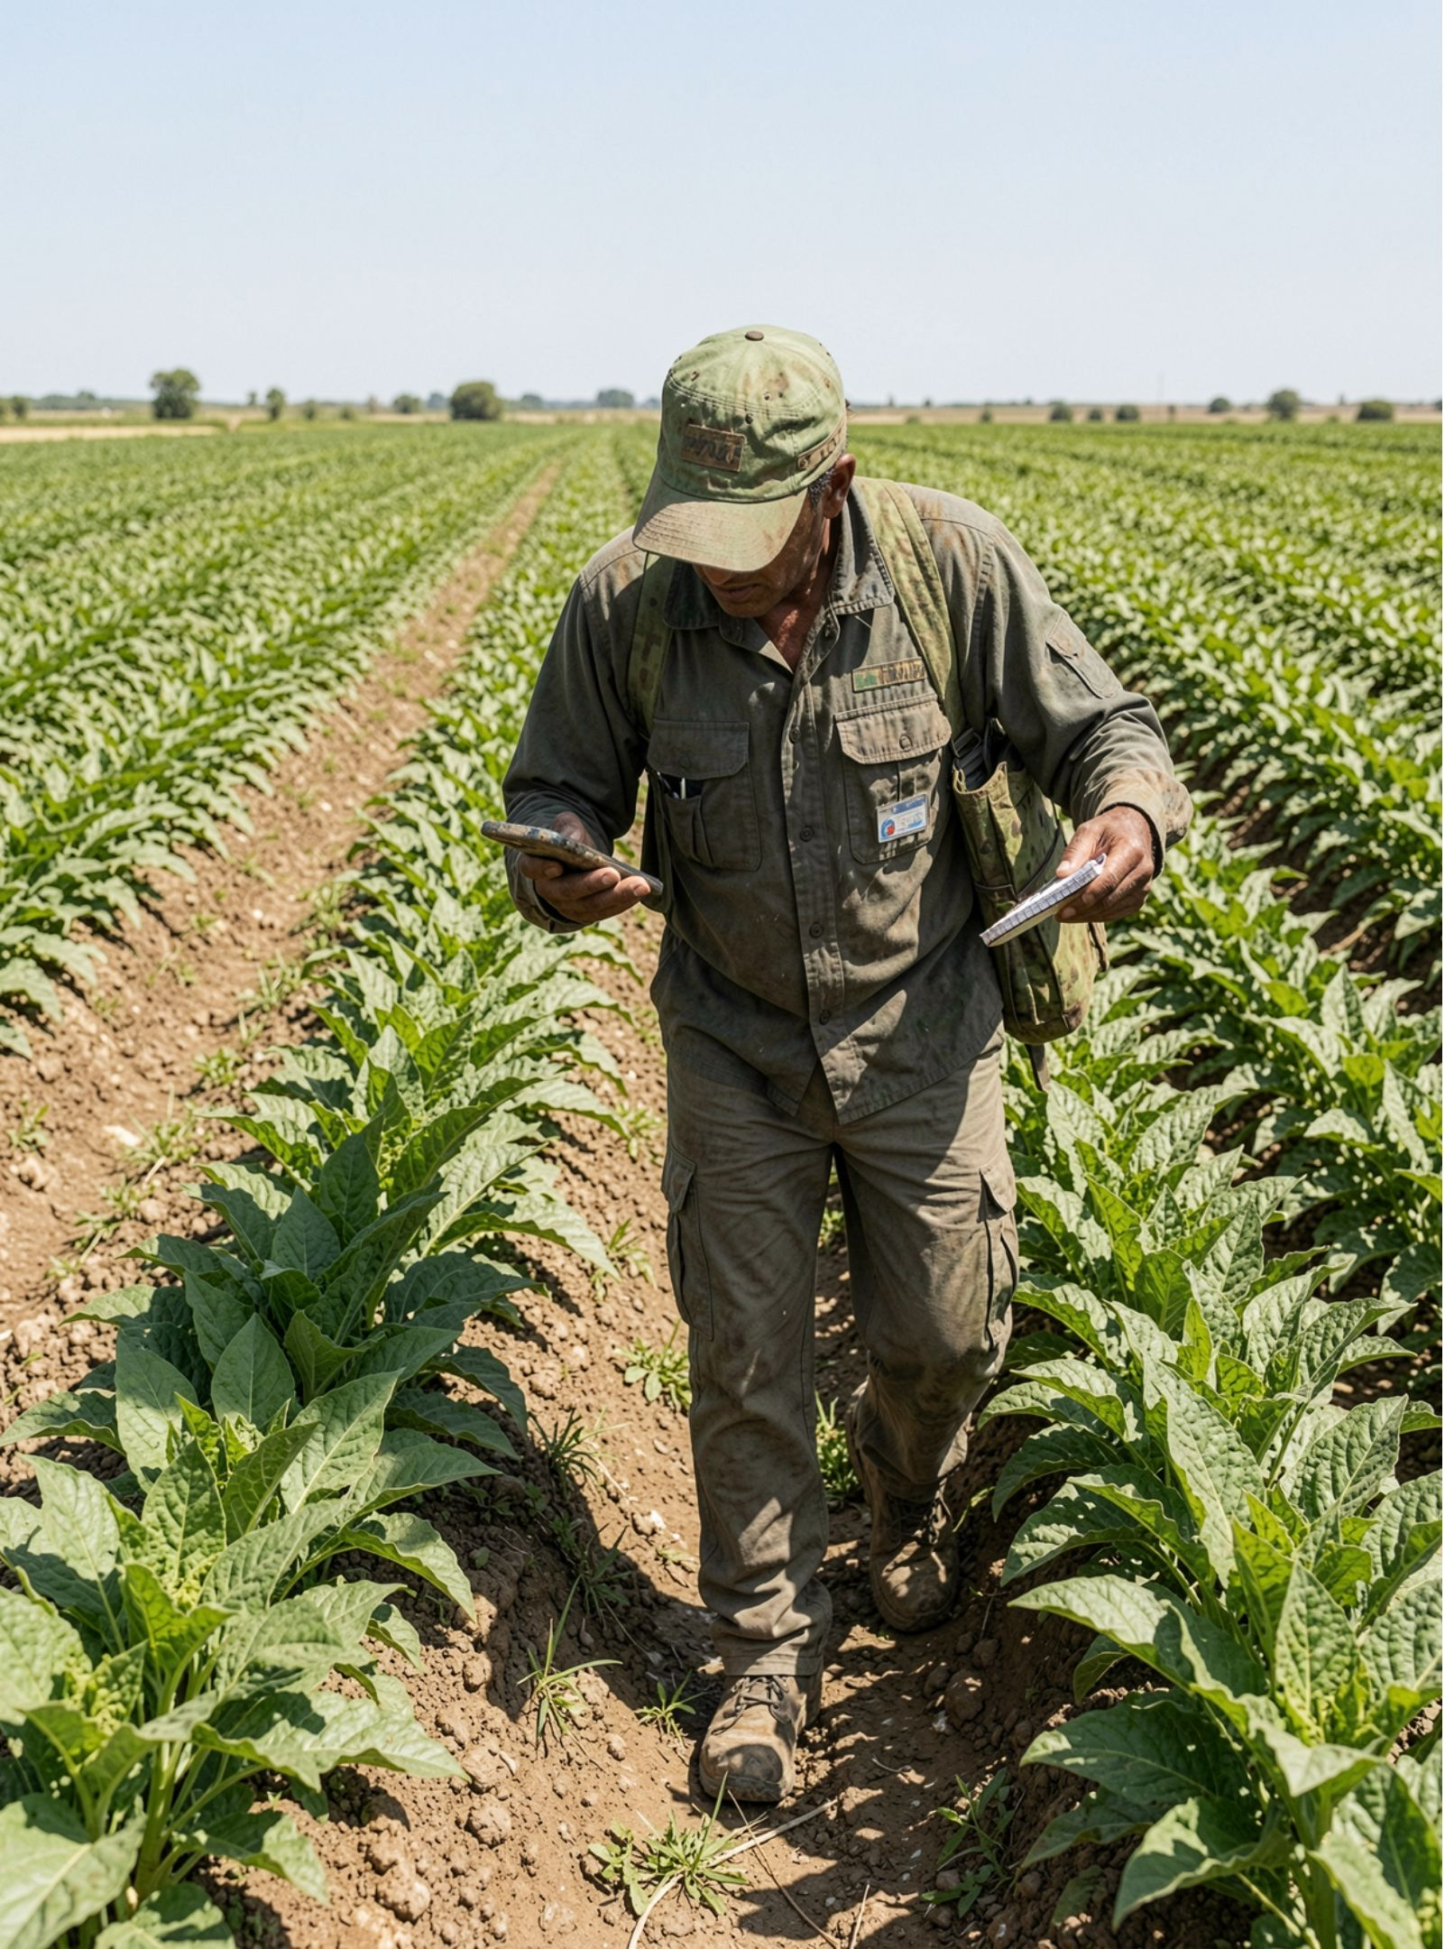
THE FIELD PROBLEM
The field problem is timing, not just diagnosis
A useful system shortens the distance between the first visible signal and the next field action.

Slide 4
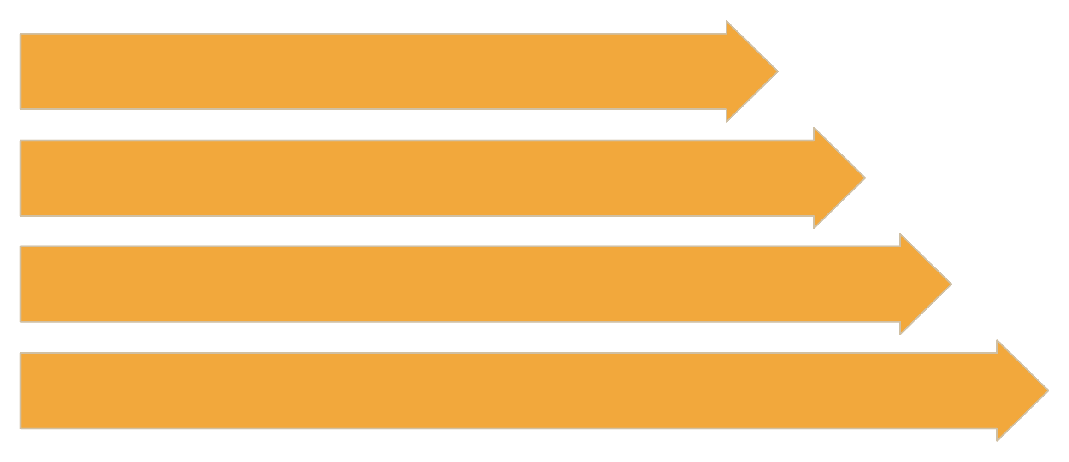
THE PIPELINE
From leaf image to disease prediction
Capture Image
Preprocess Image
Classify Leaf
Return Prediction

Slide 5

HOW THE MODEL LEARNS
The classifier learns visual patterns, not symptoms in isolation
Augmentation
Vary lighting, angle, and background for robustness.
Training
Validation
Teach color, texture, spots, edges, shape differences.
Check generalization beyond seen images.

Slide 6



TRUST AND EVIDENCE
A trustworthy result needs more than accuracy
Measure the misses
Expose uncertainty
Test where it matters
Track precision, recall, and confusion between similar diseases.
Show confidence and flag uncertain images for human review.
Test across crops, regions, devices, and real field conditions.

Slide 7
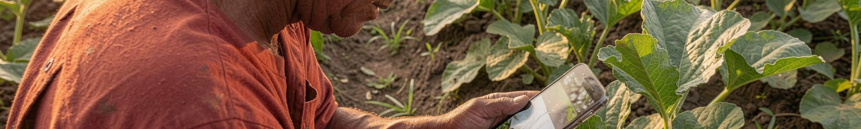
THE FIELD EXPERIENCE
Design the experience around the person in the field
01
02
03
04
Capture
Confirm
Review
Act
Take or upload a leaf image.
Confirm the crop and visible symptoms.
Review the likely disease and confidence.
Follow an agronomist-approved action or escalate for expert review.

Slide 8
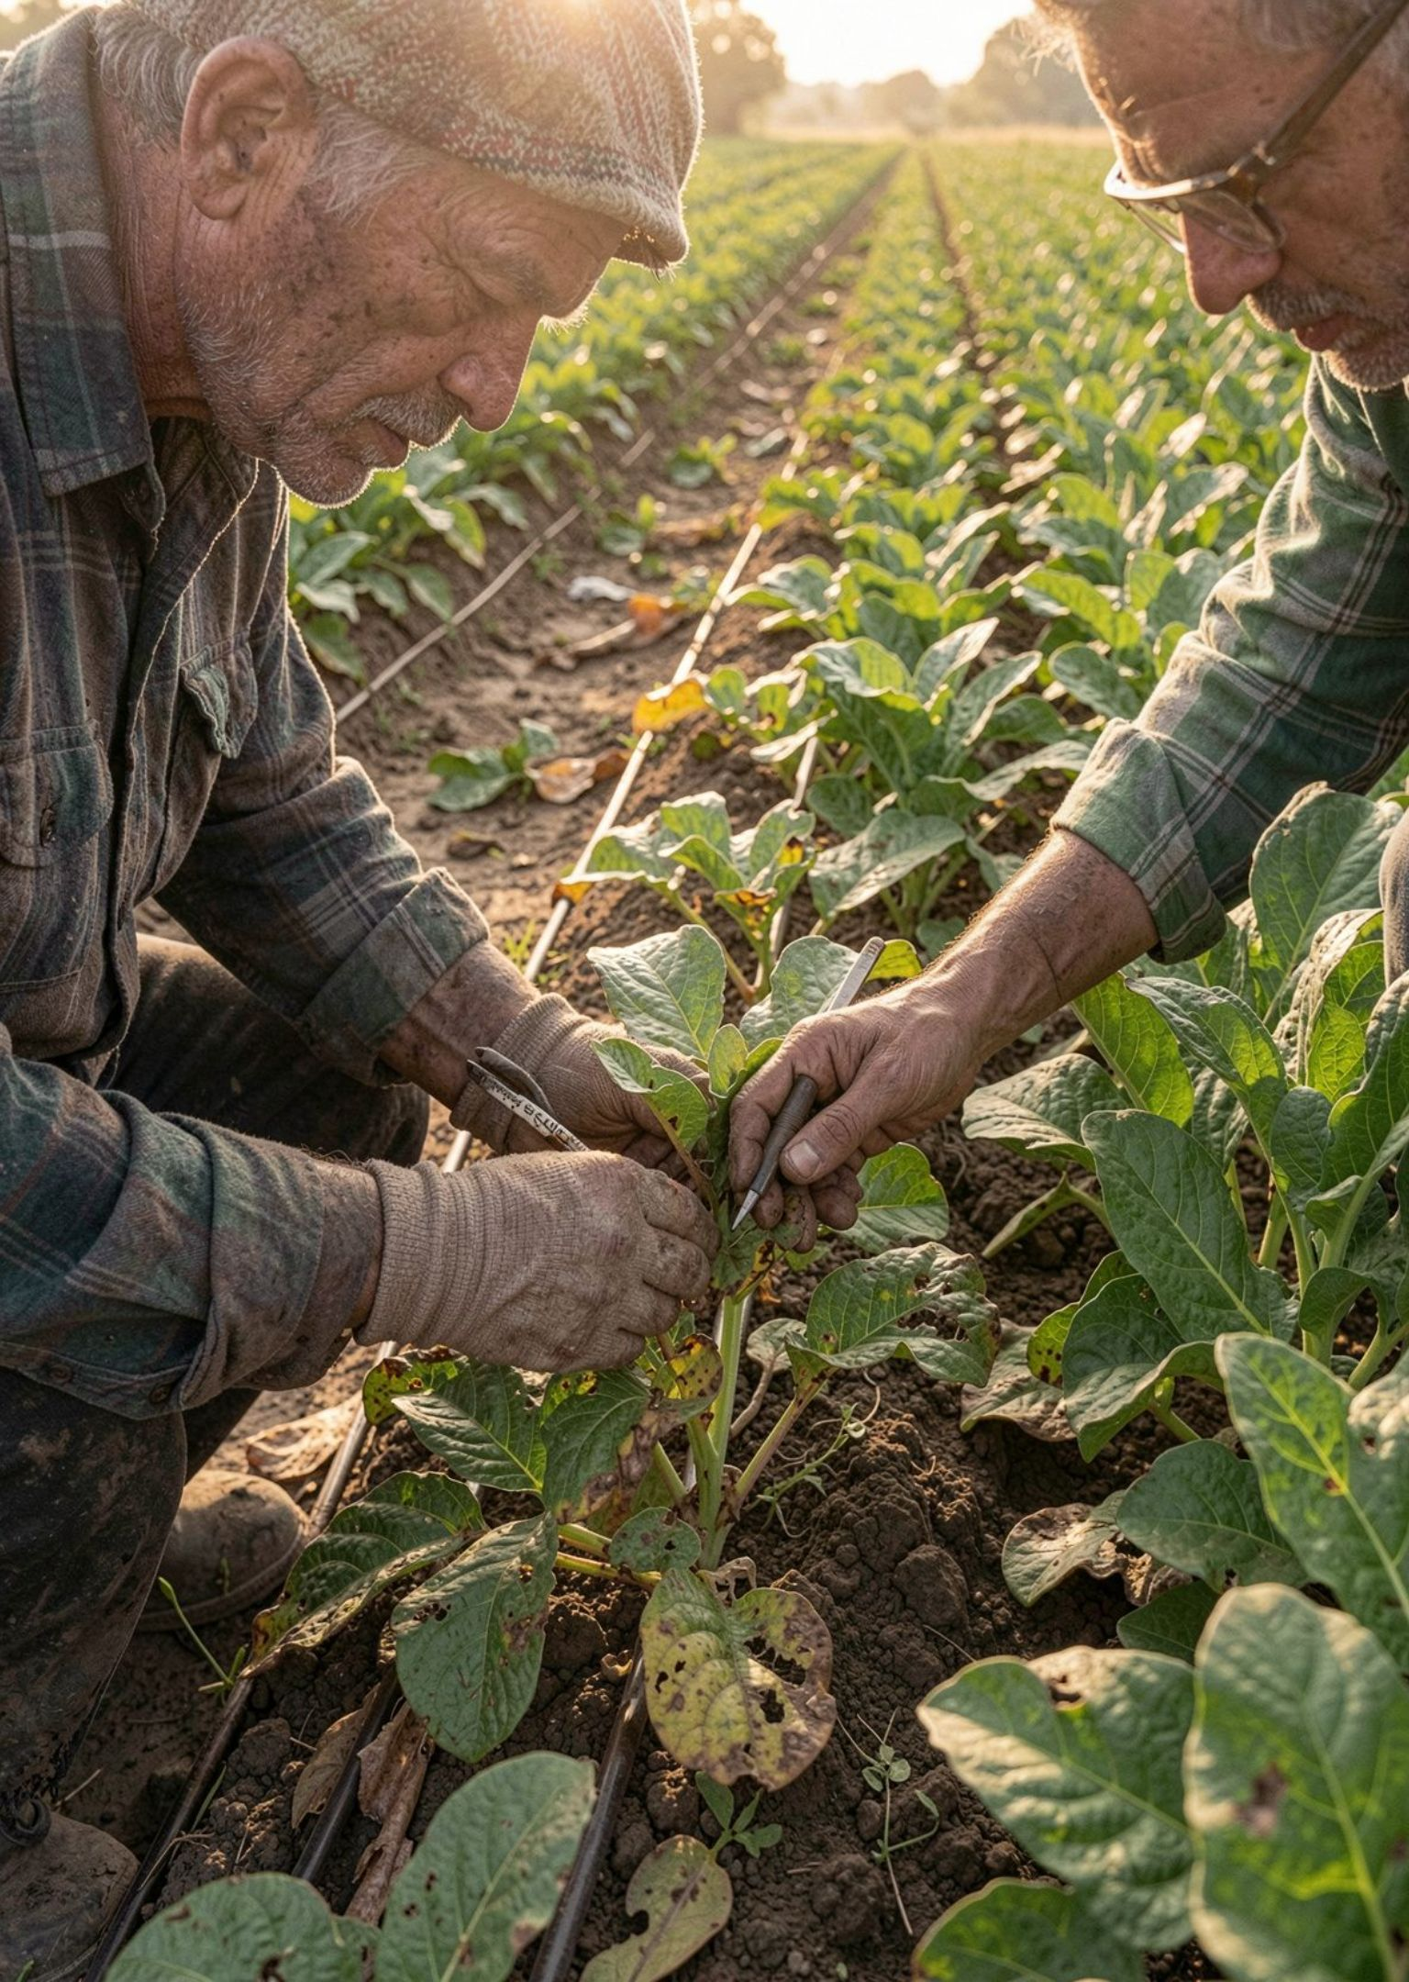


FROM PREDICTION TO MANAGEMENT
Early detection turns a model into a management tool
Scout next
Act locally
Learn over time
Reduce blanket treatment when localized action is possible.
Prioritize where to scout next.
Build a record of disease patterns over time.

Slide 9








SAFE DEPLOYMENT
Deploy carefully, then improve with field feedback
Start narrow
Monitor
Begin with a limited crop and disease set.
Track false positives, false negatives, and uncertain cases.
Improve safely
Capture feedback
Refresh the dataset and retrain carefully.
Record what the field reveals.

Slide 10
THE DECISION
The goal is
earlier, clearer decisions
Pair image classification with human expertise, field validation, and a feedback loop that improves the system over time.

