Slide 1
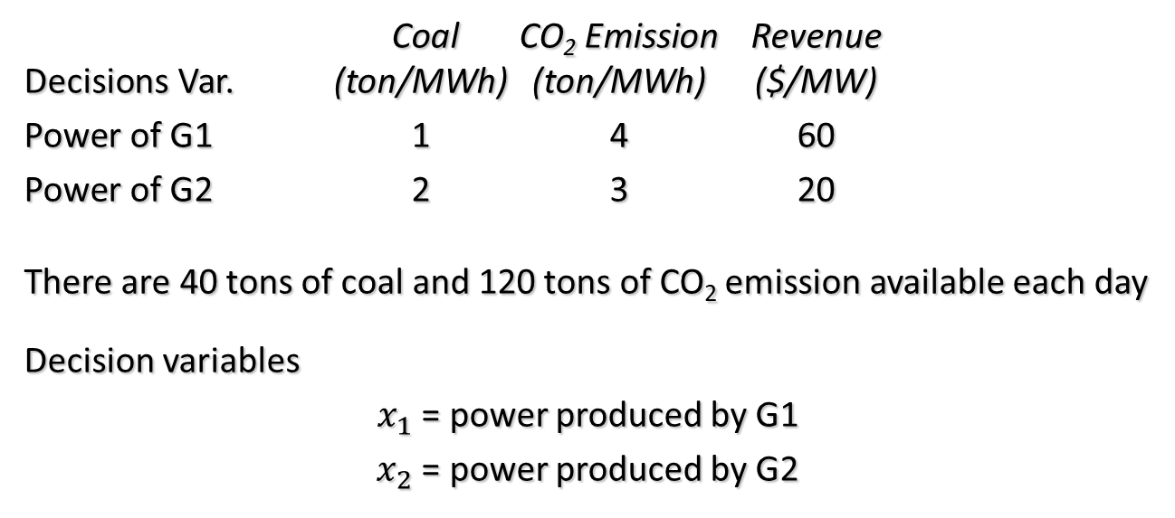
Chapter 2: Traditional Math. Prog./Optimization
HW1:
Solve the “Economic Dispatch” of Gen. Company (maximize profit)
with Yalmip and Gurobi
Carbon Emission and Resource Requirements
Coal CO₂ Emission Revenue
Decisions Var. (ton/MWh) (ton/MWh) ($/MW)
Power of G1 1 4 60
Power of G2 2 3 20
There are 40 tons of coal and 120 tons of CO₂ emission available each day
Decision variables
$x_{1}$ = power produced by G1
$x_{2}$ = power produced by G2

Slide 2




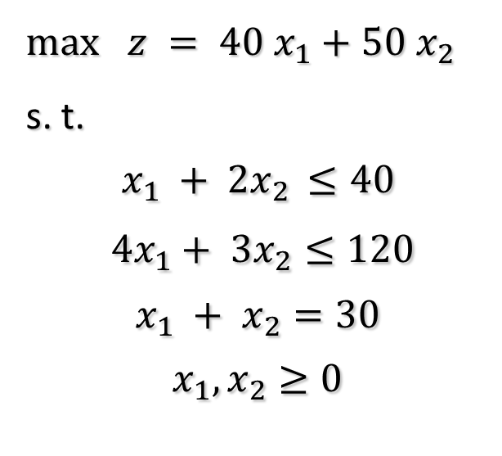
HW2:
Write the revised “Economic Dispatch” of Gen. Company (maximize profit)
and its dual problem (minimize cost) with Yalmip and Gurobi in Matrix Form, compare their results.
$max$ $z = 40 x_{1}+50 x_{2}$
s. t.
$$x_{1} + 2x_{2} ≤40$$
$$4x_{1}+ 3x_{2}≤120$$
$$x_{1} + x_{2}=30$$
$$x_{1},x_{2}≥0$$
$$maximize c^{T}x$$
$$A:m×n$$
$x,c:$ $n×1$
$b:m$ $×1$
$$subject to$$
$$Ax≤b$$
$$x≥0$$

Slide 3



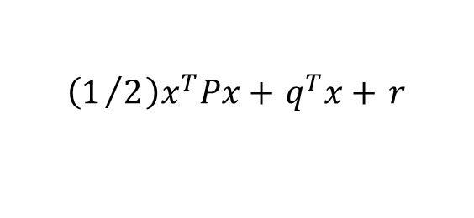

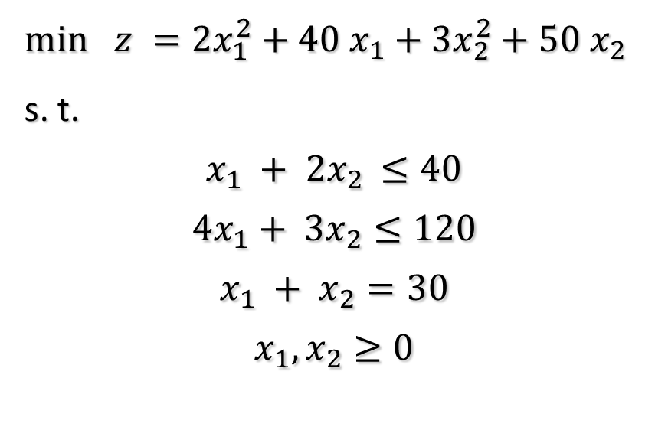

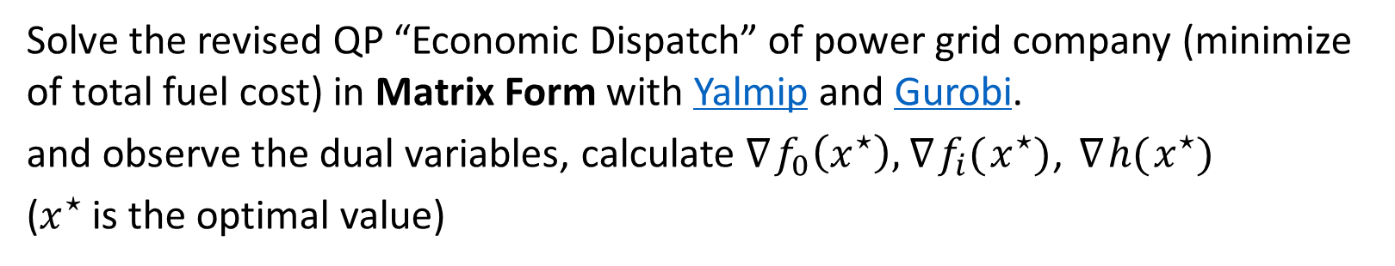

Chapter 2 Part II Basics of Convex Optimization
HW3:
Solve the revised QP “Economic Dispatch” of power grid company (minimize of total fuel cost) in Matrix Form with Yalmip and Gurobi.
and observe the dual variables, calculate $∇f_{0}\left(x^{⋆}\right),∇f_{i}(x^{⋆})$, $∇h(x^{⋆})$
($x^{⋆}$is the optimal value)
$min$ $z =2x_{1}^{2}+40 x_{1}+3x_{2}^{2}+50 x_{2}$
s. t.
$$x_{1} + 2x_{2} ≤40$$
$$4x_{1}+ 3x_{2}≤120$$
$$x_{1} + x_{2}=30$$
$$x_{1},x_{2}≥0$$
Quadratic program (QP)
$$:u_{1}$$
minimize subject to
$$\left(1/2\right)x^{T}Px+q^{T}x+r$$
$$Gx≼h$$
$$Ax=b$$
$${→f}_{i}\left(x\right)≤0$$
$$:u_{2}$$
$$→h_{i}\left(x\right)=0$$
$$:u_{3}$$
$$:u_{4},u_{5}$$

Slide 4










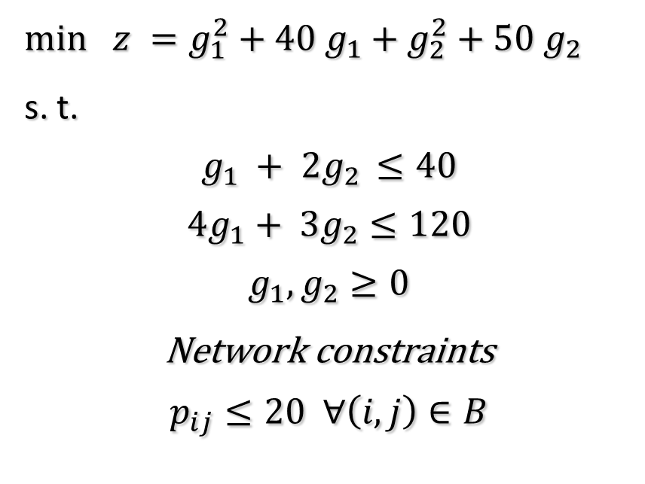


Chapter 2 Part III Graph Description for Power Network
HW4:
Solve the DC optimal power flow (OPF) of power grid company (minimize of total fuel cost) with Yalmip and Graph Toolbox in Matlab. And try to plot the graph with the results you obtained.
$min$ $z =g_{1}^{2}+40 g_{1}+g_{2}^{2}+50 g_{2}$
s. t.
$$g_{1} + 2g_{2} ≤40$$
$$4g_{1}+ 3g_{2}≤120$$
$$g_{1},g_{2}≥0$$
Network constraints
$$p_{ij}≤20 ∀\left(i,j\right)∈B$$
$$g_{2}=?$$
2
$$p_{42}$$
$$p_{12}$$
$$g_{1}=?$$
4
1
$$p_{23}$$
$$p_{34}$$
$$d_{4}=20$$
$$p_{13}$$
3
$$IN∗p=g−d$$
$$d_{3}=10$$
$$IN^{T}∗θ=p.∗X$$
$$X={\left[0.01,0.01,0.01,0.02,0.01\right]}^{T}$$

