Slide 1

Open-Source Project
Anushka Mahapatra

Slide 2


The OpenCV Project
OpenCV is a library of programming functions mainly used as a tool for image processing and performing computer vision tasks.
Originally developed by Intel, the library is cross-platform and free for use under the Apache 2 License
It’s an opensource project available on GitHub and can can be used to perform tasks like face detection, objection tracking, landmark detection, and much more. It supports multiple languages including python, java C++
.

Slide 3
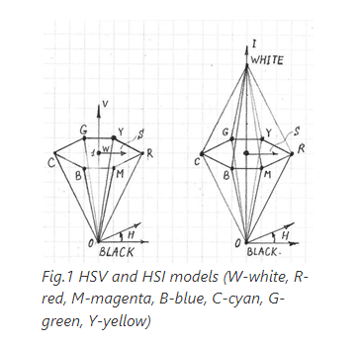
Understanding the Functions Implemented on OpenCV
Every colored image consists of pixels which contains RGB values
In computer vision tasks, points in RGB color models are represented in cylindrical coordinates most commonly through HSV (hue-saturation-value), HSI (hue-saturation-intensity) and HSL (hue-saturation-lightness)
The reason we use these cylindrical coordinates is because in color detection over RGB/BGR models HSV , HSI , HSL is more robust towards external lighting changes. This means that in cases of minor changes in external lighting (such as pale shadows,etc. ) Hue values vary relatively lesser than RGB values which means that Formats like RGB are more machine-readable than human-readable. HSI & HSV its, the opposite, meaning it is more understandable by humans

Slide 4
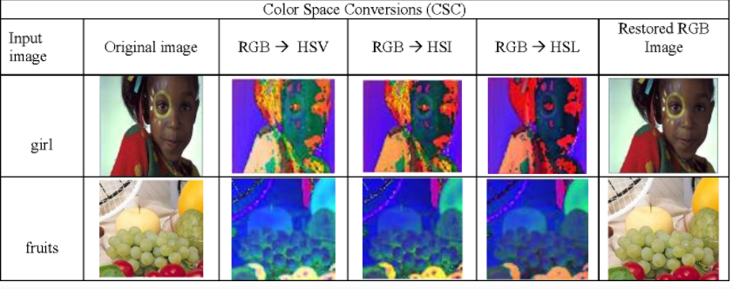

Slide 5
HSI (Hue , Saturation Intensity) Conversion
Brightness depends upon color intensity, which is key factor in describing color sensation. The intensity is easily measurable and the results are also easily interpretable. Thus the model that is used to describe a color object is the HSI model. It is a very important and attractive color model because it represents the colors the same way as the human eye senses colors.
Furth more HSI models are used for color segmentation because clustering in HSI space is much better than RGB space. (image clustering is the process of grouping images into clusters such that the images within the same clusters are similar to each other, while those in different clusters are dissimilar.)
In OpenCV a function to convert RGB values into the HSI cylindrical coordinate and vice versa was not available .

Slide 6
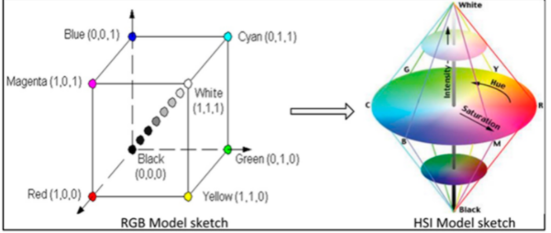
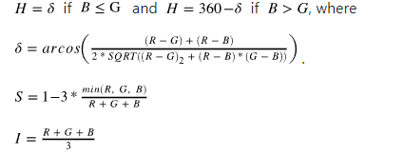
Brief Explanation Of How The Code In My Function Works
Firstly , I installed OpenCV version 4.5.0 on visual studio. I changed the source variables and directories accordingly and this allowed me access the in built OpenCV functions
Functions imread , imshow and Mat were used from OpenCV. These functions allow to read , display and store an image into a matrix respectively
To convert an RGB image to an HSI image the following formulas was used : ( RGB values were scaled in the range [0,1] , Hue was in range from 0 to 360 and S, I were also in range [0,1]

Slide 7
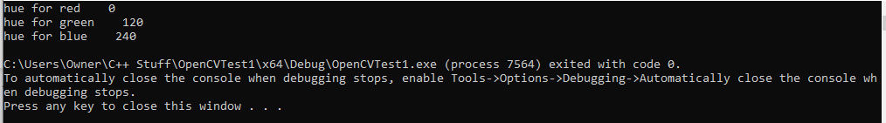
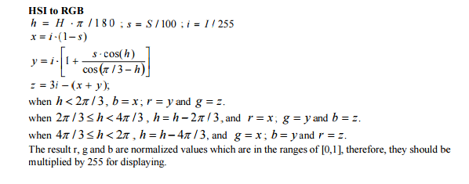
Code Explanation Continued..
To check whether I correctly converted my image from RGB to HSI , I debugged my application and checked if the hue values for pure Red, Green & Blue were 0 , 120 and 240 degrees respectively
Finally, after verifying the conversion from RGB to HSI, I created a function which converted an HSI values back to RGB which gave me the same original RGB image. The following formulas were used for this conversion

