Slide 1
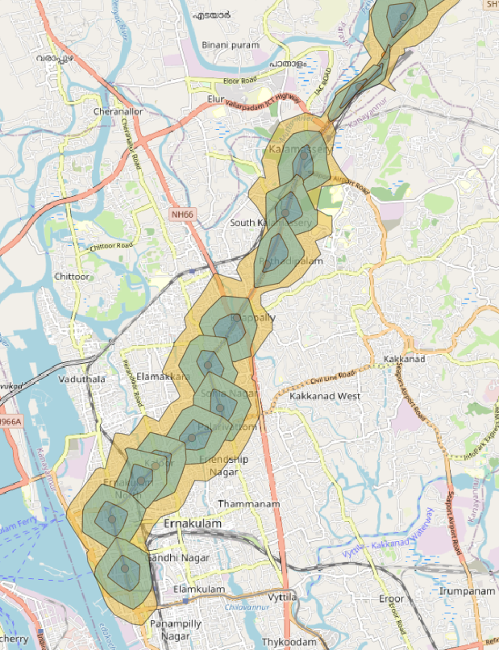
GIS Lesson 11
Spatial Analysis (3) – Service Area Analysis
空間分析 (3) – 服務區分析
2020/7/29

Slide 2
Agenda
1. Today’s Class 今日課堂
2. Tutorial 個別指導
Service Area Analysis – 服務區分析
Follow tutorial here: https://www.qgistutorials.com/en/docs/3/service_area_analysis.html
Example coursework
Demonstration in QGIS
What is Service Area Analysis?
How is service area analysis used in real life?

Slide 3
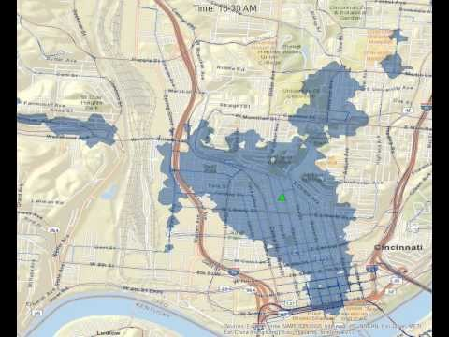
Video – Service Area Time Lapse (15 min travel time by walking from downtown Cincinaati)(0:07)
Notes:
Available buses changes throughout the day
The area reachable changes significantly

Slide 4
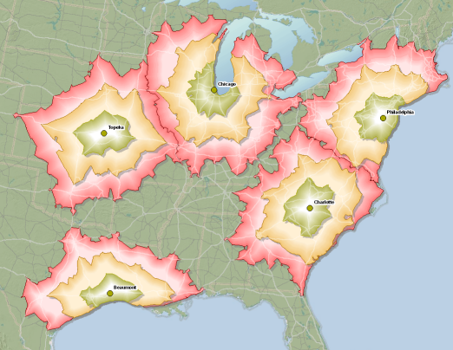
What is Service Area Analysis (SAA)?
Service Area: a region that covers all streets accessible by certain travel mode(s), such as walking, cycling and driving.
For example, a 10-minute service area for a point on a network contains all the streets that can be reached within 10 minutes from that point.
Service Area Analysis:
Is a type of network analysis that determines all accessible streets within a time interval
Can assess the travel time from selected points in a network
Mainly uses the travel speed data available in datasets for computation
Can be done in both ArcGIS and QGIS
Source: https://desktop.arcgis.com/en/arcmap/latest/extensions/network-analyst/service-area.htm#ESRI_SECTION1_DEC185407C154056B6B17077F9BAD8F2

Slide 5
How is Service Area Analysis used in the real life?
Emergency Response
E.g. Analyze the areas reachable by a local fire service department within 15 minutes (driving)
E.g. Analyze the areas reachable by residents in case a nuclear exposure in Pickering within 30 minutes (walking)
Urban Planning
E.g. Locate the streets that are reachable by car within 15 minutes from a point in Markham -> for planning a new bypass in the city
Commercial
E.g. Determine the area serviced by a Home Depot store within 20 mins by driving, and find areas that are not covered for planning for a potential store (Location-allocation problem)
E.g. Flight companies want to see the areas covered by their routes within 5 hours of flight time

Slide 6
Suppose you are a planner for the City of Markham. You want to determine the 15-minute service area serviced by all YRT buses in the city.
What travel mode are we most likely consider when creating the service areas? A) Driving; B) Cycling; C) Walking
Which of the following datasets do you need to create the service areas? Why?
(Please indicate all datasets needed)
Bus Fare
Bus Stop Locations
Street network
Vehicle Count data

Slide 7
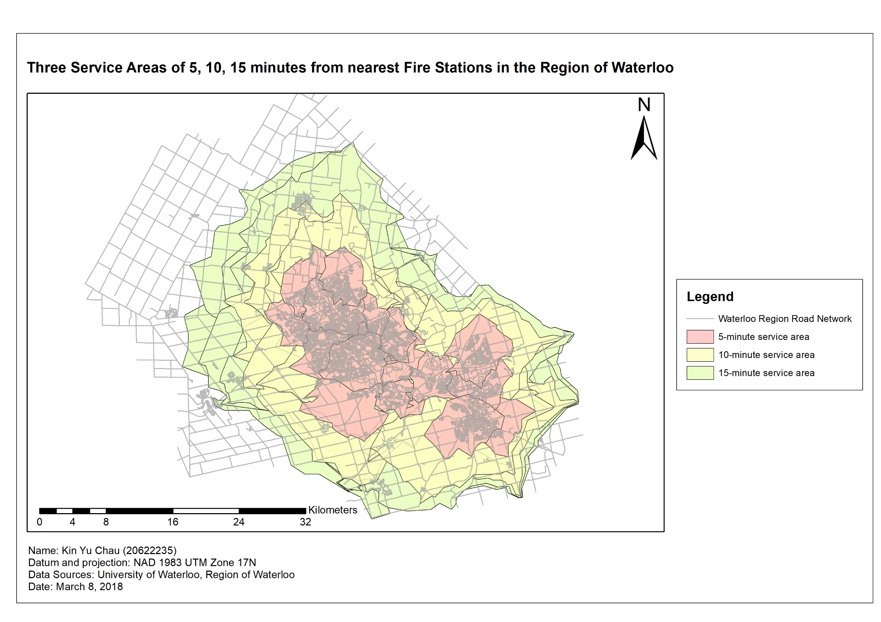
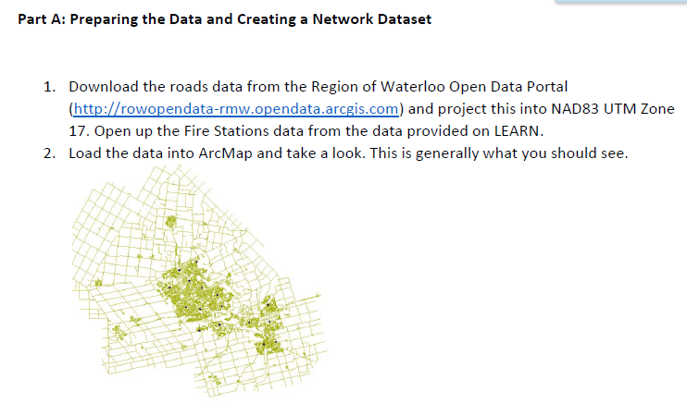
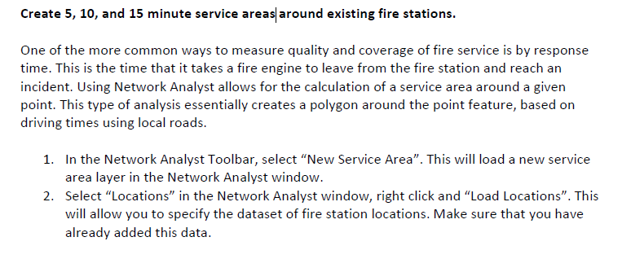
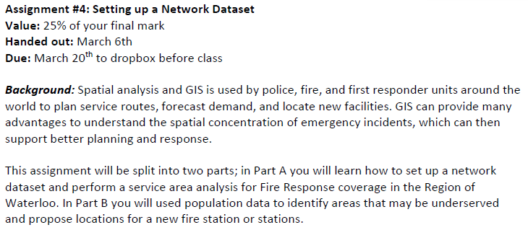
Example coursework (Advanced GIS - GEOG 381)

Slide 8
Questions?

Slide 9
2. Tutorial
Follow tutorial here: https://www.qgistutorials.com/en/docs/3/service_area_analysis.html

