Slide 1
GIS Lesson 1
Basic Mapping Elements and Representations
2020/5/1

Slide 2
Agenda
1. Introduction to Cartography
A. Brief history
B. Map reading (types of map, skills)
C. Map making (basic elements of a map, things to note)
2. Tutorial – Making your first map!

Slide 3
1. Introduction to Cartography

Slide 4
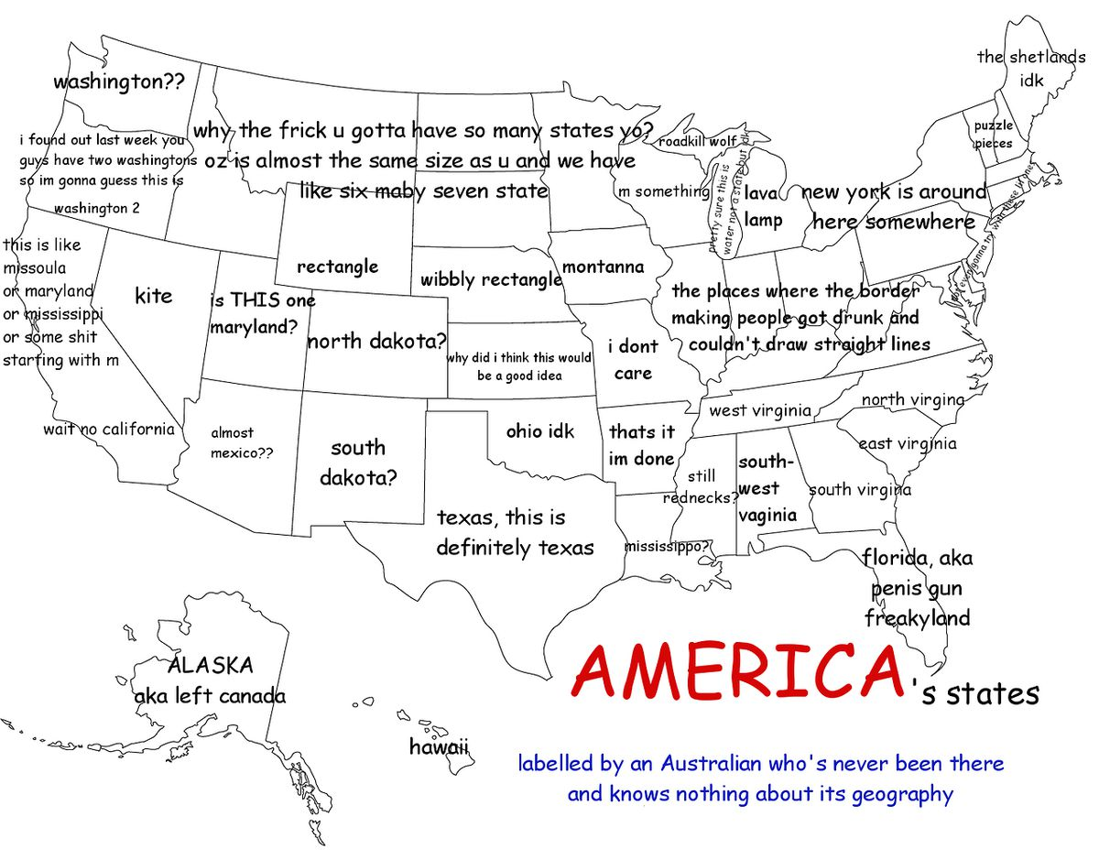
What do you think about this map?
Source: https://www.vox.com/2015/2/18/8056325/bad-maps
Notes:
Possible answers
Too messy
Not sure what the map is trying to tell us
Colorless
Hard for readers to focus

Slide 5
What is Cartography?
It is the art and science of communicating information with maps
Alternatively, the theory, technique and practice of map making and map use (Kolacny, 1969)
Chinese: 制圖法
In other words, we make maps to communicate information with others.
What do you think are some of the elements of good communication?

Slide 6
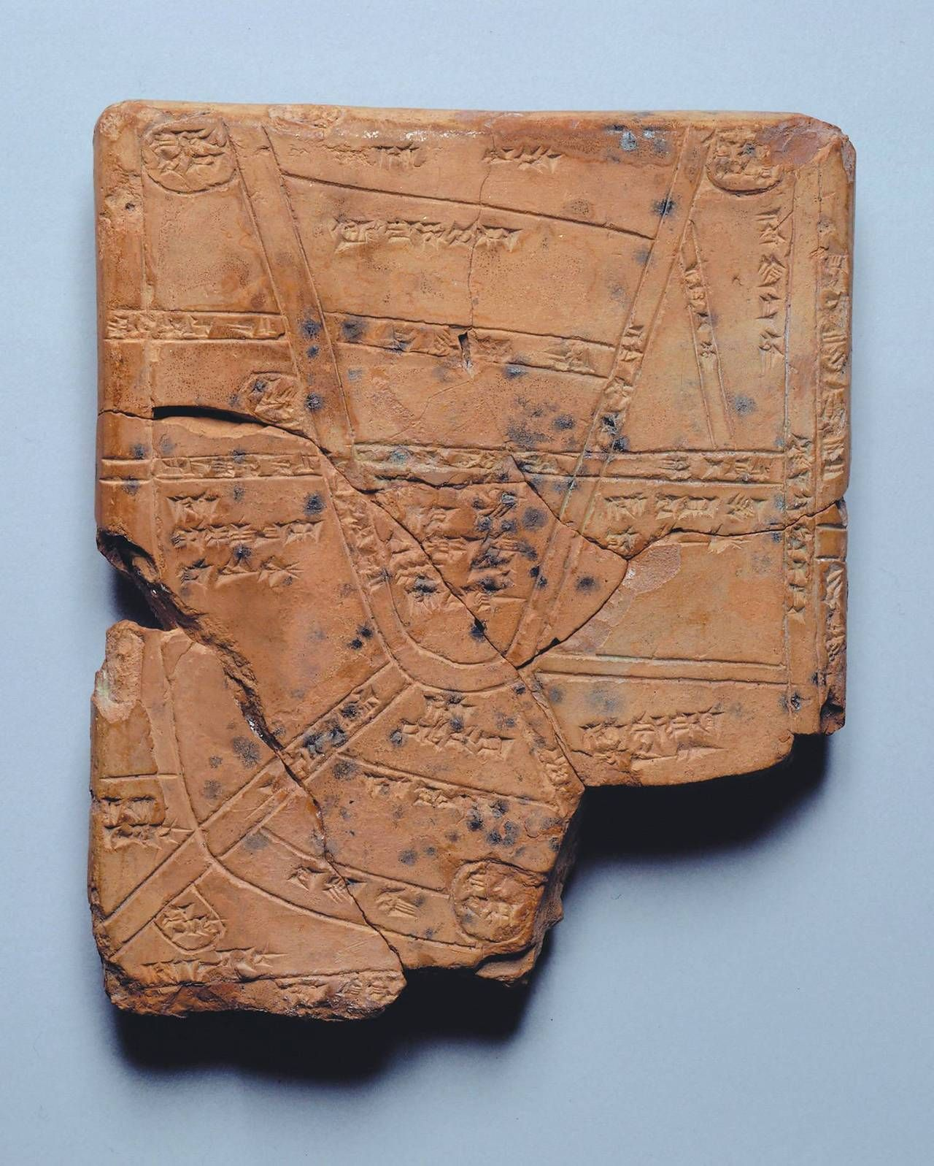
History of Cartography
Earliest maps: from Egypt and Mesopotamia (around Iraq currently)
Egyptians: to show property boundaries after flooding
Mesopotamians: use clay tablets (黏土片) to create maps of different scales
Source: https://www.pinterest.ca/pin/177821885261027275/?autologin=true
Notes:
Source: University of Waterloo – GEOG 187 2015 L02 Slide 05

Slide 7
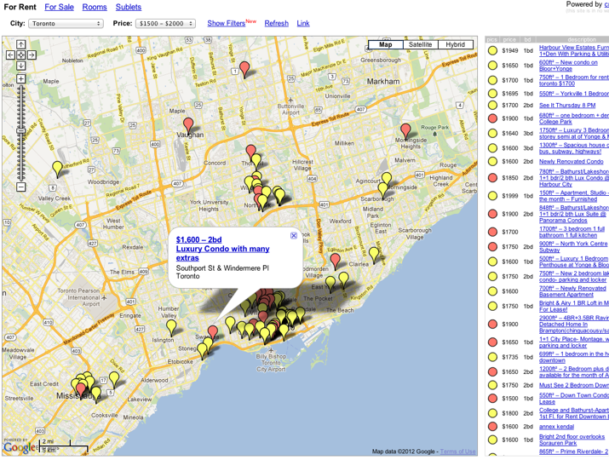
History of Cartography (cont’d)
Post WWII
A set of standard instructions were developed
Degree programs were created
2004+
Map-making became democratized
Users can generate own data and contribute to maps
Source: University of Waterloo – GEOG 187 (2015) Slide 19
Notes:
Source: University of Waterloo – GEOG 187 2015 L02 Slides 16 and 18

Slide 8
Types of Maps
Maps
Mental Maps
Maps using collected data
General (reference, topographic, photomaps)
Charts/Plans
Thematic (with a specific purpose, derived)
Notes:
Source: University of Waterloo – GEOG 187 2015 L02 Slide 28

Slide 9
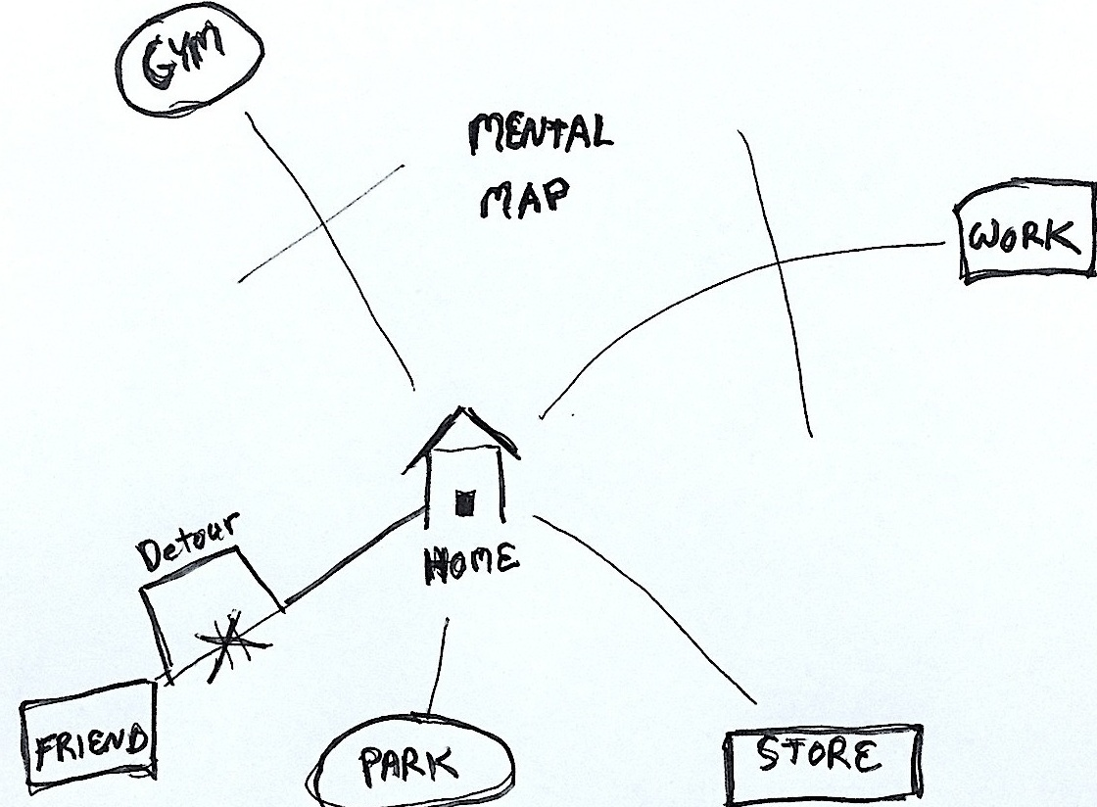
Mental Maps
Source: https://www.psychologytoday.com/ca/blog/shadow-boxing/201601/mental-maps-and-cognitive-gaps

Slide 10
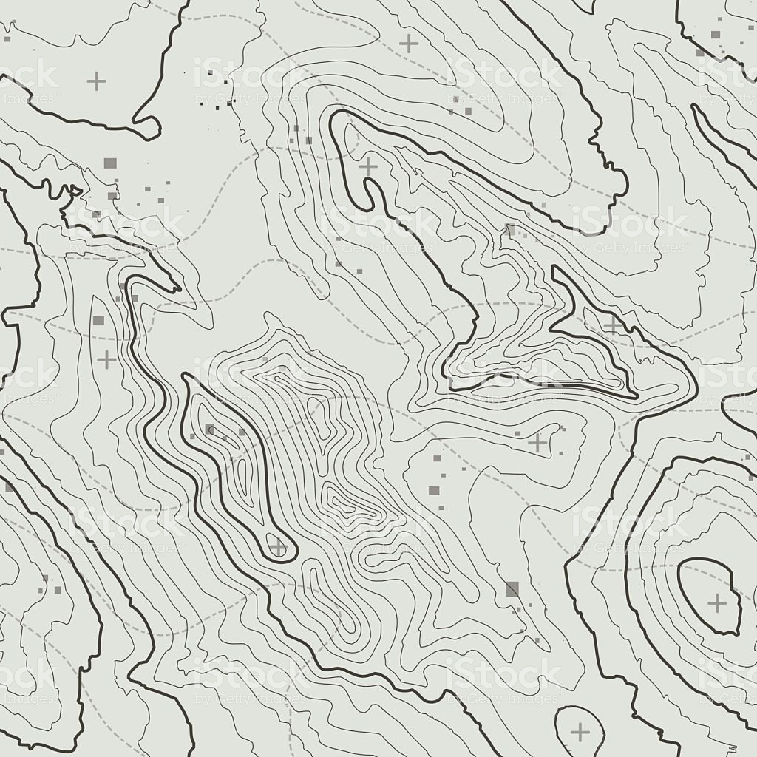
General (Topographic)
Source: https://www.istockphoto.com/ca/vector/topographic-map-background-concept-with-space-for-your-copy-topography-gm600694100-103302897

Slide 11
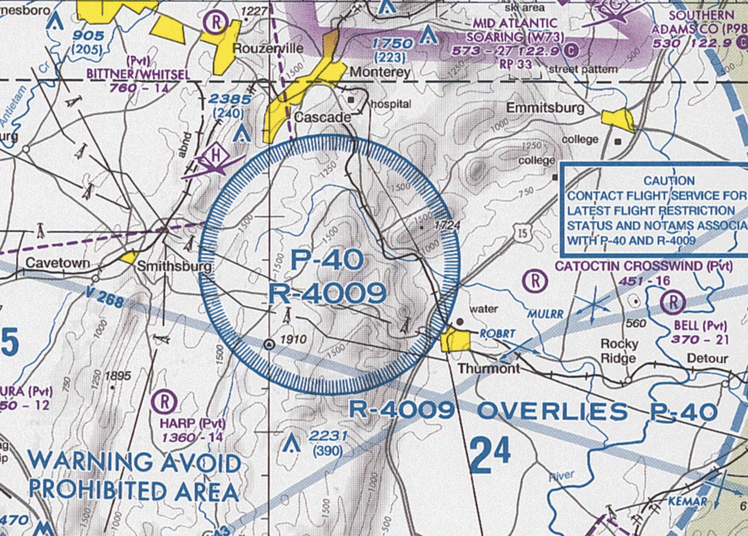
Charts/Plan
Flight chart example
Source: https://en.wikipedia.org/wiki/Prohibited_airspace

Slide 12
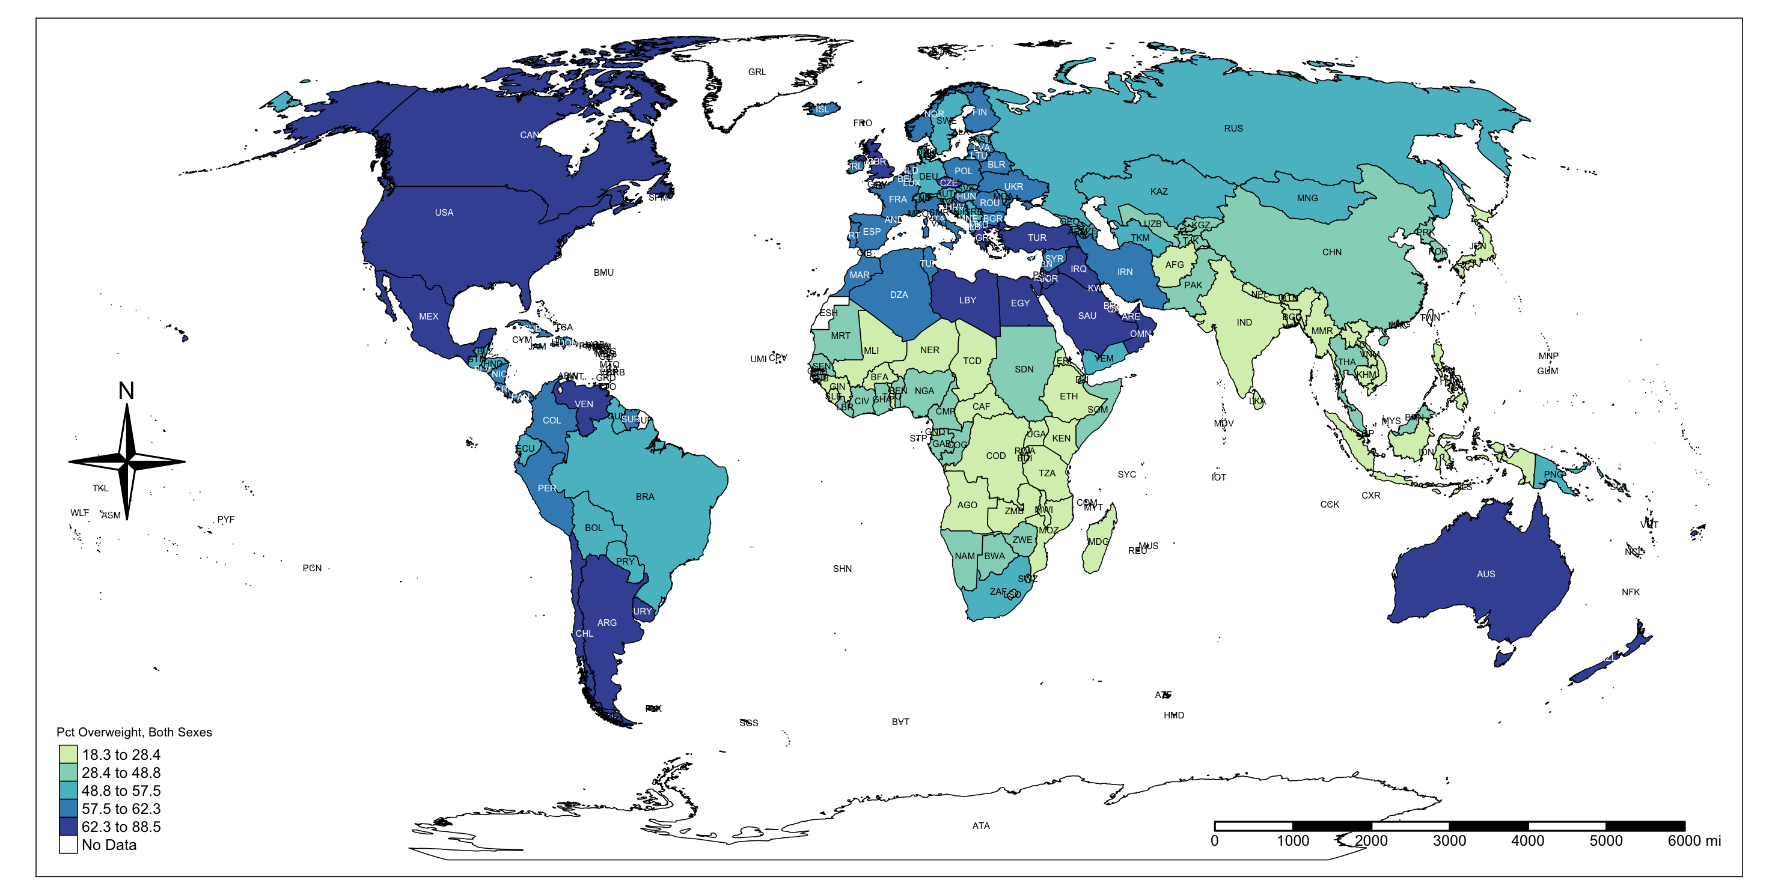
Thematic Maps
Alcohol Dependence (Source: https://medium.com/swlh/a-quick-thematic-map-of-alcohol-dependence-in-the-world-using-r-programming-473045164af8)

Slide 13
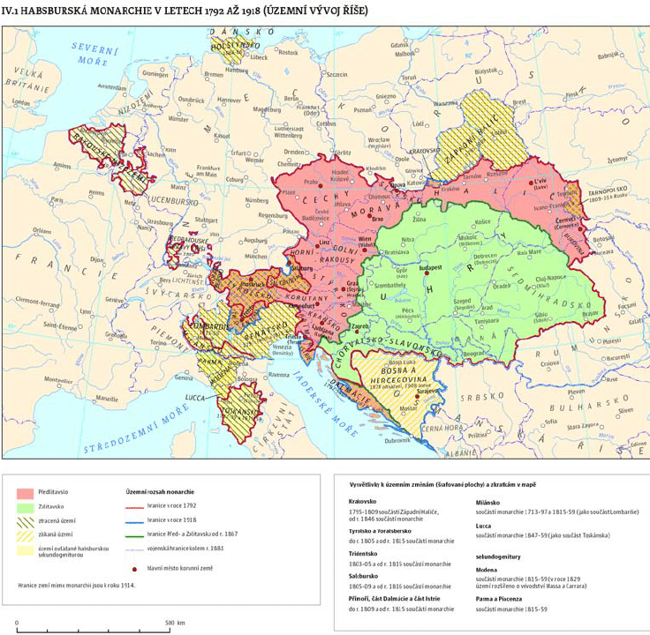
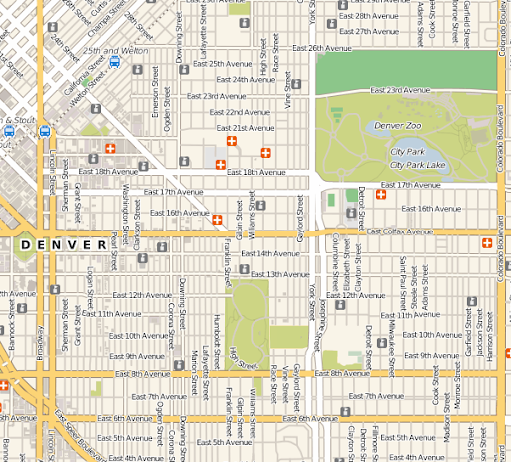
Map Scale
Small scale map (1:500,000)
Large scale map (1:1500)
Source: https://www.researchgate.net/figure/Example-of-a-small-scale-map_fig1_259574183
Source: http://ianbroad.com/large-scale-and-small-scale-maps/

Slide 14
Map reading skills
Level 1: Basic map reading skills
Identify symbols (e.g. representing different types of features)
Make a mental image (e.g. relative positions of places)
Level 2: Map analysis skills
Identify interesting spatial patterns
Determine direction/path
Level 3: Map interpretation skills
Link the map information with the knowledge about the region of interest
Know how to explain the spatial patterns
Notes:
Source: University of Waterloo – GEOG 187 2015 L02 Slide 26

Slide 15
Map-making (Basic map elements)

Slide 16
2. Tutorial

Slide 17
Let’s make a map now!
1. Download QGIS on your computer (https://qgis.org/en/site/forusers/download.html)
Select 64-bit (OSGeo4W Network Installer)
Follow the download wizard
2. Load the income data for York Region
Data link: https://insights-york.opendata.arcgis.com/datasets/profile-of-income-by-dissemination-area-2016-census?geometry=-80.379%2C43.726%2C-78.553%2C44.417&selectedAttribute=MEDIAN_ATI_CPL_ECF_WO_CHILD
Download the data as Shapefile and save to your working folder
Add the income data as a vector layer
Set the symbology to graduated, and show the MEDIAN_TOT field
For Mode, select Equal Interval.
3. Use Print Composer to make a map
Recall the basic elements of a map
Learn to design a map with the median income data

Slide 18
Questions?

