Slide 1
GIS Lesson 10
Spatial Analysis (2)
空間分析 (2)
2020/7/16

Slide 2
Agenda
1. Today’s Class 今日課堂
2. Tutorial 個別指導
Interpolation 插補
Download a set of point data for interpolation according to your interest (e.g. weather station data, elevation data)
Examples
Demonstration in QGIS
Review – Raster Data
Make a raster output
What is Interpolation?
Review – Tobler’s First Law of Geography
Pattern Analysis – Spatial Autocorrelation
Types of Interpolation Methods
Review – Stevens Measurement Levels

Slide 3
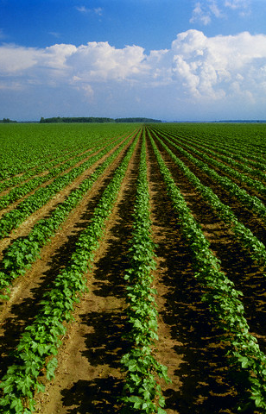
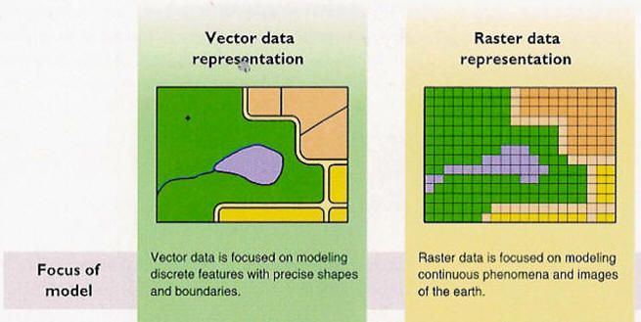
Review – Raster Data
Raster data is made up of _____________.
Raster data is used to display _______________ information (hint: what can you think about field data?)
The quality of the raster increases with (increasing/decreasing) number of cells and (increasing/decreasing) cell size, which means (higher/lower) resolution.
Notes:
Answers:
Pixels/Grid Cells
Continuous
Increasing; decreasing ; higher

Slide 4
Review – Raster Data
Raster data is made up of pixels/grid cells.
Raster data is used to display continuous information (hint: what can you think about field data?)
The quality of the raster increases with (increasing/decreasing) number of cells and (increasing/decreasing) cell size, which means (higher/lower) resolution.
Notes:
Answers:
Pixels/Grid Cells
Continuous
Increasing; decreasing ; higher

Slide 5
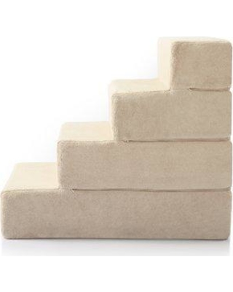
Review – Stevens Measurement Levels
Ratio: have absolute zero (e.g. distance)
Quantitative Data
Interval: measurements with fixed/equal units; no absolute zero; not absolute differences
Qualitative Data
Ordinal: ranking of classes/categories based on some criteria (e.g. differences between classes 1 and 2 != classes 3 and 4)
Nominal: distinct categories, categories are mutually exclusive (can only be in one group but not the other), no implied relationship among categories
Notes:
Interval: difference between (25 and 35) C and (50 and 60) C is 10 C, but 50 C is not twice as hot as 25 C

Slide 6
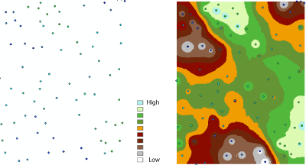
Interpolation
插補

Slide 7
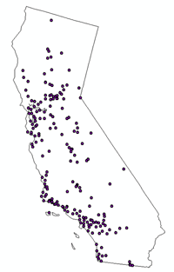
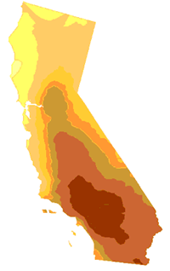
What is Interpolation?
Definition: Interpolation predicts values for cells in a raster from a limited number of sample data points. (ESRI, 2016) (由有限的數據點估計柵格的數據值)
Usage: Can be used to predict unknown values for any geographic point data, such as elevation, chemical concentrations and noise levels. (ESRI, 2016) (估計任何地理點數據的未知數據值)
You need to have a z-value field in the point data for interpolation (e.g. elevation, temperature)
Vector (Points)
Raster (Pixels)
Notes:
Source:
https://desktop.arcgis.com/en/arcmap/10.3/tools/spatial-analyst-toolbox/understanding-interpolation-analysis.htm#:~:text=Interpolation%20predicts%20values%20for%20cells,chemical%20concentrations%2C%20and%20noise%20levels.

Slide 8

Everything is related to everything else. But ______ things are more related than ________ things. (1969)
Tobler’s First Law of Geography
托伯勒的地理第一定律
Notes:
Source: https://www.urisa.org/clientuploads/directory/Documents/Awards/Waldo_Tobler.jpg
Answers:
Near
Distant (far)

Slide 9
Everything is related to everything else. But near things are more related than distant things. (1969)
Tobler’s First Law of Geography
托伯勒的地理第一定律
Notes:
Source: https://www.urisa.org/clientuploads/directory/Documents/Awards/Waldo_Tobler.jpg
Answers:
Near
Distant (far)

Slide 10
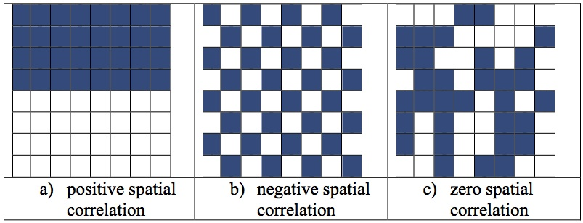
Spatial Autocorrelation (空間自相關性)
Definition: determines how well data objects correlate with other nearby objects across a spatial area.
Positive Autocorrelation (+): many similar values are located near each other (following the Tobler’s First Law of Geography)
Negative Autocorrelation (-): many different values are located near each other
Zero Spatial Autocorrelation (0): values seem to vary randomly throughout space
Notes:
Source: https://docs.aurin.org.au/wp-content/uploads/sites/2/2014/09/Spatial_Autocorrelation.jpg

Slide 11
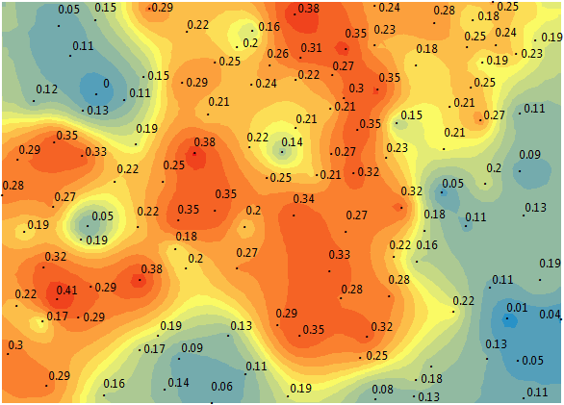
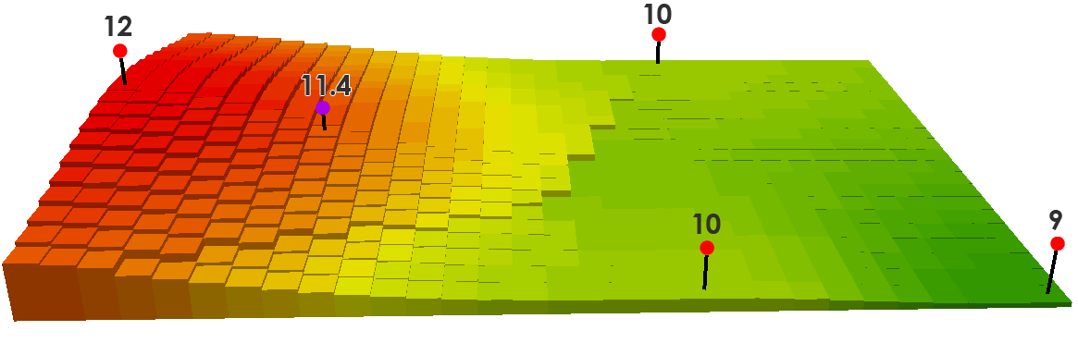
Types of Interpolation Methods
1. IDW (Inverse Distance Weighting) (反距離權重)
Estimates cells by averaging values (用平均值估算)
Closer a point is to the center of the cell → More important (愈近愈重要)
Weight = 1/distance
No statistical model is used
Easy to define
2. Kriging (克里格)
Uses a statistical model with a variogram (變異圖) (determines spatial continuity of data) (You will learn more in GEOG 318)
Calculates spatial autocorrelation by taking squared differences between points
More complicated to define

Slide 12
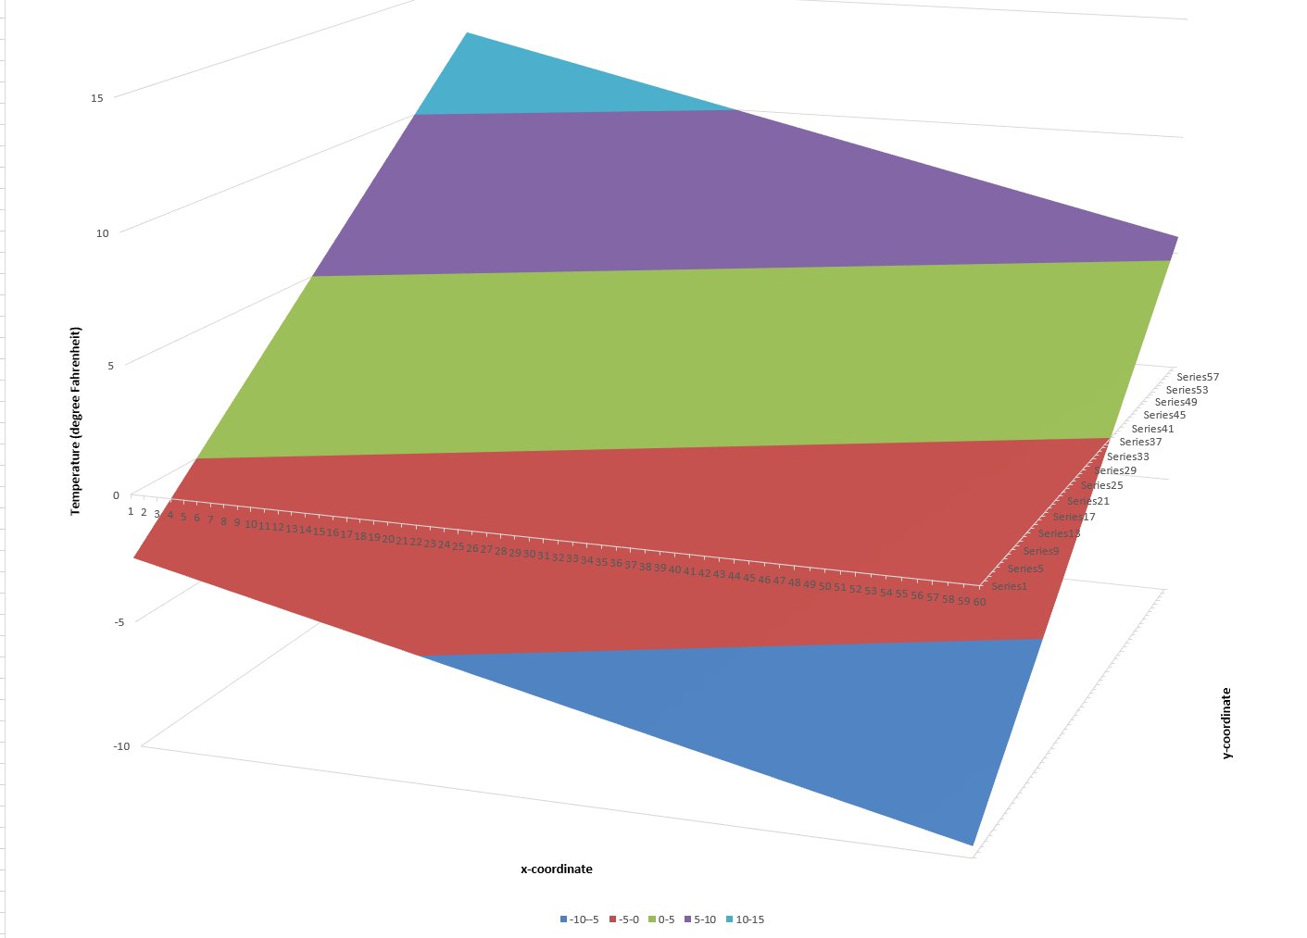
Types of Interpolation Methods
3. Trend
Fitting a surface to the sample points when the surface gradually varies from region to region over the area of interest
Just like fitting an equation to a statistical model, but with three-dimensions, including x-coordinate, y-coordinate and a value field (such as temperature or pollutant concentration)
4. Other Methods
https://desktop.arcgis.com/en/arcmap/10.3/tools/spatial-analyst-toolbox/comparing-interpolation-methods.htm

Slide 13
Examples
Predicting elevation values

Slide 14
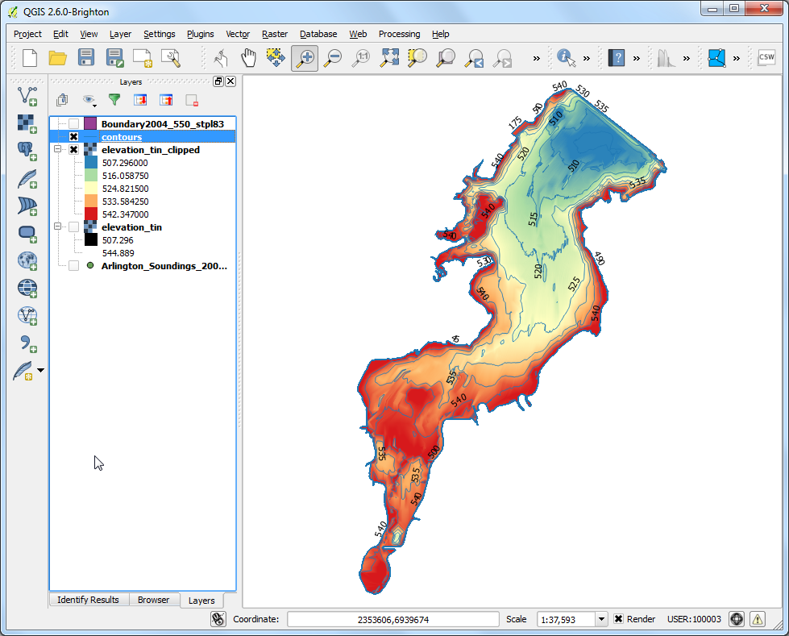
Demonstration in QGIS
IDW Interpolation (toolbox)
Notes:
Source: https://www.qgistutorials.com/en/docs/interpolating_point_data.html#:~:text=English-,Interpolating%20Point%20Data,take%20measurements%20throughout%20the%20surface.

Slide 15
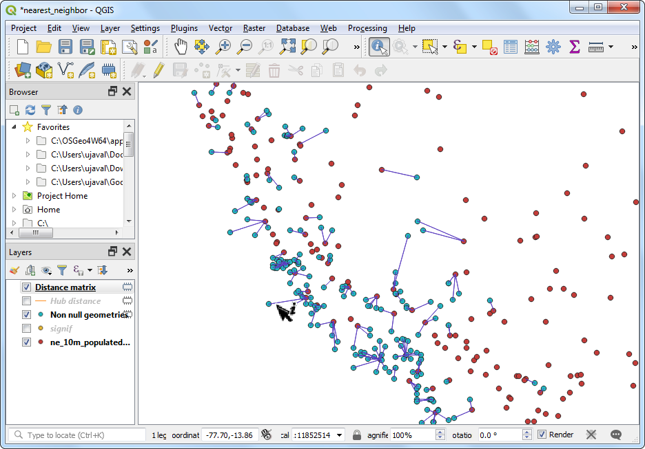
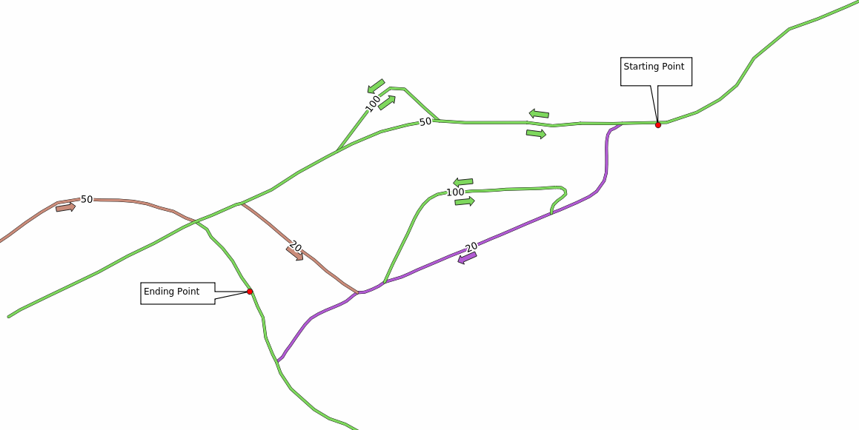
Next class… You gotta choose…
Nearest Neighbor Analysis
OR
Network Analysis
OR any topics you want to cover
Notes:
Nearest Neighbor: https://www.qgistutorials.com/en/docs/3/nearest_neighbor_analysis.html
Network Analysis: https://docs.qgis.org/3.4/en/docs/training_manual/vector_analysis/network_analysis.html

Slide 16
Questions?

Slide 17
2. Tutorial
Download a set of point data for interpolation according to your interest (e.g. weather station data, elevation data)
Make a raster output

