Slide 1
GIS Lesson 3
Introduction to Spatial Databases and Analysis Methods
空間數據庫和分析方法簡介
2020/5/20

Slide 2
Agenda
1. Introduction to Spatial Databases 空間數據庫簡介
A. What is a Spatial Database? 甚麼是空間數據庫？
Definitions 定義
Data Types 數據的種類
B. Simple Operations of a Spatial Database 空間數據庫的基本操作
Query (Select attributes, Boolean algebra) 查詢
Table joins 表格聯接
2. Spatial Analysis Methods 空間數據分析方法
A. Buffering 緩衝
B. Dissolve 溶解
3. Tutorial 個別指導
A. Create a spatial database (Waterloo Region ION network, provided with data, create a new folder database with shapefiles) 創建一個關於Waterloo 輕軌的空間數據庫
B. Perform Buffer and Dissolve operations on ION routes 設立緩衝區和溶解它們

Slide 3
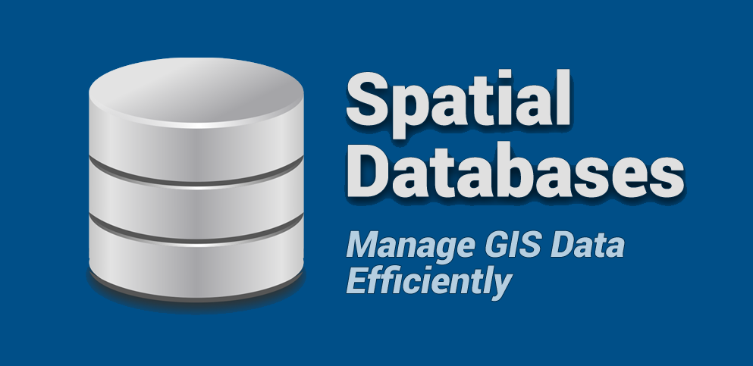
1. Introduction to Spatial Databases
空間數據庫簡介
Notes:
Source: https://gisgeography.com/spatial-databases/

Slide 4
A. What is a database? 數據(資料庫)是甚麼？
“A database is a collection of related information that permits the entry, storage, input, output and organization of data” (GIS Geography, 2020)
Collection of related information: 一組有相關性的資料
Permits entry (of data): 容許輸入資料
Permits storage (of data): 容許儲存資料
Permits output (of data): 容許輸出資料
Permits organization (of data): 容許組織資料
Input
輸入
Storage of related information
有相關性的資料儲存
Output
輸出

Slide 5
Chicago | Sun
18 | Circle
Lemon | Happy
True | Franky
Swimming Pool | Q9Tech
Fire | What is this?
Using the above table format, is the above table along with the content suitable for being imported into a database?
用以上表格的格式，你認為把以上表格和其資料放進資料庫是否合適？

Slide 6
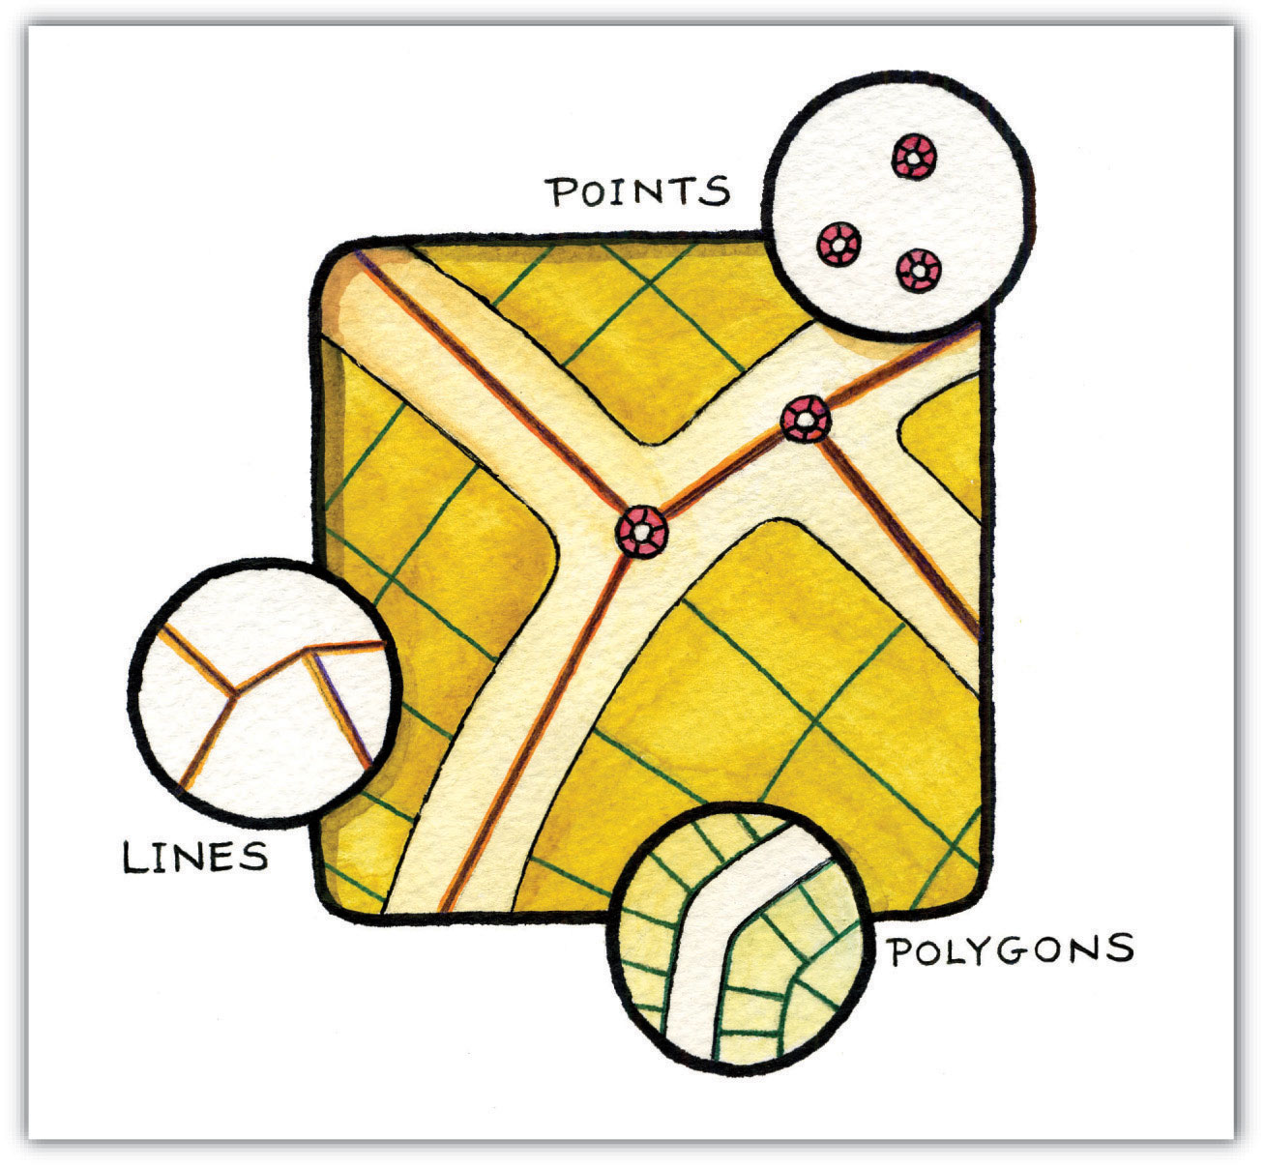
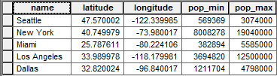
What is a spatial database then? 空間數據(資料庫)又是甚麼？
A database that includes location with geometry, such as points, lines and polygons.
Location: 地點資料
Geometry: 有幾何圖形資料
Points; 點
Lines; or 線
Polygons 多邊形
^ A sample table in a spatial database
Notes:
Sources:
https://saylordotorg.github.io/text_essentials-of-geographic-information-systems/s08-02-vector-data-models.html
https://gisgeography.com/spatial-databases/

Slide 7
Data Types in a database
Spatial (Locational) Data (空間資訊)
Coordinates (坐標), topology (spatial relationships)
Attribute (aspatial) Data (屬性資訊)– Variables, values, names

Slide 8
B. Simple Operations of a Spatial Database
空間數據庫的基本操作

Slide 9
Query（查詢）
Used to make requests to look for desired information in data (查詢合用的資料)
E.g. Find a book with a certain name in a library database, find a Canadian province with the greatest area
Need to use Boolean algebra and SQL to make a query (要運用布爾代數和SQL)
A sample query for this example above:
SELECT * FROM ResultsByRiding WHERE ENAME = “Labrador”;

Slide 10
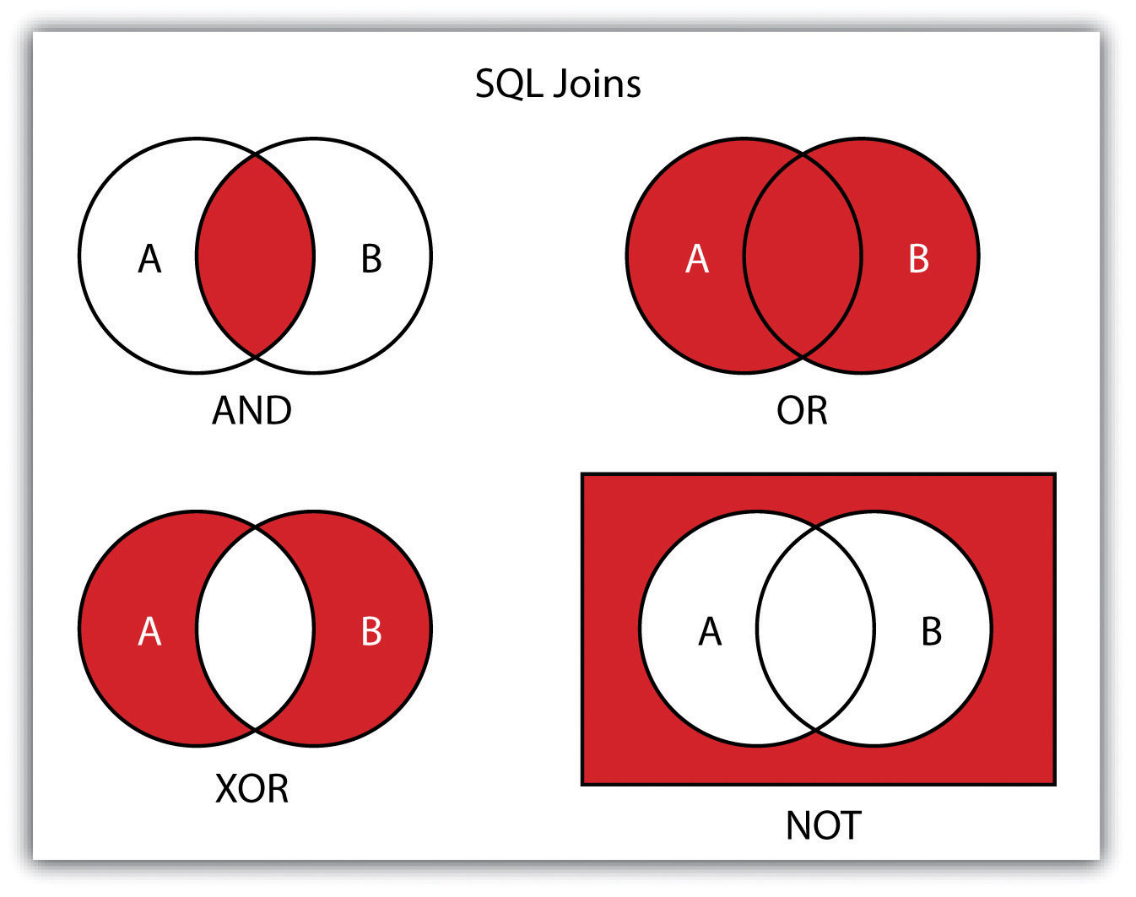
Boolean Algebra (布爾代數/ 邏輯代數)
A branch of algebra where the values of the variables are the truth values of true and false (是代數的一個分支，其變量的值僅為真和假兩種真值) (Wikipedia, 2020)
Examples
If A is true (T) and B is false (F),
** A AND B = T AND F = F
** A OR B = T OR F = T
A XOR B = T XOR F = T
NOT (A AND B) = NOT (F) = T
AND, OR are the most common operations in GIS
Notes:
Source:
https://saylordotorg.github.io/text_essentials-of-geographic-information-systems/s10-02-searches-and-queries.html
https://en.wikipedia.org/wiki/Boolean_algebra

Slide 11
AND All statements must be true in order to be true.
e.g. True AND True AND True => True
True AND True AND False => False

Slide 12
OR Only one true statement can make the whole statement to be true.
e.g. True OR False OR False => True
False OR False OR False => False

Slide 13
If A = True, B = False, C = True, what is (A OR B) AND (B AND C)?
A. True B. False

Slide 14
SQL (Structured Query Language) 結構化查詢語言
所有欄目 (all fields)
表格名稱 (Table name)
欄目名稱 (field name)
儲存數據 (Value)
SELECT * FROM ResultsByRiding WHERE ENAME = “Labrador”;
選擇
從
當
Additional Examples:
SELECT * FROM CanadaProvinces WHERE Population > 10000 AND Name LIKE ‘N%’;
SELECT * FROM WeatherStations WHERE Location = ‘New York City’ OR Location = ‘Toronto’;

Slide 15
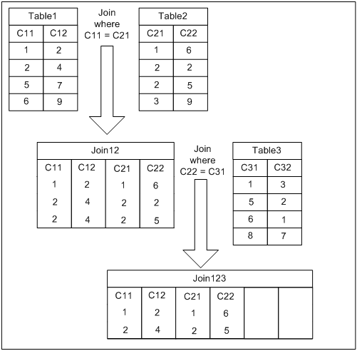
Table Joins (表格聯接)
Joining two related tables using a common key field (用一個共同的欄目將兩個表格聯接)
For the example on the right,
C11 and C21 store the related information (e.g. both store names of people in a class)
Table1 + Table2 => Join12
Join12 + Table3 => Join123
Notes:
Source: https://documentation.progress.com/output/ua/OpenEdge_latest/index.html#page/dvpin/joining-tables.html

Slide 16
2. Spatial Analysis Methods
空間數據分析方法

Slide 17
Buffering (緩衝)
Creation of new polygons at a specified distance around point, line, or polygon features (造一個圍繞點、線或多邊形一段特定距離的緩衝區)

Slide 18
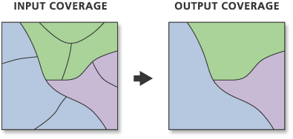
Dissolve (溶解)
Create a new coverage by merging adjacent polygons, lines or regions that have the same value for a specific item. (將鄰近、且有相同數值的多邊形、線或區域融合在一起)
Notes:
Source: https://desktop.arcgis.com/en/arcmap/10.3/tools/coverage-toolbox/dissolve.htm

Slide 19
Questions?

Slide 20
3. Tutorial
This tutorial will give you a sense of tasks at a sample government co-op job position.

Slide 21
Task 1: Create a Spatial Database
Scenario: You are working as a GIS Technician for the Region of Waterloo. Your supervisor asked you to create a spatial database for the ION LRT route in Waterloo. He gave you three layers, including ION routes, ION Stops and the Dissemination Area (DA) data for Kitchener-Waterloo. He wants you to find at least three more useful layers and put them into the same folder as the base for the spatial database.
Region of Waterloo Open Data Portal: https://rowopendata-rmw.opendata.arcgis.com/

Slide 22
Task 2: Table joins, Buffer and Dissolve for ION Stops and Routes
Scenario: Your supervisor now wants you to do the following:
Join the DA_2016_pop table with the DA layer (lda_000b16a_e).
Reproject the ION Stops and ION Routes layers to NAD 1983 UTM Zone 17N. (Hint: Use Reproject tool)
Create a 400-m buffer of ION Stops. (Hint: Use Buffer tool)
Create a 400-m buffer of ION Routes. (Hint: Use Buffer tool)
Dissolve the two buffers created above. (Hint: Use Dissolve tool)
Now make two maps:
1. A choropleth map showing the population distribution in Waterloo only.
2. A map showing the dissolved 400-m ION Stops buffer and the three layers you have added in Task 1.
Notes:
Reference: https://www.gislounge.com/working-with-tables-mastering-qgis/ (Table joins)

