Slide 1
GIS Lesson 7
Interesting Issues in GIS
有趣的地理資訊問題
2020/6/24

Slide 2
Agenda
1. Interesting Issues in GIS 有趣的地理資訊問題
B. Issues 問題
Ecological Fallacy 生態謬誤
C. Solutions 解決方法
2. Tutorial 個別指導
Use the two boundary shapefiles from last class.
How can we address the above issues? 我們如何解決上述問題？
Data Issues 數據問題
Compare and see what you observe.
Modifiable Areal Unite Problem (MAUP) 可修改的面積單位問題
A. Individual vs Aggregate Data 個別 vs 匯集的數據
Find and download a point shapefile (e.g. crime, park) that has data within York Region.

Slide 3
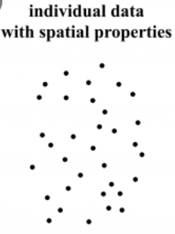
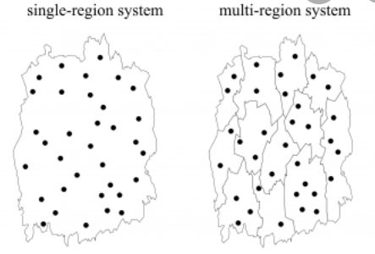
A. Individual vs Aggregate Data
https://flatten.ca/?lang=en#heatmap
What problems can you think of for using aggregate data instead of individual data?
Individual (個別)
Aggregate (匯集)
Single instances of data
e.g. individual points, lines, polygons
E.g. weather stations
Grouped instances of data, usually polygons that group and summarize smaller points, lines, polygons
e.g. census polygons containing population and income data of smaller neighborhoods, York Regional coronavirus count data
Notes:
Source: https://www.google.com/url?sa=i&url=https%3A%2F%2Fjournals.openedition.org%2Fcybergeo%2F2654%3Flang%3Den%26file%3D1&psig=AOvVaw1hIQOIRw_guVMB1bFHoSLt&ust=1593026826905000&source=images&cd=vfe&ved=0CAIQjRxqFwoTCLjX-8TVmOoCFQAAAAAdAAAAABAD

Slide 4
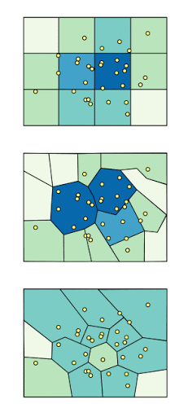
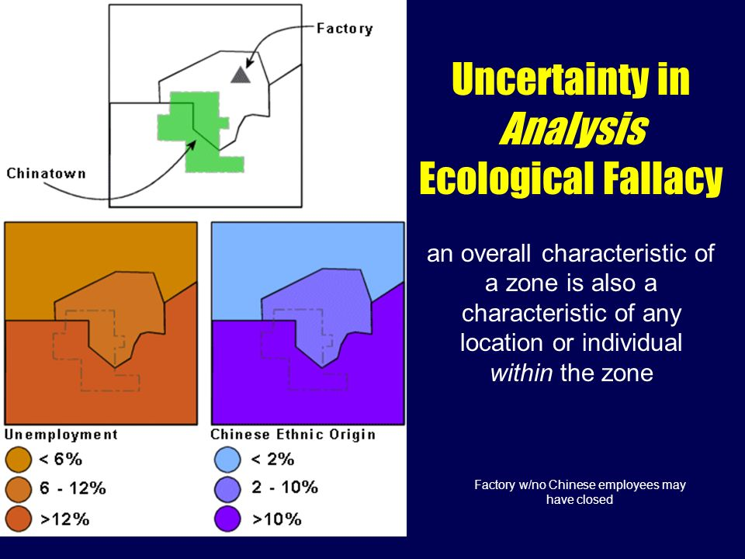
B. Issues 問題
Notes:
Sources:
https://www.google.com/url?sa=i&url=https%3A%2F%2Fslideplayer.com%2Fslide%2F9032056%2F&psig=AOvVaw32L0HJagF5m2WjtZYIBOet&ust=1593024760402000&source=images&cd=vfe&ved=0CAIQjRxqFwoTCKis7-rNmOoCFQAAAAAdAAAAABAP
https://www.google.com/url?sa=i&url=http%3A%2F%2Fgispopsci.org%2Fmaup%2F&psig=AOvVaw0_Wcv35AK-ceB9-orXqjPm&ust=1593024677499000&source=images&cd=vfe&ved=0CAIQjRxqFwoTCMj6sofOmOoCFQAAAAAdAAAAABAD

Slide 5

Video – Gerrymandering, explained (2:41)
https://www.youtube.com/watch?v=bGLRJ12uqmk
Notes:
https://www.youtube.com/watch?v=bGLRJ12uqmk

Slide 6
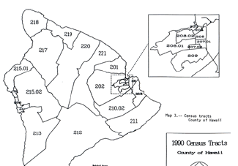
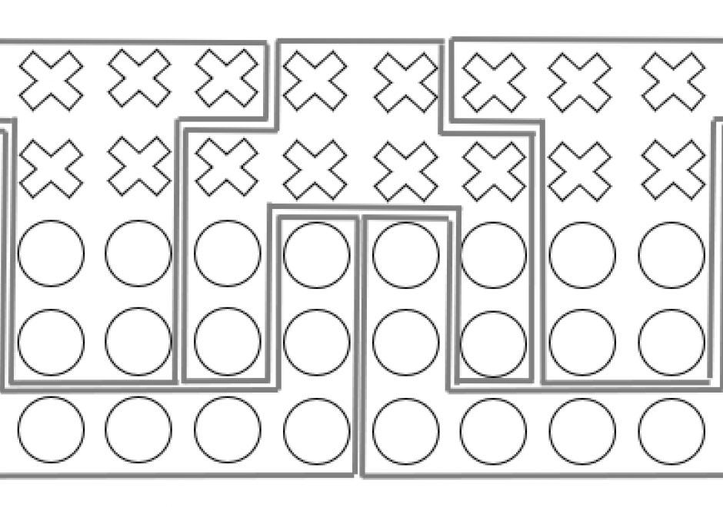
Modifiable Areal Unit Problem (MAUP) 可修改的面積單位問題
What: The sizes and boundaries of each zone can be assigned and changed arbitrarily (每個區域的大小和邊界可以隨意改變)
Why important: Results in one geographical unit CANNOT be applied to another geographical unit.
Three different problems
Zone effect: Similar size and number of units, but different boundaries
Scale effect: The size of each zone increases but the total number of zones decreases
Ecological Fallacy: discussed in further slide …
Notes:
it is difficult to analysis spatial or statistical patterns when measurements are being aggregated over arbitrarily defined areas like states

Slide 7
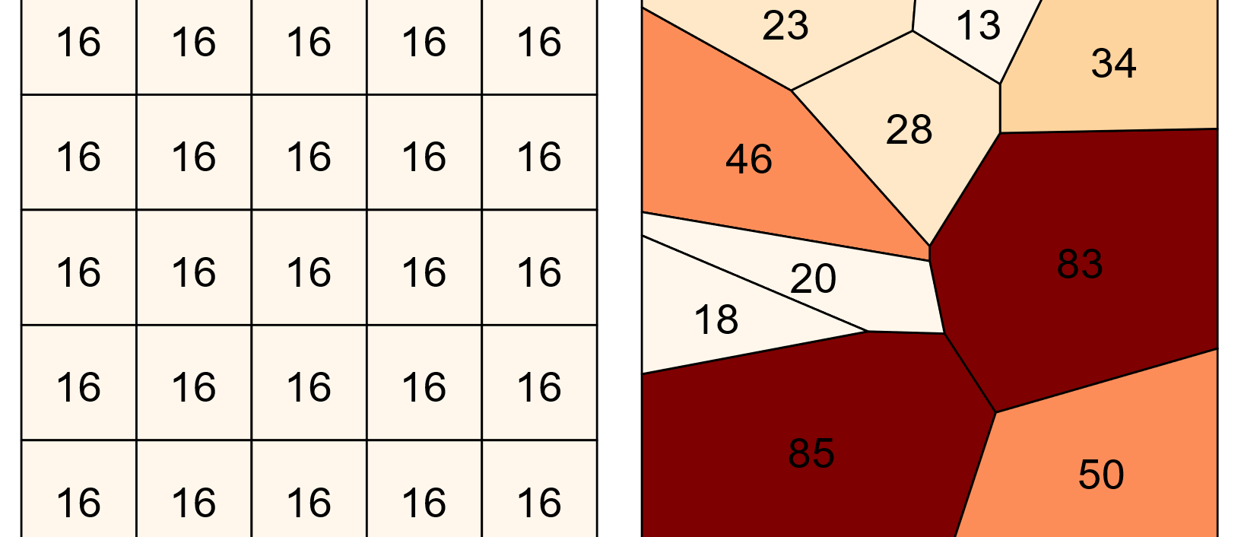
Assuming the two squares above show the same study area but different subdivisions, what do you think is the problem when creating a choropleth map?
Quick Check…
以上的兩幅圖展示出同一個地區但不同的小區。你覺得在製作地區分佈圖時會有什麼問題？

Slide 8
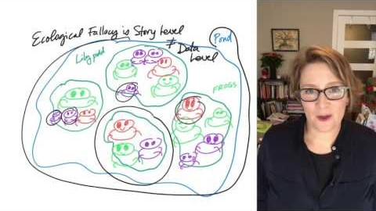
Video – Short Intro to Ecological Fallacy (2:57)
https://www.youtube.com/watch?v=RxfIXdIcpYM
Notes:
https://www.youtube.com/watch?v=RxfIXdIcpYM

Slide 9
Ecological Fallacy 生態謬誤
What: an assumption that an overall characteristic of a zone is also a characteristic of any location or individual within the zone (假設一個區域的特質等於區域內任何一處的特質)
There could be a lot of possible regrouping methods for a set of individually measured data

Slide 10

Data Issues
Multiple data sources
Government
Private companies
Data format issue
E.g. having space in a field name -> cannot be used in ArcGIS
Privacy
Data may contain sensitive personal information
Notes:
Source:
https://www.cpomagazine.com/wp-content/uploads/2020/01/big-data-brings-challenges-beyond-the-capabilities-of-traditional-siems_1500.jpg
GP 281 Lecture 9 Slide 15

Slide 11

B. Solutions 解決方法
Notes:
Source: https://www.google.com/url?sa=i&url=https%3A%2F%2Fgistbok.ucgis.org%2Ftopic-keywords%2Fspatial-data-quality&psig=AOvVaw16LBdt6dZXkctXC3680HFs&ust=1592336889668000&source=images&cd=vfe&ved=0CAIQjRxqFwoTCJDXk6nLhOoCFQAAAAAdAAAAABAD

Slide 12
MAUP
Use software to find the right spatial scale for evaluation, without a lot of aggregation, while protecting individual sensitive information
When representing counts, use a ratio to the total area or total population of each zone
E.g. For COVID-19 cases, you can express the number of confirmed cases over the total population in each zone
https://www.toronto.ca/home/covid-19/covid-19-latest-city-of-toronto-news/covid-19-status-of-cases-in-toronto/

Slide 13
Ecological Fallacy
Be careful when interpreting the spatial data results, make sure you understand that the zonal (aggregate) data does not represent individual data.
Notice the size and number of geographical units when comparing different results of the same area.

Slide 14
Data Issues
Multiple data sources: Make sure you check the data sources and see if the data are credible/trustworthy (e.g. see if the data has metadata associated with it, any missing or incorrect data)
Data format issues: You may have to open the data in Excel and change the data formats to GIS-friendly formats before use (either by programming or manually).
Privacy: Make sure you hide all sensitive information. You can:
Hide the sensitive info with asterisks (*)
Shorten/Trim the information by using abbreviations (簡稱)
Use aggregated data instead of individual data.

Slide 15
Questions?

Slide 16
2. Tutorial
It’s your turn!
Use the two boundary shapefiles from last class.
Find and download a point shapefile (e.g. crime, park) that has data within York Region.
Compare and see what you observe.

