Slide 1
GIS Lesson 8
Vector Creation and Geocoding
向量圖形製作及坐標化
2020/7/1

Slide 2
Agenda
1. Today’s Class 今日課堂
2. Tutorial 個別指導
A. Vector Creation 向量圖形製作
B. Geocoding 坐標化
Review 重溫 (Vector shapes, Attribute table)
Digitizing 數碼化
What is Geocoding? 什麼是坐標化?
Address Format 地址格式
Steps for Geocoding 坐標化步驟
You should have these fields in the attribute table at the minimum:
Facility name
Address
City
Choose a fast food restaurant chain in York Region and digitize 3 locations (Point features). Enter 10 other locations of the restaurant chain into a spreadsheet, save as CSV, and geocode the locations.
Steps for Vector Creation 向量圖形製作步驟
Demonstration in QGIS 示範
Choose a neighborhood in York Region with public facilities, e.g. libraries, police stations, fire stations and hospitals, choose an appropriate basemap and digitize AT LEAST TWO TYPES of facilities. (Polygon features)
Choose a segment of a major road in York Region to digitize it. (Line features)

Slide 3
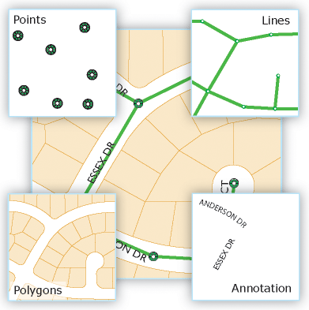
A. Vector Creation
向量圖形製作

Slide 4
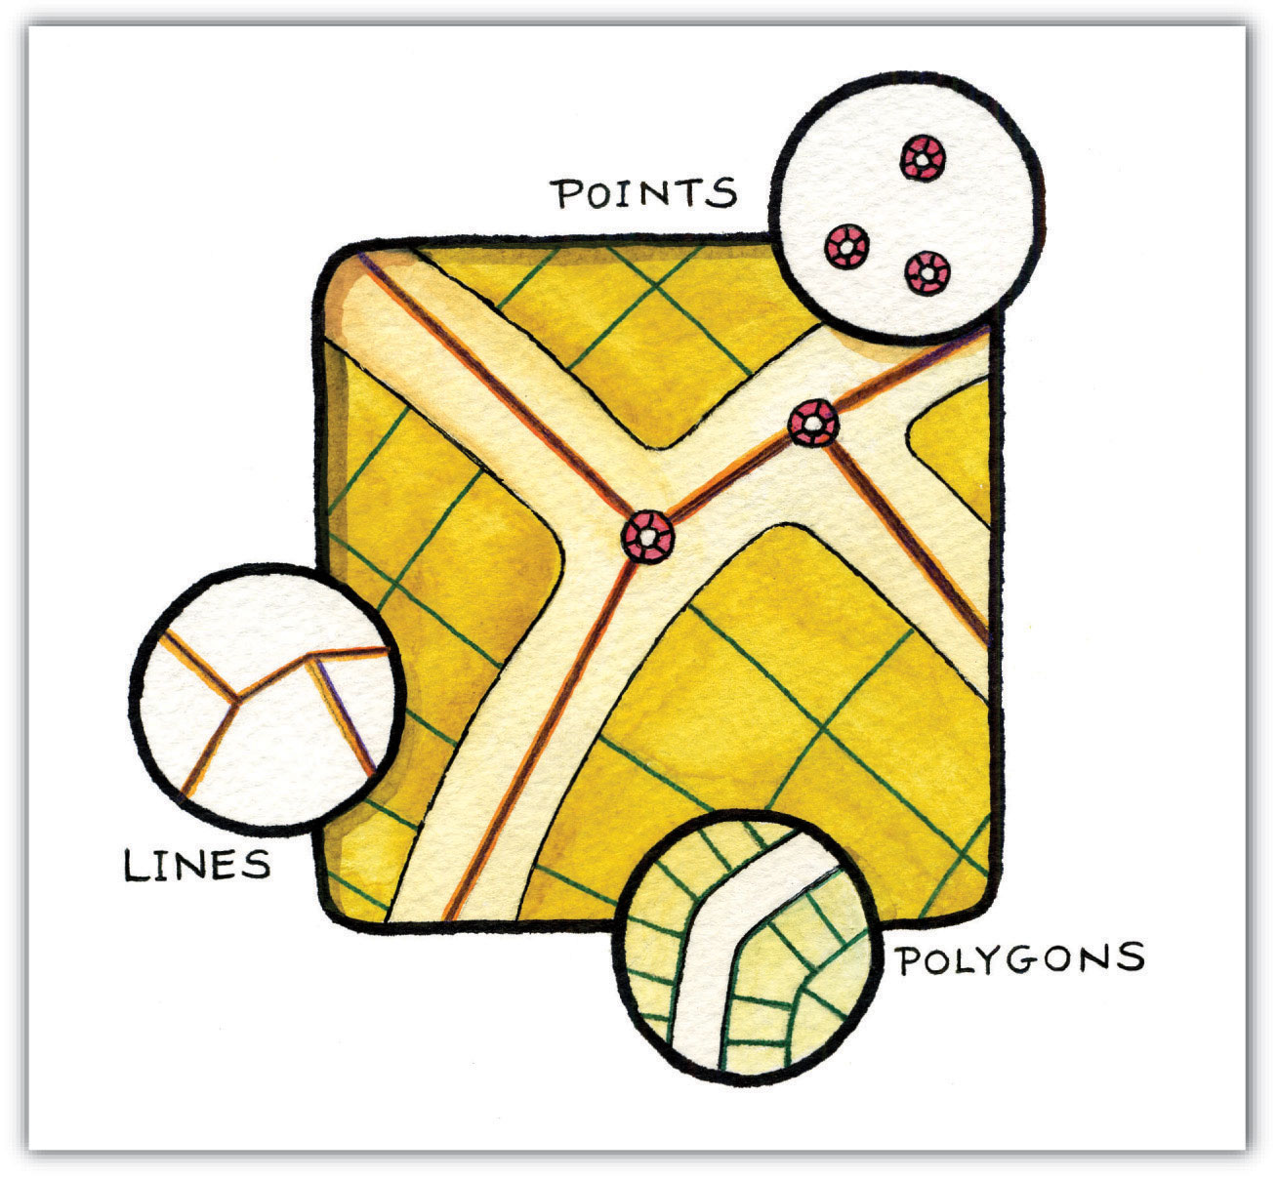
Review… Vector Data
Points (點) (0-D)
Single vertex for each point (每一點只有一個頂點)
Key attribute: coordinates (x,y)
Lines (線) (1-D)
Multiple vertices (多個頂點)
Open, not enclosed (不封閉的)
Key attributes
Length (長度)
Coordinates of each vertex point (每個頂點的坐標)
Polygons (多邊形) (2-D)
Multiple vertices (多個頂點)
Enclosed, not open (封閉的)
Key attributes
Area (面積)
Length (長度) * Width (闊度)

Slide 5
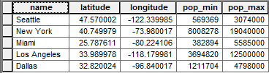
Review… Attribute Table
Field/Attribute
(Column)
Row/Record
Key points:
Each attribute/field has only ONE data type (每個屬性只有一種數據種類)
Every attribute table has a primary key field to uniquely identify each row of data (Values in the primary key field cannot be repeated)
每一個屬性表有一個主鍵，用作獨特地識別每一行的數據。
主鍵的數據值不能夠重複

Slide 6
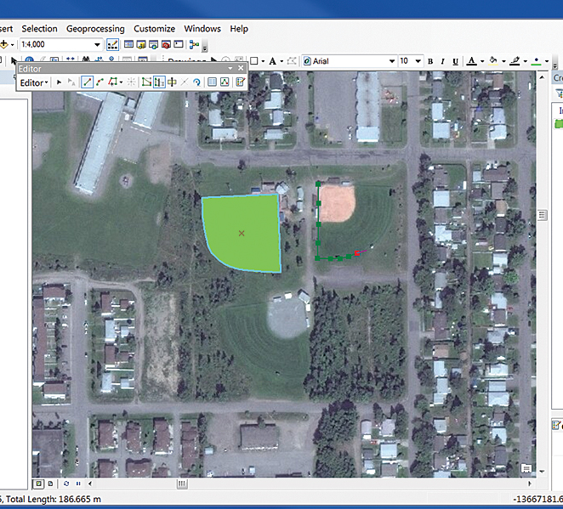
Digitizing (數碼化)
Definition: The process by which coordinates from a map, image, or other sources of data are converted into a digital format in GIS.
For example:
Drawing points to represent Home Depot locations in York Region
Drawing lines to represent rivers in a neighborhood
Drawing a polygon to represent park washrooms on a satellite image.
Notes:
Source: https://www.esri.com/about/newsroom/arcuser/use-arcgis-online-imagery-to-digitize-analyze-contribute/

Slide 7
Steps for Vector Creation 向量圖形製作步驟
Determine the vector data type based on the object type (決定要製作的向量圖形的種類): points, lines or polygons.
Determine the attributes (fields) to be included. (決定要包括的屬性)
Create a new shapefile using the Create Layer > New Shapefile Layer tool in QGIS. (用QGIS的製作新圖層工具) Specify output location.
Verify the coordinate system to check if it is appropriate. (檢查坐標系統)
Start toggle editing and add new vector features. (開始編輯新的向量圖形)
Save all the edits after editing the features. (儲存所有編輯)

Slide 8
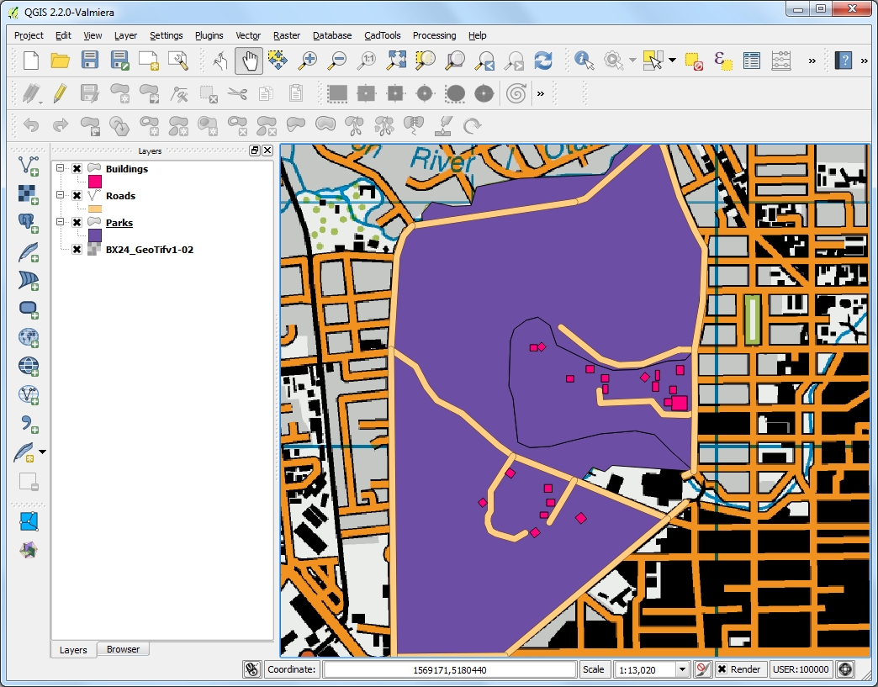
Demonstration in QGIS (Digitizing)
Notes:
Source: https://www.qgistutorials.com/en/docs/digitizing_basics.html

Slide 9
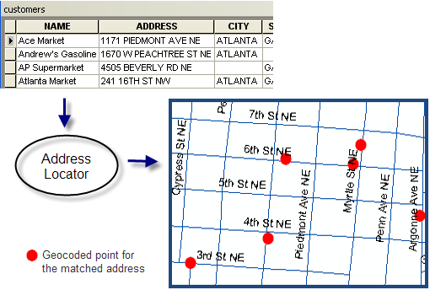
B. Geocoding 坐標化
Notes:
Source: https://desktop.arcgis.com/en/arcmap/10.3/guide-books/geocoding/geocoding-a-table-of-addresses-about.htm

Slide 10
What is Geocoding? 什麼是坐標化？
Definition: The process of changing a description of a location, such as a pair of coordinates, an address, or a name of a place, to a location on a map (將關於一個地點的描述，例如坐標、地址或地名，轉換成一個在地圖上的地點).
1
Information about the locations
(saved in CSV)
2
Use an address locator (地址定位工具) to determine the coordinates of the points
3
Locations with matched results will be displayed on a map.

Slide 11
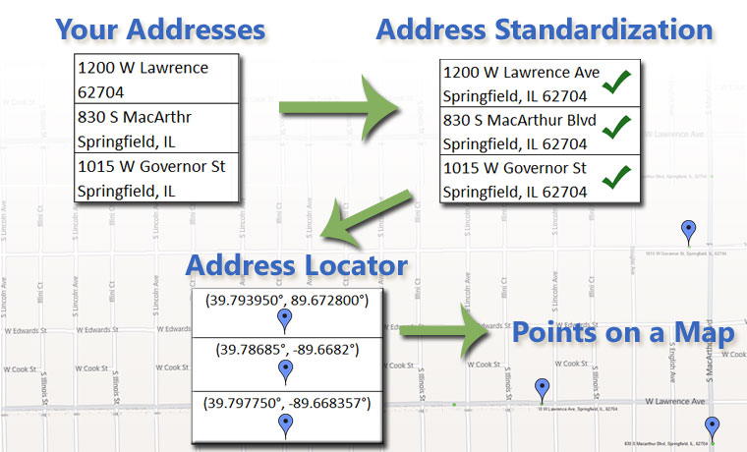
Address Format (地址格式)
Key components:
Street Address, City, Province/State
Notes:
Source: https://www.geospatialworld.net/blogs/what-is-geocoding-and-how-can-it-help-sell-products/

Slide 12
Steps for Geocoding 坐標化步驟
Create a table in Excel, and store information about the locations you want to map (name, address, city, province/state)
Make sure the addresses are in the standardized format.
Save the Excel file as a CSV (not Excel workbook!!).
Open QGIS and install the MMQGIS Plugin.
After installing, you should see a ‘MMQGIS’ tab right next to the ‘Processing’ tab in the top toolbar.
Click MMQGIS > Geocode > Geocode with OpenStreetMap.
In the pop-up window, choose the CSV file you saved and choose the address, city, and state fields. The country field can be left blank. Also choose the output location of the shapefile produced.

Slide 13
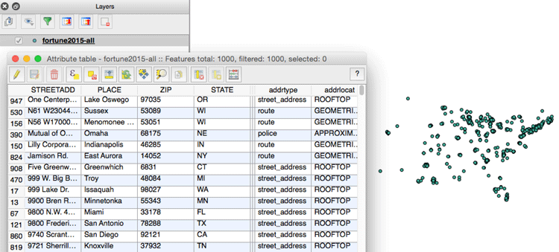
Demonstration in QGIS (Geocoding)
Notes:
Source: https://www.gislounge.com/how-to-geocode-addresses-using-qgis/

Slide 14
Questions?

Slide 15
2. Tutorial
Choose a fast food restaurant chain in York Region and digitize 3 locations (Point features). Enter 10 other locations of the restaurant chain into a spreadsheet, save as CSV, and geocode the locations.
Choose a segment of a major road in York Region to digitize it. (Line features)
Choose a neighborhood in York Region with public facilities, e.g. libraries, police stations, fire stations and hospitals, choose an appropriate basemap and digitize AT LEAST TWO TYPES of facilities. (Polygon features)
You should have these fields in the attribute table at the minimum:
Facility name
Address
City

