Slide 1
GIS Lesson 8
Spatial Analysis (1)
空間分析 (1)
2020/7/8

Slide 2
Agenda
1. Today’s Class 今日課堂
2. Tutorial 個別指導
Hotspot Analysis 熱點分析
Point Pattern 點陣
Hotspots and Coldspots 熱點和冷點
Try downloading Toronto city data to find the hotspots and Coldspots of at least two different event types in Toronto
Demonstration in QGIS 示範
Tobler’s First Law of Geography 托伯勒的地理第一定律
What is Hotspot Analysis? 什麼是熱點分析?
My GEOG 481 Project work
http://map.toronto.ca/wellbeing/
Hotspot Maps vs Heat Maps 熱點圖 vs 熱圖
Applications of Hotspot Analysis 熱點分析應用
Make a crime hotspot map for the City of Toronto

Slide 3
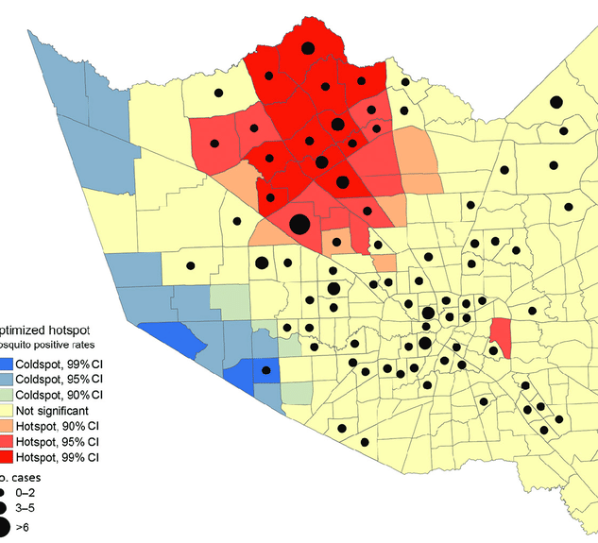
Hotspot Analysis
熱點分析
Notes:
Source: https://www.researchgate.net/figure/Optimized-hotspot-analysis-results-showing-residential-locations-of-persons-who-had-West_fig1_316940945

Slide 4

Coronavirus Hot Spots in the USA Video (2:46) (2020/6/15)

Slide 5

Everything is related to everything else. But near things are more related than distant things. (1969)
Tobler’s First Law of Geography
托伯勒的地理第一定律
Notes:
Source: https://www.urisa.org/clientuploads/directory/Documents/Awards/Waldo_Tobler.jpg

Slide 6

Point Pattern 點陣
Each point represents an event in a study area, such as a crime/coronavirus case
Each point (event) has coordinates (x,y)
Patterns of events with additional information are called marked point patterns

Slide 7
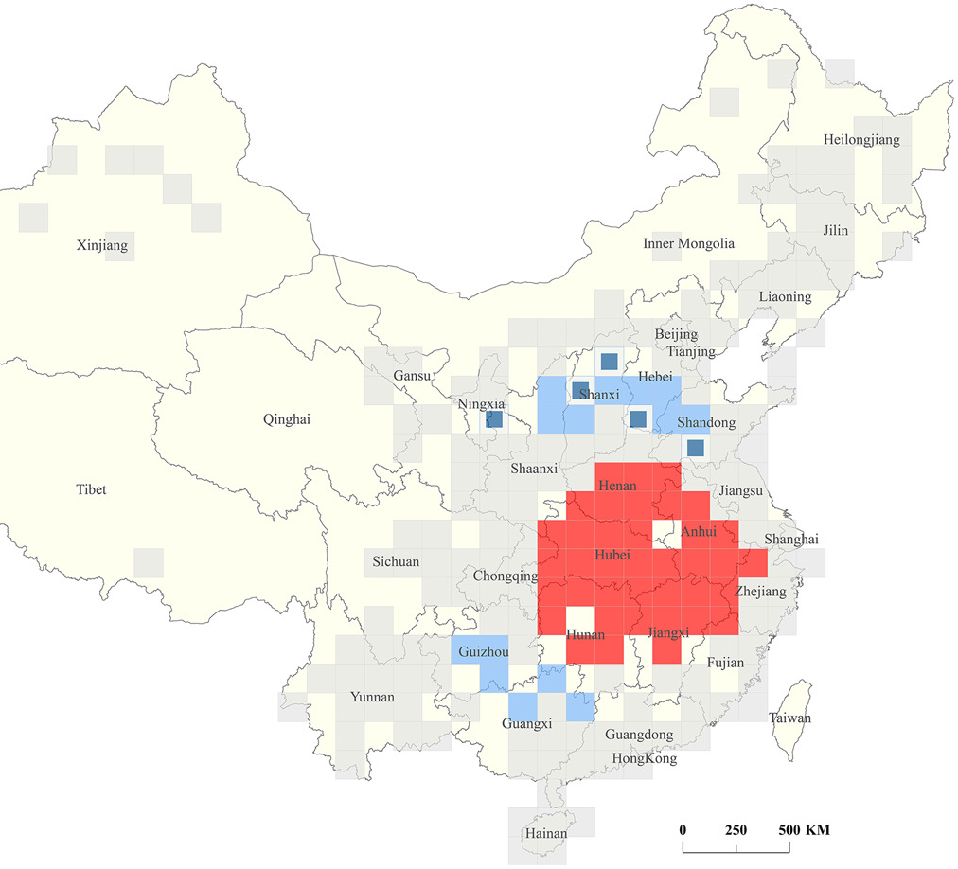
What is Hotspot Analysis? 什麼是熱點分析?
Definition: an analysis method used to identify locations of statistically significant hotspots by aggregating points of occurrence into polygons. (將發生點聚集到多邊形中來識別具有統計意義的熱點位置的分析方法)
Then, what is the meaning of statistically significant?
Having a low p-value: very unlikely (small probability) that the observed pattern is the result of random processes (很少機會那觀察到的規律是源自一個隨機的流程)
Notes:
Source: https://onlinelibrary.wiley.com/cms/asset/07ee0c84-4125-45fb-8ea9-3719ea96c479/jmv25834-fig-0007-m.jpg

Slide 8
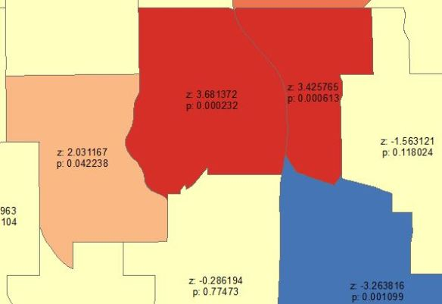
Hotspots and Coldspots 熱點和冷點
Hotspots 熱點
Concentration of high values (數據值高的點聚集地)
High positive z-score: the observed data points are having values that are higher than the mean average.
Low p-value
Coldspots 冷點
Concentration of low values (數據值低的點聚集地)
Low Negative z-score: the observed data points are having values that are lower than the mean average.
Low p-value

Slide 9
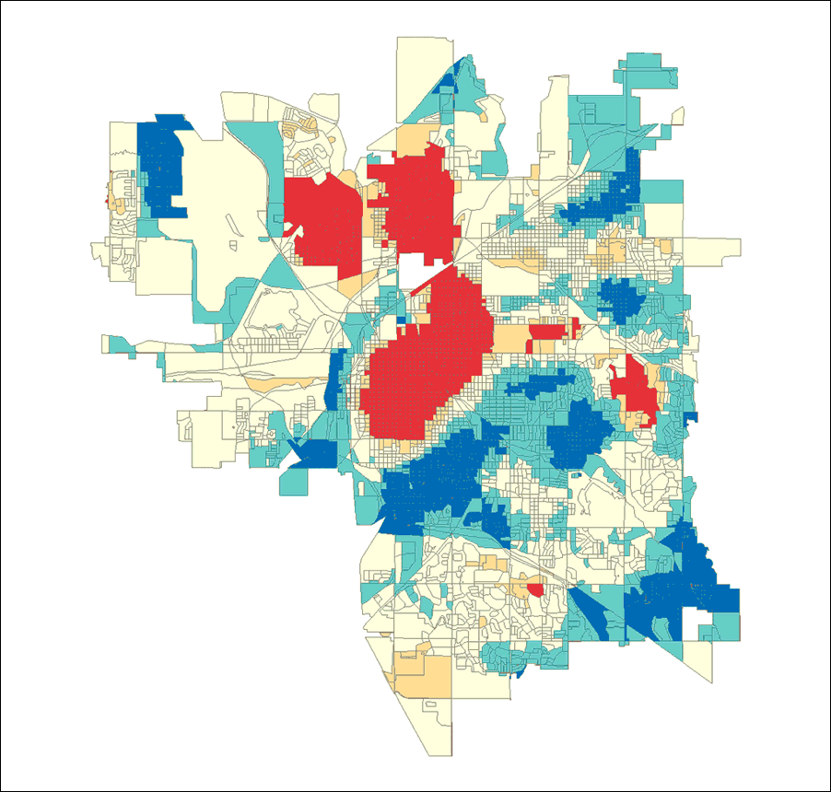
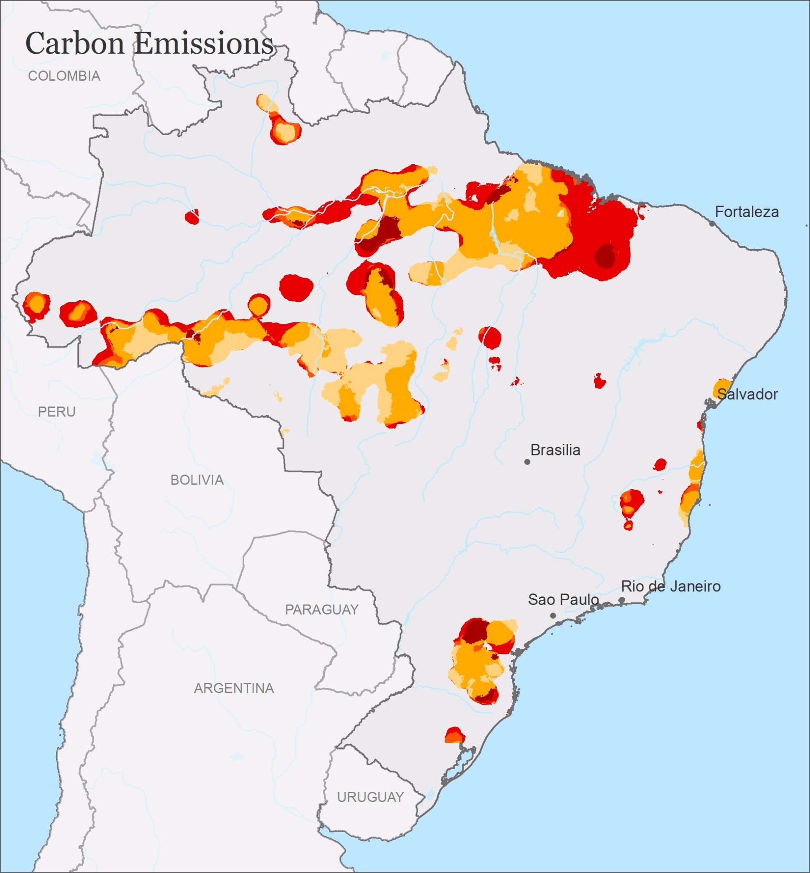
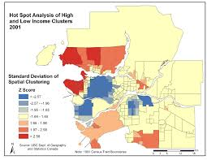
Applications of Hotspot Analysis 熱點分析應用
Risk Mapping (e.g. wildfire, floods)
Crime Analysis (e.g. crime hotspots)
Environmental Conservation (e.g. forest loss, pollutant hotspots)
Marketing for Social Welfare (e.g. income, education, lifestyle)
Notes:
https://support.pitneybowes.com/VFP05_KnowledgeWithSidebarHowTo?id=kA180000000XdloCAC&popup=false&lang=en_US

Slide 10
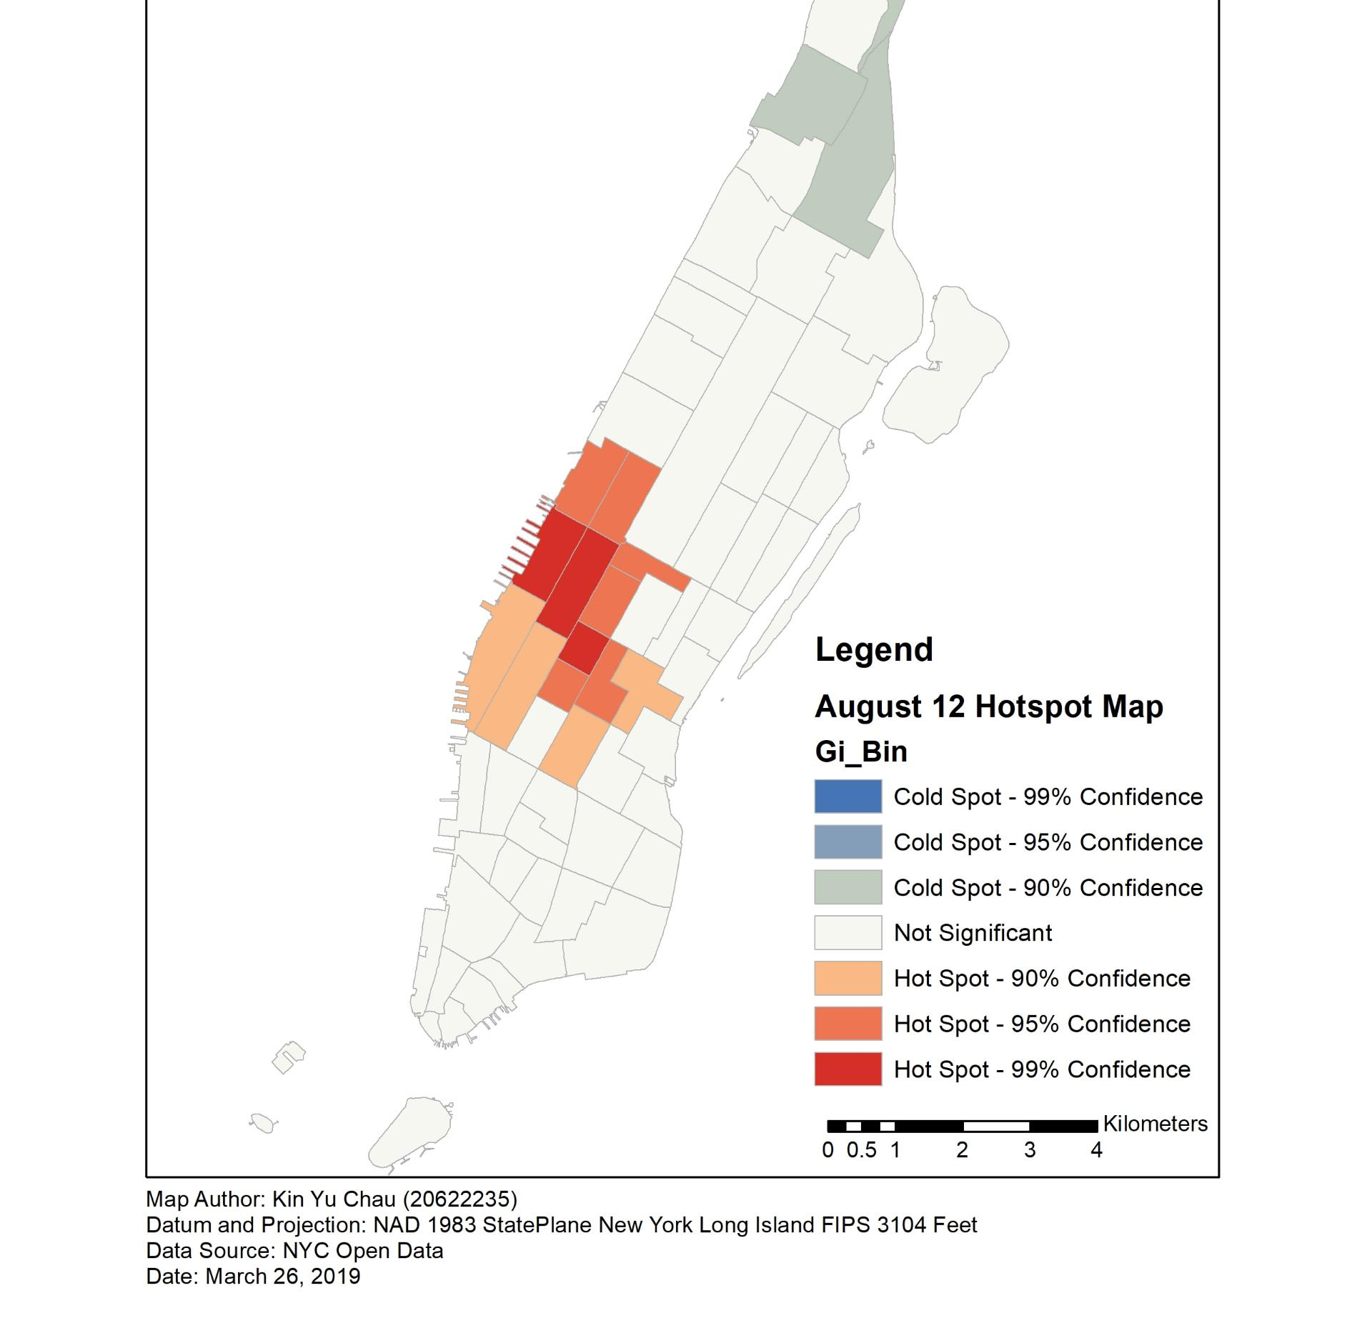
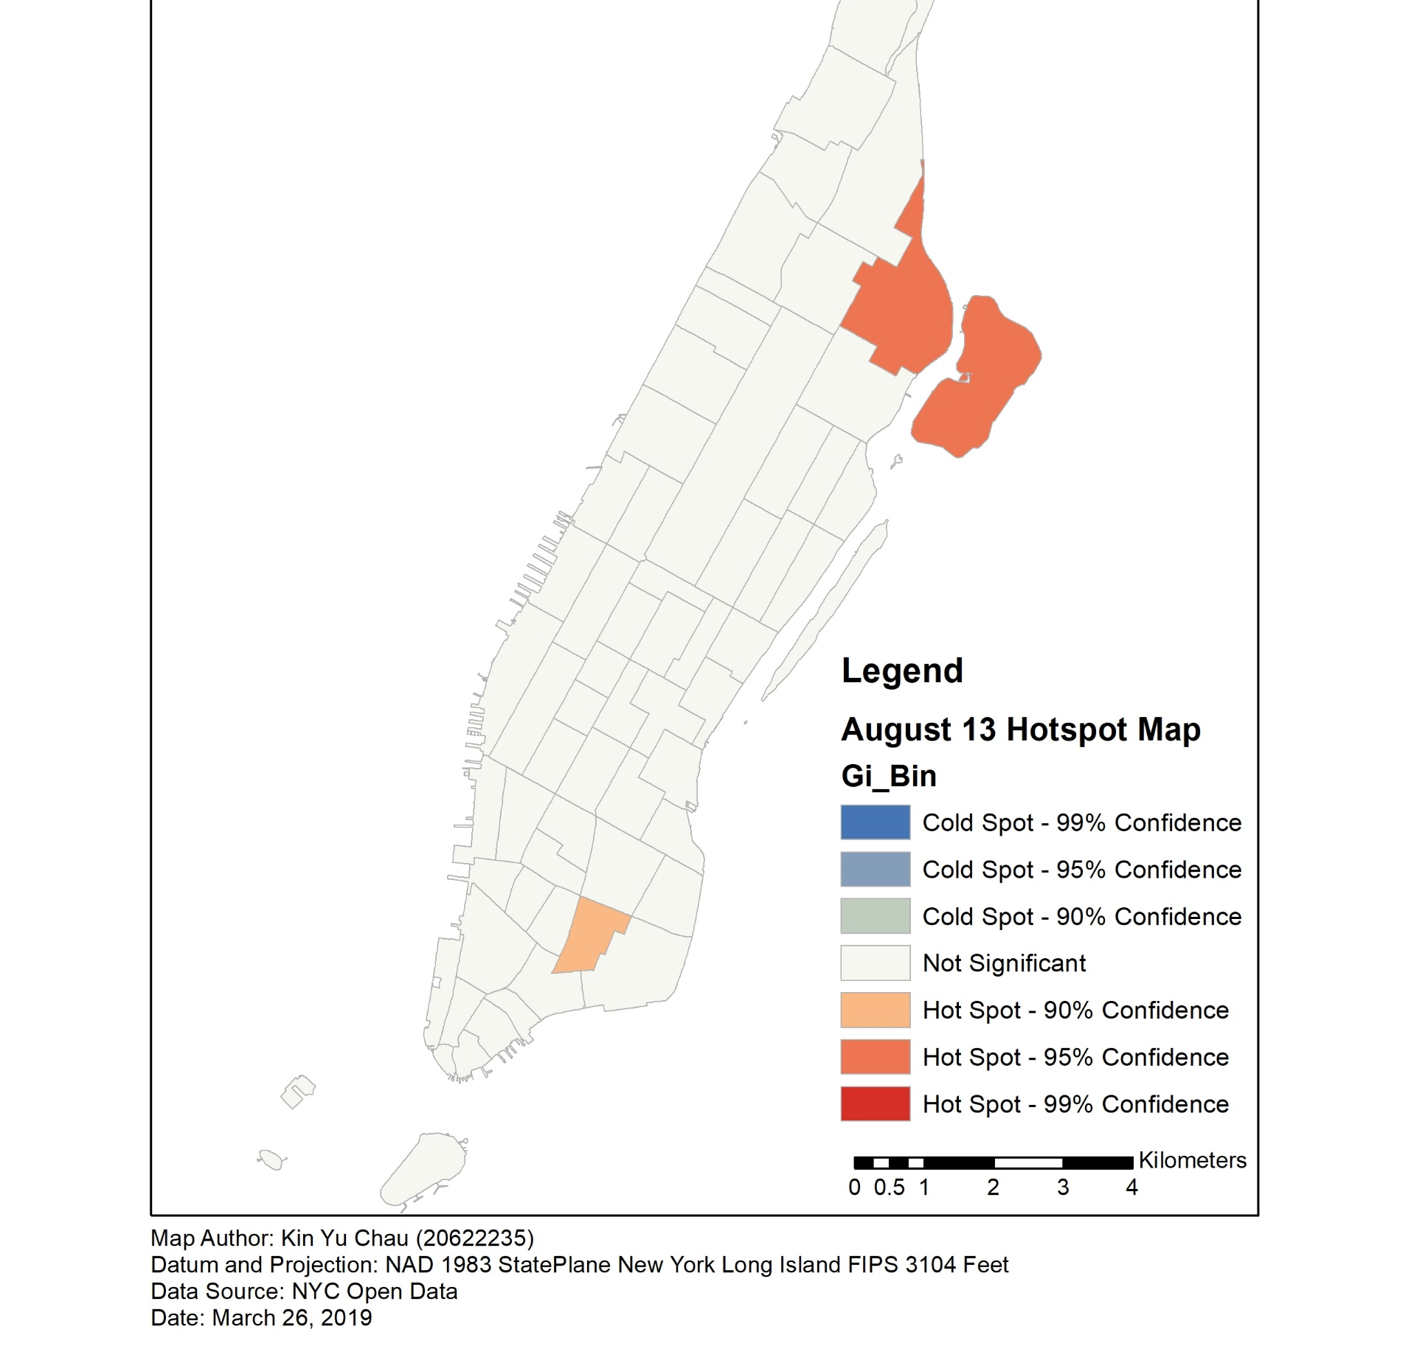
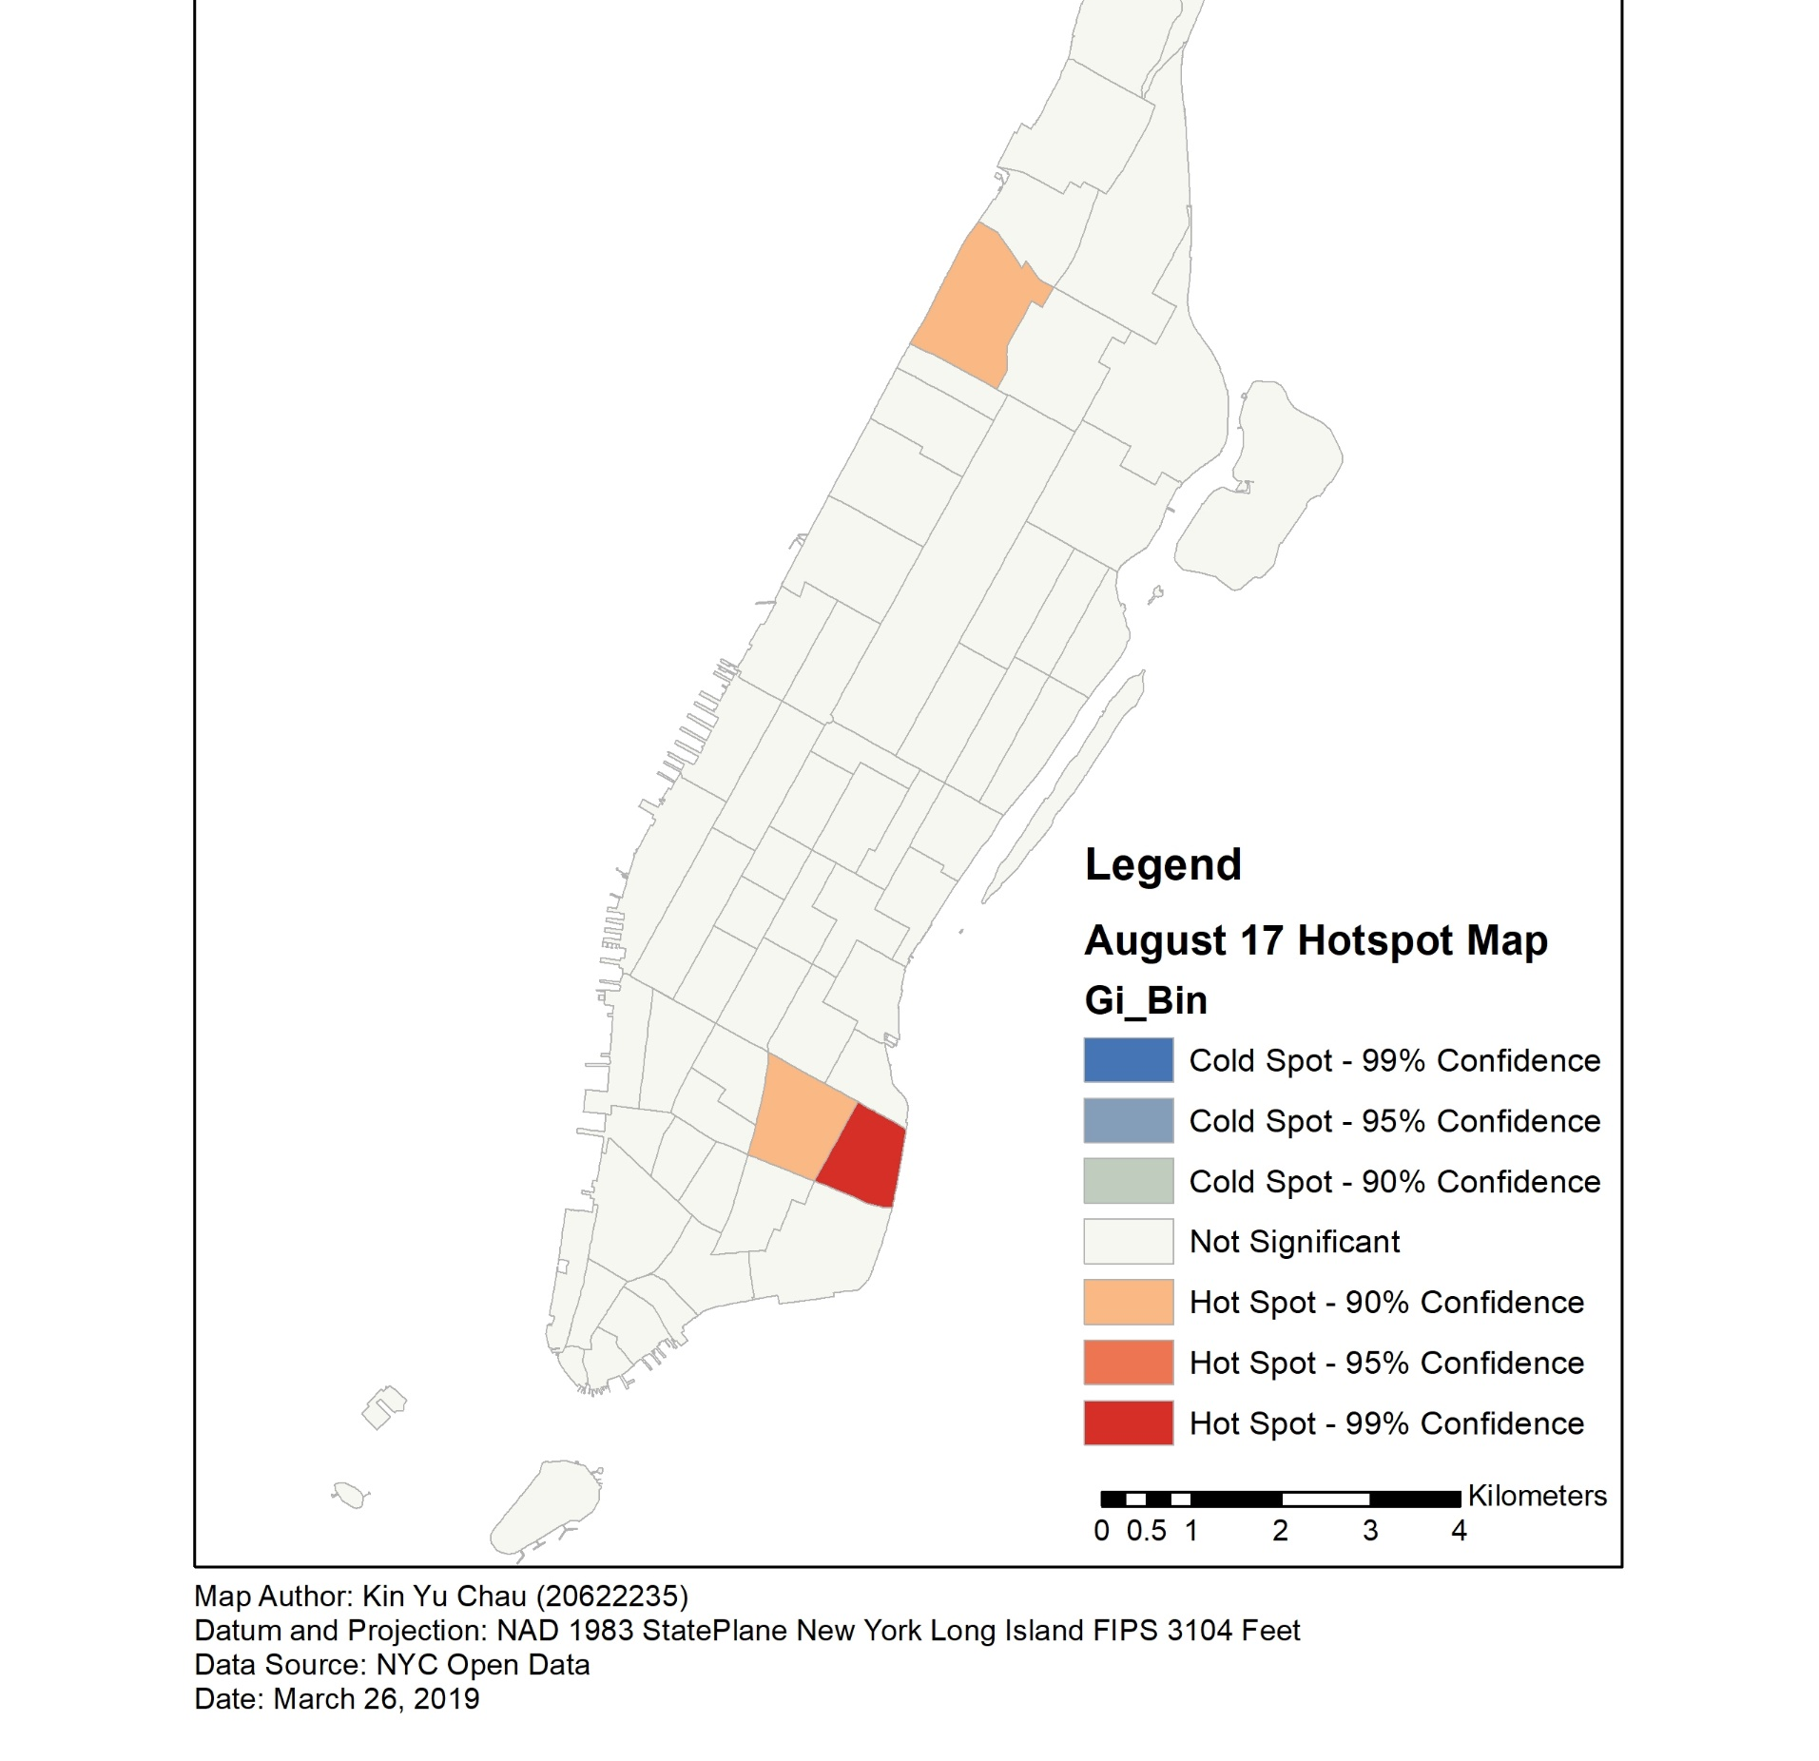
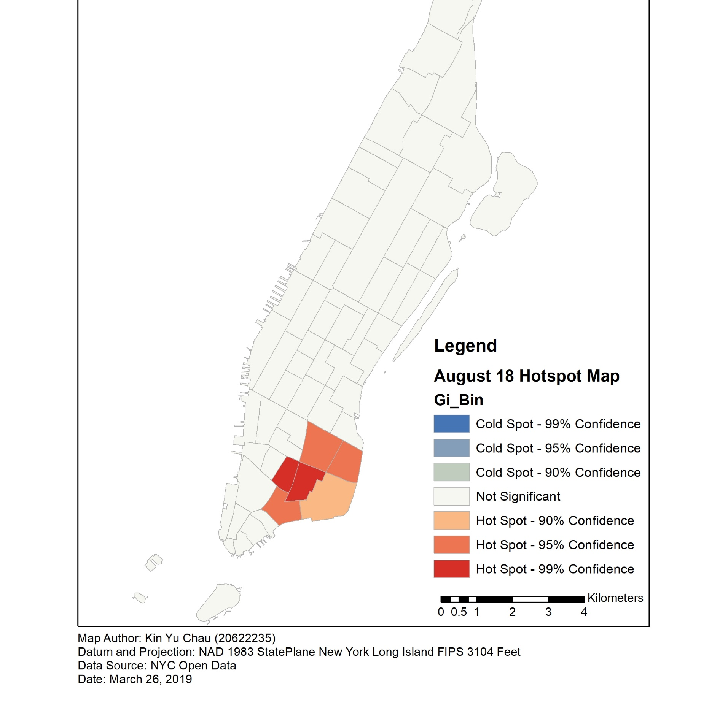
My GEOG 481 Project Work
Hotspot maps of the likelihood of finding a fare within 30 minutes in 4 days of August 2013
Weekend days were chosen

Slide 11
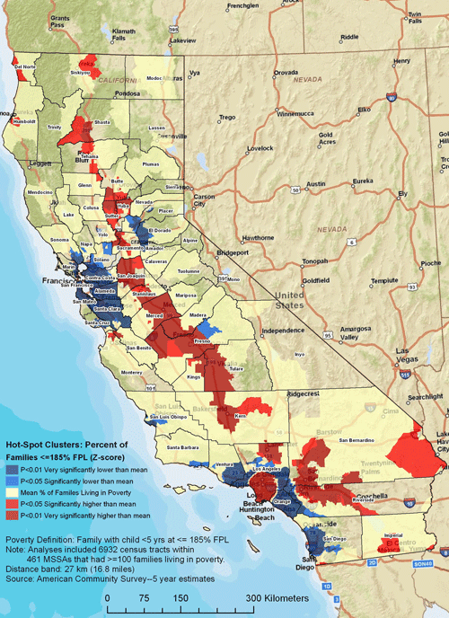
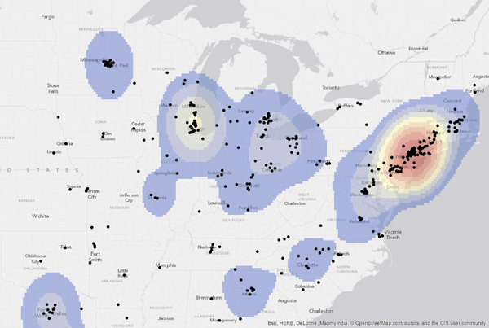
Hotspot Maps vs Heat Maps 熱點圖 vs 熱圖
Both are showing areas of high-density
Hotspot Maps
A vector representation of high-density activities (usually in terms of points/polygons)
Hotspot results are shown in the originally defined geographical units (such as counties, neighborhoods)
More objective – with statistical significance to show whether results are significant based on statistical tests
Heat Maps
A raster representation of high-density activities
An interpolated surface is created (areas with unknown values within the study area will be predicted and assigned values)
More subjective
Notes:
https://www.gislounge.com/difference-heat-map-hot-spot-map/

Slide 12
Example – Chicago Crime Maps
https://data.cityofchicago.org/Public-Safety/Gun-Crimes-Heat-Map/iinq-m3rg (Heat Map)
https://www.neighborhoodscout.com/il/chicago/crime (Choropleth Map)

Slide 13
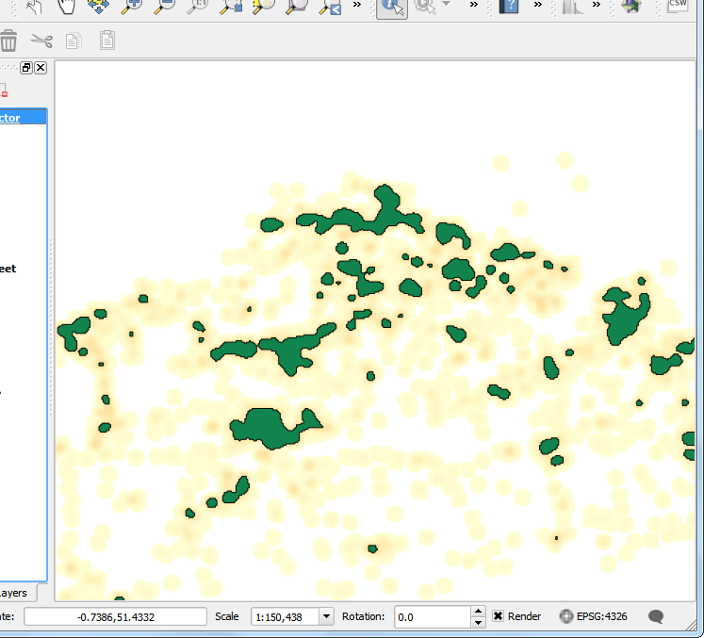
Demonstration in QGIS (Hotspot Analysis)
Notes:
https://github.com/danioxoli/HotSpotAnalysis_Plugin#:~:text=In%20All%20plugins%20tab%2C%20look,and%20in%20the%20Vector%20Menu.&text=Select%20the%20downloaded%20zip%20folder,list%20of%20the%20installed%20plugins.

Slide 14
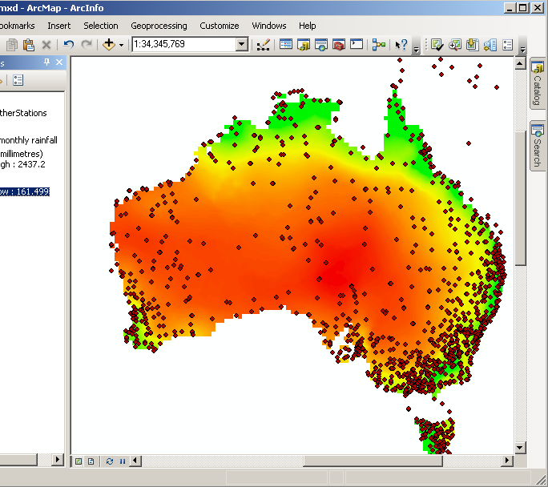
Next class…
We will talk about Interpolation methods (e.g. IDW, Kriging) in Spatial Analysis (2)
Stay tuned!
Notes:
https://i.stack.imgur.com/zu0gO.png

Slide 15
Questions?

Slide 16
2. Tutorial
Follow the instructions here to create heat maps:
https://www.qgistutorials.com/en/docs/3/creating_heatmaps.html
Make a crime hotspot map for the City of Toronto
MCI (Major Crime Index) data
- Try downloading Toronto city data to find the hotspots and Coldspots of at least two different event types in Toronto
http://map.toronto.ca/wellbeing/ (download two different datasets)
Join the two datasets with the neighborhood layer given to you

