Slide 1
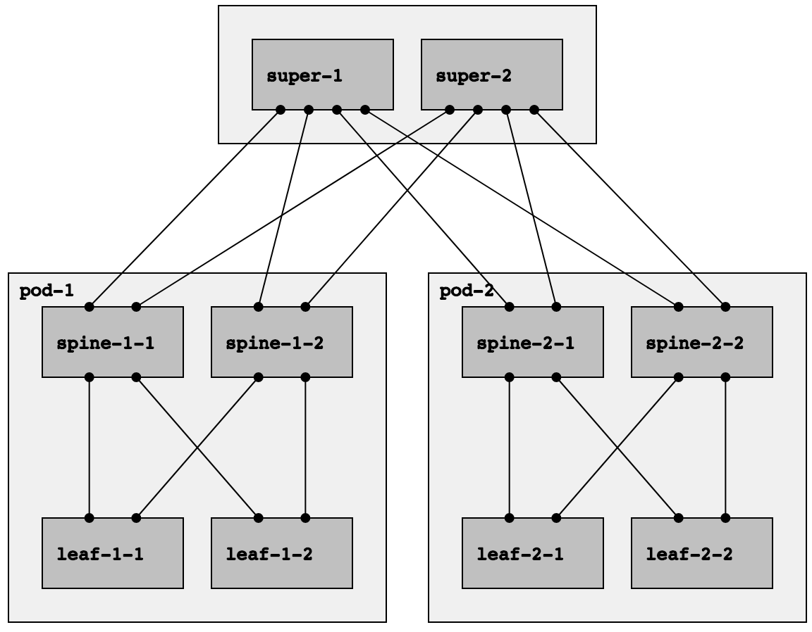
Super-1 route table
Destination | ECMP Next-hops
2.0.1.1/32 | spine-1-1
2.0.1.2/32 | spine-1-2
2.0.2.1/32 | spine-2-1
2.0.2.2/32 | spine-2-2
3.0.1.1/32 | spine-1-1, spine-1-2
3.0.1.2/32 | spine-1-1, spine-1-2
3.0.2.1/32 | spine-2-1, spine-2-2
3.0.2.2/32 | spine-2-1, spine-2-2
1.0.0.1/32
1.0.0.2/32
Spine-2-2- route table
2.0.1.1/32
2.0.1.2/32
2.0.2.1/32
2.0.2.2/32
Destination | ECMP Next-hops
0.0.0.0/0 | super-1, super-2
3.0.2.1/32 | leaf-2-1
3.0.2.2/32 | leaf-2-2
3.0.1.1/32
3.0.1.2/32
3.0.2.1/32
3.0.2.2/32
Leaf-2-2 route table
Destination | ECMP Next-hops
0.0.0.0/0 | spine-1-1, spine-1-2

Slide 2
spine-1
1.0.0.1/32
spine-2
1.0.0.2/32
spine-3
1.0.0.3/32
Default prefix: 0.0.0.0/0
leaf-1
2.0.0.1/32
leaf-2
2.0.0.2/32
leaf-3
2.0.0.3/32
Routing Information Base (RIB)
Forwarding Information Base (FIB)
Destination | ECMP Next-hops
0.0.0.0/0 | spine-1, spine-2, spine-3
Destination | ECMP Next-hops
0.0.0.0/0 | spine-1, spine-2, spine-3

Slide 3
spine-1
1.0.0.1/32
spine-2
1.0.0.2/32
spine-3
1.0.0.3/32
Default prefix: 0.0.0.0/0
Positive disaggregation prefix: 2.0.0.3/32
leaf-1
2.0.0.1/32
leaf-2
2.0.0.2/32
leaf-3
2.0.0.3/32
Routing Information Base (RIB)
Forwarding Information Base (FIB)
Destination | ECMP Next-hops
0.0.0.0/0 | spine-1, spine-2, spine-3
2.0.0.3/32 | spine-2, spine-3
Destination | ECMP Next-hops
0.0.0.0/0 | spine-1, spine-2, spine-3
2.0.0.3/32 | spine-2, spine-3

Slide 4
super-1
1.0.0.1/32
super-2
1.0.0.2/32
super-3
1.0.0.3/32
Positive disaggregation prefix TIE for prefix 2.0.1.3/32
pod-1
pod-2
spine-1-1
2.0.1.1/32
spine-1-2
2.0.1.2/32
spine-1-3
2.0.1.3/32
spine-2-1
2.0.2.1/32
spine-2-2
2.0.2.2/32
spine-2-3
2.0.2.3/32
leaf-1-1
3.0.1.1/32
leaf-1-2
3.0.1.2/32
leaf-1-3
3.0.1.3/32
leaf-1-1
3.0.2.1/32
leaf-1-2
3.0.2.2/32
leaf-1-3
3.0.2.3/32

Slide 5
Positive disaggregation prefix TIE for prefixes: 2.0.1.1/32, 2.0.1.2/32, 2.0.1.3/32,
3.0.1.1/32, 3.0.1.2/32, 3.0.1.3/32
super-1
1.0.0.1/32
super-2
1.0.0.2/32
super-3
1.0.0.3/32
pod-1
pod-2
spine-1-1
2.0.1.1/32
spine-1-2
2.0.1.2/32
spine-1-3
2.0.1.3/32
spine-2-1
2.0.2.1/32
spine-2-2
2.0.2.2/32
spine-2-3
2.0.2.3/32
leaf-1-1
3.0.1.1/32
leaf-1-2
3.0.1.2/32
leaf-1-3
3.0.1.3/32
leaf-1-1
3.0.2.1/32
leaf-1-2
3.0.2.2/32
leaf-1-3
3.0.2.3/32

Slide 6
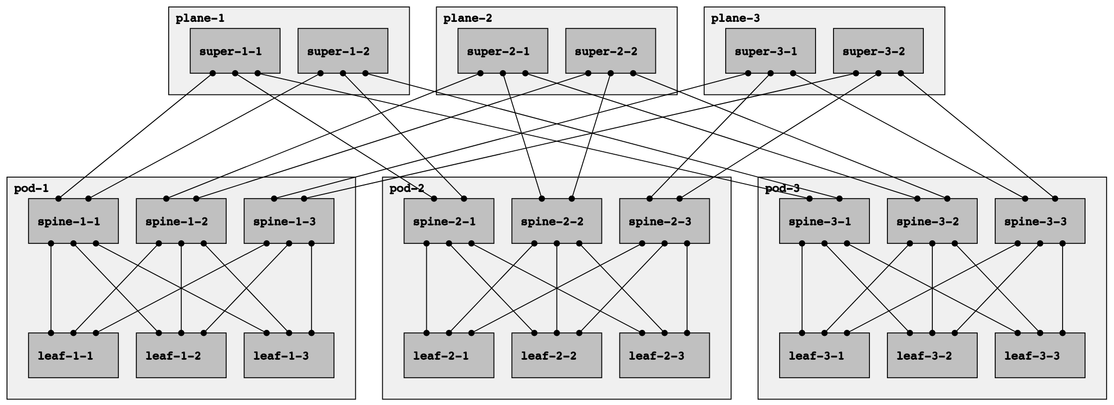

Slide 8
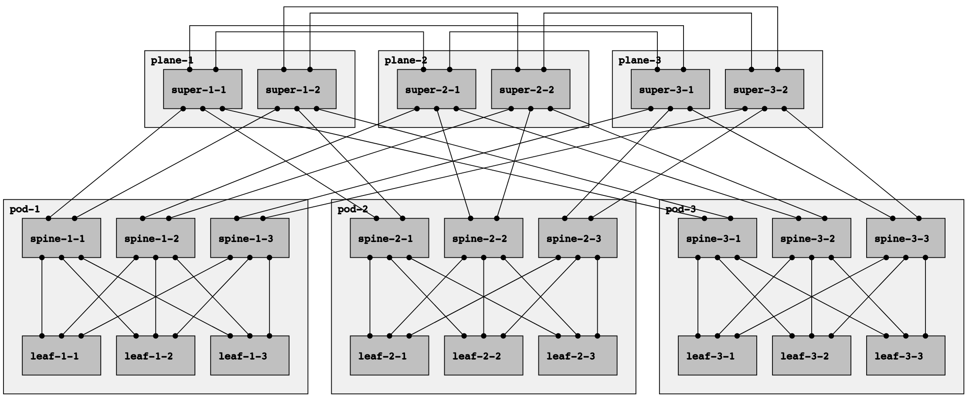

Slide 10
Negative disaggregation prefix TIEs for all prefixes originated by leaf-1-1, leaf-1-2, and leaf-1-3

Slide 11
Negative disaggregation prefix TIEs for all prefixes originated by leaf-1-1, leaf-1-2, and leaf-1-3

Slide 12
1.0.1.1/32
1.0.1.2/32
1.0.2.1/32
1.0.2.2/32
1.0.3.1/32
1.0.3.2/32
2.0.1.1/32
2.0.1.2/32
2.0.1.3/32
2.0.2.1/32
2.0.2.2/32
2.0.2.3/32
2.0.3.1/32
2.0.3.2/32
2.0.3.3/32
3.0.1.1/32
3.0.1.2/32
3.0.1.3/32
3.0.2.1/32
3.0.2.2/32
3.0.2.3/32
3.0.3.1/32
3.0.3.2/32
3.0.3.3/32
Leaf-2-2 Routing Information Base (RIB)
Destination | ECMP Next-hops
0.0.0.0/0 | spine-1, spine-2, spine-3
3.0.1.1/32 | Negative spine-1
3.0.1.2/32 | Negative spine-1
3.0.1.3/32 | Negative spine-1

Slide 13
Routing Information Base (RIB)
Forwarding Information Base (FIB)
3.0.1.1/32
Most specific covering aggregate
0.0.0.0/0
0.0.0.0/0
Negative spine-1
spine-1
+
spine-2
=
spine-2
spine-3
spine-3

Slide 14
1.0.1.1/32
1.0.1.2/32
1.0.2.1/32
1.0.2.2/32
1.0.3.1/32
1.0.3.2/32
2.0.1.1/32
2.0.1.2/32
2.0.1.3/32
2.0.2.1/32
2.0.2.2/32
2.0.2.3/32
2.0.3.1/32
2.0.3.2/32
2.0.3.3/32
3.0.1.1/32
3.0.1.2/32
3.0.1.3/32
3.0.2.1/32
3.0.2.2/32
3.0.2.3/32
3.0.3.1/32
3.0.3.2/32
3.0.3.3/32
Leaf-2-2 Routing Information Base (RIB)
Leaf-2-2 Forwarding Information Base (FIB)
Destination | ECMP Next-hops
0.0.0.0/0 | spine-1, spine-2, spine-3
3.0.1.1/32 | Negative spine-1
3.0.1.2/32 | Negative spine-1
3.0.1.3/32 | Negative spine-1
Destination | ECMP Next-hops
0.0.0.0/0 | spine-1, spine-2, spine-3
3.0.1.1/32 | spine-2, spine-3
3.0.1.2/32 | spine-2, spine-3
3.0.1.3/32 | spine-2, spine-3

