Slide 1
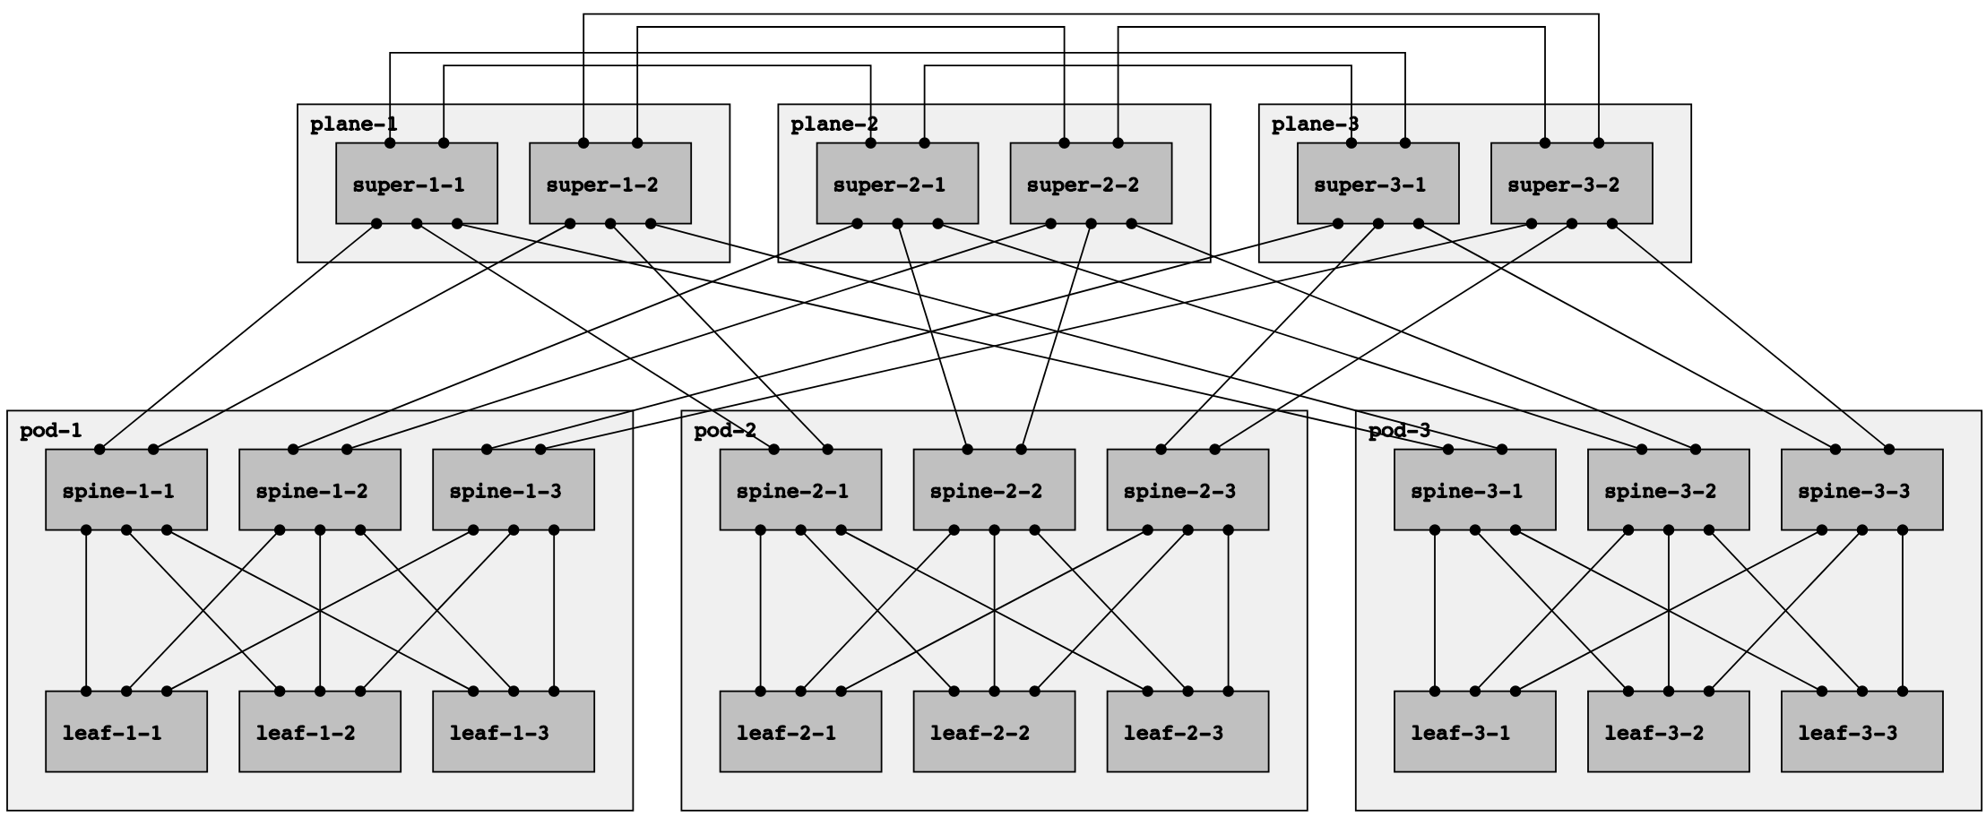

Slide 2
Positive disaggregation prefix TIEs for spine-1-1, leaf-1-1, leaf-1-2, and leaf-1-3
Negative disaggregation prefix TIEs for leaf-1-1, leaf-1-2, and leaf-1-3

Slide 3
Negative disaggregation prefix TIEs for all prefixes originated by leaf-1-1, leaf-1-2, and leaf-1-3

Slide 4
Negative disaggregation prefix TIEs for all prefixes originated by leaf-1-1, leaf-1-2, and leaf-1-3

