Slide 1
RIFT Hackathon
IETF 102
Bruno Rijsman (brunorijsman@gmail.com)

Slide 2
Participants
Dmitry Afanasiev (Yandex)
Don Fedyk (HPE)
Tony Przygienda (Juniper)
Bruno Rijsman (No affiliation)
Jeff Tantsura (Nuage Networks)
Pascal Thubert (Cisco)
Ilya Vershkov (Mellanox)
Zhaohui (Jeffrey) Zhang (Juniper)

Slide 3
Participating RIFT Implementations
Vendor RIFT implementation
Open source Python RIFT implementation

Slide 4
Vendor RIFT Implementation
Contributed by Tony Przygienda
Nearly complete implementation of draft-ietf-rift-rift-02: LIE FSM, ZTP FSM, Flooding FSM, IPv4, IPv6
Binary available: https://www.juniper.net/us/en/dm/free-rift-trial/
Runs on MacOS or Linux (no physical router needed)
Can simulate large multi-node topologies defined in “topology YAML”

Slide 5
Open Source Python RIFT Implementation
Contributed by Bruno Rijsman
Very partial implementation of draft-ietf-rift-rift-02: LIE FSM, IPv4
Started implementing ZTP FSM during hackathon (not complete yet)
Open source: https://github.com/brunorijsman/rift-python
Written in Python, tested on MacOS and Linux
Intended for experimentation, not for production
Can simulate small multi-node topologies
Uses same topology configuration file as vendor implementation

Slide 6
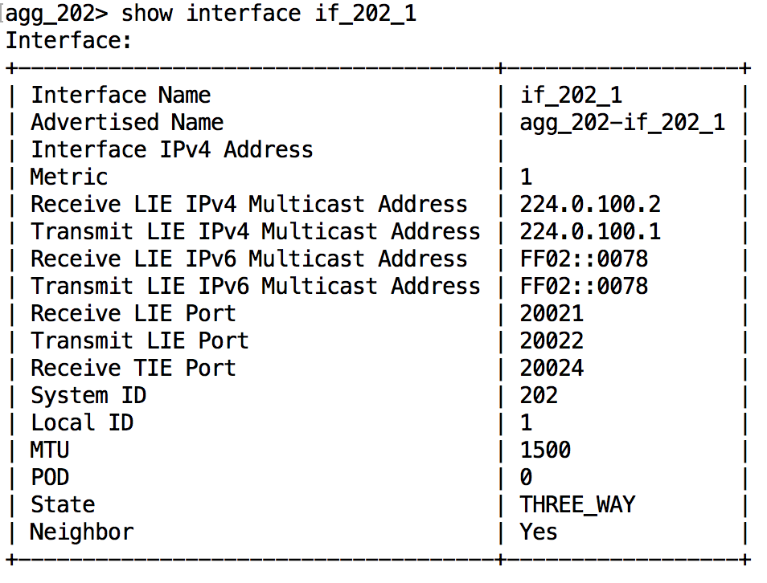
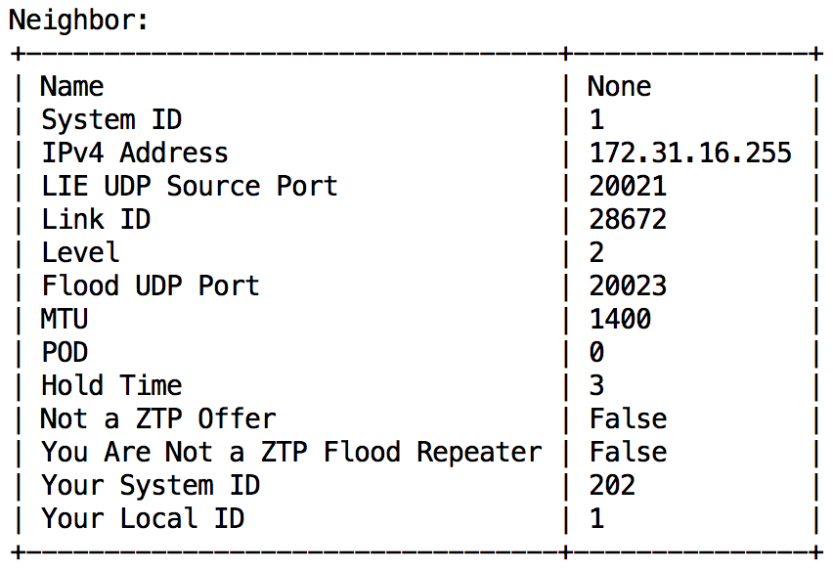
Achieved LIE FSM 3-Way Adjacency in 3 hours

Slide 7
Summary of Results
Quickly achieved interoperability between vendor and Python RIFT: LIE FSM adjacency in state 3-way (IPv4)
Very detailed interoperability report: http://bit.ly/ietf-102-rift-hackathon-interop-report
Started implementation of ZTP FSM in Python RIFT Expected to be completed in weeks
Detailed review of ietf-draft-rift-rift-02: http://bit.ly/rift-comments Live document for other commenters and author responses
Additional minor comments on draft while implementing ZTP

Slide 8
Summary of Lessons Learned
Model-based protocol encoding works and has great benefits
Multicast is very platform dependent
Attending a hackathon is very useful even for non-coders

Slide 9
Lesson Learned Model-Based Protocol Encoding
RIFT uses Thrift to model protocol packet encoding
All packet encoding and decoding code is generated
Can implement encoding and decoding in a matter of minutes
High confidence in correctness of encoding and decoding code
Discovered limitations of Thrift
Thrift does not support unsigned integers (only signed i8, i16, i32, i64)
The RIFT draft specifies that certain signed integers MUST be treated as unsigned
This severely dilutes the value of code auto-generation (must manually “fudge” fields)
Actually caused platform-dependent crash (encoded IP address out of range in Python)
Existing Thrift framework for transport cannot be used (UDP is not supported)
Bottom line: using model-based encoding works and helps a lot

Slide 10
Lesson Learned Multicast is Very Platform-Dependent
Particularly IPv6 multicasts
Different socket options across platforms
Different behavior of same socket options across platforms

Slide 11
Follow-up Work
Finish Python RIFT
ZTP FSM, flooding FSM, IPv6, …
Considering port to Free Range Router (FRR)
More interoperability testing
In future IETF hackathons
In interim hackathon (ZTP state machine)
Convergence and correctness testing in addition to interop testing
Performance: How quickly does RIFT (re)converge
Correctness: Does RIFT (re)converge to the correct tables in all scenarios
More RIFT implementations are welcome to join

