Slide 1
Abhijeet Paunikar
Agenda
About me (~5min)
Portfolio (~10 min)
Case Study (~50 min)

Slide 2
About me
Professional
11+ years of experience in software engineering
Expertise in enterprise applications (desktop as well as Web)
Proven record of delivering operational savings, scalable systems, and performance improvements
Started my career as a Windows Application Developer specializing in C#, .NET, and WPF.
At Microsoft as Senior Software Engineer focused on full-stack development with React and TypeScript for the front-end, and C# for the back-end.
Languages/Frameworks: .NET, C#, WPF, MVVM, React, TypeScript
Personal
Happily married and one kid
Love to Console games in free time

Slide 3
Portfolio
Case handling time in Dynamics 365
Autonomous service agents in Dynamics 365
Case Management Agent

Slide 4
Portfolio – Case handling Time
About
Case handling time is the total time you spend to actively work on a case.
Case handling time helps supervisors measure your productivity and plan staffing.
Challenge
Forecasting team needed better data to predict capacity
Competitors already had similar functionality
Multiple stakeholders: Design, Forecasting, Sales
Conflicting use cases:
Forecasting accuracy
Wage & performance tracking
My Role
Architecting and leading development of project
Coordinate across design, forecasting, sales teams
Ensure accuracy, reliability, scalability
Balance multiple use cases with a single robust solution
Approach
Collaboration & Communication
Weekly stakeholder demos + feedback
Detailed technical design doc
Conflict resolution → consensus via structured discussions
Transparency
Shared meeting minutes & progress updates
Results
Largest Malaysian customer onboarded successfully

Slide 5
Portfolio – Autonomous service agents
About
Autonomous agents are intelligent tools designed to enhance customer service efficiency and effectiveness in Dynamics 365 Contact Center and Dynamics 365 Customer Service.
With generative AI, they improve customer intent discovery and real-time knowledge management and support self-service and assisted scenarios.
Challenge
Product team proposed prediction based on last 10 records
Limited real-world value for users
My Approach
Conducted customer interviews → identified mismatch with actual usage
Proposed contextual prediction using email & conversation data
Built POC + side-by-side comparison
Presented findings to leadership & customers
Outcome
Customers embraced contextual prediction
Feature evolved into full-fledged AI capability
Microsoft 1st-party customer achieved $2M+ cost savings
Improved collaboration between product & engineering teams

Slide 6
Case Study Statement
Design and implement a desktop application to view and manage videos :
Displays relevant information related to Files
Supporting Operations to view, upload/download, versioning etc.
Tech Stack
Client – C# WPF
Server – C# WebApi
Storage - DropBox

Slide 7
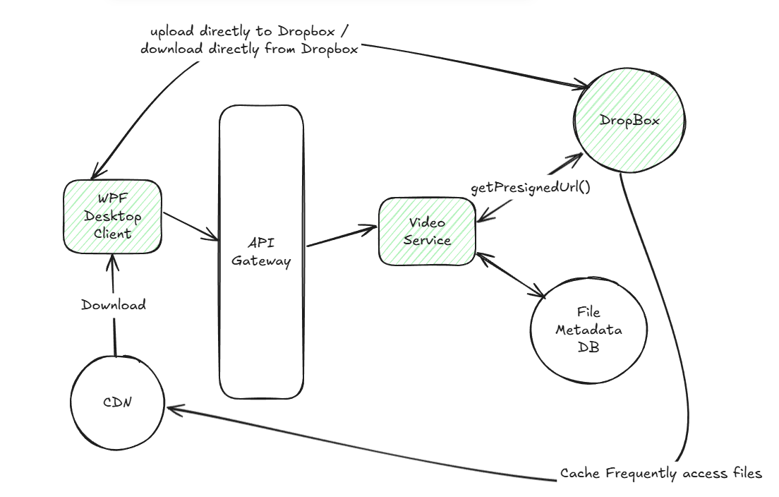
Case Study - High Level Diagram

Slide 8
Case Study - Demo
HLD link - https://excalidraw.com/#json=6V-F0yn9_xMPkUsBSBwnG,n19Bk1H6TBq-PBDCJw1RJA
Github Repo - https://github.com/a2bhijeet/DropBoxClient.git

