Slide 1

16CS270 - PROJECT
Domain:
Cyber Security
Title:
Honeypot based cyber attack detection
Guide:
Mrs. M. KARTHIGHA
Team:
Abishek PS (1901002)
Hari Kishore VP (1901043)
Kugaanesen S (1901068)

Slide 2
AGENDA
Literature Survey
Existing Systems
Proposed System
Architecture Diagram
Algorithm Implemented
Results
Conclusion
References
Publication

Slide 3
LITERATURE SURVEY
STUDY OF THE ATTRIBUTES USING FOUR CLASS LABELS ON KDD99 AND NSL-KDD DATASETS WITH MACHINE LEARNING TECHNIQUES (Nilesh Kunhare and Ritu Tiwari)
The paper analyzes the performance of different machine learning algorithms for detecting attacks in the KDD99 and NSL-KDD datasets. The authors preprocess the datasets and extract relevant features, and evaluate the performance of the algorithms based on metrics like accuracy, precision, recall, and F1-score.
The authors find that different algorithms perform differently on the datasets depending on the class label being predicted, and that the NSL-KDD dataset generally performs better than the KDD99 dataset.
The paper also discusses the most important features for each class label, and concludes by emphasizing the importance of selecting appropriate machine learning techniques for intrusion detection and the need for further research to improve intrusion detection systems

Slide 4
LITERATURE SURVEY
AI POWERED NETWORK THREAT DETECTION SYSTEM (Bo-Xiang Wang and Jiann-Liang Chen)
The paper presents a machine learning-based system for network threat detection, consisting of data preprocessing, feature extraction, and classification modules.
The classification module uses a Deep Sparse Autoencoder (DSA), which combines supervised and unsupervised learning, to classify network traffic as normal or anomalous.
The authors evaluate their system on benchmark datasets and demonstrate its high accuracy and detection rates, as well as its superiority over other state-of-the-art approaches.
The paper presents a promising approach to improving the security of enterprise networks and critical infrastructure using machine learning and deep learning techniques.

Slide 5
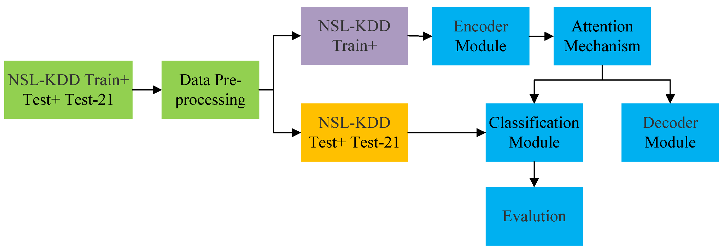
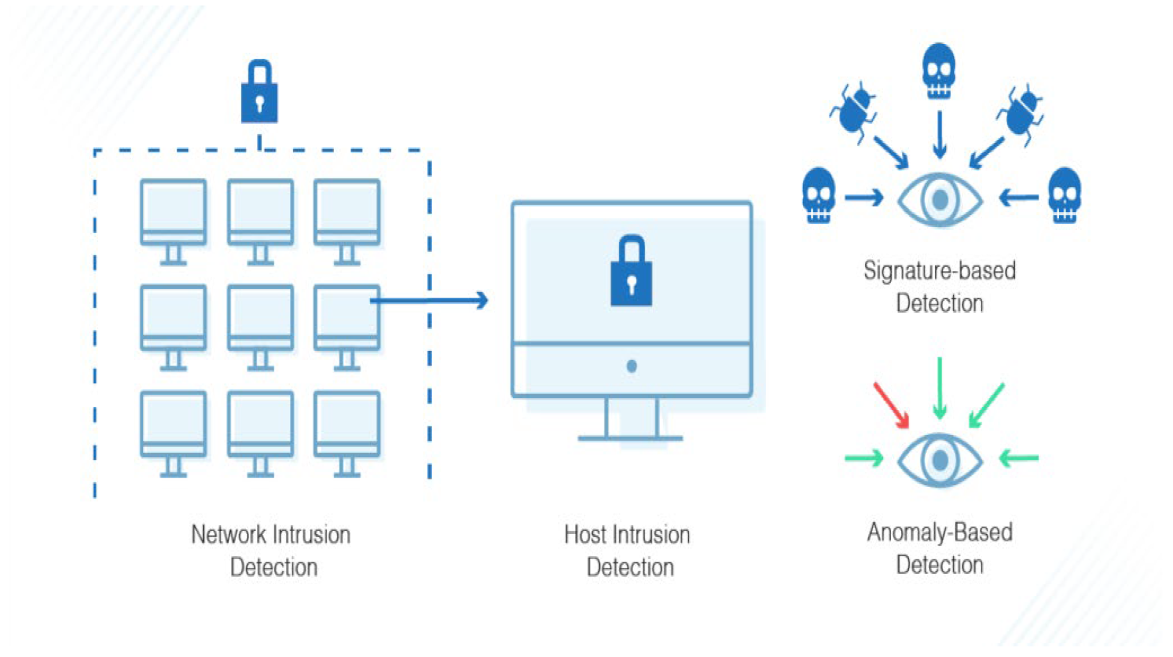
EXISTING SYSTEMS
EXISTING SYSTEMS

Slide 6
PROPOSED SYSTEM
To Come across the problems faced in the existing systems, we have come with a new solution
We propose a deep learning architecture GAN (Generative Adversarial Network) consisting of two neural networks: a generator and a discriminator.
The generator network learns to generate new data that resembles the original data, while the discriminator network learns to distinguish between the generated data and the real data.
We made the two networks train simultaneously in an adversarial manner, with the generator trying to fool the discriminator into thinking that its generated data is real, and the discriminator trying to correctly identify which data is real and which is generated.
Through this process of competition and feedback, the generator learns to create increasingly realistic data, while the discriminator becomes better at distinguishing real data from generated data.

Slide 7
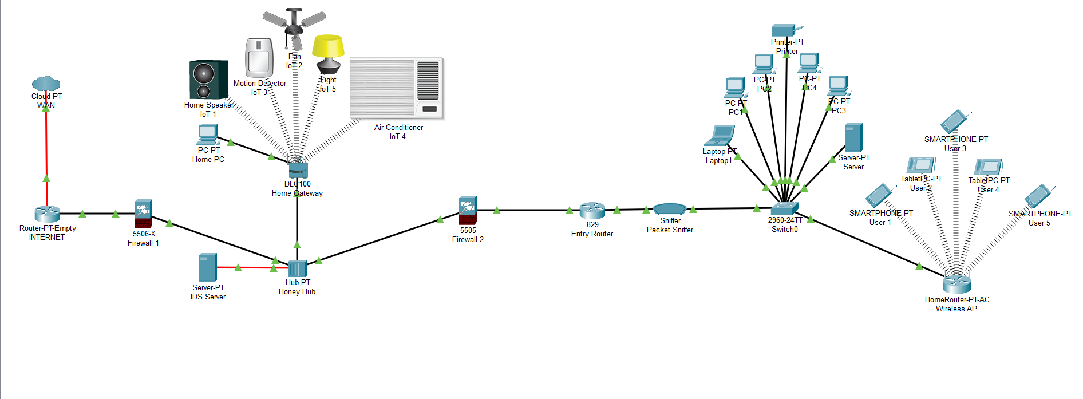

Slide 8
PROPOSED SYSTEM
We compare the performance of GAN with traditional machine learning methods. GANs generate synthetic data that closely resembles real-world data.
This is particularly useful for honeypot implementation as it allows us to generate realistic network traffic and detect more complex attack patterns that may be missed by traditional machine learning methods.
GANs can also adapt and learn from unlabeled data, which is useful for detecting unknown attack patterns and improving the overall accuracy of our IDS system.
We evaluate our proposed network with the KDD99 dataset. The experimental results show that the performance of GAN is better than the traditional methods.

Slide 9
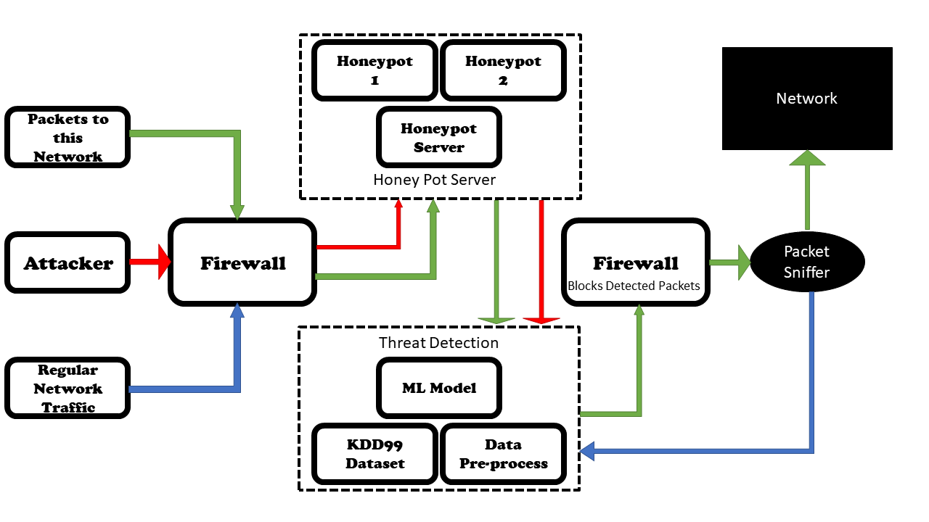
ARCHITECTURE DIAGRAM

Slide 10
ALGORITHM IMPLEMENTED
Different Machine Learning algorithms are used to determine whether the connection is good or it is an intruder. The 42 features helps in the prediction.
Tested using various Machine Learning models such as Gaussian Naive Bayes, Decision Tree, Random Forest, Gradient Boosting, Extreme Gradient Boosting, Generative adversarial network, Linear Regression, Logistic Regression, Long Short-Term Memory, and Deep Belief Network as mentioned above.
The one which is suitable for intrusion detection gives a high accuracy value and the high accuracy model is selected for the detection.

Slide 11
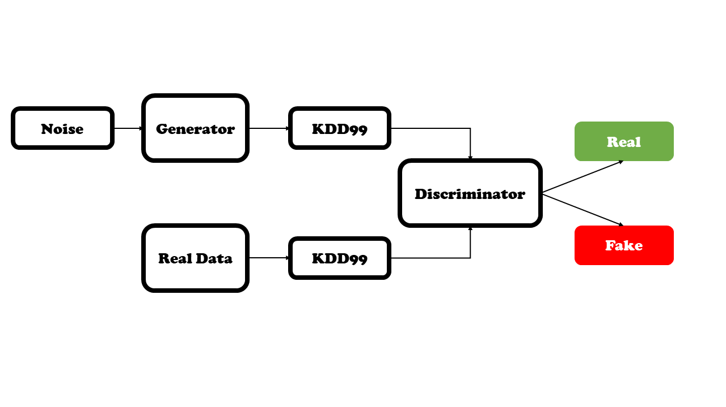
ALGORITHM IMPLEMENTED
GAN: The generator takes a random noise vector as input and maps it to an output that is meant to resemble the target data distribution. The discriminator takes in both real samples from the target data distribution and fake samples generated by the generator and tries to distinguish between the two, they are trained in an adversarial manner, generator creating samples that are realistic to the discriminator, the discriminator tries to classify the samples as either real or fake.

Slide 12
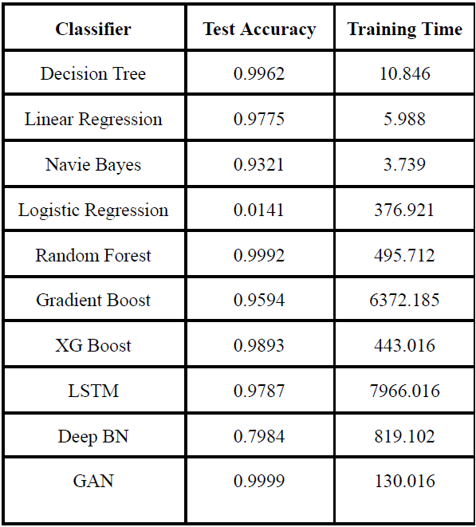
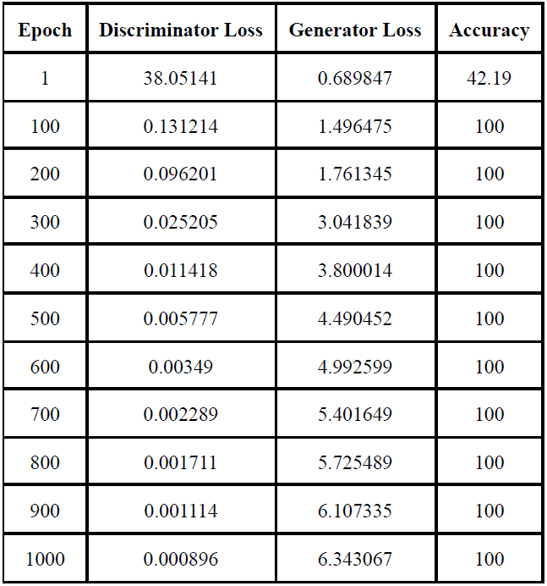
RESULTS
Realtime Honeypots capture intruders by various methods and the data required for the prediction is generated by it. As a whole, it is passed to the various Machine Learning models to get its performance and accuracy. Test and train time is also considerable for power-efficient working.

Slide 13
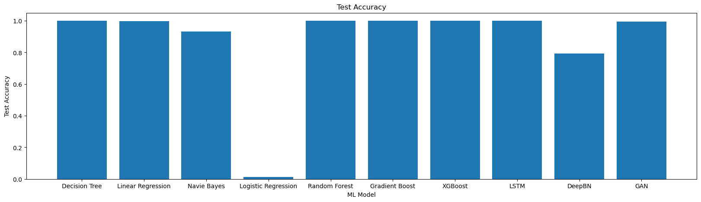
RESULTS

Slide 14
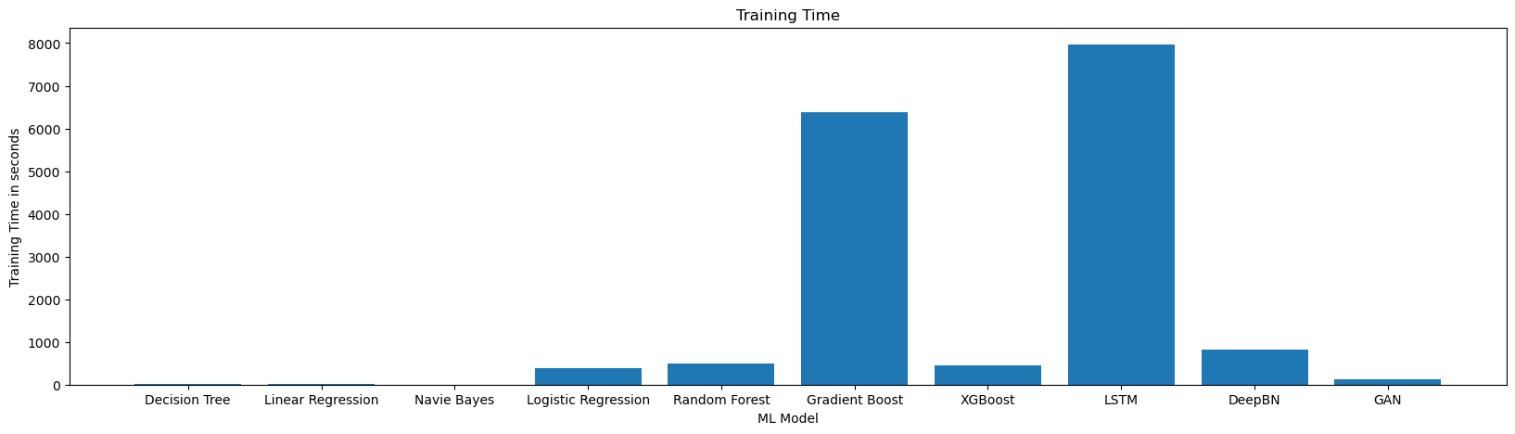
RESULTS

Slide 15
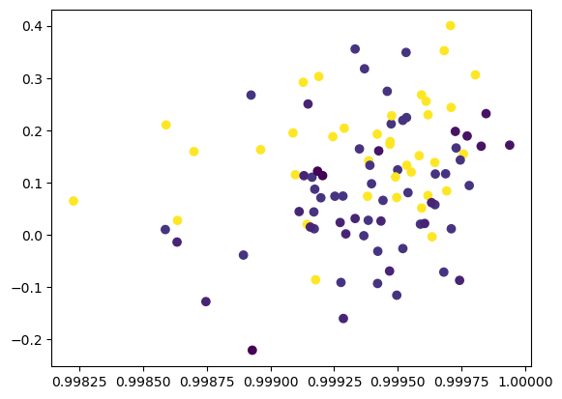
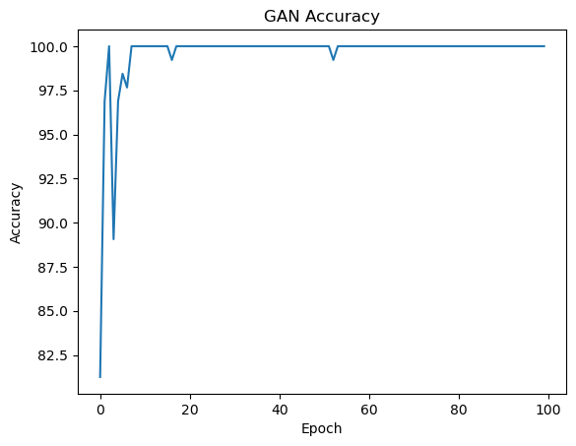
RESULTS

Slide 16
CONCLUSION
The use of Generative Adversarial Networks is used for intrusion detection. The maximum-performing algorithm exists but it is limited by the size of the dataset. Since Generative Adversarial Networks are trained using synthetically generated values, their prediction and accuracy are still high. Other models have been trained with just the input dataset of size 48,98,430 columns.
The GAN gives accurate results, compared to all other algorithms GAN is trained with a high number of inputs with about 1000 epochs. The use of network design is to reduce the regular traffic and to catch the attackers. Future research should verify the new methods of attackers and include more features for advanced attacks.
The Generative Adversarial Network gives the most accurate result for the KDD99 dataset with almost more accuracy that, most of the accuracy plot in the graph falls within 1 and 0.99825. Since synthetic data is used to train it, it is more accurate than any classifiers used for the same dataset. Thus, Generative adversarial network has been selected for the Intrusion Detection System.

Slide 17
REFERENCES
[1] Mr. Mohit Tiwari, Raj Kumar, Akash Bharti, Jai Kishan (2017) Intrusion Detection System, International Journal of Technical Research and Applications e-ISSN: 2320-8163.
[2] Gozde Karatas, Onder Demir, Ozgur Koray Sahingoz, "Deep Learning in Intrusion Detection Systems", 2018 International Congress on Big Data, Deep Learning and Fighting Cyber Terrorism, pp.113-116, 2018.
[3] Nilesh Kunhare, Ritu Tiwari, "Study of the Attributes using Four Class Labels on KDD99 and NSL-KDD Datasets with Machine Learning Techniques", 2018 8th International Conference on Communication Systems and Network Technologies (CSNT), pp.127-131, 2018.
[4] Basant Subba, "A Neural Network based NIDS framework for intrusion detection in contemporary network traffic", 2019 IEEE International Conference on Advanced Networks and Telecommunications Systems (ANTS), pp.1-6, 2019.
[5] Mridula Sharma, Haytham Elmiligi, Fayez Gebali, Abhishek Verma, "Simulating Attacks for RPL and Generating Multi-class Dataset for Supervised Machine Learning", 2019 IEEE 10th Annual Information Technology, Electronics and Mobile Communication Conference (IEMCON), pp.0020-0026, 2019.
[6] Sun N, Zhang J, Rimba P, Gao S, Zhang LY, Xiang Y, Data-driven cybersecurity incident prediction: A survey, IEEE Commun. Surv. Tutor. 21 (2019)
[7] Akshat Divya, Anchit Bhushan, Nihal Anand, Rishabh Khemka, Sumithra Devi K.A.H (2020) HONEYPOT: Intrusion Detection System. International Journal of Education, Science, Technology, Engineering vol. 3, no. 1, pp. 13-18, June 2020.
[8] Husak M, Bartos V, Sokol P, Gajdos A, Predictive methods in cyber defense: Current experience and research 43 challenges, Future Generation Computer Systems, Volume 115, 517-530 (2021)
[9] Philip Wester, Fredrik Heiding, Robert Lagerström, "Anomaly-based Intrusion Detection using Tree Augmented Naive Bayes", 2021 IEEE 25th International Enterprise Distributed Object Computing Workshop (EDOCW), pp.112-121, 2021.
[10] Ritu Bala, Ritu Nagpal, "Intrusion Detection Based on Decision Tree Using Key Attributes of Network Traffic", Applications of Artificial Intelligence and Machine Learning, vol.778, pp.583, 2021.
[11] Aakash Singh, Parth Kitawat, Shubham Kejriwal, Swapnali Kurhade, "Intrusion Detection System Using Homomorphic Encryption", Intelligent Data Communication Technologies and Internet of Things, vol.101, pp.505, 2022.
[12] Bo-Xiang Wang, Jiann-Liang Chen (2022): An AI-Powered Network Threat Detection System Doi 10.1109/ACCESS.2022.3175886
[13] Ruizhe Zhao, Yingxue Mu, Long Zou, Xiumei Wen, "A Hybrid Intrusion Detection System Based on Feature Selection and Weighted Stacking Classifier", IEEE Access, vol.10, pp.71414-71426, 2022.
[14] Zebin, Tahmina; Rezvy, Shahadate; Luo, Yuan (2022): An Explainable AI-based Intrusion Detection System for DNS
over HTTPS (DoH) Attacks. TechRxiv. Preprint.

Slide 18

PUBLICATION

Slide 19
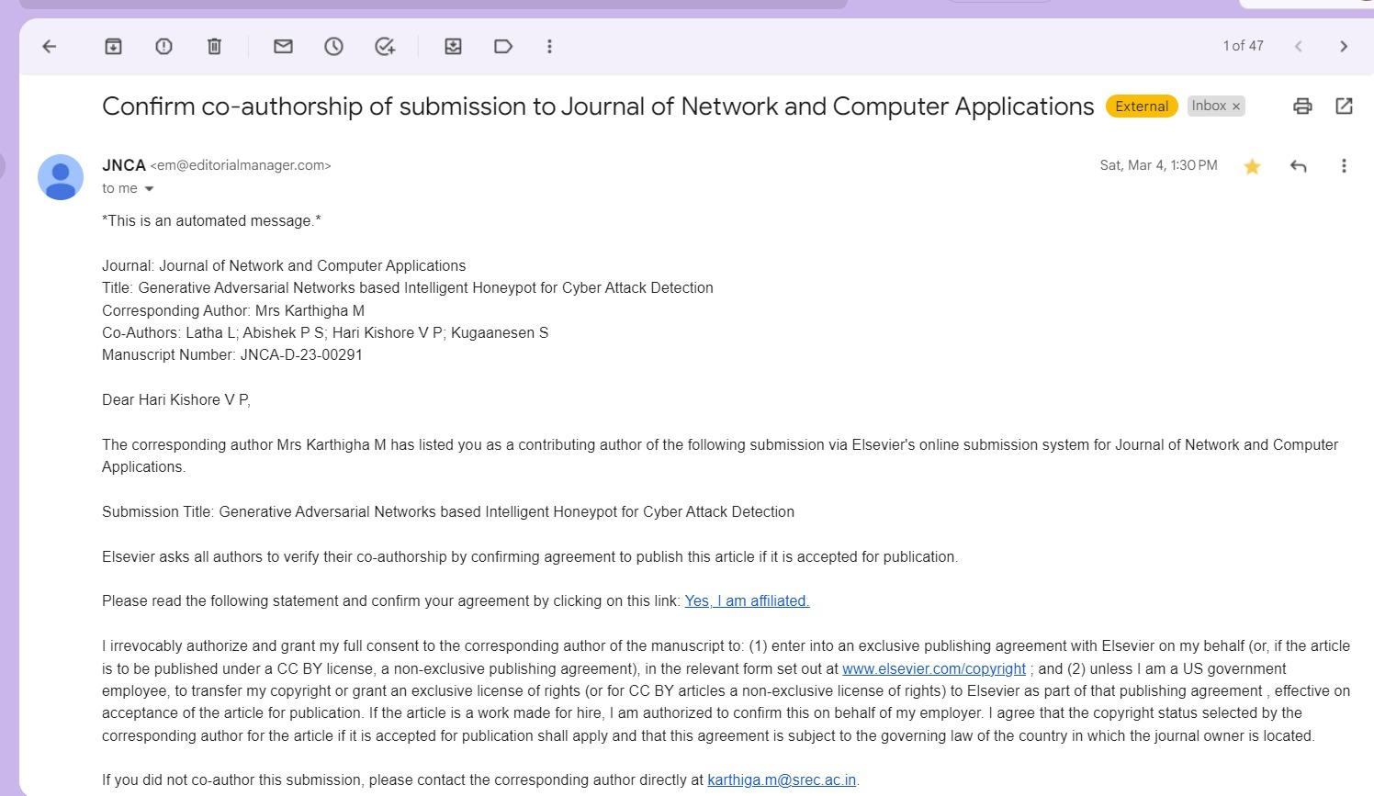
PUBLICATION

Slide 20
Thank you

