Slide 1

MINI PROJECT - II
Domain:
Cyber Security
Title:
Phishing URL Detection
Guide:
Dr. Vijayakumar R
Team:
Abishek P S (1901002)
Aditya Kushwaha (1901004)
Arjun R U (1901016)
Aswin Balaji P L (1901023)

Slide 2
AGENDA:
Introduction
Literature Survey
Problem Definition
Proposed Solution
Modules
Flowchart
Challenges
References

Slide 3
INTRODUCTION:
In this evolving world of Internet, people are subjected to many cyber attacks. Phishing is the most relentless of all the attacks.
Phishing is a fraudulent practice of sending emails purporting to be from reputable companies in order to induce individuals to reveal personal information, such as passwords and credit card numbers.
Identification of phishing URLs from genuine ones is a paramount task to minimize the financial loss incurred.
Lots of people have lost huge amount of money and personal identities. This is the problem faced by many individuals and companies today.

Slide 4
LITERATURE SURVEY:
There are various types of phishing attacks such as Spear phishing, Clone phishing, etc. Phishing can easily access the email id of any person as it is very easy to find the email id now a days and you can send an email to anyone as it is freely available across the world.
Email phishing detection is the most famous kind of phishing detection and many organizations have tools available for checking phishing emails.
There are tools such as:
https://isitphishing.org/
https://www.isitphish.com/
These tools collect the URL from the user and diagnose the references with the repository of phishing URLs updated by organizations such as PhishTank, OpenPhish etc.

Slide 5
LITERATURE SURVEY:
There are also tools which use Machine Learning models to predict whether the URL is a legitimate or Phishing URL.
In the journal “Detection of URL based Phishing Attacks using Machine Learning” which was published in the year 2019, the researches extracted 9 features from the URL and achieved accuracy of 85.5%.

Slide 6
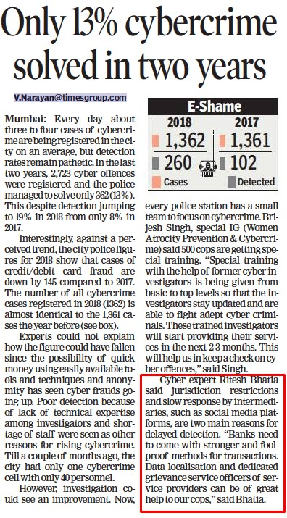
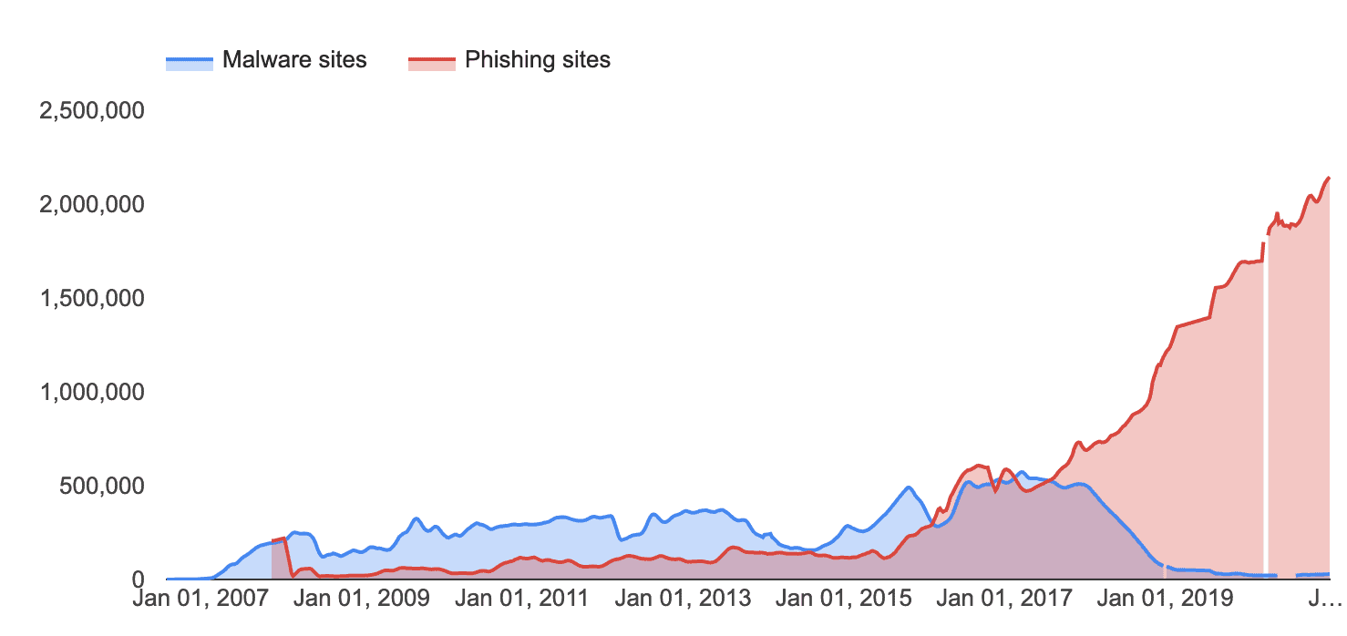
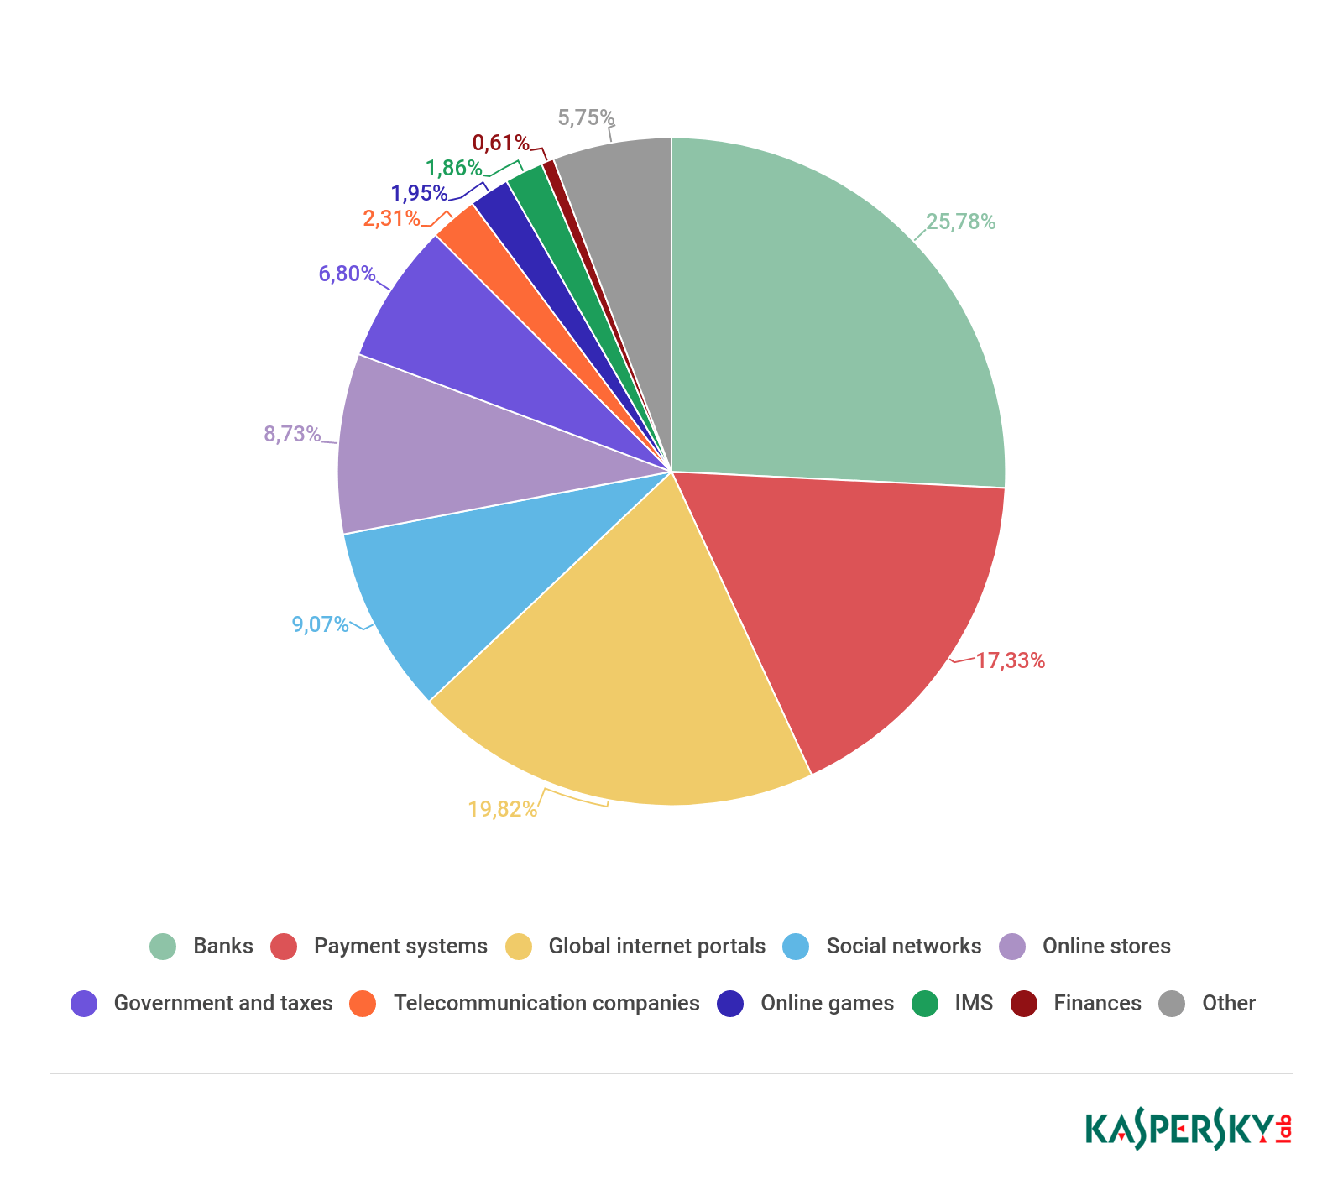

Slide 7
LITERATURE SURVEY:
According to Verizon’s 2021 Data Breach Investigations Report (DBIR), phishing is the top “action variety” seen in breaches in the last year and 43% of breaches involved phishing and/or pretexting.
India among top 3 Asian nations affected by phishing cyber attacks (TIMES OF INDIA): Asia recorded an increase of 15 per cent in average cost of a phishing attack, incurring a cost of $908,140, up from $792,840 the previous year.
According to the Ministry of Home Affairs, 2,00,000+ cybercrime cases have been reported in one year with more than 90% of them being financial frauds.

Slide 8
PROBLEM DEFINITION:
Phishing messages that spoof, or mimic banks, credit card companies or other business like Amazon and eBay that look authentic and attempt to get victims to reveal their personal information.
The aim of the attackers is to gain information from the victims. They collect the information such as IP address, bank details, personal details and use them in wrong way.
This may lead to dangerous situations for an individual and also for the organization.

Slide 9
PROPOSED SOLUTION:
The input URL is obtained and the features are extracted.
There are about 30 unique features which specifies the URL’s characteristics.
These features are then used to train the machine learning model.
Based on the output of the model, the user will be notified with a popup saying “Phishing Detected!” and if it is a legitimate URL, the page will be redirected to the URL.

Slide 10
MODULES:
Gathering URL data:
The unclassified data set is collected from various sources like phishtank ,openphish etc
Feature Extraction:
From the obtained url the important features like url length, age of domain are extracted and checked to see if its normal or phishing.

Slide 11
MODULES:
3. ML Model Training:
Various machine learning algorithms are used find high accuracy model for both training and testing.
4. Model Testing:
The model is tested with the remaining data in the dataset after 70:30 split. This gives us the test accuracy.

Slide 12
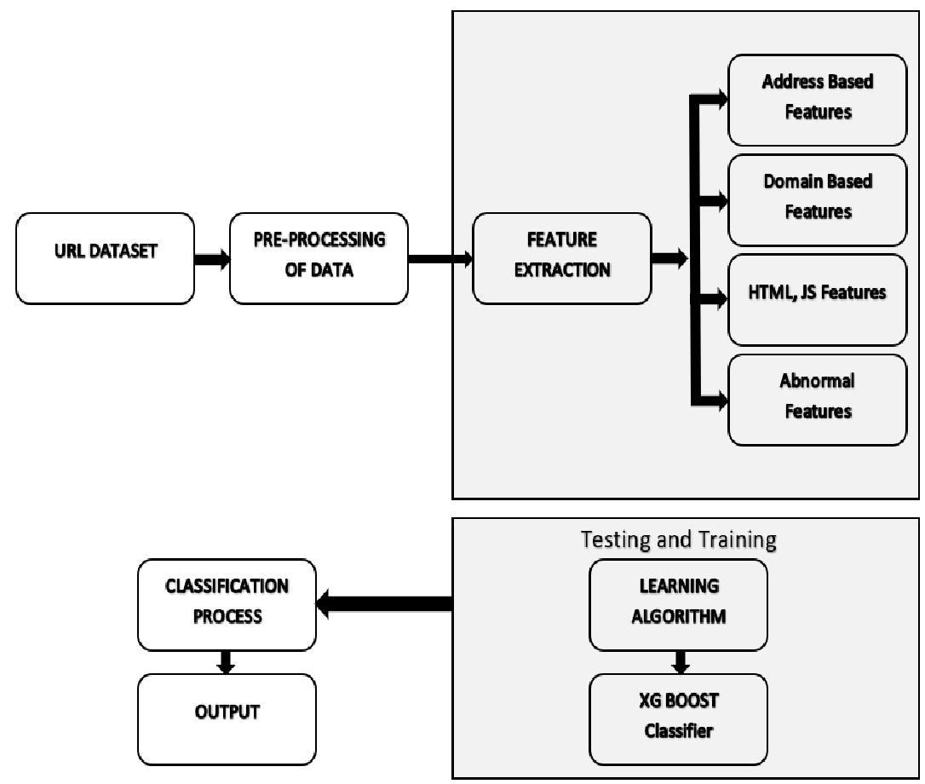
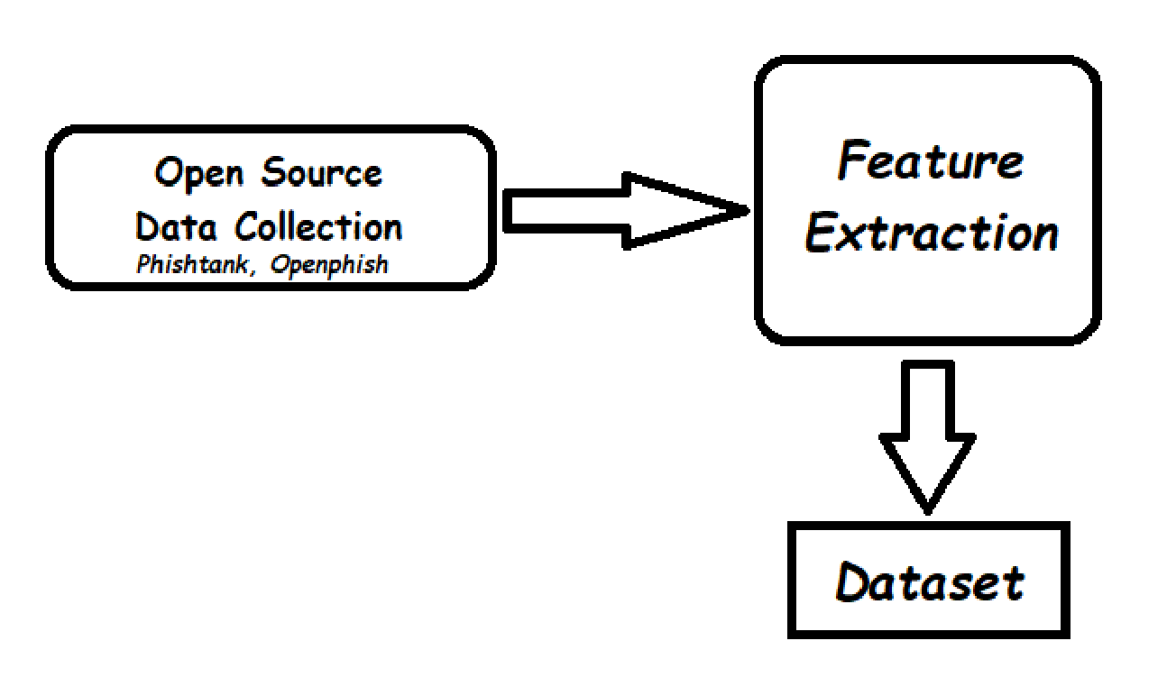
FLOW CHART

Slide 13
CHALLENGES
Size of Dataset
Execution Time
May unable to detect the DNS spoofs

Slide 14
REFERENCES:
[1] Abdallah Moubayed, Mohammad Injadat, Ali Bou Nassif (2018). “Challenges and Research Opportunities Using Machine Learning & Data Analytics”, July 2018 IEEE Access PP (99):1-1.
[2] Alwyn Roshan Pais, Routhu Srinivasa Rao “An Enhanced Blacklist Method to Detect Phishing Websites”. Information Systems Security. ICISS 2017. Lecture Notes in Computer Science, vol 10717.
[3] Ding Y, Luktarhan N, Slamu W (2019). A keyword-based combination approach for detecting phishing webpages” Computers & security, 84, 256-275.
[4] Doyen Sahoo, Chenghao Liu, Steven (2019) – “Malicious URL Detection using Machine Learning: A Survey”. last revised 21 Aug 2019 (version, v3).
[5] Gunter Ollmann “Securing against the ‘threat’ of instant” Published by Network Security Volume 2004, Issue 3, March 2004, Pages 8-11.
[6] Joseph Johnson “Worldwide digital population as of April 2022” Published by, May 9, 2022.
[7] Miramirkhani N, Antonakakis M (2017). “Hiding in Plain Sight: A Longitudinal Study of Combosquatting Abuse. Association of Computer Machinery's”, Computer and Communications Security (ACM CCS) 2017.
[8] Rao, R. S., & Pais, A. R. (2019). “Jail-Phish: An improved search engine-based phishing detection system”, Computers & Security, 83, 246-267.
[9] Sagar Patil, Yogesh Shetye (2020). “Detecting Phishing Websites Using Machine Learning”. IRJET e-ISSN: 2395-0056 Volume: 07 Issue: Feb 2020.
[10] Sophiya Shikalgar , Dr. S. D. Sawarkar, Mrs.Swati Narwane (2019) – “Detection of URL based Phishing Attacks using Machine Learning“. IJERT ISSN: 2278-0181 Vol. 8 Issue 11, November-2019.
[11] Suzanne Widup, Alex Pinto, Gabriel Bassett, David Hylender (2021) Verizon Data Breach Investigations Report, May 2021.
[12] WidupSuzanne, WidupMarc, SpitlerDavid Hylender Gabriel (2018). “Verizon Data Breach Investigations Report 2018”. April 2018.

Slide 15
Thank you

