Slide 1
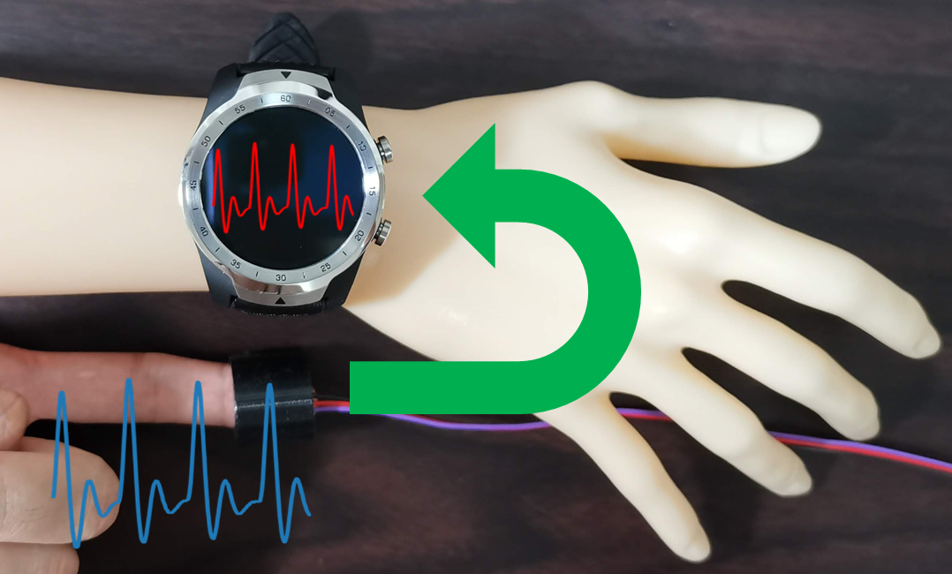
Disp2ppg Pulse Wave Generation to PPG Sensor using Display
Atsuhiro FUJII¹, Kazuya MURAO^{1, 3}, Naoji Matsuhisa^{2, 3}
¹Ritsumeikan University, Japan / ²Keio University, Japan /
³Japan Science and Technology Agency, PRESTO

Slide 2

Background (1/3)
Wearable devices are widely used.
It has the following functions.
Call, message, clock, and payment functions.
Biometric recording function.
Heart rate, respiratory rate, body temperature, etc.
Activity annotation function.
Walking, eating, sleeping, etc.

Slide 3
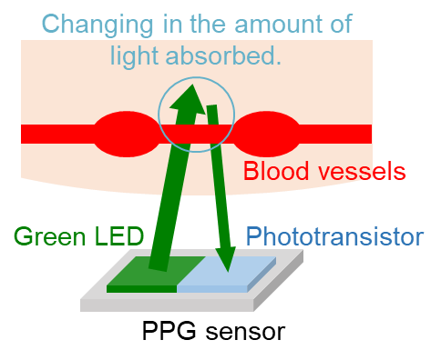
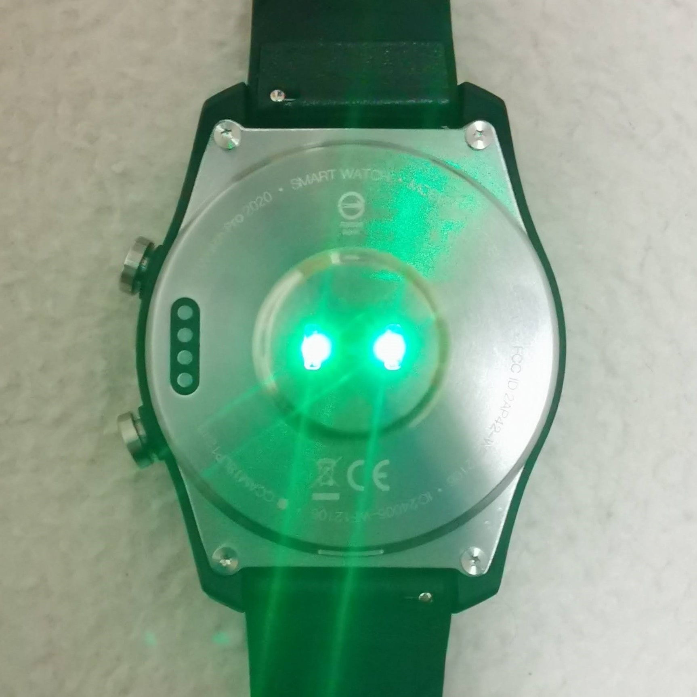
Background (2/3)
The most common technique of recording pulse data is called photoplethysmography (PPG).
It measures pulse data by irradiating LED light onto the skin and detecting changes in the light reflected through blood vessels.
Oxidized hemoglobin has the property of absorbing this LED light.
→ Need blood flow.
PPG sensor

Slide 4
Background (3/3)
Assumption of a wearable device on an artificial body.
Call, message, clock, and payment functions: available
Acceleration, gyroscope, and GPS sensors: available
PPG sensor: unavailable
→ Functions designed for the living body are not available on the artificial body.
Solutions:
① Attach device to ankle. → Usability will be reduced.
② Attach additional sensors. → It is difficult to input data into commercial applications.
③ Input arbitrary values to the sensors mounted on the device.

Slide 5

Our approach
Input pulse data using the display.
No need blood flow.
Commercially available devices can be used on artificial hands.
An arbitrary heart rate can be input.
The heart rate obtained from additional sensors can be reproduced.
Revealing the vulnerability of PPG sensors.
It is possible for a healthy person to pretend to be ill.
It is possible for a sick person to pretend to be rest.

Slide 6
Related works
Estimating respiratory rate from pulse wave.[1]
Detecting arrhythmia from pulse wave.[2]
Predicting emotions during work from behavioral and pulse wave.[3]
[1] Havriushenko et al.: Smartwatch based respiratory rate estimation during sleep using cnn/lstm neural network. ELNANO, pp. 584-587 (2020).
[2] Han et al.: Premature atrial and ventricular contraction detection using photoplethysmographic data from a smartwatch. Sensors, Vol. 20, No. 19, pp. 5683 (2020).
[3] Kajiwara et al.: Predicting emotion and engagement of workers in order picking based on behavior and pulse waves acquired by wearable devices. Sensors, Vol. 19, No. 1 (2019).

