Slide 1
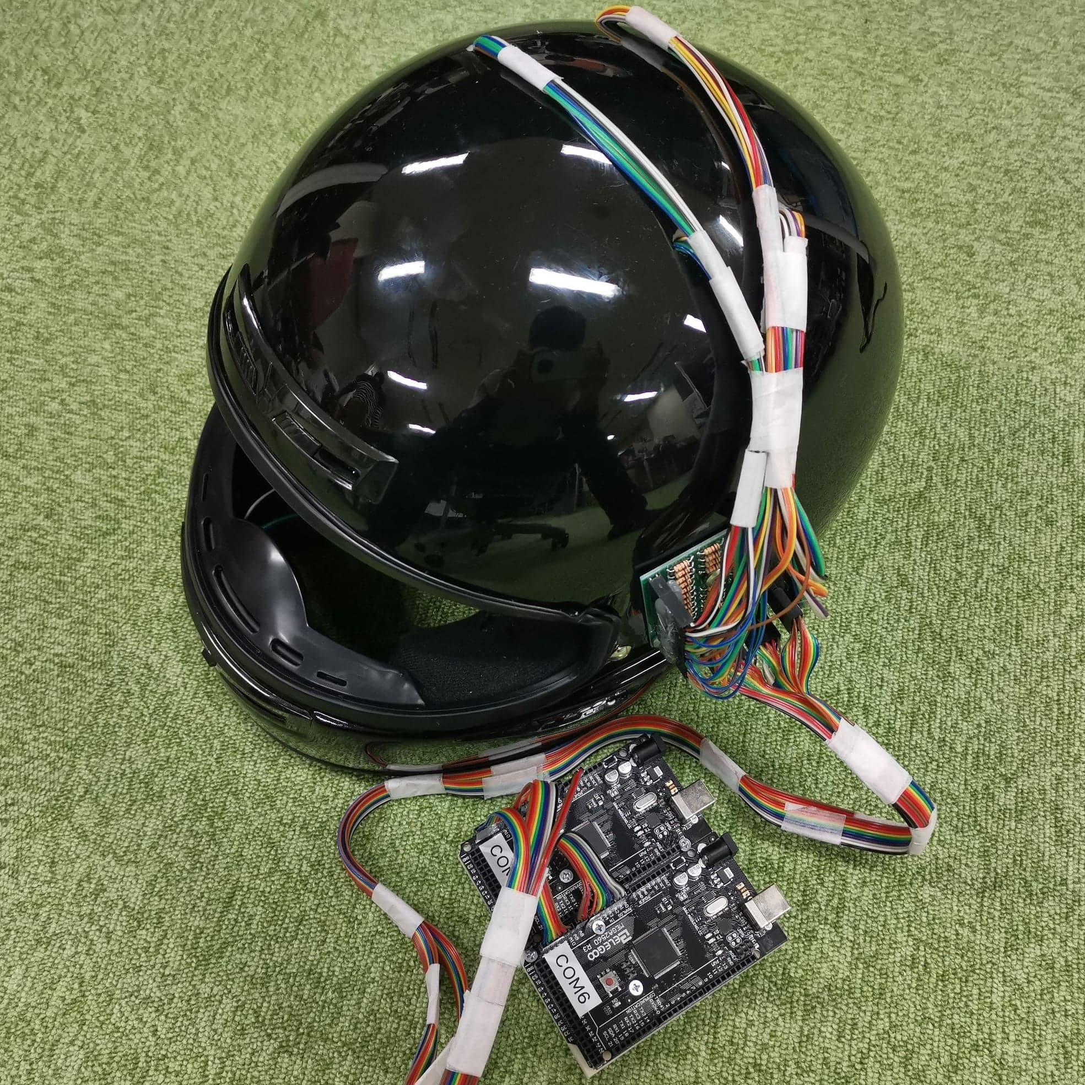
Printed circuit board
Microcomputers

Slide 2
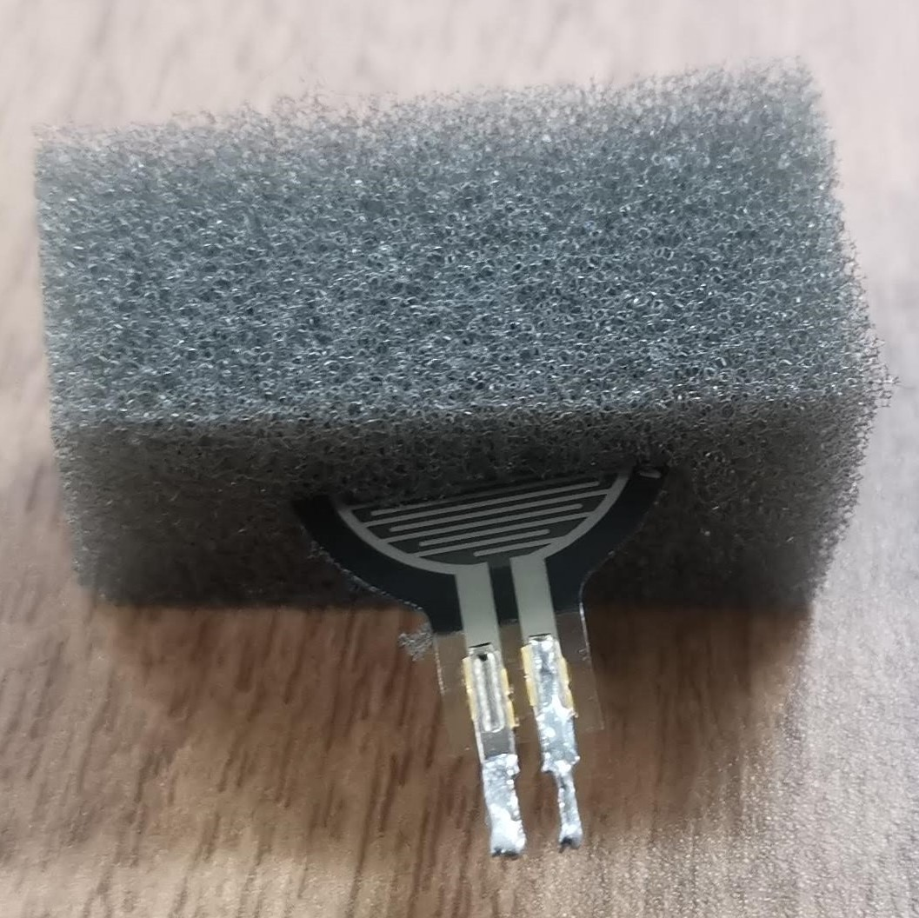
月曜日に計測する！
10 mm

Slide 3
9
8
18
19
10
0
11
1
7
6
5
4
3
2
1
0
10
11
12
13
14
15
16
17
12
2
18
8
22
21
20
26
29
25
24
23
13
3
14
19
9
4
27
30
28
31
15
5
16
6
17
7
23
20
24
25
22
21
Pressure sensors

Slide 4
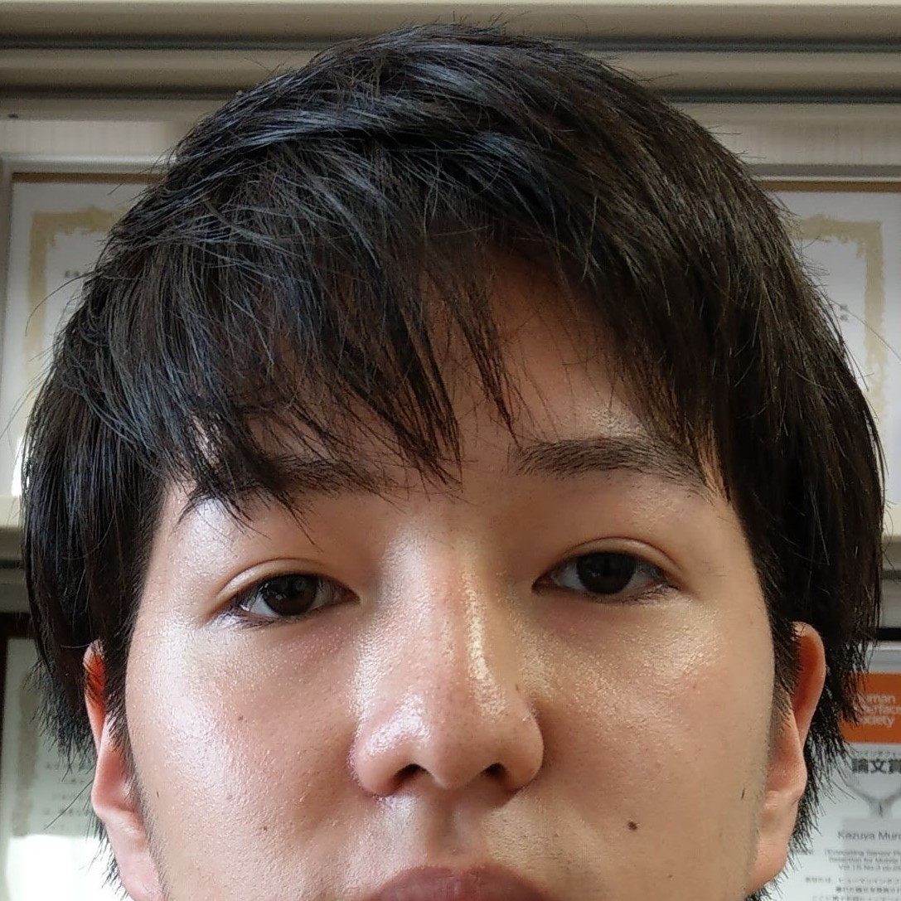
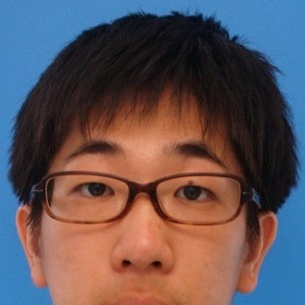
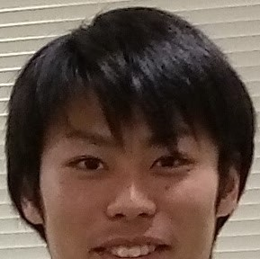
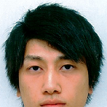



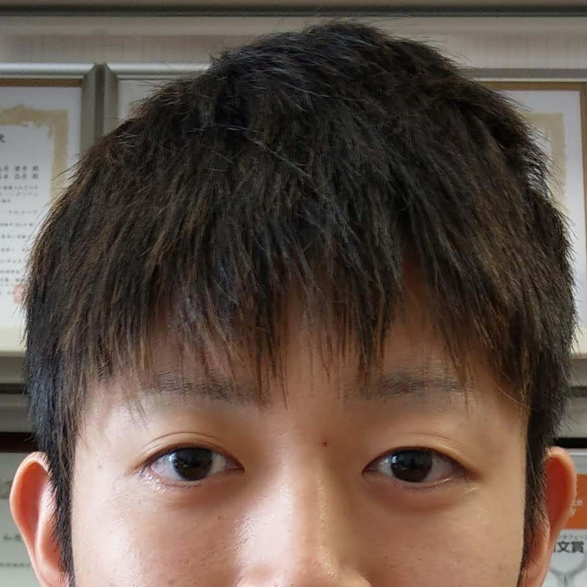
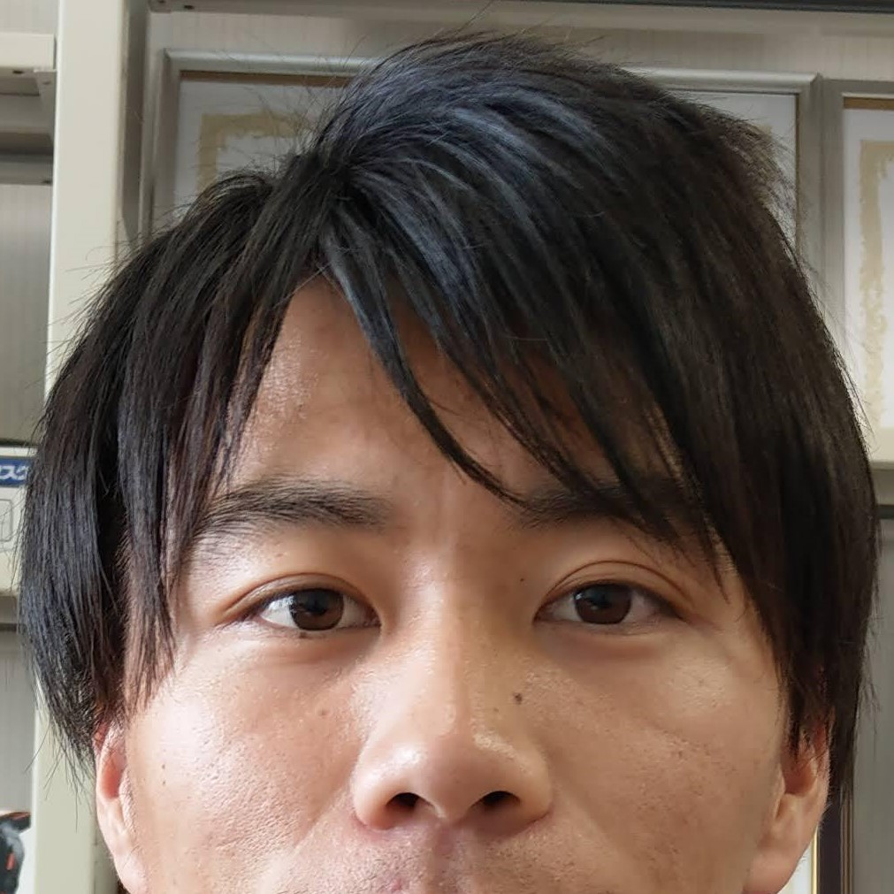
Subject A
Subject B
Subject C
Subject D
Subject E
Subject F
Subject G
Subject H
Subject I

