Slide 1
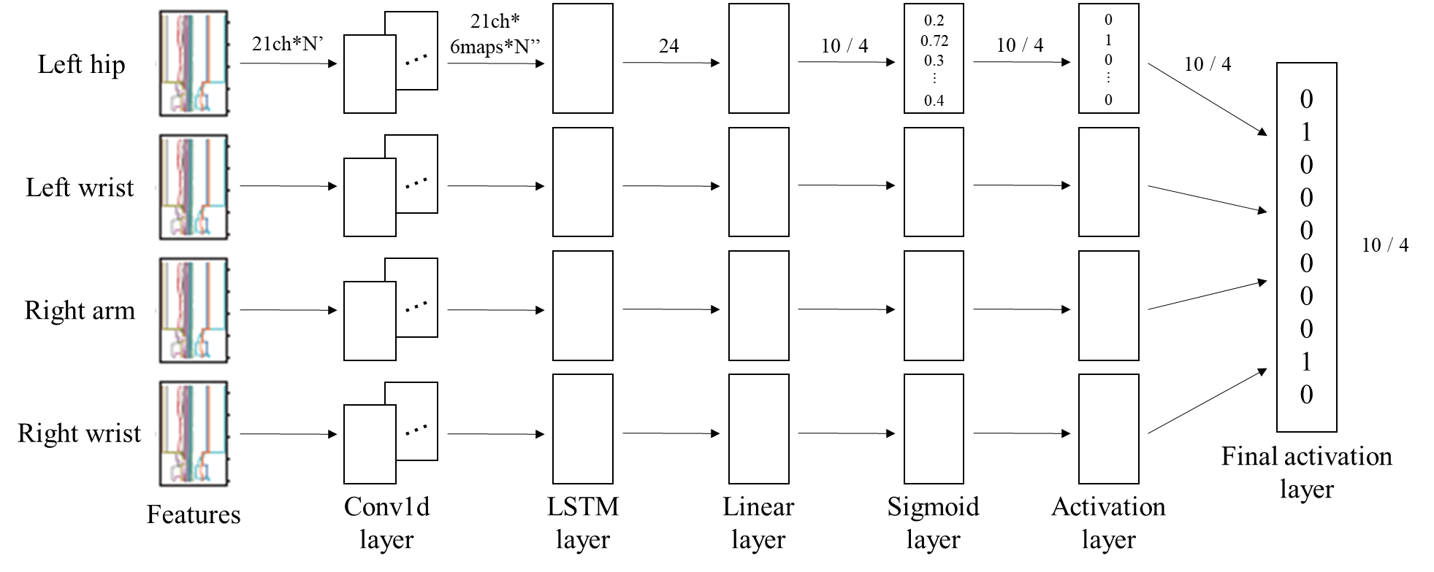
Cooking Activity Recognition with Convolutional LSTM using Multi-label Loss Function and Majority Vote
Atsuhiro FUJII / Daiki KAJIWARA / Kazuya MURAO
Ritsumeikan University, Japan
Notes:
Hello everyone.
My name is Atsuhiro FUJII from Ritsumeikan University in Japan.
OK, Let’s start.
I will talk about “Cooking Activity Recognition with Convolutional LSTM using Multi-label Loss Function and Majority Vote”.
First, we will explain the rules and goals of the challenge.
In this challenge, we are given a data set obtained by four subjects performing cooking activities with sensors attached to their bodies.
This dataset contains training data for three subjects and test data for one subject.
Each team comes up with an optimal identification model and competes on the identification accuracy of the test data.
“Cooking Activity Recognition with Convolutional LSTM using Multi-label Loss Function and Majority Vote”について説明する．
まず，チャレンジのルールとゴールを説明する．
このチャレンジでは，4人の被験者が体にセンサを取り付けて調理活動を行うことで得られたデータセットが我々に与えられる．
このデータセットには，3人分の被験者の学習データと1人の被験者のテストデータが含まれる．
各チームは最適な識別モデルを考え，テストデータの識別精度を競う．

Slide 2
Dataset (1/2)
Four subjects had attached some devices; on the right arm, left hip, both wrists, and one motion capture system.
Each recording has been segmented into 30-second segments, and it was assigned a random identifier.
Micro activity; [“Cut”, “Peel”, “Open”, “Take”, “Put”,
“Pour”, “Wash”, “Add”, “Mix”, “other”]
Macro activity; [“sandwich”, “fruitsalad”, “cereal”]
Notes:
I will explain about the given dataset.
We were given train dataset and test dataset.
The subjects cooked three recipes (sandwich, fruit salad, cereal) five times each by following a script for each recipe.
The data has been collected from four subjects who had attached two smartphones on the right arm and left hip, two smartwatches on both wrists, and one motion capture system with 29 markers.
Each recording has been segmented into 30-second segments, like this figure.
Each segment was assigned a random identifier, so the order of the segments is unknown.
Training data contains data from three subjects out of the four subjects and test data contains the data from the fourth subject.
まず，与えられたデータセットについて説明する．
我々は学習用のデータセットとテスト用のデータセットを与えられた．
各被験者は3つのレシピを5回作った．
データは4人の被験者にセンサを取り付けて収集されたものである．
各記録は30秒ごとに別れている．
各セグメントにはランダムな識別子が与えられており，順番は不明．
学習データは3人の被験者のデータを含み，テストデータには1人の被験者のデータが含まれる．
マイクロアクティビティはこのラベルが含まれていて，マクロアクティビティはこのラベルが含まれているというのを過剰書き．

Slide 3
Dataset (2/2)
Subject | Body part | # of segments | # of macro | # of micro |  |  | Length
 |  |  |  | max | mean | min | max | mean | min
1 | left hip | 80 | 1 | 5 | 2.09 | 1 | 159 | 131.9 | 1
 | left wrist |  |  |  |  |  | 8191 | 2945 | 0
 | right arm |  |  |  |  |  | 1470 | 1309 | 8
 | right wrist |  |  |  |  |  | 8257 | 4484 | 0
2 | left hip | 105 | 1 | 6 | 2.26 | 1 | 505 | 428.3 | 10
 | left wrist |  |  |  |  |  | 5986 | 2171 | 0
 | right arm |  |  |  |  |  | 1500 | 1272 | 8
 | right wrist |  |  |  |  |  | 2992 | 2465 | 0
3 | left hip | 103 | 1 | 6 | 2.3 | 1 | 519 | 429.3 | 32
 | left wrist |  |  |  |  |  | 5529 | 774.6 | 0
 | right arm |  |  |  |  |  | 1594 | 1182 | 164
 | right wrist |  |  |  |  |  | 5938 | 3559 | 0
4 | left hip | 180 | 1 | Unknown | Unknown | Unknown | 534 | 406.7 | 46
 | left wrist |  |  |  |  |  | 7143 | 1126 | 0
 | right arm |  |  |  |  |  | 1479 | 1233 | 86
 | right wrist |  |  |  |  |  | 8761 | 2080 | 0
Notes:
This is the details of the dataset.
Each segment contains one macro behavior and up to six micro behaviors.
Some of the files may have missing data.
これはデータセットの詳細です．
1つのセグメントにつき，マクロ行動は1つ，マイクロ行動は最大6つ含まれています．
また，ファイルの中にはデータが欠損しているものも存在します．
Lengthは8000から0まである．0の場合はデータが欠損している．

Slide 4







Method - Preprocessing
Hand crafted feature values are extracted from the raw data.
30 seconds
$$x$$
$z$ features
・・・・・・・・・・
$y$ features
3 sec
21 dimensions
$x$mean, $x$variance, $x$max, $x$min, $x$root mean square,
$x$interquartile range,
$x$zero crossing rate
$x$ features
50 ms
$$N_{x}$$
$$N′$$
Notes:
Hand crafted feature values are extracted from the raw data.
The features are mean, variance, max, min, root mean square, interquartile range, and zero crossing rate for each axis, respectively.
These features are calculated over a 50ms-window slid in steps of 3 seconds.
From the preprocessing, 21 dimensions feature are obtained for one sensor.
生データから特徴量を抽出する。
特徴量は、各軸の平均、分散、最大、最小、二乗平均平方根（RMS）、四分位間距離（IQR）、ゼロクロスレート（ZCR）です。
これらの特徴は、50msのウィンドウを3秒単位でスライドさせて計算されます。
前処理により、1 つのセンサに対して21次元の特徴量が得られた。

Slide 5

Method - Model (Micro activity)
21ch*
6maps*N’’
0.2
0.72
0.3
︙
0.4
0
1
0
︙
0
21ch*N’
24
10 / 3
10 / 3
Left hip
・・・
10 / 3
0
1
0
0
0
0
0
0
1
0
Left wrist
・・・
10 / 3
Right arm
・・・
Right wrist
・・・
Final activation
layer
Features
Conv1d
layer
LSTM
layer
Linear
layer
Sigmoid
layer
Activation
layer
Notes:
This is our identification model.
From left to right: "Conv1d layer", "LSTM layer", "Sigmoid layer", and There are "Activation layer" and "Final activation layer".
In "Conv1d layer", Mapsize was set to 6, we input features of 21 dimensions with length N', and get a features of 21 dimensions with 6 map and length N''.
Then, in the "LSTM layer", that features are inputted to form a 24-dimensional feature.
"Linear layer" compresses 24 dimensional features into 10 dimensions for micro activities and 4 dimensions for macro activities.
"Sigmoid layer" applies a sigmoid function.
Next, we use the "activation layer" to obtain one-hot vectors.
これが私達の識別モデルです．
左から順に“Conv1d layer”，”LSTM layer”，”Sigmoid layer”，”Activation layer”，”Final activation layer”があります．
“Conv1d layer”はmapsizeを6に設定しており，21次元で長さN’の特徴量を入力して21次元×6マップで長さN’’の特徴量を得る．
次に”LSTM layer”ではその特徴量を入力し，24次元の特徴量とする．
“Linear layer”は24次元の特徴量をmacro活動では4次元，micro活動では10次元に圧縮する．
“Sigmoid layer”ではシグモイド関数を適用する．
次に“Activation layer”でone-hot vectorを取得する．

Slide 6

Method - Model
BCEWith
LogistsLoss
Threshold $T_{h}$
Micro activity
21ch*
6maps*N’’
21ch*N’
24 dim
10 dim
10 dim
0.72
0.2
︙
0.4
1
0
︙
0
SUM
Left hip
・・・
2
1
2
0
0
0
0
0
0
0
“Cut”
“Peel”
“Open”
“Take”
“Put”
“Pour”
“Wash”
“Add”
“Mix”
“other”
0.8
0.3
︙
0.13
1
0
︙
0
Left wrist
・・・
0.2
0.13
︙
0.02
0
0
︙
0
Right arm
・・・
0.11
0.81
︙
0.28
0
1
︙
0
Right wrist
・・・
Final activation
layer
Features
Conv1d
layer
LSTM
layer
Linear
layer
Sigmoid
layer
Activation
layer
Notes:
This is our identification model.
From left to right: "Conv1d layer", "LSTM layer", "Sigmoid layer", and There are "Activation layer" and "Final activation layer".
In "Conv1d layer", Mapsize was set to 6, we input features of 21 dimensions with length N', and get a features of 21 dimensions with 6 map and length N''.
Then, in the "LSTM layer", that features are inputted to form a 24-dimensional feature.
"Linear layer" compresses 24 dimensional features into 10 dimensions for micro activities and 4 dimensions for macro activities.
"Sigmoid layer" applies a sigmoid function.
Next, we use the "activation layer" to obtain one-hot vectors.
これが私達の識別モデルです．
左から順に“Conv1d layer”，”LSTM layer”，”Sigmoid layer”，”Activation layer”，”Final activation layer”があります．
“Conv1d layer”はmapsizeを6に設定しており，21次元で長さN’の特徴量を入力して21次元×6マップで長さN’’の特徴量を得る．
次に”LSTM layer”ではその特徴量を入力し，24次元の特徴量とする．
“Linear layer”は24次元の特徴量をmacro活動では4次元，micro活動では10次元に圧縮する．
“Sigmoid layer”ではシグモイド関数を適用する．
次に“Activation layer”でone-hot vectorを取得する．

Slide 7
Method - Model
21ch*
6maps*N’’
0.2
0.72
0.3
︙
0.4
0
1
0
︙
0
21ch*N’
24
10 / 3
10 / 3
Left hip
・・・
10 / 3
0
1
0
0
0
0
0
0
1
0
Left wrist
・・・
10 / 3
Right arm
・・・
Right wrist
・・・
Final activation
layer
Features
Conv1d
layer
LSTM
layer
Linear
layer
Sigmoid
layer
Activation
layer
Notes:
This is our identification model.
From left to right: "Conv1d layer", "LSTM layer", "Sigmoid layer", and There are "Activation layer" and "Final activation layer".
In "Conv1d layer", Mapsize was set to 6, we input features of 21 dimensions with length N', and get a features of 21 dimensions with 6 map and length N''.
Then, in the "LSTM layer", that features are inputted to form a 24-dimensional feature.
"Linear layer" compresses 24 dimensional features into 10 dimensions for micro activities and 4 dimensions for macro activities.
"Sigmoid layer" applies a sigmoid function.
Next, we use the "activation layer" to obtain one-hot vectors.
これが私達の識別モデルです．
左から順に“Conv1d layer”，”LSTM layer”，”Sigmoid layer”，”Activation layer”，”Final activation layer”があります．
“Conv1d layer”はmapsizeを6に設定しており，21次元で長さN’の特徴量を入力して21次元×6マップで長さN’’の特徴量を得る．
次に”LSTM layer”ではその特徴量を入力し，24次元の特徴量とする．
“Linear layer”は24次元の特徴量をmacro活動では4次元，micro活動では10次元に圧縮する．
“Sigmoid layer”ではシグモイド関数を適用する．
次に“Activation layer”でone-hot vectorを取得する．

Slide 8
Result
Activity type | Train data | Test data | Max. accuracy | Min. loss
Micro | Subject 1, 2 | Subject 3 | 0.536 | 0.436
 | Subject 2, 3 | Subject 1 | 0.497 | 0.445
 | Subject 1, 3 | Subject 2 | 0.532 | 0.424
 | Average |  | 0.521 | 0.435
Macro | Subject 1, 2 | Subject 3 | 0.522 | 1.057
 | Subject 2, 3 | Subject 1 | 0.416 | 1.094
 | Subject 1, 3 | Subject 2 | 0.535 | 1.050
 | Average |  | 0.491 | 1.067
Notes:
This table shows maximum accuracy and minimum loss of micro and macro activities over 1,000 epochs by changing training data and test data.
This is average value of the four sensor positions.
The accuracy was calculated using the one-hot vectors in the activation layer.
The loss was calculated using the vectors in the sigmoid layer.
From these results, average accuracy of 0.521 and 0.491 were achieved among subjects 1, 2, and 3 in leave-one-subject-out manner for micro and macro activities, respectively.
Considering ten multi-label micro activities, it would be said that 0.521 accuracy is good, while 0.491 accuracy for 3-class macro activity can be improved.
We trained the model on data from subjects 1, 2, and 3, and obtained prediction results for subject 4's data, and the results were then submitted.
Now all finished. Thank you for listening.
この表は、トレーニングデータとテストデータを変化させて、1,000エポック以上のミクロ活動とマクロ活動の最大精度と最小損失を示したものです。
4つのセンサ位置の平均値である。
精度は活性化層のワンホットベクトルを用いて計算した。
損失関数はシグモイド層のベクトルを用いて計算した。
これらの結果から、被験者 1,2,3 の間では、マイクロアクティビティとマクロアクティビティの平均精度がそれぞれ 0.521, 0.491 となった。
10 個のマルチラベルのマイクロアクティビティを考慮すると、0.521 の精度は良好であるが、3 クラスのマクロアクティビティでは 0.491 の精度が向上する可能性があると言えるだろう。
我々は被験者1,2,3のデータでこのモデルを学習させ，被験者4のデータの予測結果を得た．
そして，その結果を提出した．
ご清聴ありがとうございました．

Slide 9
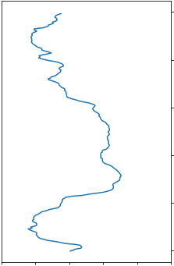
Dataset (1/2)
Four subjects cooked three recipes; sandwich, fruit salad, cereal.
The subjects had attached some devices; on the right arm, left hip, both wrists, and one motion capture system.
Each recording has been segmented into 30-second segments, and it was assigned a random identifier.
30 seconds
subject1_file_72.csv
30 seconds
subject1_file_140.csv
30 seconds
subject1_file_213.csv
30 seconds
subject1_file_417.csv
30 seconds
subject1_file_873.csv
Notes:
I will explain about the given dataset.
We were given train dataset and test dataset.
The subjects cooked three recipes (sandwich, fruit salad, cereal) five times each by following a script for each recipe.
The data has been collected from four subjects who had attached two smartphones on the right arm and left hip, two smartwatches on both wrists, and one motion capture system with 29 markers.
Each recording has been segmented into 30-second segments, like this figure.
Each segment was assigned a random identifier, so the order of the segments is unknown.
Training data contains data from three subjects out of the four subjects and test data contains the data from the fourth subject.
まず，与えられたデータセットについて説明する．
我々は学習用のデータセットとテスト用のデータセットを与えられた．
各被験者は3つのレシピを5回作った．
データは4人の被験者にセンサを取り付けて収集されたものである．
各記録は30秒ごとに別れている．
各セグメントにはランダムな識別子が与えられており，順番は不明．
学習データは3人の被験者のデータを含み，テストデータには1人の被験者のデータが含まれる．
マイクロアクティビティはこのラベルが含まれていて，マクロアクティビティはこのラベルが含まれているというのを過剰書き．

Slide 10
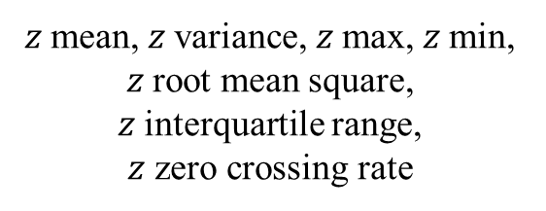

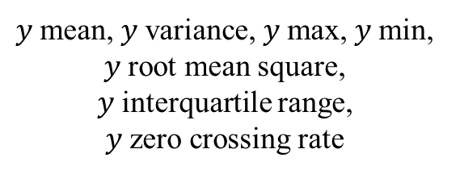
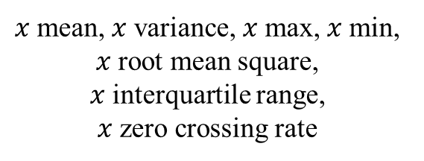

Method - Preprocessing
Hand crafted feature values are extracted from the raw data.
30 seconds
$$x$$
$$y$$
$$z$$
3 sec
$x$mean, $x$variance, $x$max, $x$min, $x$root mean square,
$x$interquartile range,
$x$zero crossing rate
$y$mean, $y$variance, $y$max, $y$min, $y$root mean square,
$y$interquartile range,
$y$zero crossing rate
$z$mean, $z$variance, $z$max, $z$min, $z$root mean square,
$z$interquartile range,
$z$ zero crossing rate
21 dimensions features
Notes:
Hand crafted feature values are extracted from the raw data.
The features are mean, variance, max, min, root mean square, interquartile range, and zero crossing rate for each axis, respectively.
These features are calculated over a 50ms-window slid in steps of 3 seconds.
From the preprocessing, 21 dimensions feature are obtained for one sensor.
生データから特徴量を抽出する。
特徴量は、各軸の平均、分散、最大、最小、二乗平均平方根（RMS）、四分位間距離（IQR）、ゼロクロスレート（ZCR）です。
これらの特徴は、50msのウィンドウを3秒単位でスライドさせて計算されます。
前処理により、1 つのセンサに対して21次元の特徴量が得られた。

Slide 11
Method - Loss Function and Optimizer
Micro activity
BCEWithLogistsLoss
Macro activity
CrossEntropyLoss
Notes:
We use "BCEWithLogistsLoss" in the case of "Micro activity" as "Loss Function and Optimizer", and in the case of "Macro activity", we use "CrossEntropyLoss".
“Loss Function and Optimizer”には，”Macro activity”の場合は”CrossEntropyLoss”を，”Micro activity”の場合は”BCEWithLogistsLoss”を使用した．

Slide 12
Method - Final activation
Left hip
Left wrist
Right arm
Right wrist
Majority Vote
1
0
0
0
0
0
0
0
0
0
1
0
1
0
0
0
0
0
0
0
0
0
1
0
0
0
0
0
0
0
0
1
0
0
0
0
0
0
0
0
2
1
2
0
0
0
0
0
0
0
“Cut”
“Peel”
“Open”
“Take”
“Put”
“Pour”
“Wash”
“Add”
“Mix”
“other”
“Cut”, “Open”
Micro activity
Macro activity
0.1
0.5
0.9
0.1
0.2
0.6
0.1
0.6
0.8
0.3
0.2
0.7
0.6
1.5
3.0
“sandwich”
“fruitsalad”
“cereal”
“cereal”
Notes:
In "Final activation layer", a majority vote is taken.
In the micro activity, the one-hot vectors of each position obtained in the "activation layer" are added together, and labels with a value of 2 or more is output as the result.
However, if the number of sensors is 2 or less because of missing data, we adopt labels with a value of 1 or more.
On the other hand, in the macro activity, we add the results obtained by the "Sigmoid layer" and adopt the label with the largest value.
“Final activation layer”では多数決を行う．
micro活動では“Activation layer”で得られた各部位のone-hot vectorを加算し，結果が2以上となったラベルを結果として出力する．
ただし，欠損のため，センサ数が2個以下である場合は，結果が1以上のラベルを採用する．
一方，macro活動では”Sigmoid layer”で得られた結果を加算し，値が最大となったラベルを採用する．

