Slide 1
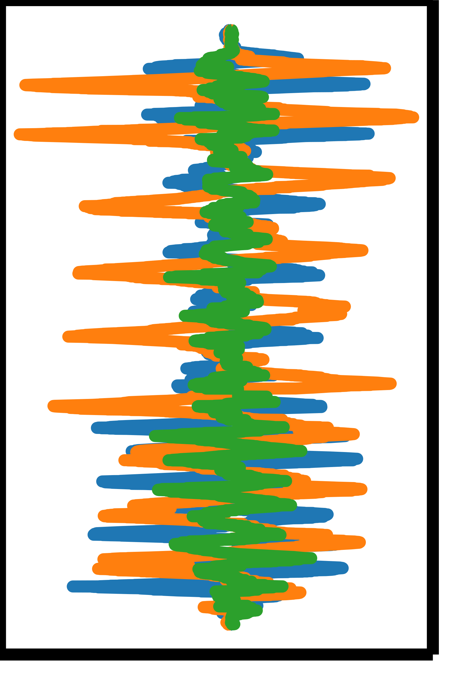
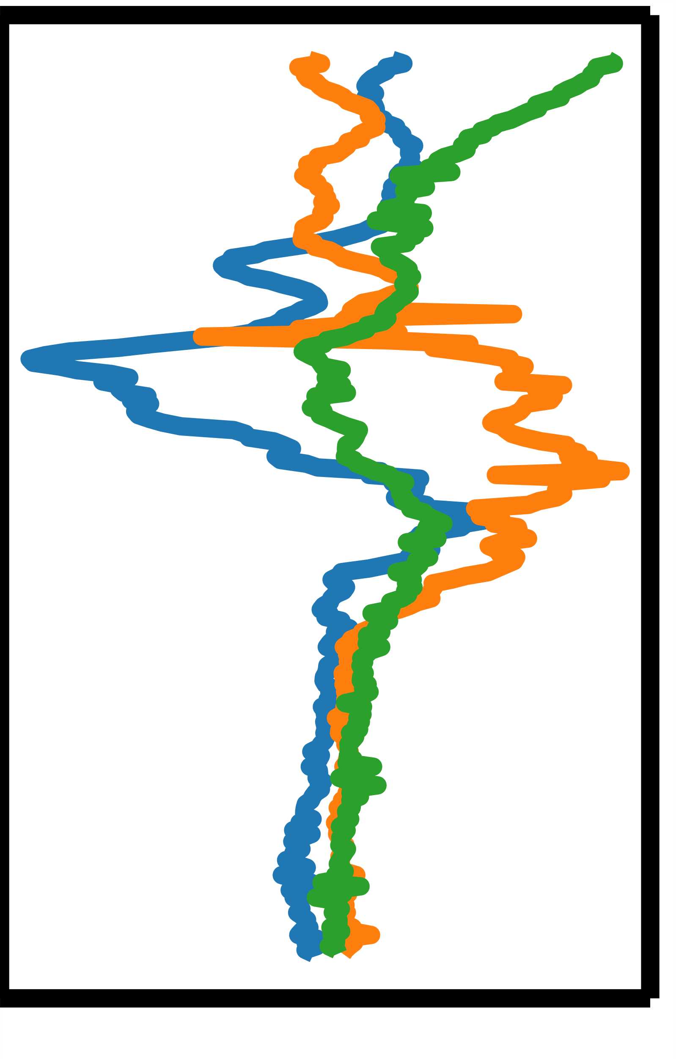
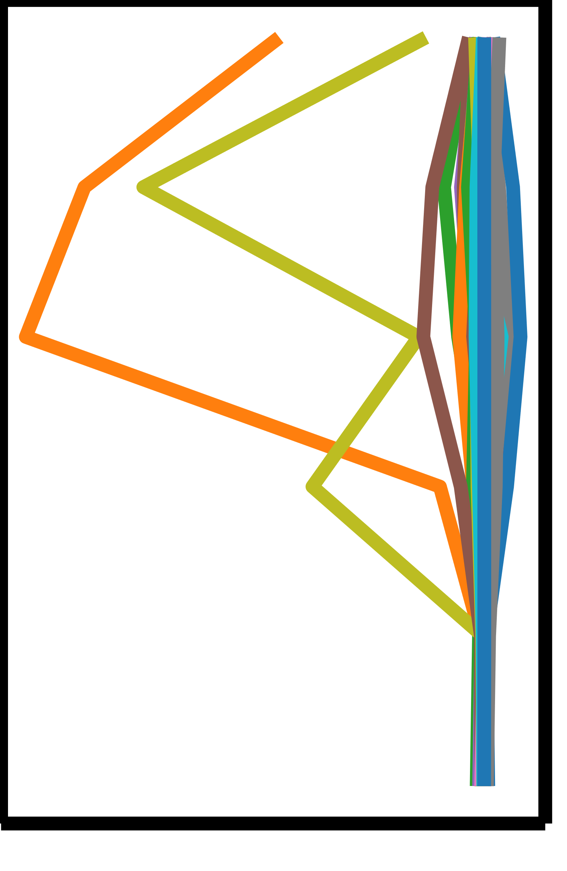
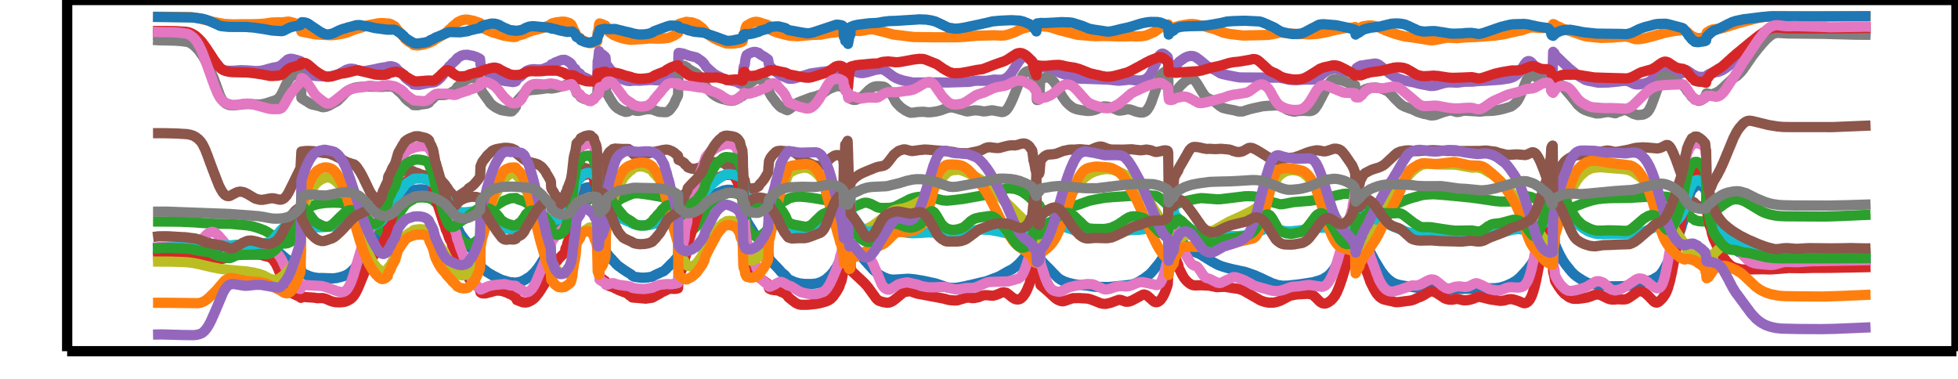
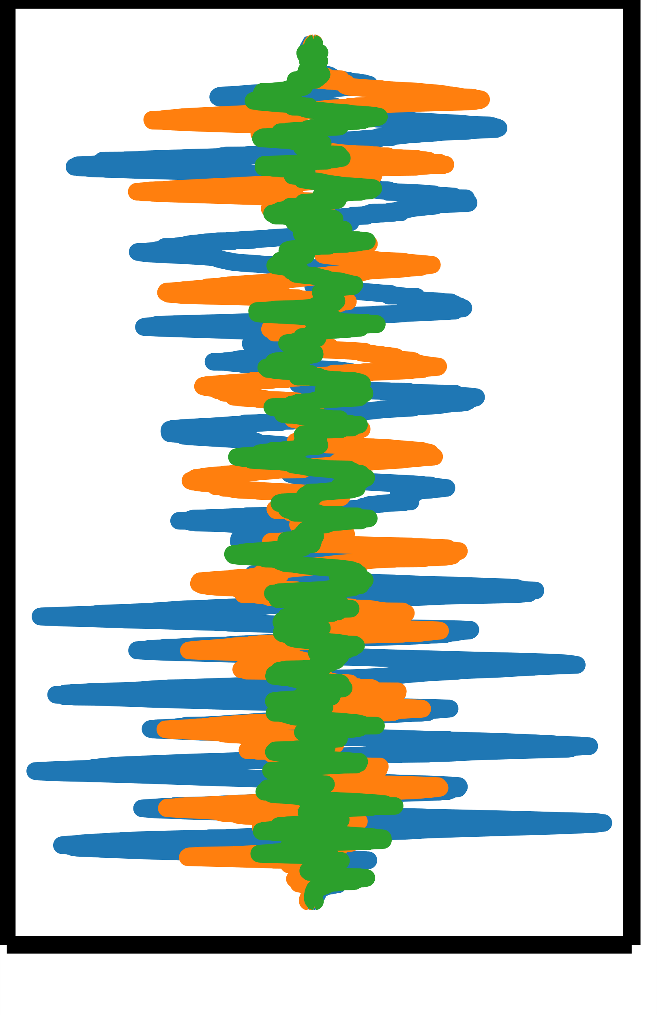
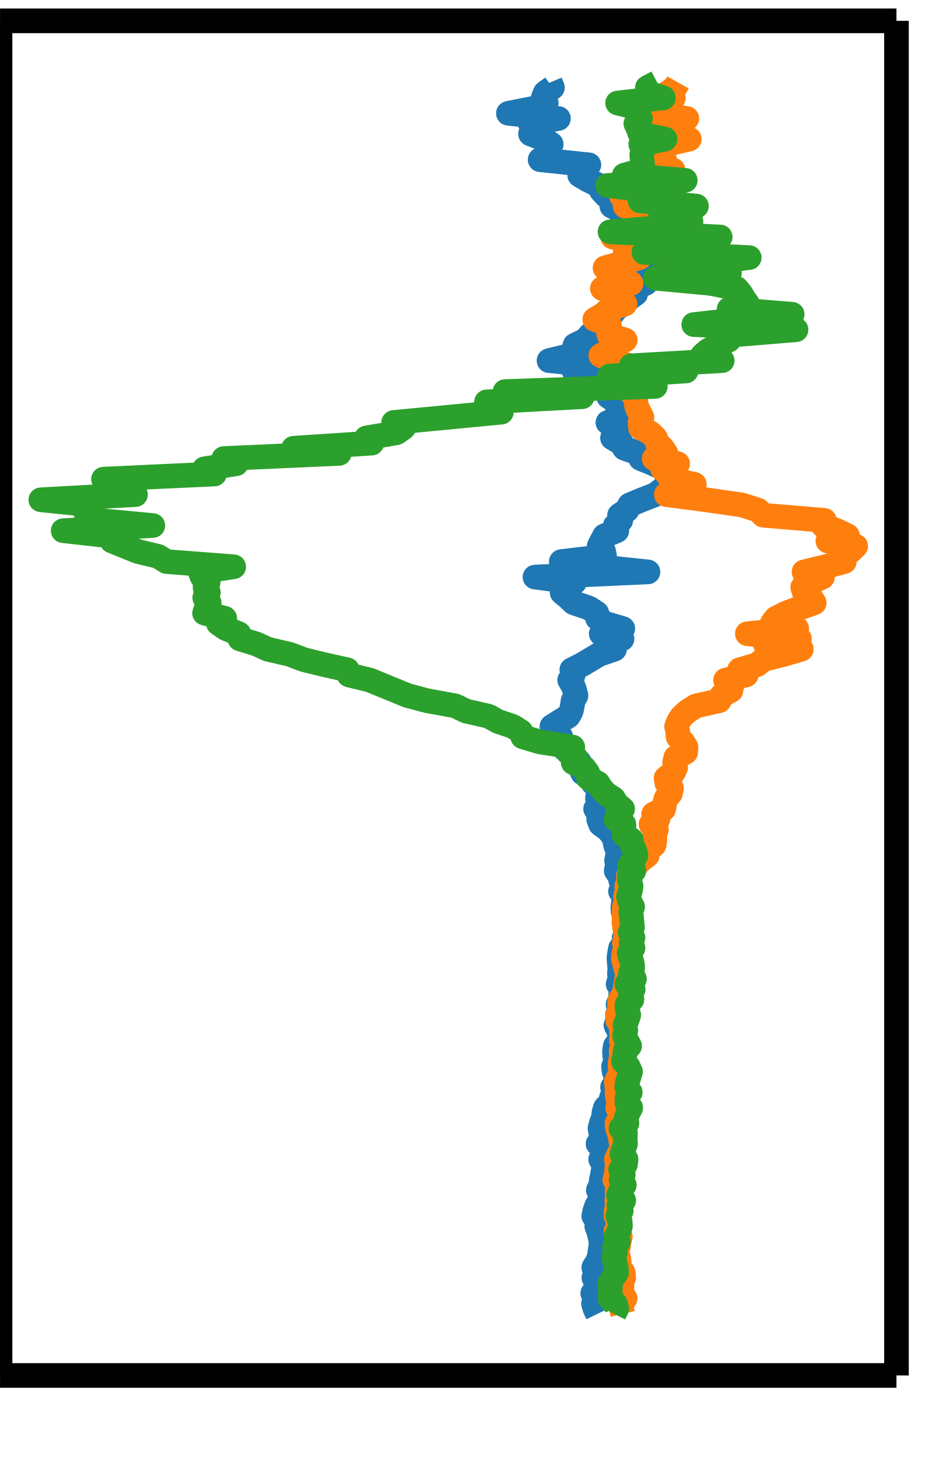
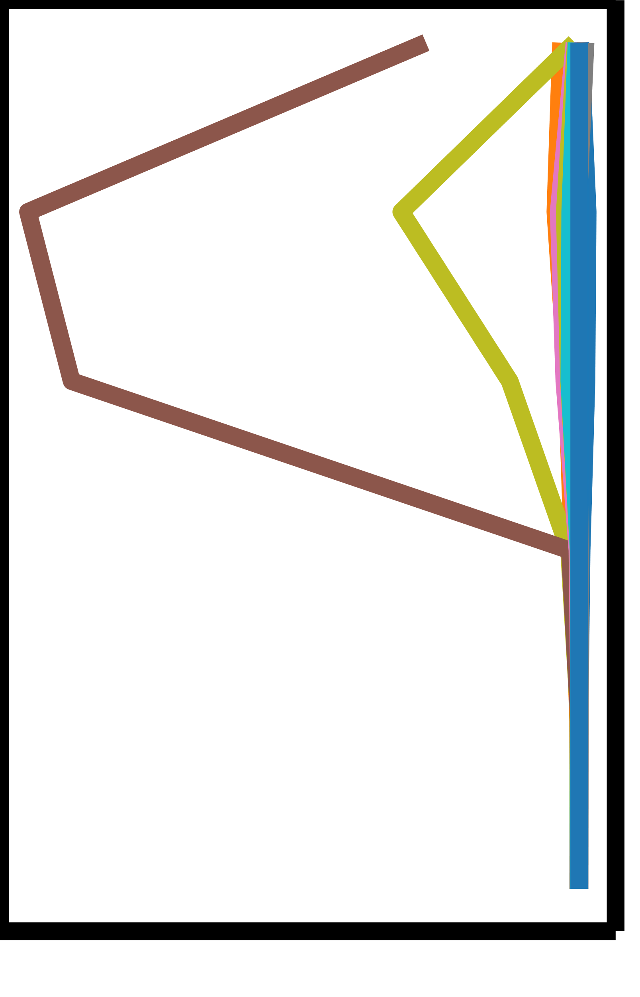


One file
One file
$R$ files
$R$ files
Right Shoulder
…
…
……
Left Wrist
…
…
Reading data
process
Converting
process
Partitioning
process
Feature extraction
process

Slide 2


21ch×$N′$
21ch×6maps×$N′$
24
10
10
10
0.2
0.41
0.7
︙
0.1
1.8
1.2
2.7
0.45
2.3
0.29
1.1
0.9
4.3
0.61
Right
Shoulder
…
……
……
9
0.79
0.0
0.1
︙
0.38
Left
Wrist
…
Features
Conv1d
layer
LSTM
layer
Linear
layer
Sigmoid
layer
Final Activation
layer

