Slide 1
Cooking Activity Recognition with Convolutional LSTM using Multi-label Loss Function and Majority Vote
Atsuhiro FUJII / Daiki KAJIWARA / Kazuya MURAO
Ritsumeikan University, Japan
Challenge GOAL
Each team competes on the recognition accuracy of cooking activities.
Notes:
Each team competes on the recognition accuracy of cooking activities.
各チームは調理行動の識別精度を競う．

Slide 2
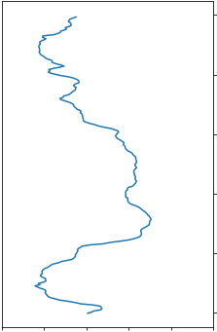
Dataset (1/2)
Four subjects cooked three recipes; sandwich, fruit salad, cereal.
The subjects had attached some devices; on the right arm, left hip, both wrists, and one motion capture system.
Each recording has been segmented into 30-second segments, and it was assigned a random identifier.
30 seconds
subject1_file_72.csv
30 seconds
subject1_file_140.csv
30 seconds
subject1_file_213.csv
30 seconds
subject1_file_417.csv
30 seconds
subject1_file_873.csv
Notes:
First, I will explain about this challenge.
We were given train dataset and test dataset.
The subjects cooked three recipes (sandwich, fruit salad, cereal) five times each by following a script for each recipe.
The data has been collected from four subjects who had attached two smartphones on the right arm and left hip, two smartwatches on both wrists, and one motion capture system with 29 markers.
Each recording has been segmented into 30-second segments, like this figure.
Each segment was assigned a random identifier, so the order of the segments is unknown.
Training data contains data from three subjects (subject 1, 2, 3) out of the four subjects and test data contains the data from the fourth subject (subject 4).
まず，このチャレンジについて説明する．
我々は学習用のデータセットとテスト用のデータセットを与えられた．
各被験者は3つのレシピを5回作った．
データは4人の被験者にセンサを取り付けて収集されたものである．
各記録は30秒ごとに別れている．
各セグメントにはランダムな識別子が与えられており，順番は不明．
学習データは3人の被験者のデータを含み，テストデータには1人の被験者のデータが含まれる．

Slide 3
Dataset (2/2)
Subject | Body part | # of segments | # of macro | # of micro |  |  | Length
 |  |  |  | max | mean | min | max | mean | min
1 | left hip | 80 | 1 | 5 | 2.09 | 1 | 159 | 131.9 | 1
 | left wrist |  |  |  |  |  | 8191 | 2945 | 0
 | right arm |  |  |  |  |  | 1470 | 1309 | 8
 | right wrist |  |  |  |  |  | 8257 | 4484 | 0
2 | left hip | 105 | 1 | 6 | 2.26 | 1 | 505 | 428.3 | 10
 | left wrist |  |  |  |  |  | 5986 | 2171 | 0
 | right arm |  |  |  |  |  | 1500 | 1272 | 8
 | right wrist |  |  |  |  |  | 2992 | 2465 | 0
3 | left hip | 103 | 1 | 6 | 2.3 | 1 | 519 | 429.3 | 32
 | left wrist |  |  |  |  |  | 5529 | 774.6 | 0
 | right arm |  |  |  |  |  | 1594 | 1182 | 164
 | right wrist |  |  |  |  |  | 5938 | 3559 | 0
4 | left hip | 180 | 1 | Unknown | Unknown | Unknown | 534 | 406.7 | 46
 | left wrist |  |  |  |  |  | 7143 | 1126 | 0
 | right arm |  |  |  |  |  | 1479 | 1233 | 86
 | right wrist |  |  |  |  |  | 8761 | 2080 | 0
Notes:
This is the details of the dataset.
Each segment contains one macro behavior and up to six micro behaviors.
Some of the files may have missing data.
これはデータセットの詳細です．
1つのセグメントにつき，マクロ行動は1つ，マイクロ行動は最大6つ含まれています．
また，ファイルの中にはデータが欠損しているものも存在します．

Slide 4
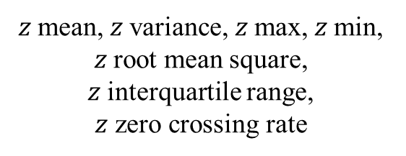

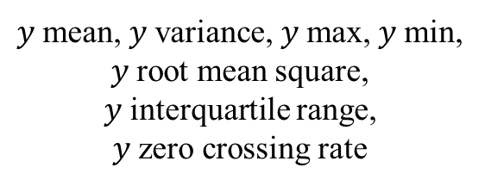
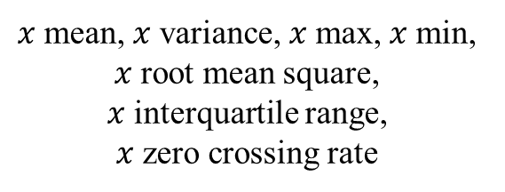

Method - Preprocessing
Hand crafted feature values are extracted from the raw data.
30 seconds
$$x$$
$$y$$
$$z$$
3 sec
$x$mean, $x$variance, $x$max, $x$min, $x$root mean square,
$x$interquartile range,
$x$zero crossing rate
$y$mean, $y$variance, $y$max, $y$min, $y$root mean square,
$y$interquartile range,
$y$zero crossing rate
$z$mean, $z$variance, $z$max, $z$min, $z$root mean square,
$z$interquartile range,
$z$ zero crossing rate
21 dimensions features
Notes:
Hand crafted feature values are extracted from the rawdata.
The features are mean, variance, max, min, root mean square (RMS), interquartile range (IQR), and zero crossing rate (ZCR) for each axis, respectively.
These features are calculated over a 50ms-window slid in steps of 3 seconds.
From the preprocessing, 21 dimensions feature are obtained for one sensor.
生データから特徴量を抽出する。
特徴量は、各軸の平均、分散、最大、最小、二乗平均平方根（RMS）、四分位間距離（IQR）、ゼロクロスレート（ZCR）です。
これらの特徴は、50msのウィンドウを3秒単位でスライドさせて計算されます。
前処理により、1 つのセンサに対して21次元の特徴量が得られた。

Slide 5
Method - Model

