Slide 1
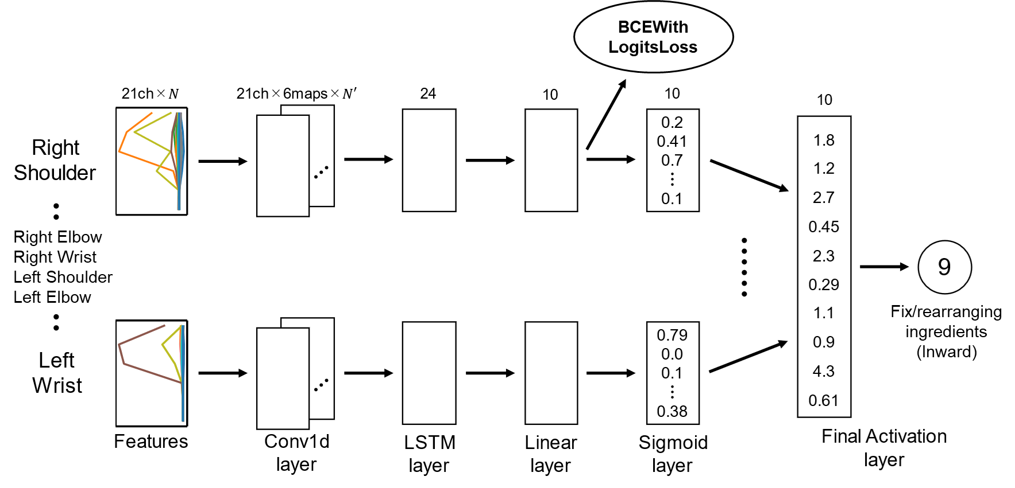
Bento Packaging Activity Recognition with Convolutional LSTM using Autocorrelation Function and Majority Vote
Atsuhiro FUJII, Kazuki YOSHIDA, Kiichi SHIRAI, Kazuya MURAO
Ritsumeikan University, Japan
Notes:
Hello everyone.
My name is Atsuhiro Fujii from Ritsumeikan University in Japan.
Now, I will talk about our Bento Packaging Activity Recognition method.
(00:15)

Slide 2
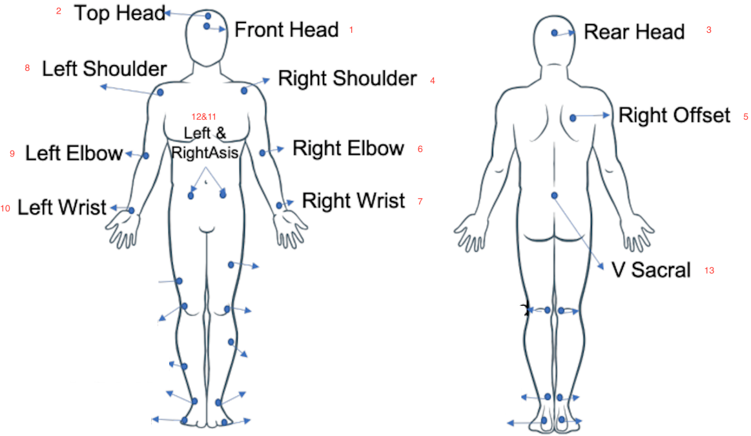
Dataset (1/3)
Four subjects had attached one motion capture system with 29 markers.
The markers may be labeled incorrectly in some cases due to the complex setting.
https://abc-research.github.io/bento2021/data/
Notes:
I will explain about the given dataset.
We were given train dataset and test dataset.
Four subjects had attached one motion capture system with 29 markers.
The markers may be labeled incorrectly in some cases due to the complex setting.
(00:40)

Slide 3
Dataset (2/3)
Activity name | Movement direction pattern | Activity label
Normal | Inward | 1
 | Outward | 2
Forgot to put ingredients | Inward | 3
 | Outward | 4
Failed to put ingredients | Inward | 5
 | Outward | 6
Turn over bento-box | Inward | 7
 | Outward | 8
Fix/rearranging ingredients | Inward | 9
 | Outward | 10
The measurement time for each file ranges from 50 to 70 s.
Notes:
The five activities to be identified are Normal, Forgot to put ingredients, Failed to put ingredients, Turn over bento-box, Fix/rearranging ingredients.
Then, these activities are classified into a total of 10 labels because of the orientation of their actions.
The measurement time for each file ranges from 50 to 70 s.
(01:10)

Slide 4
Dataset (3/3)
Subject | Activity label | # of segment | Length
 |  |  | max | mean | min
1 | 1~10 | 49 | 6962 | 5818 | 5516
2 | 1~10 | 52 | 8441 | 6303 | 6343
3 | 1~10 | 50 | 6337 | 5514 | 5459
4 | Unknown | 48 | 5947 | 5024 | 5481
Notes:
!! Three subjects' data were given as training data, !! and one subject's data was given as test data.
We need to classify what activities are included in the 48 segments of subject 4. !!
Each segment contains one activity.
The length of the data is approximately 6000.
(01:35)

Slide 5
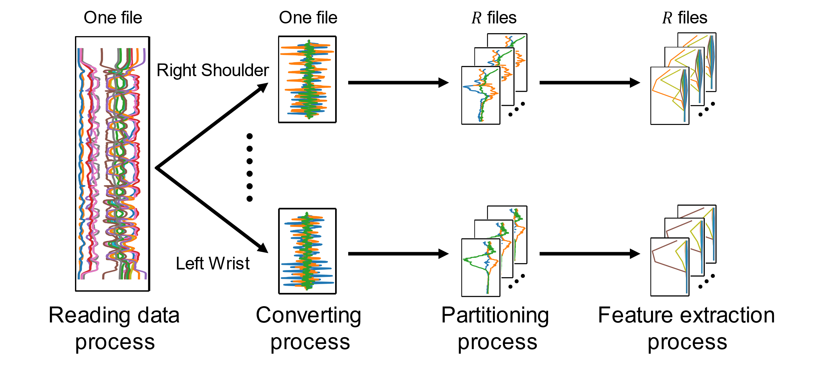
Method – Preprocessing (Overall)
Right Elbow
Right Wrist
Left Shoulder
Left Elbow
…………
Notes:
In the proposed method, preprocessing is performed before feeding the data into the classification model.
After explaining the overall flow, each process will be explained in detail. !!
First, Reading data process reads the motion capture data from the file for each part. !!
Converting process converts motion capture data to velocity data. !!
This velocity data contains repetitive behaviors, so it is divided into files for each motion by Partitioning process. !!
Finally, feature values are extracted from each velocity data.
(02:20)

Slide 6
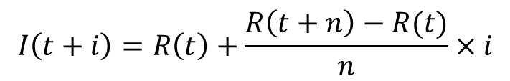






Method – Preprocessing (Converting process)
Converting to velocity data from the raw data.
The process interpolate the missing values in the raw data.
The interpolated data was used to calculate the velocity data.
$$t$$
$$t+1$$
$$t+2$$
$$t+3$$
$$t+4$$
$$I\left(t+i\right)=R\left(t\right)+\frac{R\left(t+n\right)−R(t)}{n}×i$$
100
300
500
700
900
$$V\left(j\right)=\frac{I\left(j\right)−I(j−1)}{0.01}$$
The dataset frequency was 100 Hz.
Notes:
I will explain the detail of Converting process.
This process convert to velocity data from the raw data.
First, the process interpolate the missing values in the raw data. !!
The interpolation algorithm is represented by this equation. !!
If t is 100 and t+4 is 900, increasing by 200, !! then t+1 is 300, !! t+2 is 500, !! and t+3 is 700.
Next, the interpolated data was used to calculate the velocity data.
The method calculates the difference between adjacent values, !! and then divides by 0.01 to calculate the velocity data.
(03:20)

Slide 7
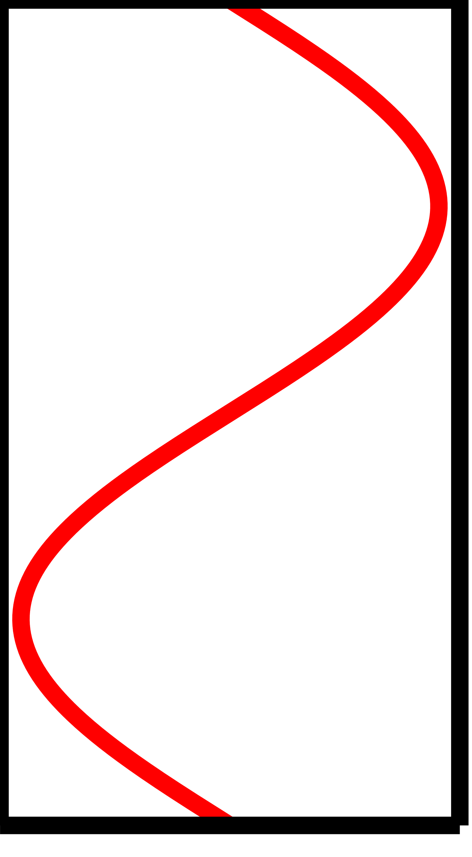
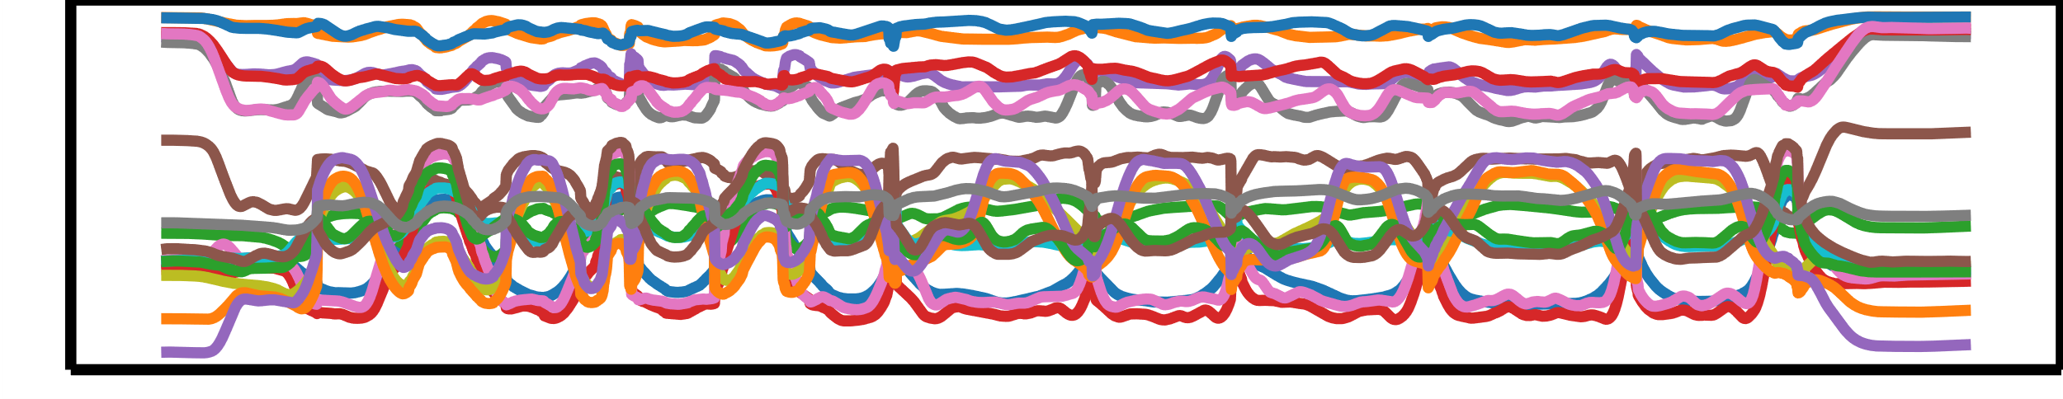
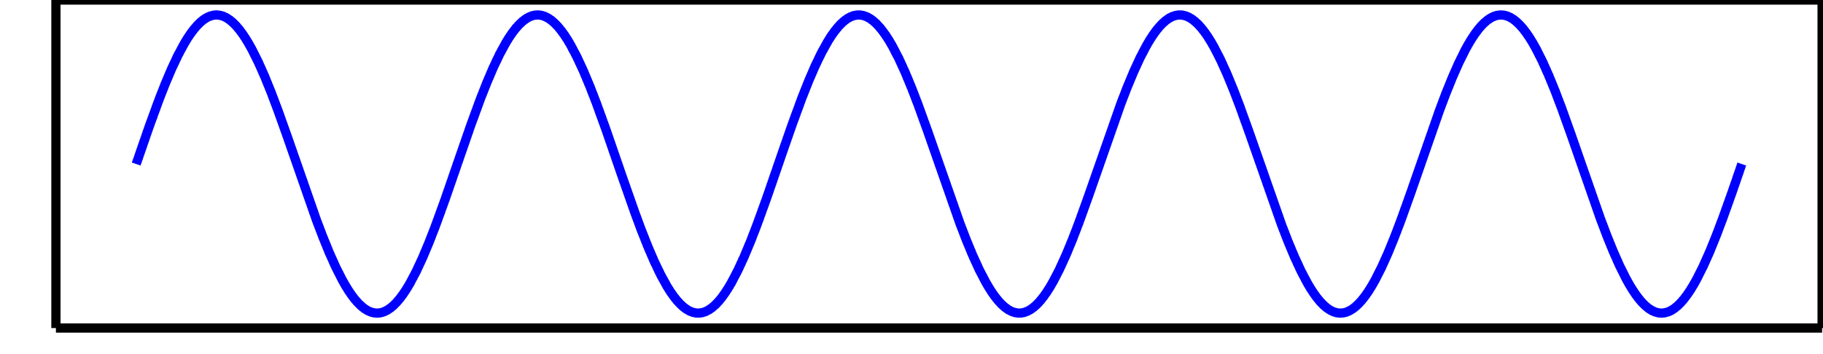

Method – Preprocessing (Partitioning process)
This process of divide the given data of approximately 60 s into data for one operation.
One file
One file
$R$ files
Sum
Autocorrelation
function
One operation
time-series
velocity data
Time-series
velocity data
Synthetic wave
Notes:
This is the detail of Partitioning process.
This process of divide the given data of approximately 60 s into data for one operation. !!
The data given is the velocity data of the time series after Converting process. !!
The process sums the data for all axes and calculates the composite wave.
The autocorrelation function is a function for detecting repetitive actions. !!
An autocorrelation function is applied to the calculated synthetic wave, and the data is divided into separate data for each repetitive action.
(04:10)

Slide 8





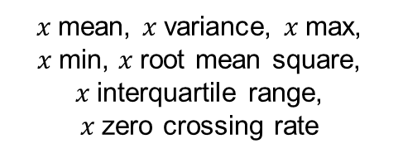

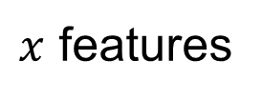
Method – Preprocessing (Feature extraction process)
This process extract the feature data.
One operation
time-series velocity data
$$x$$
$z$ features
・・・・・・
$y$ features
400 ms
$x$ features
21 dimensions
$x$mean, $x$variance, $x$max, $x$min, $x$root mean square,
$x$interquartile range,
$x$zero crossing rate
$x$ features
50 ms
$$L$$
$$L′$$
Notes:
Feature extraction process extract the feature values from the single behavior velocity data. !!
These features are calculated over a 400 milliseconds-window slid in steps of 50 milliseconds. !!
From this process, 21 dimensions features are obtained for one sensor.
(04:30)

Slide 9
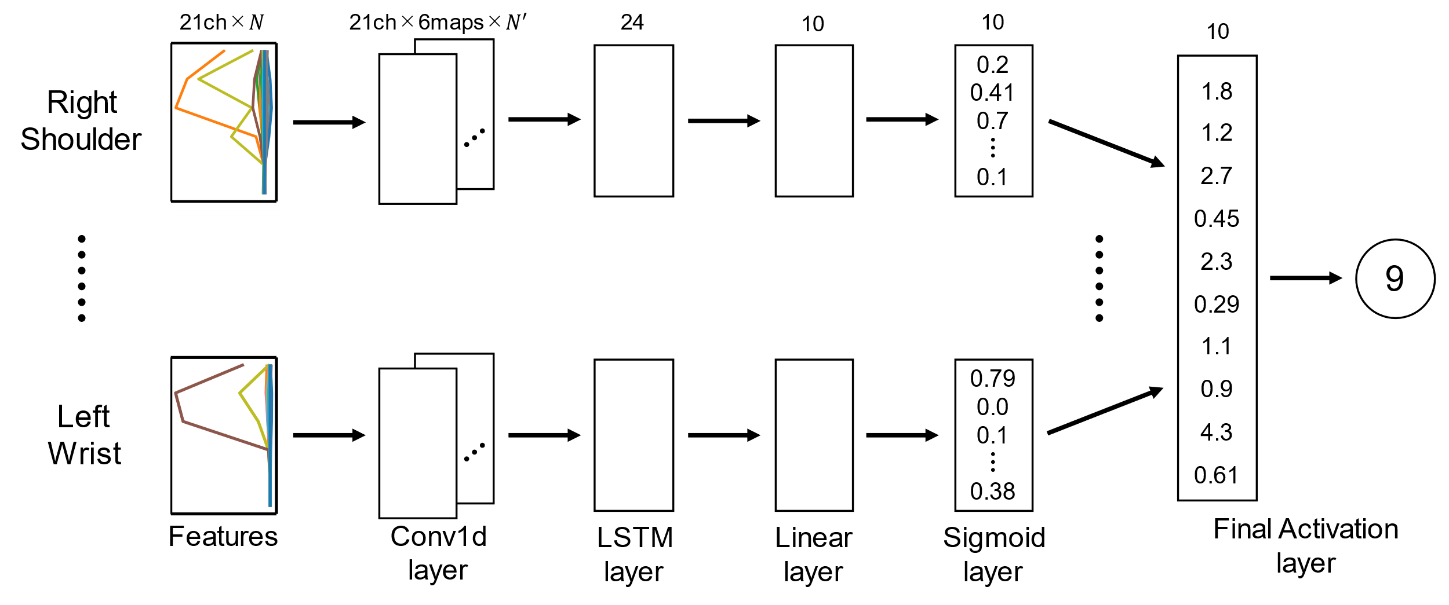
Method – Model
BCEWith
LogitsLoss
Right Elbow
Right Wrist
Left Shoulder
Left Elbow
…………
Fix/rearranging
ingredients
(Inward)
Notes:
This is our classification model. !!
The preprocessed features are 21-dimensional and of length N. !!
In Conv1d layer, Mapsize was set to 6, the method input features and get a features of 21 dimensions with 6 map and length N‘. !!
Then, in LSTM layer, that features are inputted to form a 24-dimensional feature. !!
Linear layer compresses 24 dimensional features into 10 dimensional ones. !!
In Sigmoid layer, sigmoid function is applied. !!
In Final activation layer, a majority vote is taken.
The sigmoid vectors of each position are added together, and the label with a result of max value is output as the result. !!
In training phase, BCEWithLogistsLoss was used for the loss function.
This loss function is built-in the Sigmoid function, so the output value of Linear layer is used for the loss calculation.
(06:00)

Slide 10
Evaluation
Training data | Test data | Sensor position | Accuracy | Loss
Subject 1, 2 | Subject 3 | Right Shoulder | 0.135 | 0.238
 |  | Right Elbow | 0.137 | 0.266
 |  | Right Wrist | 0.127 | 0.272
 |  | Left Shoulder | 0.118 | 0.265
 |  | Left Elbow | 0.119 | 0.261
 |  | Left Wrist | 0.136 | 0.270
Subject 1, 3 | Subject 2 | Right Shoulder | 0.136 | 0.250
 |  | Right Elbow | 0.121 | 0.290
 |  | Right Wrist | 0.133 | 0.284
 |  | Left Shoulder | 0.097 | 0.280
 |  | Left Elbow | 0.092 | 0.282
 |  | Left Wrist | 0.134 | 0.279
Subject 2, 3 | Subject 1 | Right Shoulder | 0.142 | 0.236
 |  | Right Elbow | 0.130 | 0.276
 |  | Right Wrist | 0.115 | 0.282
 |  | Left Shoulder | 0.110 | 0.278
 |  | Left Elbow | 0.127 | 0.267
 |  | Left Wrist | 0.110 | 0.280
Notes:
In order to confirm the effectiveness of the proposed method, we conducted the evaluation experiment with subjects 1, 2, and 3 in leave-one-subject-out manner.
The result shown the accuracy of approximately 0.1.
Even if we take into account the fact that it is a classification of 10 labels, this accuracy is not high.
The training dataset could have contained missing data and incorrect activity labels due to the complexity of the motion capture sensor setup.
However, we did not take any action on the data with incorrect activity labels, and there was a possibility that training was performed based on the wrong activity labels.
In addition, the proposed method used the autocorrelation function in a preprocessing to extract the repetitive motion.
However, it was possible that the data was not extracted correctly because the lengths of the waveforms after the partitioning process were significantly different.
It was thought that the accuracy became low due to training on incorrectly extracted data with incorrect activity labels.
(07:50)

Slide 11
Conclusion
Our method used the autocorrelation function in a preprocessing.
The model consisted of Convolution layer and LSTM.
The accuracy was approximately 0.12.
CPU memory | 3,043MB
GPU memory | 271MB
Training time (during 5,000 epoch) | 1,112.233 sec
Testing time (at 5,000 epoch) | 5.577 sec
OS: Windows 10 Pro
CPU: Intel Core i9-10900K 3.70GHz
RAM: DDR4 128GB
GPU: NVIDIA GeForce RTX 3060 GDDR6 12GB
Notes:
This is conclusion.
Our method used the autocorrelation function in a preprocessing.
The model consisted of Convolution layer and LSTM.
The accuracy was approximately 0.12.
Thank you for your attention.
(08:30)

