Slide 1
Bento Packaging Activity Recognition with Convolutional LSTM using Autocorrelation Function and Majority Vote
Atsuhiro FUJII, Kazuki YOSHIDA, Kiichi SHIRAI, Kazuya MURAO
Ritsumeikan University, Japan

Slide 2
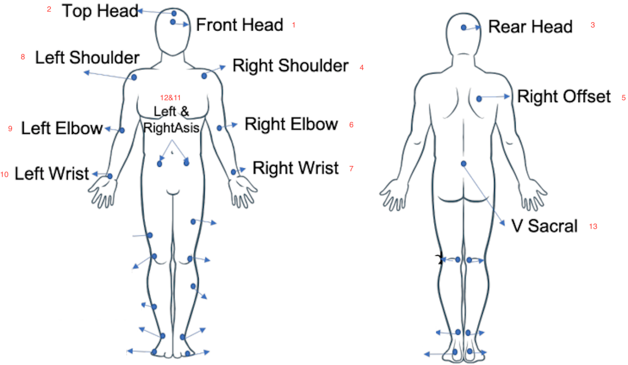
Dataset (1/3)
Four subjects had attached one motion capture system with 29 markers.
The markers may be labeled incorrectly in some cases due to the complex setting.
https://abc-research.github.io/bento2021/data/

Slide 3
Dataset (2/3)
Activity name | Movement direction pattern | Activity label
Normal | Inward | 1
 | Outward | 2
Forgot to put ingredients | Inward | 3
 | Outward | 4
Failed to put ingredients | Inward | 5
 | Outward | 6
Turn over bento-box | Inward | 7
 | Outward | 8
Fix/rearranging ingredients | Inward | 9
 | Outward | 10
The measurement time for each file ranges from 50 to 70 s.

Slide 4
Dataset (3/3)
Subject | Activity label | # of segment | Length
 |  |  | max | mean | min
1 | 1~10 | 49 | 6962 | 5818 | 5516
2 | 1~10 | 52 | 8441 | 6303 | 6343
3 | 1~10 | 50 | 6337 | 5514 | 5459
4 | Unknown | 48 | 5947 | 5024 | 5481

Slide 5
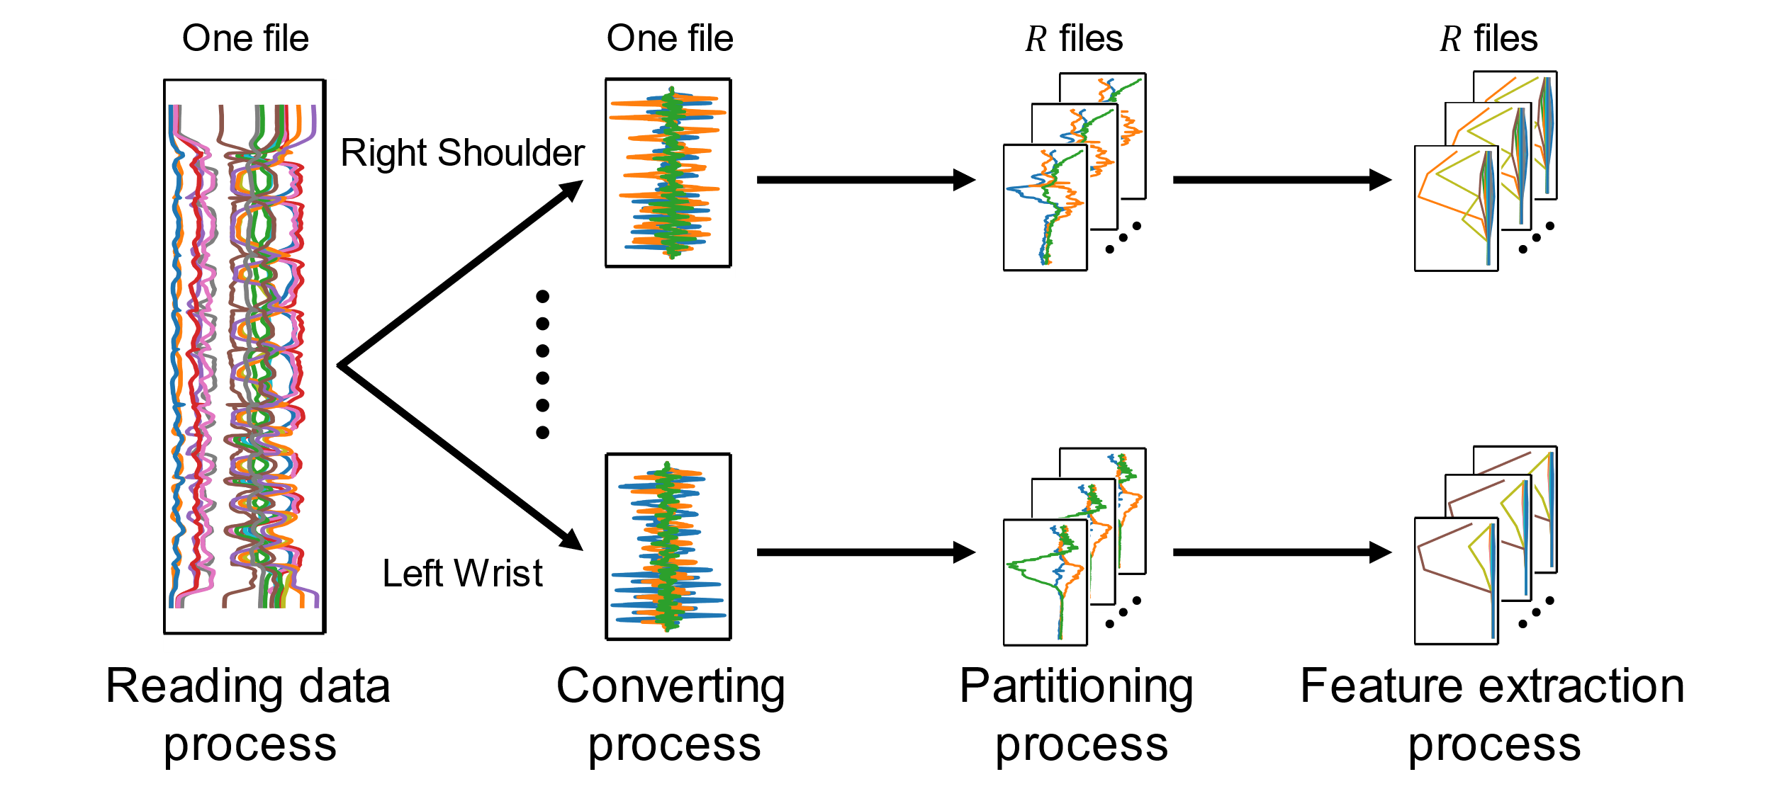
Method – Preprocessing (Overall)

