Slide 1
ISWC2020
32 pressure sensors in the helmet
32 sensor values
Training data set of the wearers
Identifier
Result
Learning Phase
Identification Phase

Slide 2
ISWC2020
32 pressure sensors in the helmet
32 sensor values
Calculating
the Mahalanobis Distance
Authentication
Training data set of the wearers
Identifier
Rejection
Learning Phase
Identification Phase

Slide 3
32 pressure sensors
・・・
・・・
・・・
Helmet
10KΩ
Printed circuit board
・・・
・・・
Analog IN Port
Analog IN Port
5V
Microcomputer
GND
Microcomputer
Computer

Slide 4
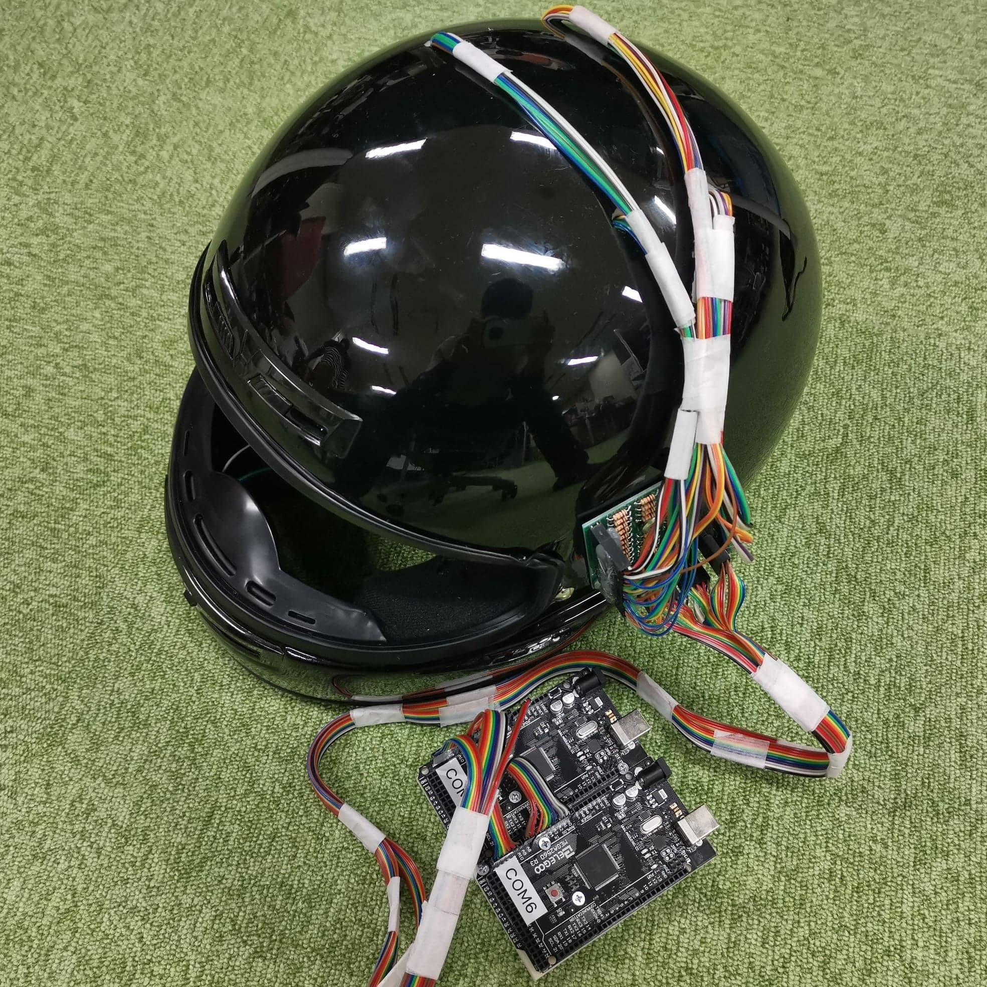
Printed circuit board
Microcomputers

Slide 5
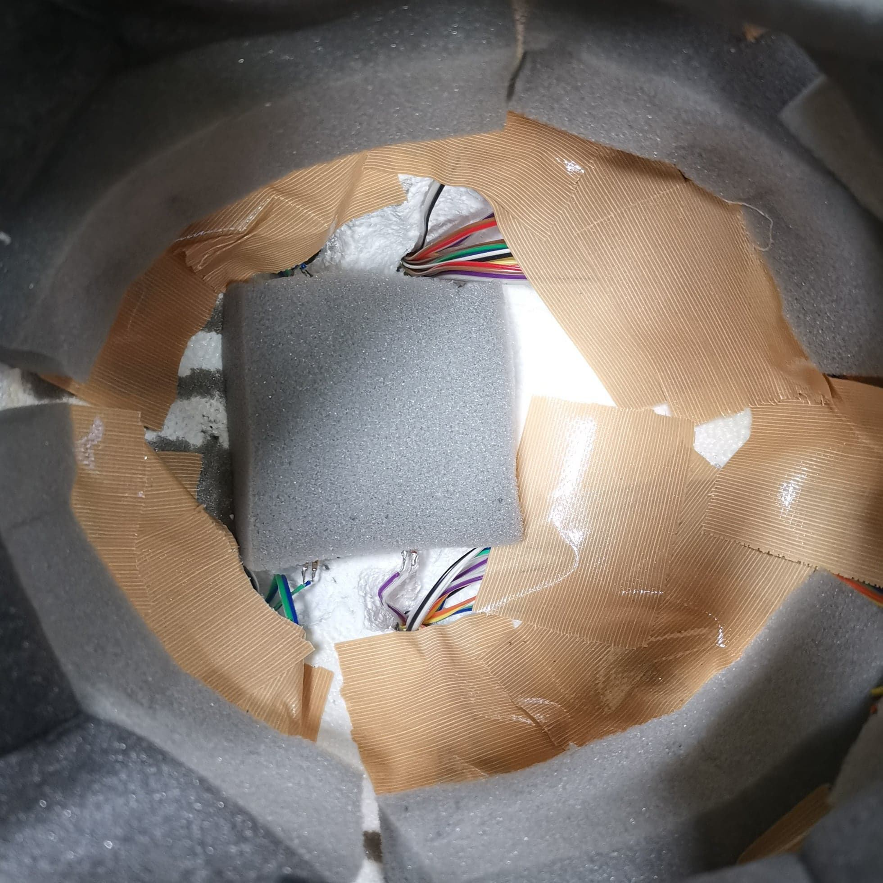
Urethane sponge with sensors

Slide 6
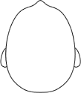
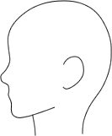
10
0
11
1
12
2
13
18
8
3
14
19
9
4
26
29
15
5
27
30
28
31
16
6
17
7
23
20
24
25
22
21
Pressure sensors

Slide 7
26
29
27
30
28
31

