Slide 1
ISWC2020
32 pressure sensors in the helmet
32 sensor values
Training data set of the wearers
Identifier
Result
Learning Phase
Identification Phase

Slide 2
ISWC2020
32 pressure sensors in the helmet
32 sensor values
Calculating
the Mahalanobis Distance
Authentication
Training data set of the wearers
Identifier
Rejection
Learning Phase
Identification Phase

Slide 3
32 pressure sensors
・・・
・・・
・・・
Helmet
10KΩ
Printed circuit board
・・・
・・・
Analog IN Port
Analog IN Port
5V
Microcomputer
GND
Microcomputer
Computer

Slide 4
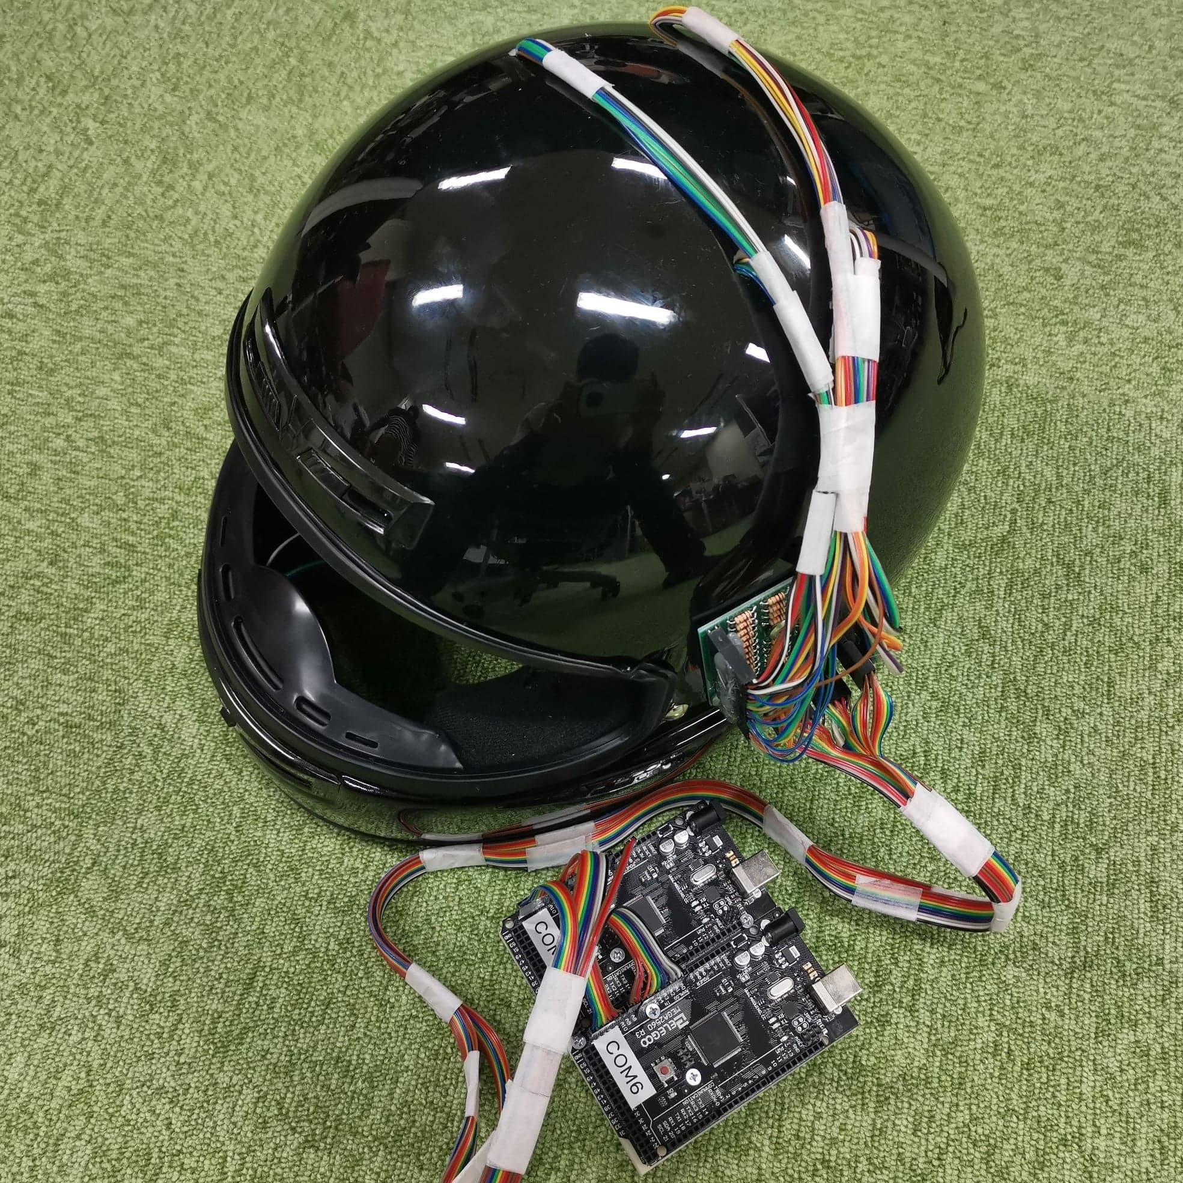
Printed circuit board
Microcomputers

Slide 5
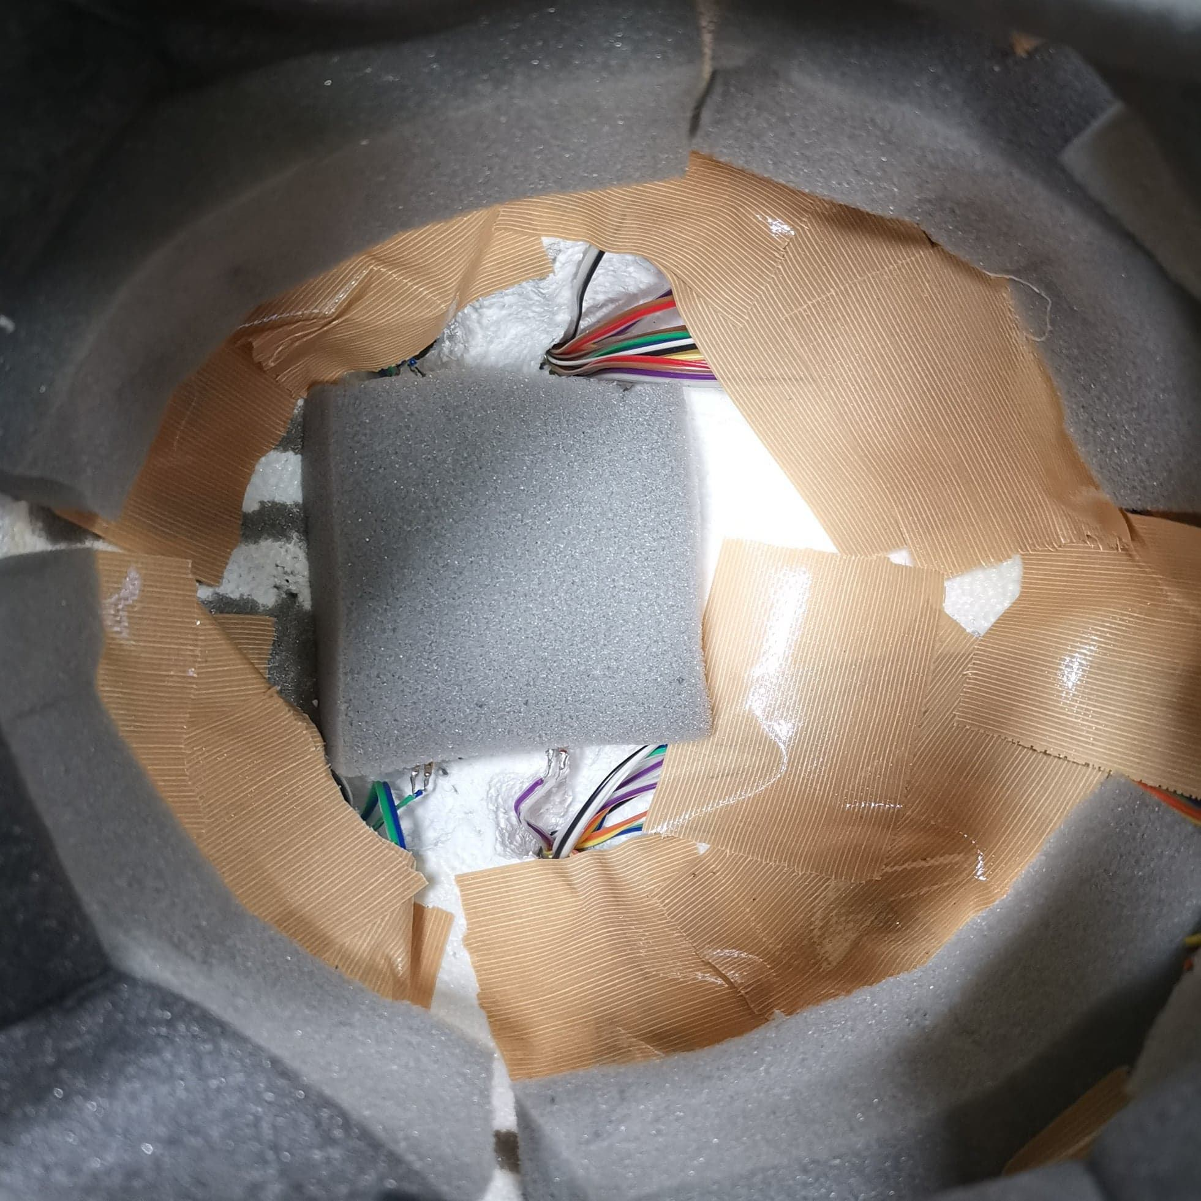
Urethane sponge with sensors

Slide 6
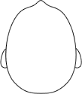
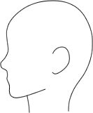
A：20 B：21 C：22 D：23 E：24 F：25
あ：26 い：27 う：28 ア：29 イ：30 ウ：31
10
0
11
1
12
2
13
18
8
3
26
29
14
19
9
4
27
30
28
31
15
5
16
6
17
7
23
20
24
25
22
21
Pressure sensors

Slide 7
10
0
11
1
12
2
13
18
8
3
26
29
14
19
9
4
27
30
28
31
15
5
16
6
17
7
23
20
24
25
22
21
Pressure sensors

Slide 8
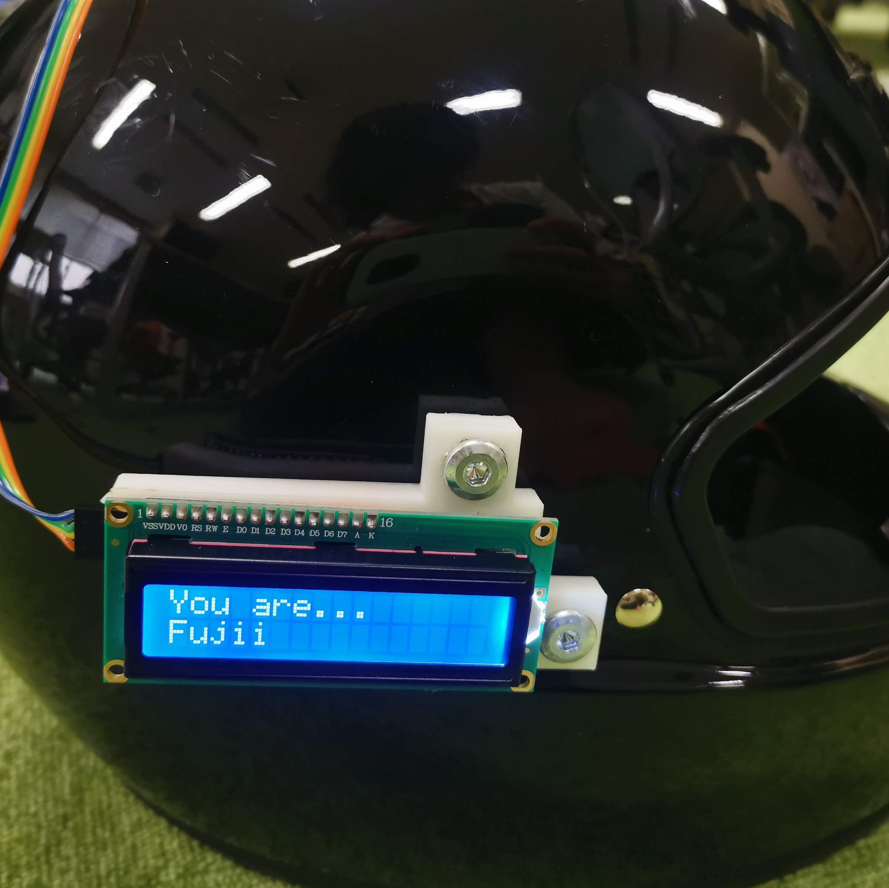
LCD Panel

Slide 9
LCD Panel

