Slide 1
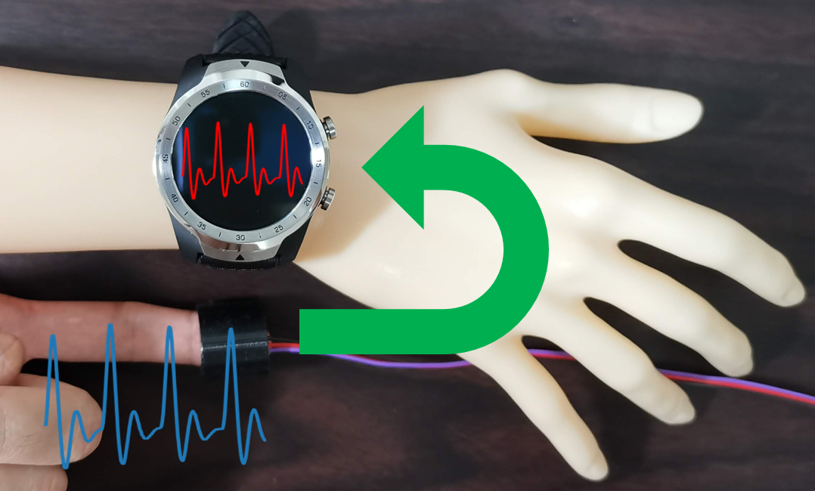
Disp2ppg Pulse Wave Generation to PPG Sensor using Display
Atsuhiro FUJII¹, Kazuya MURAO^{1, 3}, Naoji Matsuhisa^{2, 3}
¹Ritsumeikan University, Japan / ²Keio University, Japan /
³Japan Science and Technology Agency, PRESTO

Slide 2

Background (1/3)
Wearable devices are widely used.
It has the following functions.
Call, message, clock, and payment functions.
Biometric recording function.
Heart rate, respiratory rate, body temperature, etc.
Activity annotation function.
Walking, eating, sleeping, etc.

Slide 3
Background (2/3)
The most common technique of recording pulse data is called photoplethysmography (PPG).
It measures pulse data by irradiating LED light onto the skin and detecting changes in the light reflected through blood vessels.
Oxidized hemoglobin has the property of absorbing this LED light.
→ Need blood flow.

Slide 4
Background (3/3)
Assumption of a wearable device on an artificial body.
Call, message, clock, and payment functions: available

