Slide 1
ISWC2020
32 pressure sensors in the helmet
32 sensor values
Training data set of the wearers
Identifier
Result
Learning Phase
Identification Phase

Slide 2
ISWC2020
32 pressure sensors in the helmet
32 sensor values
Calculating
the Mahalanobis Distance
Authentication
Training data set of the wearers
Identifier
Rejection
Learning Phase
Identification Phase

Slide 3
32 pressure sensors
・・・
・・・
・・・
Helmet
10KΩ
Printed circuit board
・・・
・・・
Analog IN Port
Analog IN Port
5V
Microcomputer
GND
Microcomputer
Computer

Slide 4
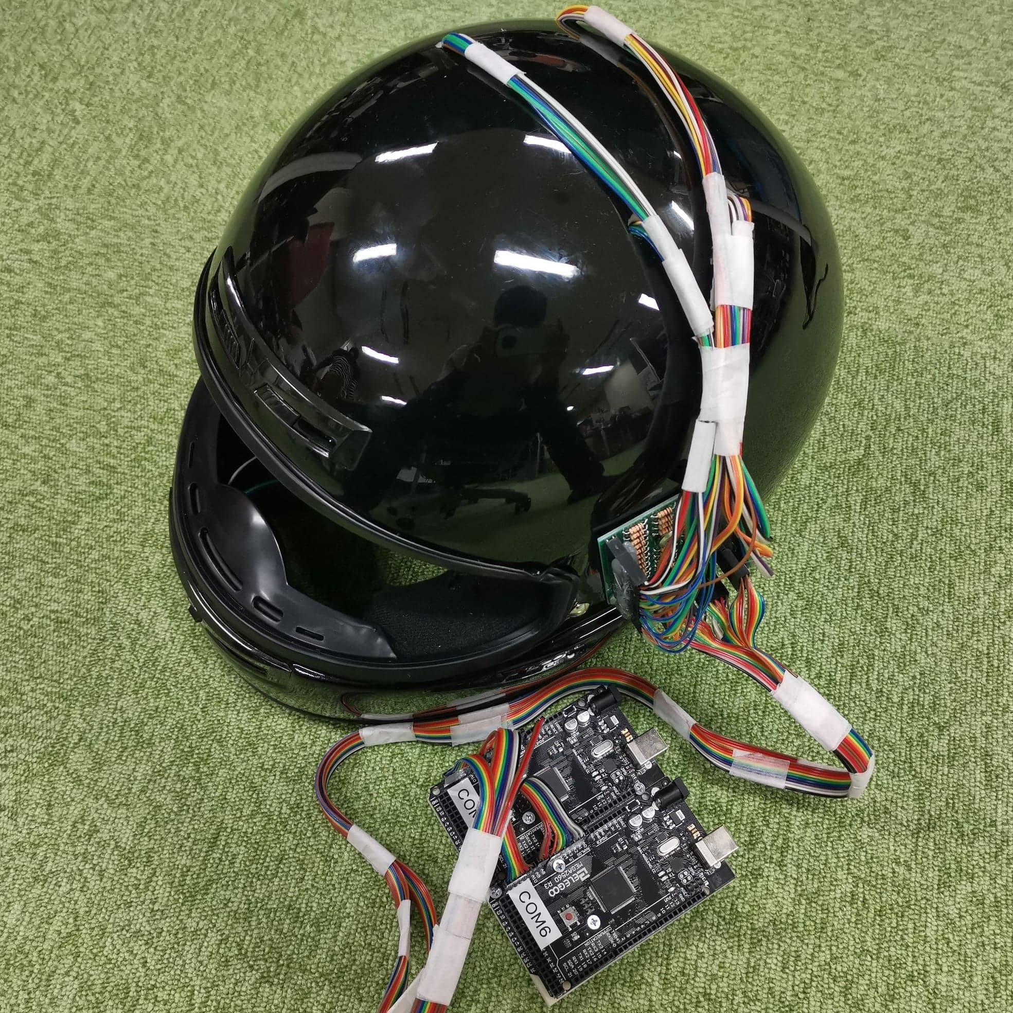
Printed circuit board
Microcomputers

Slide 5
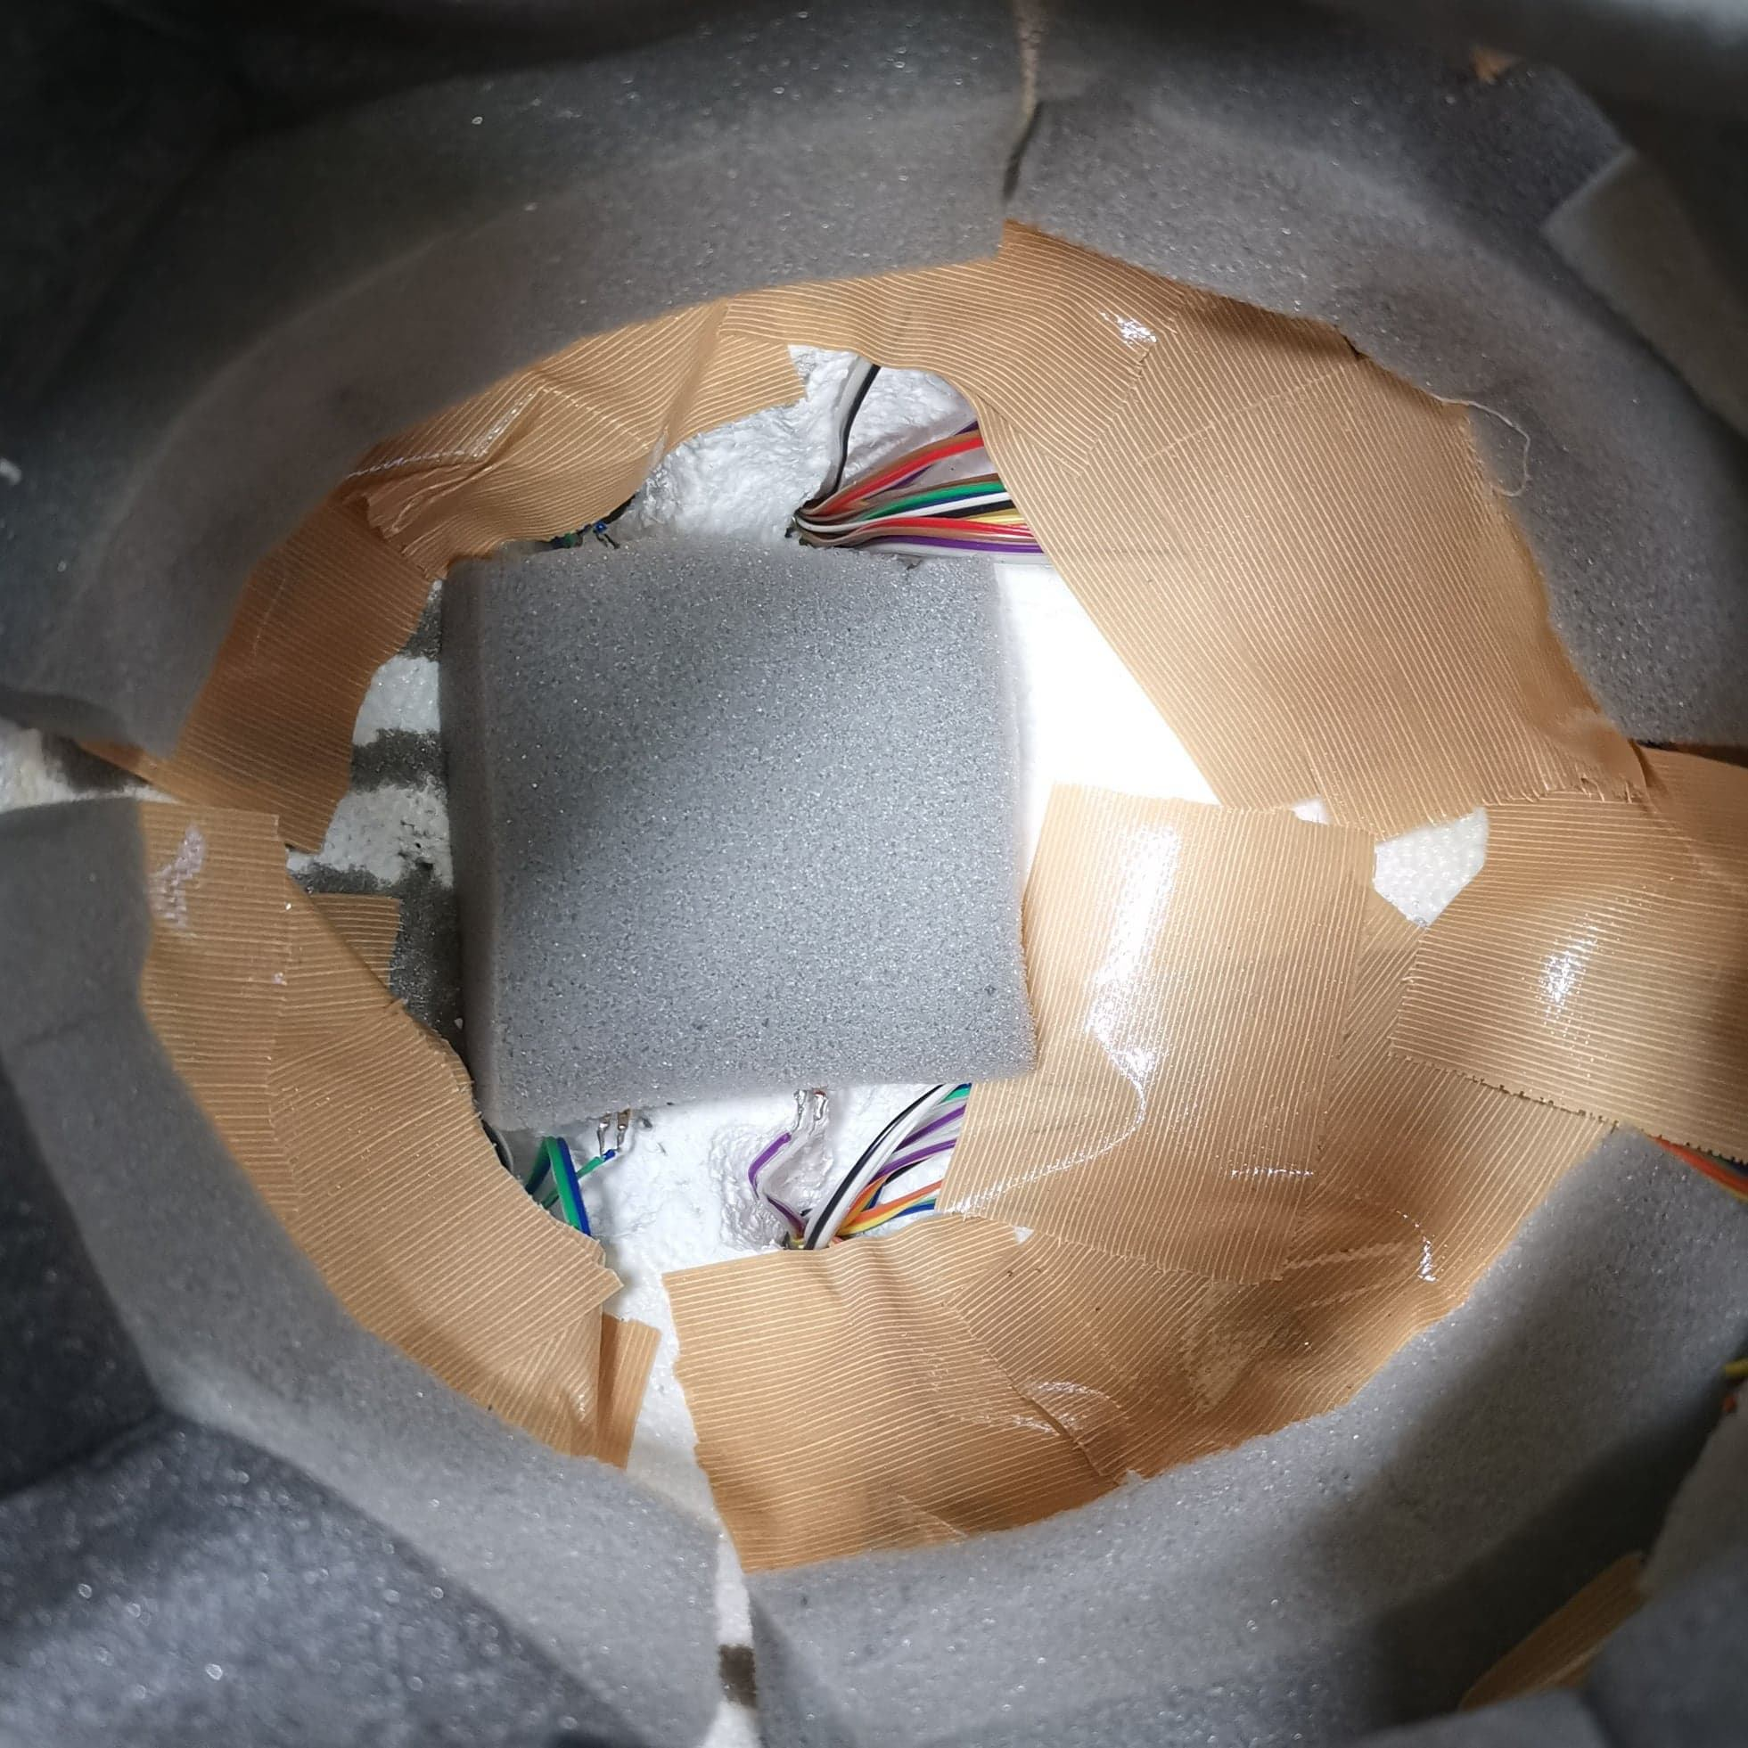
Urethane sponge with sensors

