Slide 1
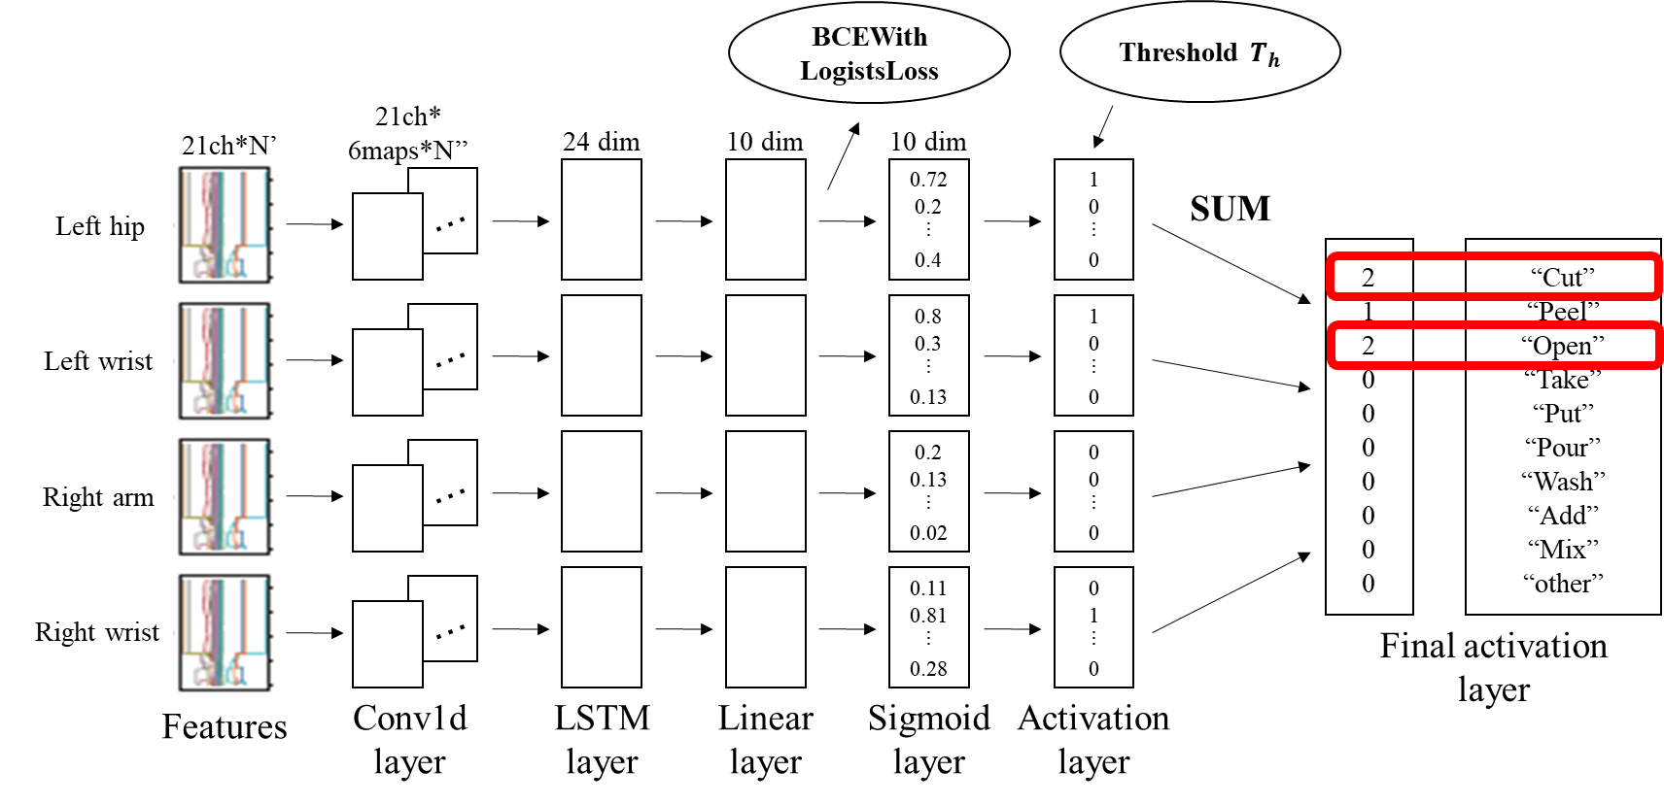
Cooking Activity Recognition with Convolutional LSTM using Multi-label Loss Function and Majority Vote
Atsuhiro FUJII / Daiki KAJIWARA / Kazuya MURAO
Ritsumeikan University, Japan
Notes:
Hello everyone.
My name is Atsuhiro FUJII from Ritsumeikan University in Japan.
OK, Let’s start.
I will talk about “Cooking Activity Recognition with Convolutional LSTM using Multi-label Loss Function and Majority Vote”.

Slide 2
Dataset (1/2)
Four subjects had attached some devices; on the right arm, left hip, both wrists, and one motion capture system.
Each recording has been segmented into 30-second segments, and it was assigned a random identifier.
Micro activity; [“Cut”, “Peel”, “Open”, “Take”, “Put”,
“Pour”, “Wash”, “Add”, “Mix”, “other”]
Macro activity; [“sandwich”, “fruitsalad”, “cereal”]
Notes:
I will explain about the given dataset.
We were given train dataset and test dataset.
Micro-activities consist of ten labels, and macro-activities consist of three labels.
***
与えられたデータセットについて説明する。
与えられたデータセットは、訓練データセットとテストデータセットである。
マイクロアクティビティは10個のラベルで構成され、マクロアクティビティは3個のラベルで構成されています。

Slide 3
Dataset (2/2)
Subject | Body part | # of segments | # of macro | # of micro |  |  | Length
 |  |  |  | max | mean | min | max | mean | min
1 | left hip | 80 | 1 | 5 | 2.09 | 1 | 159 | 131.9 | 1
 | left wrist |  |  |  |  |  | 8191 | 2945 | 0
 | right arm |  |  |  |  |  | 1470 | 1309 | 8
 | right wrist |  |  |  |  |  | 8257 | 4484 | 0
2 | left hip | 105 | 1 | 6 | 2.26 | 1 | 505 | 428.3 | 10
 | left wrist |  |  |  |  |  | 5986 | 2171 | 0
 | right arm |  |  |  |  |  | 1500 | 1272 | 8
 | right wrist |  |  |  |  |  | 2992 | 2465 | 0
3 | left hip | 103 | 1 | 6 | 2.3 | 1 | 519 | 429.3 | 32
 | left wrist |  |  |  |  |  | 5529 | 774.6 | 0
 | right arm |  |  |  |  |  | 1594 | 1182 | 164
 | right wrist |  |  |  |  |  | 5938 | 3559 | 0
4 | left hip | 180 | 1 | Unknown | Unknown | Unknown | 534 | 406.7 | 46
 | left wrist |  |  |  |  |  | 7143 | 1126 | 0
 | right arm |  |  |  |  |  | 1479 | 1233 | 86
 | right wrist |  |  |  |  |  | 8761 | 2080 | 0
Notes:
This is the details of the dataset. !!
Each segment contains one macro behavior !! and up to six micro behaviors. !!
The length of the data ranges from 0 to about 9000.
Zero length means that the data is missing.
The data for Subjects 1, 2, and 3 are for training and the data for Subject 4 are for testing.
***
これがデータセットの詳細です。
各セグメントには、1つのマクロ行動と最大6つのマイクロ行動が含まれています。
データの長さは0から約9000までの範囲です。
長さが0の場合は、データが欠落していることを意味します。
被験者1、2、3のデータはトレーニング用で、被験者4のデータはテスト用です。

Slide 4








Method - Preprocessing
Hand crafted feature values are extracted from the raw data.
30 seconds
$$x$$
$z$ features
・・・・・・・・・・
$y$ features
3 sec
$x$ features
21 dimensions
$x$mean, $x$variance, $x$max, $x$min, $x$root mean square,
$x$interquartile range,
$x$zero crossing rate
$x$ features
50 ms
$$N$$
$$N′$$
Notes:
Hand crafted feature values are extracted from the raw data.
These features are calculated over a 50 milliseconds-window slid in steps of 3 seconds.
From the preprocessing, 21 dimensions feature are obtained for one sensor.
***
生データから特徴量を抽出する。
これらの特徴は、50msのウィンドウを3秒単位でスライドさせて計算されます。
前処理により、1つのセンサに対して21次元の特徴量が得られた。

Slide 5


Method - Model (1/2)
BCEWith
LogistsLoss
Threshold $T_{h}$
Micro activity
21ch*
6maps*N’’
21ch*N’
24 dim
10 dim
10 dim
0.72
0.2
︙
0.4
1
0
︙
0
SUM
Left hip
・・・
2
1
2
0
0
0
0
0
0
0
“Cut”
“Peel”
“Open”
“Take”
“Put”
“Pour”
“Wash”
“Add”
“Mix”
“other”
0.8
0.3
︙
0.13
1
0
︙
0
Left wrist
・・・
0.2
0.13
︙
0.02
0
0
︙
0
Right arm
・・・
0.11
0.81
︙
0.28
0
1
︙
0
Right wrist
・・・
Final activation
layer
Features
Conv1d
layer
LSTM
layer
Linear
layer
Sigmoid
layer
Activation
layer
Notes:
This is our identification model. !!
In "Conv1d layer", Mapsize was set to 6, we input features of 21 dimensions with length N', and get a features of 21 dimensions with 6 map and length N‘’. !!
Then, in the "LSTM layer", that features are inputted to form a 24-dimensional feature. !!
"Linear layer" compresses 24 dimensional features into 10 dimensional ones.
In training phase, that output data are inputted to "BCEWithLogistsLoss“ in Pytorch library, and train model. !!
In the "Sigmoid layer", Sigmoid function is applied. !!
Next, we obtain one-hot vectors in the "activation layer" using the threshold T_h.
This T_h is the threshold at which the most accuracy is achieved in the tests within the training data. !!
In "Final activation layer", a majority vote is taken.
The one-hot vectors of each position obtained by the "activation layer" are added together, and the label with a result of 2 or more is output as the result.
However, if the number of sensors is 2 or less because of missing data, we adopt a label with a result of 1 or more.
***
これが私達の識別モデルです．
“Conv1d layer”はmapsizeを6に設定しており，21次元で長さN’の特徴量を入力して21次元×6マップで長さN’’の特徴量を得る．
次に”LSTM layer”ではその特徴量を入力し，24次元の特徴量とする．
"Linear layer"は24次元の特徴量を10次元の特徴量に圧縮する。
訓練段階では、その出力データをPytorchライブラリの "BCEWithLogistsLoss "に入力し、モデルを訓練する。
“Sigmoid layer”では” BCEWithLogistsLoss”を適用する．
次に“Activation layer”で閾値T_hを使って，one-hot vectorを取得する．
このT_hは，学習データ内でのテストにおいて，最も精度が高くなった閾値である．
“Final activation layer”では多数決を行う．
“Activation layer”で得られた各部位のone-hot vectorを加算し，結果が2以上となったラベルを結果として出力する．
ただし，欠損のため，センサ数が2個以下である場合は，結果が1以上のラベルを採用する．

Slide 6
Method - Model (2/2)
Cross
EntropyLoss
Macro activity
21ch*
6maps*N’’
21ch*N’
24 dim
3 dim
3 dim
0.1
0.5
0.9
SUM
Left hip
・・・
0.1
0.2
0.6
Left wrist
・・・
0.6
1.5
3.0
“sandwich”
“fruitsalad”
“cereal”
0.1
0.6
0.8
Right arm
・・・
Final activation
layer
0.3
0.2
0.7
Right wrist
・・・
Features
Conv1d
layer
LSTM
layer
Linear
layer
Sigmoid
layer
Notes:
On the other hand, for macro activities, !! in training phase, we apply "CrossEntropyLoss“after the “Linear layer“, and train model. !!
Then, the results obtained by the "Sigmoid layer“ !! are added together and the label with the largest value is adopted.
***
一方、マクロ活動については、学習段階で“Linear layer“の後にCrossEntropyLoss”を適用し、モデルを学習します。
そして、“Sigmoid layer”で得られた結果を加算し、最も値の大きいラベルを採用します。

Slide 7
Result
Activity type | Train data | Test data | Max. accuracy | Min. loss
Micro | Subject 1, 2 | Subject 3 | 0.536 | 0.436
 | Subject 2, 3 | Subject 1 | 0.497 | 0.445
 | Subject 1, 3 | Subject 2 | 0.532 | 0.424
 | Average |  | 0.521 | 0.435
Macro | Subject 1, 2 | Subject 3 | 0.522 | 1.057
 | Subject 2, 3 | Subject 1 | 0.416 | 1.094
 | Subject 1, 3 | Subject 2 | 0.535 | 1.050
 | Average |  | 0.491 | 1.067
Notes:
From these results, !! the average accuracy of 0.521 and 0.491 were achieved among subjects 1, 2, and 3 in leave-one-subject-out manner for micro and macro activities, respectively.
Considering ten multi-label micro activities, it would be said that 0.521 accuracy is good.
On the other hand, 0.491 accuracy for 3-class macro activity may be improved.
We trained the model on data from subjects 1, 2, and 3, and obtained prediction results for subject 4's data, and the results were then submitted.
***
これらの結果から、被験者１、被験者２、被験者３の間では、マイクロアクティビティ、マクロアクティビティについて、それぞれLeave-one-subject-out方式で平均0.521、0.491の精度が得られた。
10個のマルチラベルのマイクロアクティビティを考えると、0.521の精度が良いと言えるだろう。
一方、3クラスのマクロアクティビティについては、0.491の精度が改善される可能性がある。
そこで、被験者1,2,3のデータに対してモデルを学習させ、被験者4のデータに対して予測結果を得て、その結果を提出した。

Slide 8
Conclusion
Our model uses convolution layer and LSTM.
The evaluation results showed that average accuracy of 0.521 and 0.491 for micro and macro activities.
Resource | Micro | Macro
CPU memory | 2391MB | 2391MB
GPU memory | 1.6GB | 1.6GB
Training time (1,000 epoch) | 28.891s | 21.554s
Testing time (1,000 epoch) | 59.299s | 58.042s
OS: Windows 10 Pro
CPU: Intel Core i7-8700K 3.7GHz
RAM: DDR4 64GB
GPU: NVIDIA GeForce RTX 2080Ti GDDR6 11GB
Notes:
Conclusion, our model uses convolution layer and LSTM.
The evaluation results showed that the average accuracy of 0.521 and 0.491 for micro and macro activities.
Now all finished. Thank you for your attention.
***
結論として、我々のモデルは畳み込み層とLSTMを使用している。
評価の結果、ミクロとマクロの平均精度は0.521、0.491であった。
以上で全て終了です。ご清聴ありがとうございました。

Slide 9
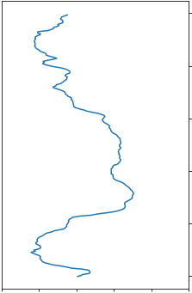
Dataset (1/2)
Four subjects cooked three recipes; sandwich, fruit salad, cereal.
The subjects had attached some devices; on the right arm, left hip, both wrists, and one motion capture system.
Each recording has been segmented into 30-second segments, and it was assigned a random identifier.
30 seconds
subject1_file_72.csv
30 seconds
subject1_file_140.csv
30 seconds
subject1_file_213.csv
30 seconds
subject1_file_417.csv
30 seconds
subject1_file_873.csv
Notes:
I will explain about the given dataset.
We were given train dataset and test dataset.
The subjects cooked three recipes (sandwich, fruit salad, cereal) five times each by following a script for each recipe.
The data has been collected from four subjects who had attached two smartphones on the right arm and left hip, two smartwatches on both wrists, and one motion capture system with 29 markers.
Each recording has been segmented into 30-second segments, like this figure.
Each segment was assigned a random identifier, so the order of the segments is unknown.
Training data contains data from three subjects out of the four subjects and test data contains the data from the fourth subject.
まず，与えられたデータセットについて説明する．
我々は学習用のデータセットとテスト用のデータセットを与えられた．
各被験者は3つのレシピを5回作った．
データは4人の被験者にセンサを取り付けて収集されたものである．
各記録は30秒ごとに別れている．
各セグメントにはランダムな識別子が与えられており，順番は不明．
学習データは3人の被験者のデータを含み，テストデータには1人の被験者のデータが含まれる．
マイクロアクティビティはこのラベルが含まれていて，マクロアクティビティはこのラベルが含まれているというのを過剰書き．

Slide 10
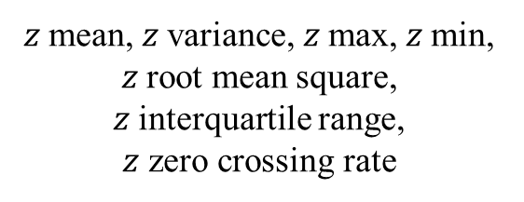

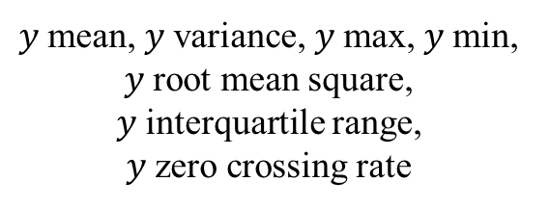
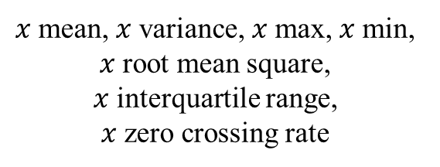

Method - Preprocessing
Hand crafted feature values are extracted from the raw data.
30 seconds
$$x$$
$$y$$
$$z$$
3 sec
$x$mean, $x$variance, $x$max, $x$min, $x$root mean square,
$x$interquartile range,
$x$zero crossing rate
$y$mean, $y$variance, $y$max, $y$min, $y$root mean square,
$y$interquartile range,
$y$zero crossing rate
$z$mean, $z$variance, $z$max, $z$min, $z$root mean square,
$z$interquartile range,
$z$ zero crossing rate
21 dimensions features
Notes:
Hand crafted feature values are extracted from the raw data.
The features are mean, variance, max, min, root mean square, interquartile range, and zero crossing rate for each axis, respectively.
These features are calculated over a 50ms-window slid in steps of 3 seconds.
From the preprocessing, 21 dimensions feature are obtained for one sensor.
生データから特徴量を抽出する。
特徴量は、各軸の平均、分散、最大、最小、二乗平均平方根（RMS）、四分位間距離（IQR）、ゼロクロスレート（ZCR）です。
これらの特徴は、50msのウィンドウを3秒単位でスライドさせて計算されます。
前処理により、1 つのセンサに対して21次元の特徴量が得られた。

Slide 11
Method - Model
21ch*
6maps*N’’
0.2
0.72
0.3
︙
0.4
0
1
0
︙
0
21ch*N’
24
10 / 3
10 / 3
Left hip
・・・
10 / 3
0
1
0
0
0
0
0
0
1
0
Left wrist
・・・
10 / 3
Right arm
・・・
Right wrist
・・・
Final activation
layer
Features
Conv1d
layer
LSTM
layer
Linear
layer
Sigmoid
layer
Activation
layer
Notes:
This is our identification model.
From left to right: "Conv1d layer", "LSTM layer", "Sigmoid layer", and There are "Activation layer" and "Final activation layer".
In "Conv1d layer", Mapsize was set to 6, we input features of 21 dimensions with length N', and get a features of 21 dimensions with 6 map and length N''.
Then, in the "LSTM layer", that features are inputted to form a 24-dimensional feature.
"Linear layer" compresses 24 dimensional features into 10 dimensions for micro activities and 4 dimensions for macro activities.
"Sigmoid layer" applies a sigmoid function.
Next, we use the "activation layer" to obtain one-hot vectors.
これが私達の識別モデルです．
左から順に“Conv1d layer”，”LSTM layer”，”Sigmoid layer”，”Activation layer”，”Final activation layer”があります．
“Conv1d layer”はmapsizeを6に設定しており，21次元で長さN’の特徴量を入力して21次元×6マップで長さN’’の特徴量を得る．
次に”LSTM layer”ではその特徴量を入力し，24次元の特徴量とする．
“Linear layer”は24次元の特徴量をmacro活動では4次元，micro活動では10次元に圧縮する．
“Sigmoid layer”ではシグモイド関数を適用する．
次に“Activation layer”でone-hot vectorを取得する．

Slide 12
Method - Loss Function and Optimizer
Micro activity
BCEWithLogistsLoss
Macro activity
CrossEntropyLoss
Notes:
We use "BCEWithLogistsLoss" in the case of "Micro activity" as "Loss Function and Optimizer", and in the case of "Macro activity", we use "CrossEntropyLoss".
“Loss Function and Optimizer”には，”Macro activity”の場合は”CrossEntropyLoss”を，”Micro activity”の場合は”BCEWithLogistsLoss”を使用した．

Slide 13
Method - Final activation
Left hip
Left wrist
Right arm
Right wrist
Majority Vote
1
0
0
0
0
0
0
0
0
0
1
0
1
0
0
0
0
0
0
0
0
0
1
0
0
0
0
0
0
0
0
1
0
0
0
0
0
0
0
0
2
1
2
0
0
0
0
0
0
0
“Cut”
“Peel”
“Open”
“Take”
“Put”
“Pour”
“Wash”
“Add”
“Mix”
“other”
“Cut”, “Open”
Micro activity
Macro activity
0.1
0.5
0.9
0.1
0.2
0.6
0.1
0.6
0.8
0.3
0.2
0.7
0.6
1.5
3.0
“sandwich”
“fruitsalad”
“cereal”
“cereal”
Notes:
In "Final activation layer", a majority vote is taken.
In the micro activity, the one-hot vectors of each position obtained in the "activation layer" are added together, and labels with a value of 2 or more is output as the result.
However, if the number of sensors is 2 or less because of missing data, we adopt labels with a value of 1 or more.
On the other hand, in the macro activity, we add the results obtained by the "Sigmoid layer" and adopt the label with the largest value.
“Final activation layer”では多数決を行う．
micro活動では“Activation layer”で得られた各部位のone-hot vectorを加算し，結果が2以上となったラベルを結果として出力する．
ただし，欠損のため，センサ数が2個以下である場合は，結果が1以上のラベルを採用する．
一方，macro活動では”Sigmoid layer”で得られた結果を加算し，値が最大となったラベルを採用する．

