Slide 1
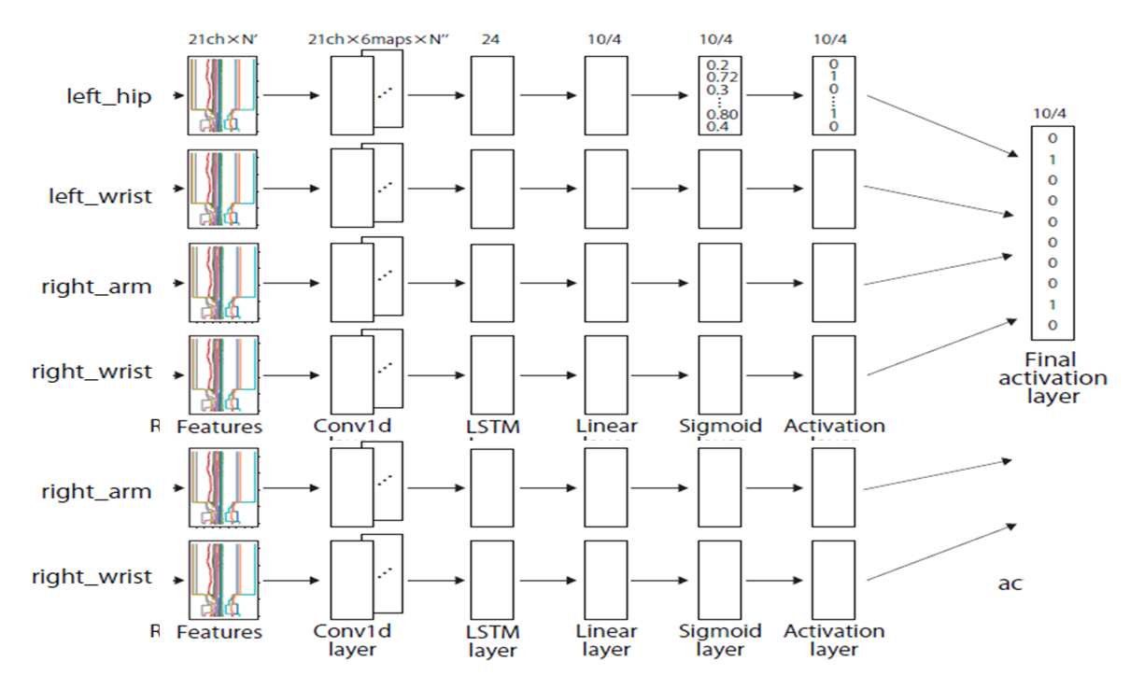

Slide 2
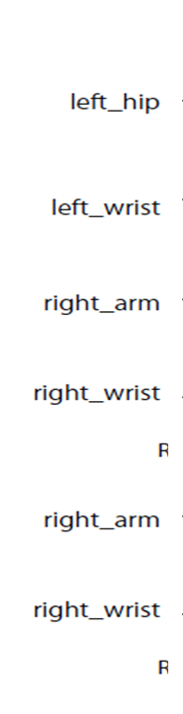
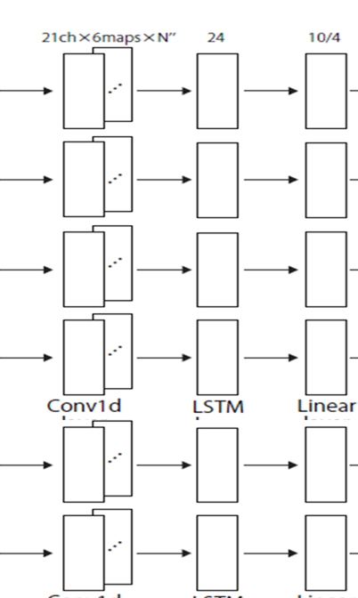
Read data process
Convert process
Feature extraction process
Raw data
Repetition partitioning process

